Slide 1
APPROACH TO HEMOPTYSIS
BY DEPARTMENT OF RESPIRATORY MEDICINE
MODERATED BY-DR ANSHUMALI SRIVASTAVA(HEAD OF DEPARTMENT)

Slide 2
DEFINITION
The word hemoptysis comes from the greek word “haima “meaning “blood” & “ptysis” which means “a spitting”.
Hemoptysis is defined as coughing of blood originating from lower respiratory tract.
Hemoptysis can range from blood streaking sputum to presence of gross blood .

Slide 3
HOW TO DIFFERENTIATE HEMOPTYSIS FROM HEMETEMESIS
HEMOPTYSIS | HEMATEMESIS
HISTORY
ABSENCE OF NAUSEA,VOMITING | PRESENCE OF NAUSEA,VOMITING
SOURCE-LRT | SOURCE-GIT
FREQUENCY- REPEATED (MIN TO HR) | FREQUENCY- (HRS TO DAYS-WEEKS)
BRIGHT RED,FROTHY APPEREANCE | COFFEE GROUND APPEREANCE,RARELY FROTHY
pH-ALKALINE | pH-ACIDIC
MIXED WITH MACROPHAGES,NEUTROPHILS | MIXED WITH FOOD PARTICLES
.

Slide 4
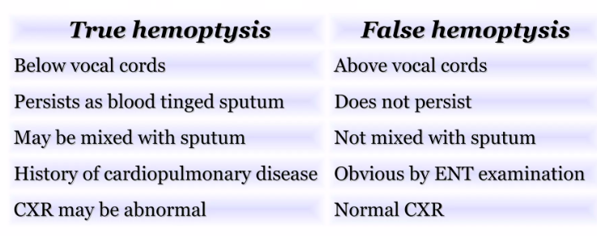
TRUE HEMOPTYSIS VS PSEUDOHEMOPTYSIS

Slide 5
CLASSIFICATION OF HEMOPTYSIS
Hemoptysis is mild when there are less than 20 ml in 24 hours
Moderate /submassive when 20-600 ml in 24 hours
Massive hemoptysis is >600 ml in 24 hour period.
The amount of blood does not parallel the severity of the underlying cause.

Slide 6
.
The faster the bleeding ,the greater risk of mortality(rate of blood loss above 15 ml/hr substantially increase the risk of death due to asphyxiation.
The anatomical dead space of the major airways is around 100-200 ml.Thus brisk bleed of 150-200 ml could lead to major airway obstruction and rapid demise of the patient due to inability to oxygenate and ventilate.

Slide 7
BLOOD SUPPLY OF LUNG
The lungs have dual blood supply .
The pulmonary artery that originate from right ventricle ,is responsible for gas exchange .Pulmonary artery circulation is low pressure circuit .
The bronchial artery ,arises from aorta and brings nutrients to lung parenchyma and airways is high pressure circulation.
The bronchia artery is the source of bleeding in 90% of cases.

Slide 8
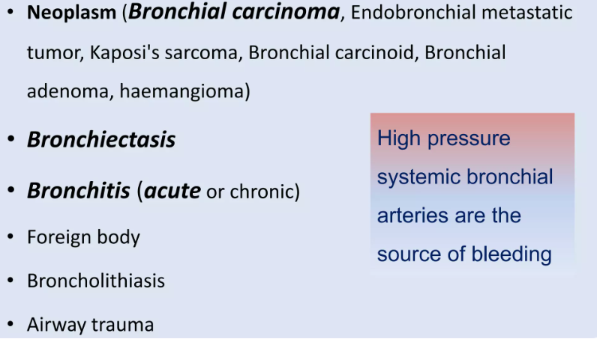
CAUSES OF HEMOPTYSIS
1)BRONCHIAL CAUSES OF HEMOPTYSIS

Slide 9
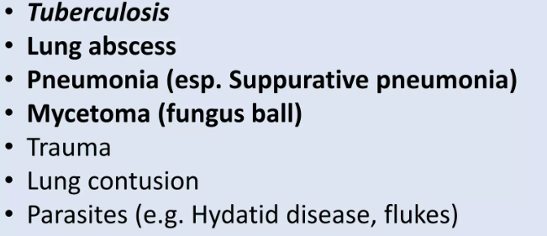
CAUSES OF HEMOPTYSIS
2)PARENCHYMAL CAUSES

Slide 10
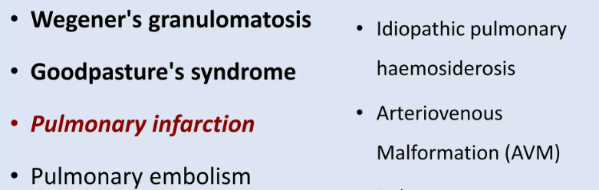
CAUSES OF HEMOPTYSIS
3)VASCULAR CAUSES

Slide 11
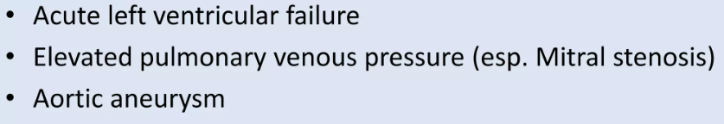
CAUSES OF HEMOPTYSIS
4)CVS CAUSES OF HEMOPTYSIS

Slide 12
CAUSES OF HEMOPTYSIS
5)TRAUMATIC CAUSES
Post intubation
Foreign body aspiration
Post transthoracic needle biopsy
Transbronchial lung biopsy
Tracheostomy
Central line catheter
6)Drugs causing hemoptysis (rare cause)
Penicillamine,mitomycin-c,abciximab,sirolimus,all trans retinoic acid ,crack cocaine.

Slide 13
PARASITES CAUSING HEMOPTYSIS
HEMOPTYSIS OCCUR IN PARTICULAR TRIBE WHICH EAT CRAB ,THIS TYPE OF HEMOPTYSIS IS CALLED ENDEMIC HEMOPTYSIS.
ORGANISM RESPONSIBLE IS PARAGONOMIA WESTMANI(LUNG FLUKE).

Slide 14
CAUSES OF HEMOPTYSIS
7)OTHER CAUSES OF HEMOPTYSIS
BLOOD DISORDERS:
LEUKAEMIA
HAEMOPHILLIA
ANTICOAGULANT THERAPY
DIC
8)MISCELLANEOUS CAUSES
-PULMONARY ENDOMETRIOSIS(CATAMENIAL HEMOPTYSIS)
-Cocaine
9)IDIOPATHIC
Many episodes of hemoptysis are unexplained (up to 30%)even after full investigation are likely to be caused bysimple bronchial infection.

Slide 15
Causes of massive hemoptysis
Bronchiectasis
Tuberculosis
Mycetoma
Bronchogenic carcinoma
Pulmonary arterio venous fistula
Bronchial adenoma

Slide 16
PATHOPHYSIOLOGY OF HEMOPTYSIS
Chronic airway inflammation that causes hypertrophy and tortuosity of the bronchial arteries.
This circulation is under systemic blood pressure, so that rupture of either the tortuous vessels or the capillary plexus causes rapid bleeding.
Bleeding may occur acutely from necrosis of lung tissue or from rupture of hypertrophied bronchial arteries in the setting of chronic inflammation.

Slide 17
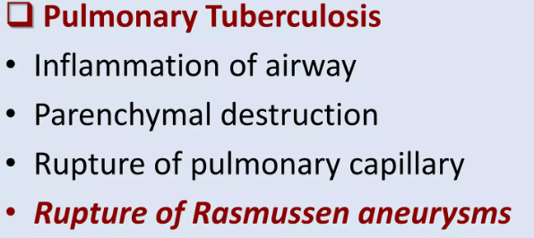
MECHANISM OF HEMORRHAGE

Slide 18
Calcified lymph nodes impinging on the airway can erode the airway lumen and cause streaky hemoptysis by disrupting vessels.
They can lead to massive hemoptysis where there is large bronchial artery in the path of this eroding calcified lymph node.

Slide 19
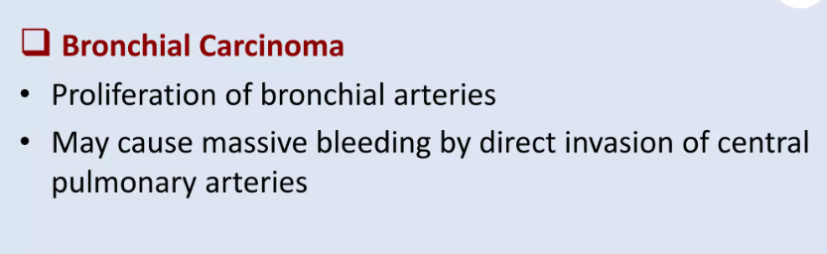
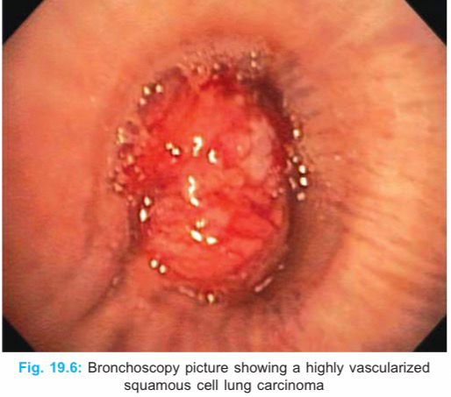
MECHANISM OF HEMORRHAGE
Hemoptysis can be presenting symptom in 10%of lung cancer patient.
Squamous cell carcinoma seems to be the most likely type to cause massive hemoptysis because of its central location and tendency to cavitate.
Squamous cell carcinoma is 10 times more likely to bleed than other types.

Slide 20
MECHANISM OF HEMORRHAGE
IN BRONCHIECTASIS
PROLIFERATION AND ENLARGMENT OF BRONCHIAL ARTERY.
FREQUENT INFECTIONS ARE COMMON IN BRONCHIECTASIS. IT CAUSE ERROSION OF THESE VESSELS LEAD TO BLEEDING.

Slide 21
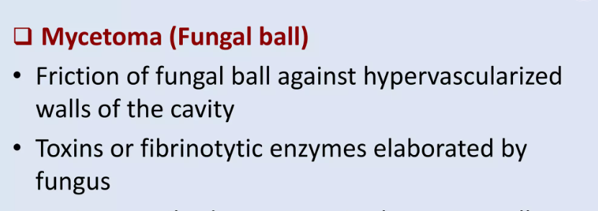
MECHANISM OF HEMORRHAGE
IN FUNGAL INFECTION

Slide 22
MECHANISM OF HEMORRHAGE
COPD
PATIENTS WITH COPD HAVE INCREASED VASCULARITY BENEATH THE ENDOBRONCHIAL SURFACE.
MUCOSA IS FRIABLE AND PRONE TO BLEED ESPECIALLY IN THE PRSENCE OF BACTERIAL AND VIRAL INFECTION.

Slide 23
MECHANISM OF HEMORRHAGE
CARDIAC CAUSES
ELEVATED PRESSURE IN PULMONARY CIRCULATION DUE TO CONGESTIVE HEART FAILURE AND MITRAL STENOSIS MAY LEAD TO DISTENSION AND RUPTURE OF PULMONARY AND BRONCIAL VEIN THAT LEADS TO BLEEDING.

Slide 24
Evaluation of Hemoptysis and Diagnostic Clues
FIRST RULE OUT DENTAL AND ENT CAUSES OF BLEEDING.
Hemoptysis that is describe as a blood streaking of sputum often suggest bronchitis.
Patient complaning of fever ,loss of weight,loss of appetite,night sweats suggestive of tuberculosis.
When sputum production is chronic and copious it suggests bronchiectasis.
Foul smelling sputum (associted with postural variation ) with hemoptysis raises the possibility of lung abscess.
Rusty sputum(degradation product of hb mixed with sputum )found in pneumococcal pneumonia and klebsiella pneumonia.
Pink frothy sputum is seen in pulmonary edema due to left ventricular failure.
Blood mixed with gritty white material sugestive of broncholithiasis.

Slide 25
Two Conditions may be associated with sputum that contain no blood but may be confused with hemoptysis.
1)Patient with pneumonia due to serratia marcescens ,gram negative bacilli which is pigmented red ,may produce red sputum which does not contain red blood cells.
2)An amoebic abscess may rupture into bronchus and cause expectoration of anchovy paste ,sputum resembling old blood.

Slide 26
CLINICAL CLUES | SUSPECTED DIAGNOSIS
ANTICOAGULANT USE | MEDICATION EFFECT
ASSOCIATED WITH MENSES | CATAMENIAL HEMOPTYSIS
DYSPNEA ON EXERTION,ORTHOPNEA, FATIGUE,PAROXYSMAL NOCTURNAL DYSPNEA, | CONGESTIVE HEART FAILURE, MITRAL STENOSIS ,LEFT VENTRICULAR DYSFUNCTION.
FEVER ,PRODUCTIVE COUGH | URTI, PNEUMONIA ,LUNG ABSCESS, ACUTE BRONCHITIS
HISTORY OF CHRONIC LUNG DISEASE,RECURRENT RESPIRATORY TRACT INFECTION,COPIOUS PURULENT SPUTUM | BRONCHIECTASIS,LUNG ABSCESS
NAUSEA,VOMITING,CHRONIC ALCOHOL USE ,CHRONIC USE OF NSAIDS,MELAENA | GASTRIC OR PEPTIC ULCER ESOPHAGEAL VARICES

Slide 27
CLINICAL CLUES | SUGGESTED DIAGNOSIS
PLEURITIC CHEST PAIN ,CALF TENDERNESS | PULMONARY EMBOLISM INFARCTION
CLUBBING | LUNG CANCER BRONCHIECTASIS LUNG ABSCESS
SADDLE NOSE,GINGIVAL THICKNING,MULBERRY GINGIVITIS,SEPTAL PERFORATION | WEGNER GRANULOMATOSIS
HEART MURMUR(MID DIASTOLIC),PECTUS EXCAVATUM | MITRAL STENOSIS
DULLNESS TO PERCUSSION,HIGH GRADE FEVER ,CRACKELS | PNEUMONIA
CACHEXIA,CLUBBING, HOARSNESS OF VOICE,CUSHING SYNDROME,HORNER SYNDROME | BRONCHOGENIC CARCINOMA SMALL CELL LUNG CANCER OTHER LUNG MALIGNANCY

Slide 28
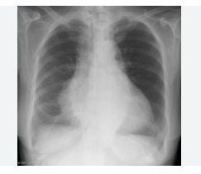
INVESTIGATIONS-
RADIOLOGICAL -CHEST XRAY
-Approx 30%of patients with hemoptysis have normal chest x ray.
Abnormality may not reflect the exact site of bleeding .
Cardiomegaly seen in mitral stenosis,CHF.

Slide 29
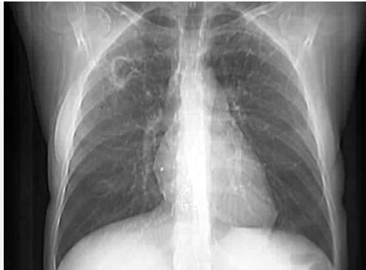
.
2) Cavitatory lesion seen in tuberculosis and lung abscess.

Slide 30
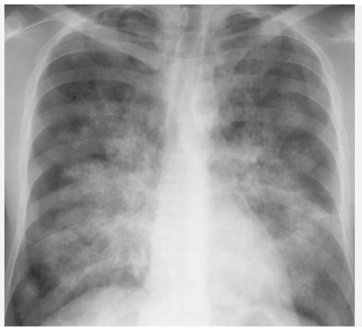
3) Diffuse alveolar infiltrate seen in pulmonary edema,aspiration.
.

Slide 31
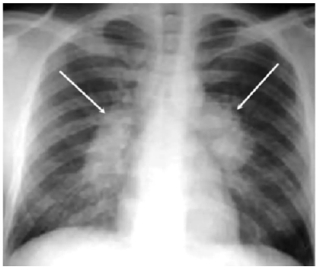
4) Hilar adenopathy seen in –carcinoma ,infection,metastatic disease.
.

Slide 32
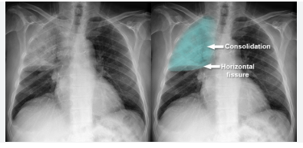
5) Lobar infiltrate –s/o pneumonia.
.

Slide 33
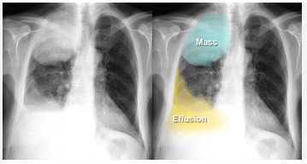
6) Mass lesion ,nodules-s/o carcinoma ,metastatic disease.
.

Slide 34
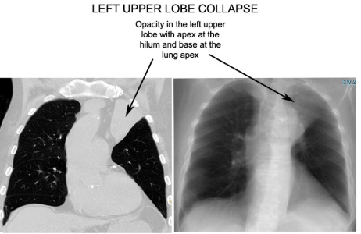
7) Segemental atelectasis/lobar atelectasis -due to obstruction from lung cancer,bronchial adenoma ,foreign body
.

Slide 35
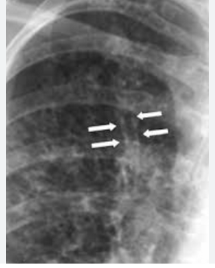
7)Bronchiectasis –tram tract appereance
.

Slide 36
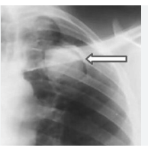
8) Mycetoma or fungal balls-”air crescent sign”
.

Slide 37
RADIOLOGICAL INVESTIGATION
CT SCAN
Despite history ,clinical examination,chest xray,bronchoscopy 20-30 % of patient remain without diagnosis.
Hrct is more sensitive to the disease involving interstitium and alveoli.
For diagnosis of bronchiectasis sensitivity of hrct is 90-95%.

Slide 38
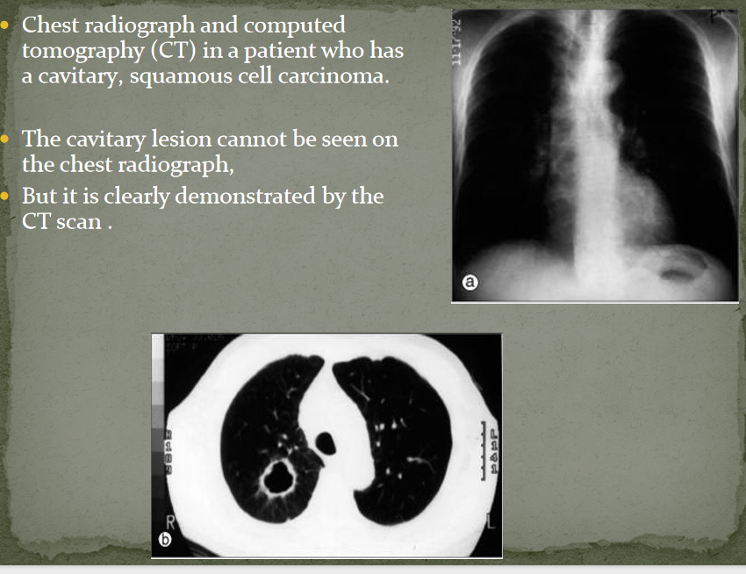
.

Slide 39
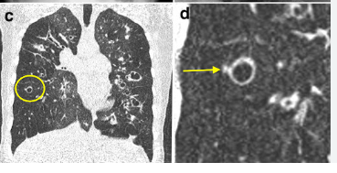
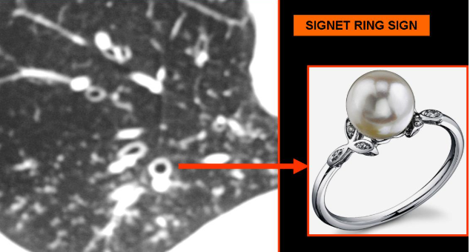
Hrct thorax shows signet ring appereance
.

Slide 40
Bronchial artery angiography
It is useful to identify source of bleeding and indentifying a vessel for embolization.
If bronchial artery angiography does not reveal bleeding vessel,pulmonary angiogram(CTPA) is required to investigate pulmonary circulation.
If CTPA is not possible a perfussion scan may be performed.

Slide 41
Bronchoscopy
In patient with mild to moderate bleeding bronchoscopy has been used primarily to exclude bronchogenic carcinoma.
in many case of non massive hemoptysis the cause is obvious and bronchoscopy is not necessary.
Ex-it is not required in active tuberculosis,pneumonia,bronchiectasis,acute tracheobronchitis.however if bleeding is persistent or recurrent bronchoscopic evaluation is required.

Slide 42
Examination of sputum &blood investigation
Sputum should be collected in sterile container and send for gram stain and culture sensitivity.
Patient with hemoptysis sputum malignant cytology may give some important clue for diagnosis of bronchogenic carcinoma.
Sputum should also be examined for parasitic cyst like paragomonia westmani ,cyst of ameba,hydatid cyst.
Cbc and coagulation profile should be examined in every patient of hemoptysis.

Slide 43
TREATMENT OF HEMOPTYSIS
Goals of treatment are to prevent asphyxiation due to aspiration of large volume of blood and to stop bleeding.
Both supportive care and specific definitive measure are necessory.

Slide 44
Supportive care of hemoptysis
Bed rest
Affected lung should be placed down in lateral supine position(if the site of bleeding is known)
Mild sedation can be used to attenuate vigrous coughing.
Chest physiotherapy and postural drainage should be avoided

Slide 45
Supportive care of hemoptysis
Patient who expirenced rapid detoriation with worsening of oxygenation may require endotracheal intubation,whenever intubation is needed an 8.0 mm or greater endotracheal tube should be used to allow future bronchoscopy.
Another option is to intubate with double lumen tube and try to isolate other unaffected lung.However these tubes have smaller internal diameter and that can be more easily obstructed by clots and secretion.

Slide 46
Definitive care of hemoptysis
For non massive hemoptysis treatment to specific cause.
Bronchiectasis should be treated with antibiotic and bronchodialators.
Bronchitis can be controlled with steroids, antibiotics, but most importantly by smoking cessation.
Congestive heart failure can be treated with diuretics .
Pulmonary thromboembolism should be treated with *anticoagulation.( In case of hemoptysis anticoagulation therapy should be given with caution after assessing risk benefit ratio.)

Slide 47
General consideration
In mild hemoptysis with preserved gas exchange establishing diagnosis is the first priority followed by treatment of the cause.
In massive hemoptysis treatment should be started as soon as possible followed by investigations.

Slide 48
Management of massive hemoptysis
Medical management
Endobronchial management
Vascular management
Surgical management

Slide 49
1)Medical management
Oxygen supplementation.
Mechanical ventilation.
Intravenous fluids supports..
Correct clotting(by vit k ,platlet ).
Oral/intravenous tranexamic acid 1 gm 8 hrly.
Terlipressin (vasopressin analogue)-potent vasoconstrictor may be used.(if there is a confusion regarding true hemoptysis viz.a.viz. esophageal varieces.

Slide 50
2)Endobronchial management
Bronchoscopic modality include airway tamponade,cryotherapy,instillation of vasoconstrictive medication at the site of bleeding.
Two types of bronchoscopes are used.
Fiber optic | rigid
Better visualization. | Better suctioning.
Poor ability to suction . | Used under general anathesia.
Can be used bed side icu. | Used for therapeutic intervention.

Slide 51
Endobronchial management cont
Endobronchial balloon can be used for tamponade in all lobes except the right upper lobe where acute angle of right upper lobe bronchus prevent placement
Placement is done with 100 cm four french fogarty balloon catheter.it completely occlude the bronchus and cause distal pulmonary collapse.
Application of topical epinephrine(1:20000),thrombin,fibrinogen-thrombin combination.
Other intervention include Laser bronchoscopy,ice saline lavage.

Slide 52
Vascular management
-Bronchial artery embolization
In bronchial artery embolization vessel proximal to bleeding site is canulated and material such as gelfoam is injected to occlude the bleeding site.
Anterior spinal artery arise form bronchial artery in 5% people, paraplegia may result if it is cannulated.
Angiographic embolization has high success rate to control massive hemoptysis in 80-95% cases,however there is a chance of rebleeding.

Slide 53
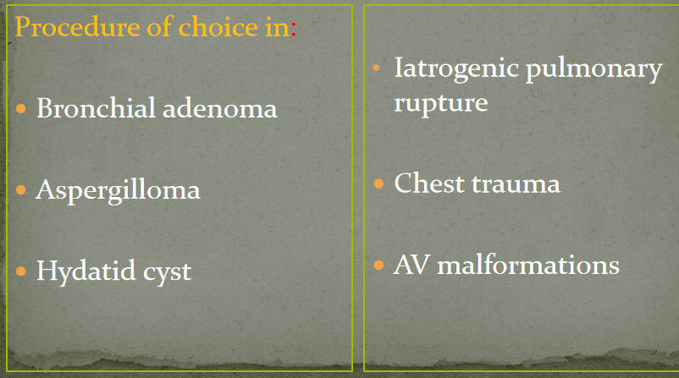
Surgical management
Surgical resection is a therapeutic option for emergency therapy of life threatning hemoptysis that fails to respond other measure.

Slide 54
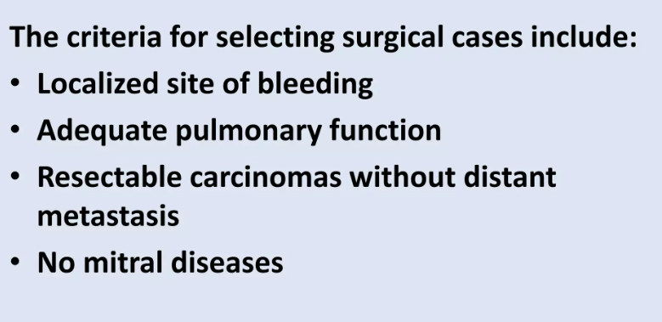
Surgical management conti
Urgent surgery is needed in case of obstruction of main bronchus with a clot that cannot suctioned by rigid bronchoscope,failure to control bleeding by other method.

Slide 55


