Slide 1



Antenatal Assessment
MODERATOR :- DR. ANJU YADAV

Slide 2
Definition :-
Systematic supervision involving both examination and advice to a woman during pregnancy.
2

Slide 3

Goals of Antenatal Assessment :-
To identify High risk Pregnancies
Prevention , Early Identification and Treatment of Pregnancy
complications
To educate pregnant females and their families about danger signs.
To discuss place , time , mode of delivery and care of newborn
To provide adequate psychosocial counselling
To ensure continued medical surveillance and Prophylaxis
To plan contraceptive use for future.

Slide 4
Antenatal Visits :-
Ideal Antenatal Visits :- 13/14
1 in every for 4 weeks till 28 weeks
1 in every 2 weeks till 36 weeks
1 in every week till child birth
Minimum Antenatal Visits (acc. To GOI) :- 4
1st visit :- as soon as possible (not later than second missed period)
2nd visit :- 14 to 26 weeks
3rd visit :- 28 to 34 weeks
4th visit :- 36 weeks to term

Slide 5
First Antenatal Visit :-
1. Detailed History Taking:-
Date of first examination
Last Menstrual Period
Expected Date of Delivery
Period of Gestation
Obstetric Score
Blood Group
Complaints
Obstetric History
Menstrual History
Past Medical History
Name
Age
Address
Religion
Occupation
Occupation of Husband
Duration of Marriage
Consanguineous or
Non consanguineous marriage

Slide 6
Expected Date of Delivery :-
Using Naegele’s Rule
1st Day of Last Menstrual Period + 7 days and 9 months
In Case of IVF
EDD = Day of Fertilization + 266 days
*NOTE* :- In case of Irregular menstrual cycle , there is no clear Last Menstrual Period , Hence EDD is determined by early Ultrasonography, instead of Naegele’s rule
6

Slide 7
Exercise :-
1st Day of LMP :- 24th EDD = ?
February 2026
Answer :-
3rd December 2026

Slide 8
Period Of Gestation :-
POG (in weeks + days) = No. of Days between 1st day of LMP and DOE / 7
Exercise :-
LMP:- 24 Feb 2026
DOE :- 12 June 2026 POG= ?
Answer :-
POG = 108 / 7
= 15 weeks + 4 days

Slide 9
Obstetric Score :-
GTPAL system:-
G – Gravida :- Number of Pregnancies (including present pregnancy) T- Number of Previous Term deliveries(> 37 weeks)
P – Number of Previous preterm deliveries ( 20 weeks to 36 weeks + 6 days) A – Number of Abortions ( Pregnancy loss < 20 weeks )
L – Number of Living Children
GPAL Score :-
G- Gravida :- Number of Pregnancies (including present pregnancy)
P- Parity :- Number of previous pregnancies reaching the period of viability (28 weeks)
L – Number of Living children
A - Number of Abortions ( Pregnancy loss < 20 weeks )

Slide 10
Exercise :-
A 30 year old pregnant female with 3 living children, 1 twin pregnancy, third child was born of POG = 35 weeks, 2 loss of pregnancies (both before 20 weeks) and 1 still birth
GPAL = ? GTPAL =?
ANSWER :-G6 P3 L3 A2
G6 T1 P1 A2 L3

Slide 11
Obstetric History :-
Relevant in multiparas only
Obstetric events are recorded in chronological orders under the headings :-
Year and Date
Pregnancy Events
Labour events
Name of Hospital
Any complications
Mode of Delivery
Details of neonate

Slide 12
High Risk Pregnancies :-
Extremes of age : <20 years or >35 years
Short Stature : Females with Height <4’8” or 142 cm are associated with small pelvis and can cause obstructed labor
HIV +ve or HbsAg +ve
Severe Systemic illness
Severe Anemia (Hb<7g/dL)
Hypothyroidism
Multi-Fetal Pregnancy
Rh-ve mother with Rh+ve Father

Slide 13
Placenta Previa
Malpresentation
Bad Obstetric History (like Previous history of abortions or still births)
Pre-Eclampsia
GDM
Previous H/O C-section
Smoking / Alcoholism
Any previous pregnancy or Delivery complications

Slide 14
2. General Examination :-
Height
Maternal Weight
Built :- Obese/ Average / Thin
Nutrition :- Good/Average/Poor
Vitals
Pallor
Icterus
Clubbing
Cyanosis
Lymphadenopathy
Edema
Varicosities
Breasts Examination :- Condition of Nipple, Any breast lump, Any discharge etc:-

Slide 15
3. Systemic Examination :-
CVS Examination :-
S1 :- Loud and Prominent
S2:- Normal
S3:- Easily Heard
RS Examination:-
Chest Circumference :- increased by 6 cm
Transverse Diameter :- increased by 2 cm
Abdominal Examination :- Usually done in 3rd trimester
D) Vaginal Examination:- done before 12 weeks of POG
- Replaced by USG
15

Slide 16
Abdominal Examination :-
- Helps physician to make out the Foetal lie , Presentation and Position
Inspection :-
Uterine Contour
Shape of abdomen
Any excessive distension of Abdomen
Striae Gravidarum
Linea Nigra
Any Scar or Dilated veins

Slide 17
Palpation :-
1) Height of Fundus :- Upper Edge of Fundus is made out and marked after correcting the dextrorotation of uterus using ulnar border of left hand
{McDonald’s Rule}
Fundal Height (in cm) = Period of Gestation (in weeks) Discrepancy of 3 weeks/ 3 cm or more = Pathological Cause 12 weeks :- Just above Pubis Symphysis
20 weeks :- At umbilicus 36 weeks :- Xiphisternum

Slide 18
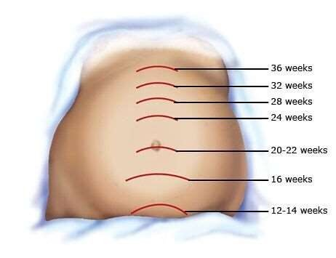
/ 40 weeks

Slide 19
Question:- How to differentiate whether the Period of Gestation is 32 weeks or 40 weeks on the basis of fundal height ?
Answer :-
Per Abdomen examination :-32 weeks – Head is not engaged 40 weeks – Head is engaged
Flanks :-
32 weeks – Empty 40 weeks – Full
3) Shelving :-
32 weeks – Absent 40 weeks – Present

Slide 20
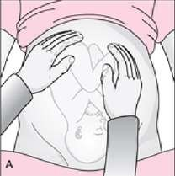
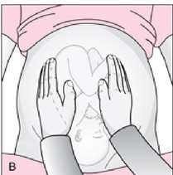
2) Leopold’s Manoeuvers :-
First Leopold / Fundal grip :-
  Fetal Parts Felt :- Longitudinal lie
  Fetal Parts not felt :- Transverse lie
  Buttocks felt :- Cephalic Presentation
  Head felt :- Breech Presentation
2) Second Leopold / Lateral grip:-
Smooth, Continous , rigid area = Back
Multiple regular knob like structures = Limbs

Slide 21
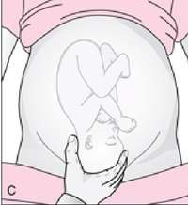
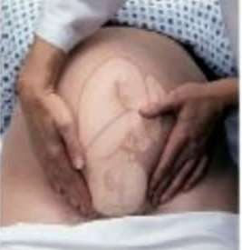
3) Third Leopold / Pawlik Grip :-
Firm globular rounded structure
Ballotable head :- Non fixed head
Non – Ballotable head :- Fixed head
4) Fourth Leopold / Deep Pelvic Grip :-Fingers converge :- Non- Fixed head Fingers diverge :- Fixed head

Slide 22
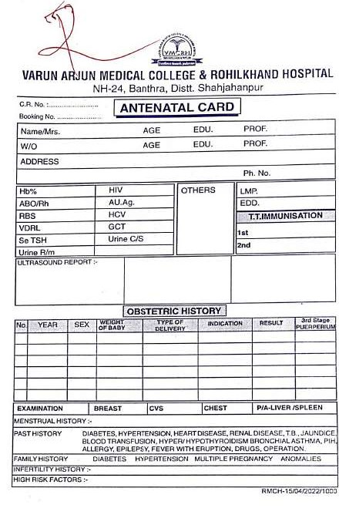

Slide 23
Complaints in Each Trimester :-
First Trimester :-
  Amenorrhea
  Nausea and Vomiting (Severe Vomiting indicates → Hyperemesis
Gravidarum
  Breast Changes
  Increased frequency of micturition
  Fatigue
  Vaginal Bleeding

Slide 24
Second Trimester :-
  Quickening (First perception of fetal movement) Normal :- 10 movements with in 12 hours
  Increased Appetite
  Backache
  Constipation
  Heartburn
  Varicose Veins
  Leg Cramps

Slide 25
C) Third Trimester :-
Breathlessness
Pedal Edema
Sleep Disturbances
Braxton Hicks Contractions
Pelvic Pressure

Slide 26
Assessments in each Antenatal Visits :-
Weight
Blood Pressure
Look for Pathological Edema
Uterine Size and Fundal Height
Auscultate Fetal Heart Sounds
Urine Dipstick Test for Proteinuria and Glycosuria

Slide 27
4. Investigations :-
UPT and USG
ABO/Rh status :- If Rh –ve Female → Check husband’s Rh status (if +ve) →
Indirect Coombs test (1st visit) → Repeat at 28 weeks
CBC + Haemoglobin
ACOG guidelines :- Repeat Hb testing at 24-28 weeks of Pregnancy Indian guidelines :- Repeat Hb testing at all visits
Thyroid Profile
Urine complete (microscopy and culture) In all trimesters

Slide 28
HIV (opt-out approach) Screening test : ELISA Diagnostic : Western blot
HbsAg Testing (regardless of Vaccination status)
VDRL test
Diabetes testing :-
acc. To DIPSI Criteria → First Test (1st visit) and Second test (24-28 weeks of Gestation)
High Performance Liquid Chromatography (HPLC) –
For Thalassemia

Slide 29
Ultrasound Scans :- There are 2 types of USG scans
TAS (Trans Abdominal Scan)
TVS (Trans Vaginal Scan)
There are 4 major USG scans in Antenatal Assessment .
  Early Pregnancy / Dating Scan
  NT scan
  TIFFA Scan
  Growth Scan

Slide 30
Early Pregnancy / Dating Scans :- 6-10 weeks
Purpose :- i) Confirm Intra Uterine Pregnancy
  Confirm Fetal Viability
  Determine Gestational Age accurately
  Detect multiple pregnancy
  Rule out Ectopic Pregnancy
  Diagnose Molar pregnancy
Structures seen :-
Gestational Sac :- First structure seen on USG . Indicates Pregnancy
Yolk Sac :- Indicates Intra uterine Pregnancy
Fetal Pole :- To measure Crown Rump Length
Cardiac Activity :- 6 weeks to 6 weeks + 2 days

Slide 31
2) Nuchal Translucency (NT) scan :- 11 weeks to 13 weeks + 6 days
Nuchal Translucency :- Fluid behind fetal neck (Normal :- usually less than <3mm)
Increased NT :-
Chromosomal Abnormalities
Congenital Heart diseases
Purpose :- Screening for chromosomal abnormalities
examples:- Down Syndrome, Edward Syndrome, Patau Syndrome
Question :- Why is NT scan done before 14 weeks?
Answer :- After 14 weeks Nuchal Translucency disappears .

Slide 32
3) Anomaly Scan (TIFFA Scan) :- 18 weeks to 22 weeks
Most Important fetal structural scan.
TIFFA :- Target Imaging for Fetal Anomalies
Purpose :- To detect congenital anomalies Examples:-
Anencephaly
Hydrocephalous
Cleft lip / Cleft Palate
Spina bifida
Congenital Heart Defects
Renal anomalies
Skeletal abnormalities

Slide 33
4) Growth Scan:- Around 28 weeks to 32 weeks
Purpose:- Assess Fetal growth and well being
Parameters assessed :-
Biparietal Diameter (BPD)
Head Circumference (HC)
Abdominal Circumference (AC)
Femur Length (FL)
Estimated Fetal Weight
Placenta :- Location and Grade
Amniotic Fluid Index :- Normal 5 – 24 cm
Fetal Presentation

Slide 34
Vaccinations:-
Td (Tetanus + diphtheria toxoid ) vaccine :
Td-1 at 1st visit → Td-2 after 4 weeks
If pregnant female received complete Td vaccination within last 3 years :- Only Td booster
TdaP (Tetanus + diphtheria + acellular pertussis) Vaccine :-Single shot between 27-36 weeks
Influenza vaccine :-During any trimester
COVID-19
Respiratory Syncytial Virus (RSV) :- after 32 weeks to protect infants from Respiratory ₃₄
infections

Slide 35
Folic Acid Supplementation :-
To prevent NTD :- 400 mcg/day (prophylactic dose)
- given to all pregnant females
To prevent recurrence of NTD :- 4 mg / day
- Given to females only with previous h/o NTD
4th Month Onwards :-
60 mg elemental iron + 500mcg Folic Acid
- Continued throughout the pregnancy and 180 days after delivery

Slide 36
Calcium Supplementation :-
RDA : 1000 mg
Given as 2 tablets from 4th month
Protein Supplementation :-
T1 :- 50g /day T2 :- +15g / day T3 :- + 25 g / day
Additional Caloric Requirements in Pregnancy :-
On Average + 350 Kcal / day
NOTE:- Lactating mothers require more calories than pregnant females.

Slide 37
Patient Counselling :-
Alert Signs and Symptoms :-
  Fever > 38 degree Celsius for more than 24 hours
  Persistent vomiting
  Headache / blurring of vision
  Generalised edema / puffiness of face
  Discharge or Bleeding PV
  Abdominal Pain
  Decreased fetal movements
  Breathlessness at rest
2) Sleep :-
Pregnant females are recommended to sleep for 2 hours in afternoon in addition to 8 hours in night and lie in Left lateral Position to prevent Supine Hypotension Syndrome

Slide 38
3) Travel:-
- Should avoid long travel in T1 and after 32 weeks
Sexual activity:- should be avoided in T1 and in last 6 weeks
Physical exercise :- 30 to 45 mins walking / day

Slide 39
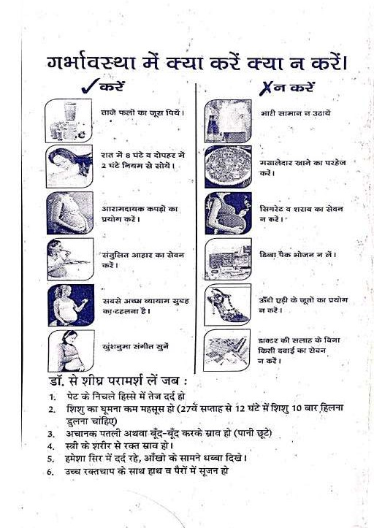

Slide 40
Q1) The most accurate method for determining gestational age in first trimester is :
Biparietal Diameter (BPD)
Femur Length (FL)
Crown Rump Length (CRL)
Abdominal Cricumference (AC)
Answer :- C
Crown Rump Length (CRL)

Slide 41
Q2) Quickening is usually felt by a primigravida at:-
10-12 weeks
14-16 weeks
18-20 weeks
24-26 weeks
Answer:- C
Primigravidas typically perceive fetal movements at 18-20 weeks while multiparas may feel them earlier

Slide 42
Q3) Normal Fetal Heart Rate in utero is :-
80-100 beats/min
100-120 beats/min
110-160 beats/min
160-200 beats/min
Answer :- C
110-160 beats/min

Slide 43
Q4) The Anamoly scan (TIFFA) is ideally performed at :-
6-8 weeks
11 – 13 weeks + 6 days
18 – 22 weeks
34 – 36 weeks
Answer:- B
11 – 13 weeks + 6 days

Slide 44
Q5) Acc. To McDonald’s Rule :-
Fundal Height (in cm) = Maternal Weight (in Kg)
Fundal Height (in inches) = Gestation Age (in weeks)
Fundal Height (in cm ) = Abdominal Circumference
Fundal Height (in cm) = Gestational Age (in weeks)
Answer :- D

Slide 45
Thank You

