Slide 1
Approach to a patient with hepatitis
Moderated by Dr. Jagrati ( medicine department)

Slide 2
History of the patient

Slide 3
Patient particulars
Name - Mukesh Age - 33 years old Gender- male Religion- hindu
Maritial status- married
Occupation - farmer Resident- Shahjahanpur
Date of admission- 3rd September,2026 Date of examination-7th september,2026

Slide 4
Chief complaints
Patient came to medicine OPD with chief complaints of
Loss of appetite from 10 days Easily fatiguability from 10 days
Yellowish discolouration of Eye from 10 days

Slide 5
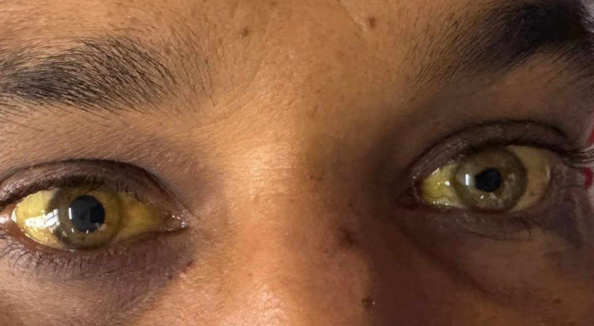

Slide 6
History of presenting illness
According to the Patient he was apparently well 10 days back when he developed loss of appetite which was gradual progressive. Patient reports to decreased oral intake compared to usual intake. Also complaints of abdominal fullness and mild abdominal discomfort associated with nausea which aggravates following meals their is no history of vomiting , difficulty in swallowing, melena,
hematemesis .no complaints of constipation and diarrhoea

Slide 7
Also complaints of easily fatiguability which was gradual and progressive in nature. Patient describes generalised tiredness and lack of energy , particularly on performing daily activities. It relieves on taking rest.
Their is no history of breathlessness, chest pain, palpitations, giddiness or syncope.
Their is no history of muscle weakness, difficulty in climbing stairs or getting up from squatting position.

Slide 8
he also noticed Yellowish discolouration of eye which was insidious in onset , gradually progressive in nature, first appeared on sclera. During the coarse of illness he observed the same discolouration on abdomen by day 4th. It is associated with nausea , dark coloured urine, weakness and weight loss. No history of fever, itching and Melena . No history of recent blood transfusion, needle prick, tattooing . No history of recurrent jaundice.
Their is no history of, breathlessness, or chest pain. No history of decreased urine output

Slide 9
Past history
No similar complaints in the past No past hospitalisation history No past surgical history
No past medication history
No history of diabetes mellitus, hypertension, TB, hypothyroidism, asthma, allergy

Slide 10
Personal history
Mixed diet
Sleep wake cycle is disturbed / interrupted at night He wakes up the night and sleeps in the day Normal bowel bladder movement
Alcohol consumption since 6 years
He consumes country liquor 125 ml per day which comes out to be 28gm absolute alcohol
Tobacco chewing since 9 years

Slide 11
Family history
No significant family history .
No complaints of similar illness in the family

Slide 12
Differential diagnosis
Alcoholic hepatitis Acute viral hepatitis Primary biliary cirrhosis Haemolytic jaundice
Post obstructive jaundice
Autoimmune hepatitis MASH
Cryptogenic hepatitis
Metabolic disorders - cystic fibrosis , haemochromatosis Hepatocellular carcinoma

Slide 13
General physical examination

Slide 14
Patient is conscious
Oriented to time, place and person Cooperative and Obeying commands. Lying comfortably in supine position
Nutritional examination height 170cm
Weight 53 kg
BMI 18.3 Kg/ m2

Slide 15
Vitals
Pulse
Rate - 80 beats per minute Rhythm - regular
Volume- normal
Character - catacrotic Vessel wall normal No Radio-radial delay
No radio-femoral delay
Peripheral pulses all present
Blood pressure-130/70 mm of Hg Left arm
Sitting position

Slide 16
Respiratory rate -19 breaths per minute
Regular Abdominothoracic
No Use of accessory muscles
Temperature- 98 degree Fahrenheit axillary
Oxygen saturation Spo2- 98% on room air

Slide 17
Pallor is Present Icterus is present Cyanosis is absent Clubbing is absent
Lymphadenopathy is absent
Oedema is present Bilateral pedal oedema Pitting oedema
Upto ankle Grading 2+

Slide 18
Head to toe examination
No signs of liver cell failure except Jaundice is present on the sclera Fine tremors

Slide 19
Systemic examination

Slide 20
Inspection
Generalized distention all over abdomen
Skin over the abdomen appears yellow discoloured Symmetry
Umbilicus is inverted centrally located
Movement of corresponding quadrants with respiration present Dilated veins are not present
No Visible mass
No Visible pulsations No Visible peristalsis No Scars or sinuses No stria
No stretch marks

Slide 21
Palpation
Inspectory findings where confirmed
Superficial palpation
no rise in local temperature Tenderness over epigastrium No Guarding
No Rigidity
Deep palpation Hepatomegaly present
2 fingers below right costal margin Rounded edge
Smooth Surface
Tenderness present over epigastrium and right hypochondrium Firm Consistency

Slide 22
No splenomegaly. Spleen is not palpable. Their is no tenderness
Kidney Ballotable puddle sign was absent
Spino umbilicus distance is equal on both sides
Distance from xiphisternum to umbilicus and umbilicus to pubic symphysis is equal

Slide 23
Percussion
On percussion the Liver span is 14 cm in Mid-clavicular line No shifting dullness
No fluid thrill

Slide 24
Auscultation
Bowel sound present, And normal frequency No abdominal bruit , friction rub heard

Slide 25
CNS : Patient is conscious and oriented to time , place, and person.
CVS : S1 S2 heard , no additional heart sounds are heard.
RESPIRATORY : Trachea is centrally placed , bilateral equal air entry present ,
no additional breath sounds are heard.

Slide 26
Summary
A young 33 year old male patient who is a chronic alcoholic and smoker came to OPD with chief complaints of loss of appetite, easily fatiguability and yellow discolouration of eye with no Fever and no high risk behaviour. His sleep cycle was disturbed with BMI on lower side and pallor , icterus and bilateral pitting oedema present. On examination mild hepatomegaly and epigastric tenderness was found . So considering the history and examination the most probable aetiology came out to be alcoholic involving hepatobilliary system. So the probable diagnosis came out to be alcoholic liver disease/ alcoholic hepatitis.

Slide 27
Investigations

Slide 28
Biochemical CBC
Liver function test (LFT)
Serum aminotransferase levels AST:ALT ratio
Bilirubin levels Serum ALP Albumin levels Viral markers KFT
Haematological Coagulation profile Prothrombin time PT INR
Indirect coombs test USG

Slide 29
Treatment

Slide 30
advised to stop alcohol consumption for life, because this is a Precirrhotic condition.
Severe hepatitis needs bed rest
nutritional supplements multivitamins mainly vitamin B Corticosteroids (prednisolone usually 40 mg per day) may be tried in severe cases (discriminant function > 32) N acetylcysteine is an antioxidant that neutralises free radicals by production of glutathione can be given

Slide 31
MCQ

Slide 32
1. The typical AST:ALT ratio in alcoholic hepatitis is:
A. <1
B. 1:1
C. >2:1
D. >5:1

Slide 33
2. In alcoholic hepatitis, AST is usually:
A. >1000 IU/L
B. Always norma
C. <500 IU/L
D. >2000 IU/L

Slide 34
Which laboratory finding is commonly associated with alcoholic hepatitis?
  Severe neutropenia
  Microcytosis
  Macrocytosis
  Low ESR

Slide 35
4. The most important initial treatment for alcoholic hepatitis is:
A. Continue alcohol in small quantities
B. Antibiotics in every patient
C Alcohol abstinence
D. Immediate liver transplantation in all patients

Slide 36
5. Which score is Common used to assess severity and guide corticosteroid treatment in alcoholic hepatitis?
A. Maddrey discriminant function
B Glasgow-Blatchford score
C. Wells score
D. Childbirth score

Slide 37


