Slide 1
Approach to obstetrical and gynaecological causes of abdominal pain..

Slide 2
Case No 1

Slide 3
PATIENT PARTICULARS
Age : 30 years
Sex : Female
Occupation : House wife
Date of examination : 22/12/2025

Slide 4
CHIEF COMPLAINTS
Patient came to casualty with complaints of
Pain in lower abdomen since 1 day
Inability to pass urine since 1 day
Mild Bleeding P/V since 1 day

Slide 5
HISTORY OF PRESENT ILLNESS
.
30 year old female presented to casualty with c/o lower abdominal pain
Pain abdomen initially was diffusely localised in the hypogastrium, mild to moderate intensity and constant in nature
Lower abdominal pain was subsequently localised in left iliac fossa, sharp in nature, radiating to left shoulder tip.
Pain was slightly reduced on medication

Slide 6
VISCERAL vs SOMATIC PAIN
Visceral pain:
Arises from intraabdominal organs. Due to bilateral innervation, it is diffusely localized in midline
Epigastrium for foregut, Periumbilical for midgut and Hypogastrium for Hindgut and Genitourinary structures
Example: Periumbilical pain in appendicitis
Somatic pain: Arises from abdominal wall or parietal peritoneum. Sharply localized with dermatomal distribution.
Example: Rt iliac fossa pain in appendicitis

Slide 7
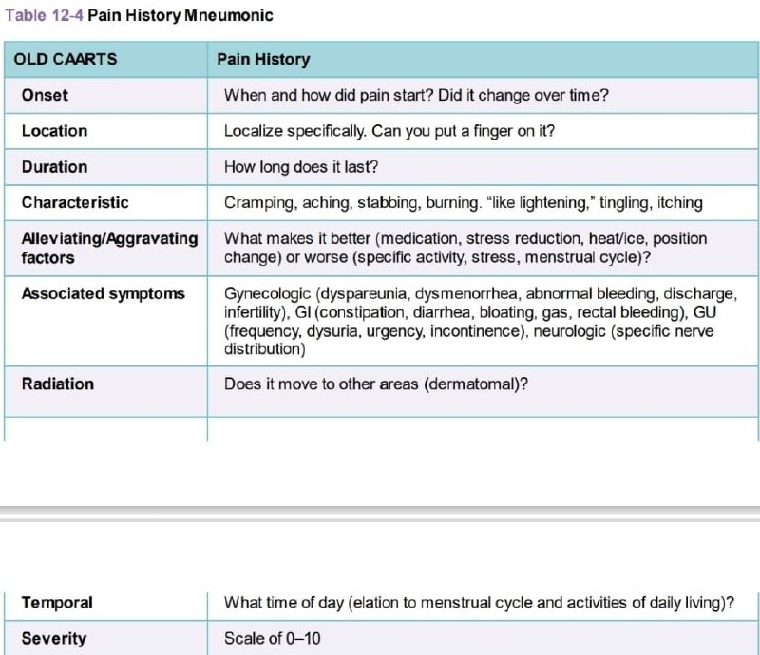

Slide 8
ONSET
Abrupt onset:
Organ torsion – Ovary, Uterus
Rupture – Ectopic, Corpus luteum
Ischaemia and vascular events

Slide 9
LOCALISATION
Diffuse vs Sharply localised

Slide 10
DURATION
Intermittent vs Constant

Slide 11
CHARACTERISTICS
Colicky pain:
Associated with obstruction
Examples:
Bowel obstruction
Urolithiasis
Incomplete abortion
Expulsion of polyp or pedunculated fibroid
Constant pain:
Examples:
Peritonitis
Hemorrhage

Slide 12
AGGRAVATING/ALLEVIATING FACTORS
Peptic ulcer disease:
Aggravated by fasting, relieved after meals
Acute pancreatitis:
Relieved by sitting up and leaning forward
Peritonitis pain:
Aggravated by increased intraabdominal pressure, movement, cough, sneezing

Slide 13
RADIATION
Radiates to dermatomal distribution
Example:
Upper ureteric pain radiates to flank and lumbar region
Lower ureteric pain radiates to groin, testicle
Pain of diaphragmatic irritation radiates to shoulder tip

Slide 14
TEMPORAL
Relationship with time of day or menstrual cycle
Example:
Nocturnal pain in duodenal ulcer
Severe dysmenorrhea in endometriosis

Slide 15
SEVERITY
Pain due to peritoneal irritation by acid perforated peptic ulcer will be more severe than biliary or fecal leak
Urinary leak and intraperitoneal hemorrhage will also cause less irritation

Slide 16
ASSOCIATED SYMPTOMS
Bleeding, discharge, amenorrhoea, dyspareunia
Dysuria, hematuria, urinary retention
Vomiting, Constipation, Obstipation

Slide 17
MECHANISMS OF PAIN
Inflammation of parietal peritoneum:
Sharply localized pain of variable severity
Hollow viscus obstruction:
Intermittent, colicky pain
Vascular :
Sudden onset or gradual increase in severity over time
Abdominal wall:
Constant pain, sharply localized
Neuropathic pain :
Radiating pain

Slide 18
HISTORY OF PRESENT ILLNESS
She was unable to pass urine since 1 day for which she was catheterised at District Hospital.
She also gave history of mild vaginal bleeding.
Bleeding was mild and soaked only half pad since yesterday without any history of passage of fleshy mass or clots per vaginam
She has history of UPT weakly positive at home done 1 week ago

Slide 19
PAST HISTORY
  Married for 10 years
  Menstrual History – Regular cycles lasting for 3-4 days, every 28-30 days
  LMP – 03/12/2025
  Obstetric History- Para 3 Live 3
  P1- Female/8yrs/ FTNVD / A&H
  P2- Female/6yrs/ FTNVD / A&H
  P3- Female/3yrs/ FTNVD / A&H
  No h/o PID or Dilatation and curettage done in past
  No history of diabetes, hypertension, asthma, epilepsy, tuberculosis.
  Drug history – No history of medication or illicit drug use
  Surgical history- Incision and Drainage of Right Breast Abscess

Slide 20
EXAMINATION
General Examination
Patient was conscious and oriented to time place and person
Pulse 138bpm, BP-96/60mmHg
Afebrile, sPO2-95%, Resp rate-24/min
Pallor present. No icterus, edema, clubbing, cyanosis or generalised lymphadenopathy

Slide 21
GENERAL EXAMINATION
Facial expression
Diaphoresis, Cold, Clammy skin
Pallor
Behaviour:
Patient rolling around in bed in ureteric colic versus patient lying deathly still in perforated peptic ulcer
Fever, tachycardia, hypotension
Orthostatic changes in Pulse, Blood pressure indicative of hypovolaemia Pulse >30bpm, BP > 20 mmHg

Slide 22
ABDOMINAL EXAMINATION
Abdomen appears mildly distended
Deep tenderness in left iliac fossa
No guarding or rigidity

Slide 23
INSPECTION
Scars: Hernia, Obstruction due to adhesion
Hernial orifices, visible cough impulse
Abdominal distension: Obstruction, perforation, ascites
Visible peristalsis
Abdominal contour: Scaphoid, distended flanks, visible masses
Mobility on respiration
Cullens sign, Gray Turner sign

Slide 24
PALPATION
Start away from area with pain, palpate quadrant by quadrant and end in the painful area
Localised Guarding:
Protective spasm of muscle
Rebound tenderness:
Peritoneal irritation
Generalised Rigidity:
Widespread muscle spasm due to generalized peritonitis
Carnett sign: To differentiate between intraabdominal vs abdominal wall source of pain

Slide 25
PERCUSSION
To elicit rebound tenderness
Obliteration of liver dullness in perforation

Slide 26
AUSCULTATION
Bowel sounds
Bruit
Fetal heart sounds

Slide 27
LOCAL EXAMINATION
Per Speculum- Minimal bleeding present; Cervix healthy
Per Vaginam- Uterus bulky; anteverted; cervix soft; cervical motion tenderness present; bogginess felt in POD
Per Rectum – Boggy mass felt in POD

Slide 28
PELVIC EXAM
Bleeding: Pregnancy complications, Genital trauma
Discharge: Infection
Uterine size: Pregnancy, Fibroid, Adenomyosis, Hematometra
Cervical excitation: Ectopic, Acute PID
Adnexal tenderness: PID
Adnexal mass

Slide 29
RECTAL EXAM
Assessment of POD
Assessment of nature and mobility of pelvic mass

Slide 30
SUMMARY
30 year old female
Nullipara
Pain abdomen, urinary retention, Bleeding Per Vaginam
Pain initially diffuse and mild in hypogastrium, later in left iliac fossa, sharp in character, increasing in severity, radiating to shoulder tip
Differential Diagnosis

Slide 31
EXMINATION FINDINGS SUMMARY
Conscious and alert, afebrile
Pulse – 138/min ; BP-96/60 mmHg
No tachypnea / hypoxaemia
Pallor present
Per Abdomen – not visibly distended; deep tenderness LIF; no guarding; no rigidity
Per Vaginam-uterus mildly enlarged; cervical motion tenderness; bogginess in POD
Differential Diagnosis

Slide 32
INVESTIGATIONS
BLOOD (22/12/2025)
ABO RH – B POSITIVE
HEMOGLOBIN – 6.4 GM%
TLC – 7,500 / cc mm
Platelet – 1.61 lacs / cc mm
INR-1.0
PROTHROMBIN TIME – 14.9 SEC
APTT – 29.1 SEC
RBS – 84.2 mg/dl
KFT – WNL
LFT- WNL
VIRAL MARKERS – NON REACTIVE
UPT – Weakly positive

Slide 33
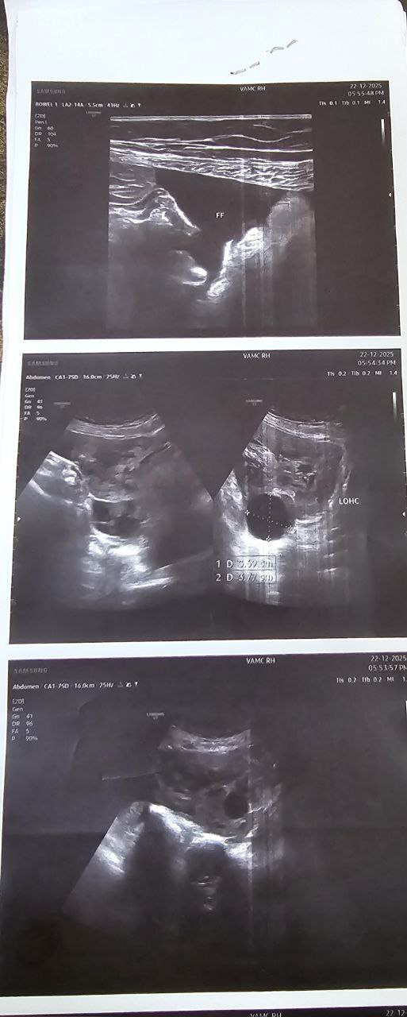
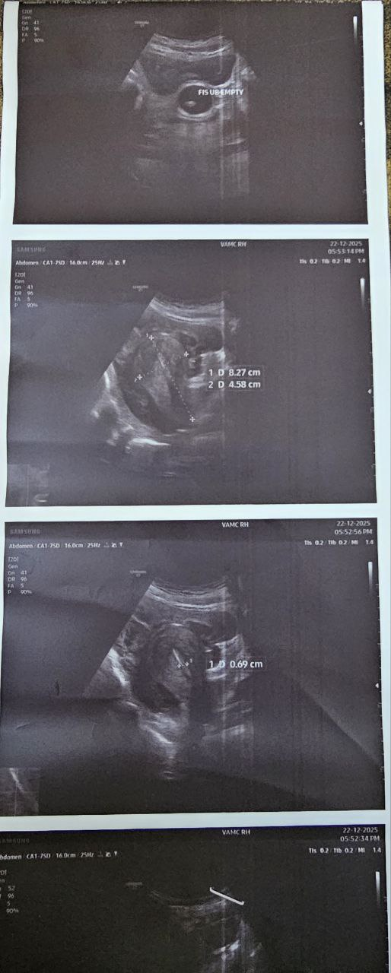
USG (22/12/2025)
Uterus is normal in size.
ET measuring – 8-9 mm
Right adnexa showing a large well defined heterogenously hyperechoic mass with increased vascularity on Doppler with well defined corpus luteum with ring of fire appearance.
Moderate amount of free fluid with internal echoes in pelvic cavity s/o hemoperitoneum.
No extra uterine gestational sac seen.
Left ovary not visualized.

Slide 34
PROVISIONAL DIAGNOSIS
MANAGEMENT
G4P3L3 With ?ruptured ectopic ?ruptured corpus luteum with hemoperitoneum with severe anemia.
Exploratory laparotomy with left salpingectomy . Intra-operatively 2 units of PRBC and 2 Units of FFP was transfused.

Slide 35
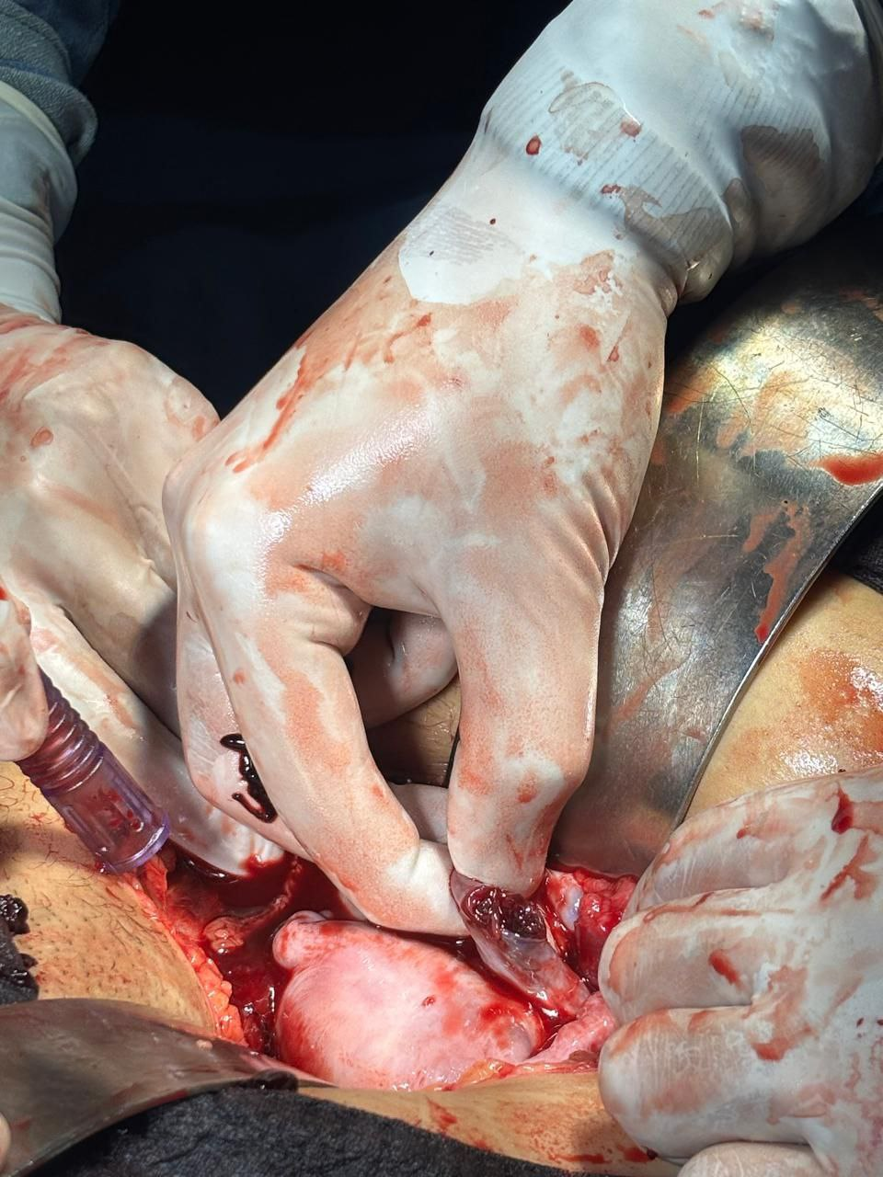
Intra-op findings:
Right side fallopian tube was healthy
Right side ovarian cyst of 5X4cm seen
Left side corpus luteal cyst of 3X3cm seen
Stigmata of left side corpus luteal cyst was ruptured, active bleeding was seen and controlled
Ampullary part of left fallopian tube was ruptured

Slide 36
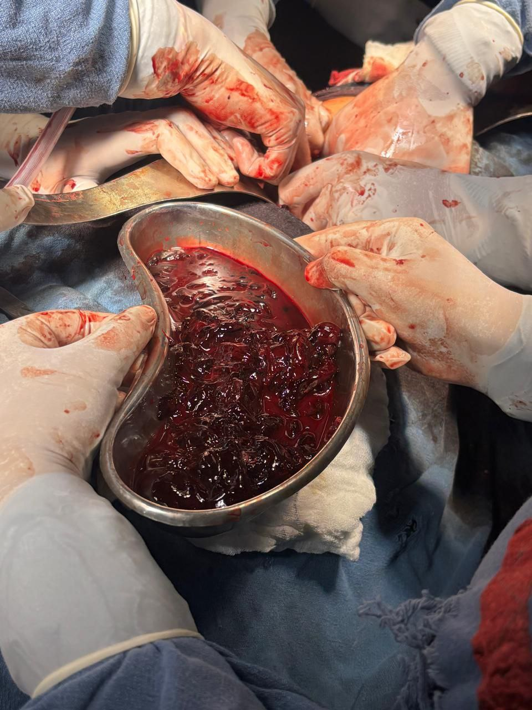
Blood and clots of approximately 1500 cc was evacuated

Slide 37
DISCUSSION

Slide 38
DEFINITION
Implantation of pregnancy in a site other than uterine cavity
Most common site – fallopian tube ( ampulla > isthmus > interstitium )
Most common non tubal site – ovary
Least common – c section scar > cervical ectopic > abdominal ectopic
Lasts longest – Interstitium
Ends earliest – Isthmus
Most dangerous - Interstitium

Slide 39
RISK FACTORS
Most important is Prior Ectopic – 10-15 % after first ectopic ; 30 % after second ectopic
History of Tubal surgery – tubal ligation; assisted reproductive technology
History of pelvic inflammatory disease ; Endometriosis ; Pelvic TB
Smoking
Contraceptives

Slide 40
IMPORTANT POINTS IN HISTORY TAKING
Age
Past menstrual history
Previous pregnancy
Infertility
Contraception

Slide 41
CLINICAL FEATURES
Triad of amenorrhea + pain abdomen + bleeding P/V ( only 50 % cases )
Pain abdomen - Most common ( 90% cases )
Before rupture – Per abdomen – non tender / mildly tender; uterus slightly enlarged
Per Vaginam – cervical motion tenderness +/- ; adnexal mass +/-
After rupture – Intra abdominal hemorrhage , tachycardia , hypotension
Per abdomen– distended; tender; rebound tenderness
Per Vaginam– cervical motion tenderness +
Differential Diagnosis – corpus luteal cyst

Slide 42
SONOGRAPHY
Definitive ectopic pregnancy
Probable ectopic pregnancy
Probable intra uterine pregnancy
Definite intra uterine pregnancy
Pregnancy of unknown location

Slide 43
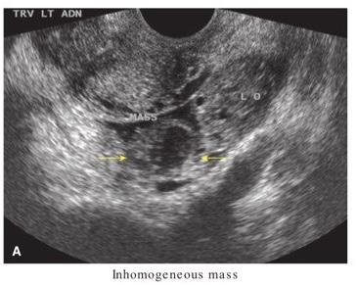
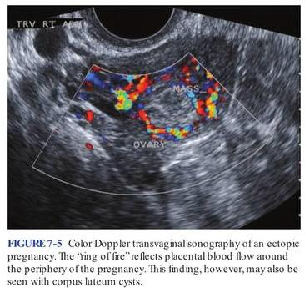
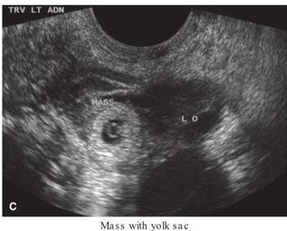
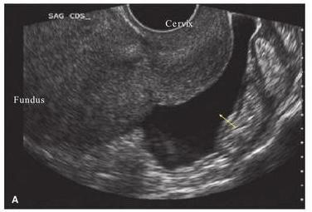

Slide 44
MANAGEMENT
Expectant Management
Medical Management
Laparoscopic / TVS guided medical Management
Surgical management – laparoscopic / laparotomy
Conservative Surgery – Salpingostomy / salpingotomy
Salpingectomy

Slide 45
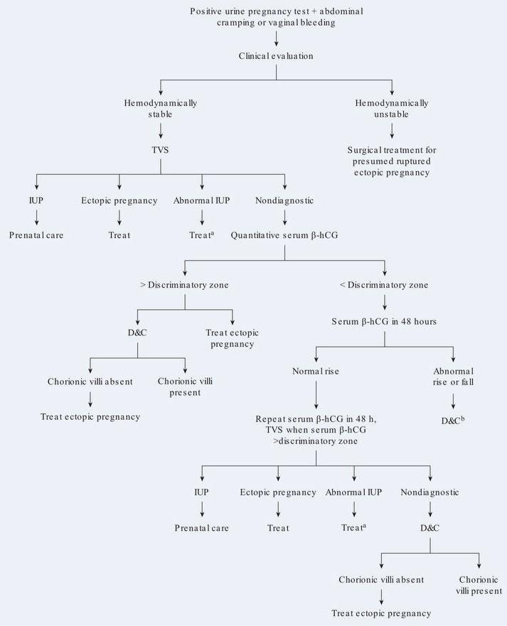

Slide 46
MEDICAL MANAGEMENT
Drug of choice – Methotrexate
Route – Intra muscular
Pre – requisite – 1- Unrupture ectopic
2- Stable vitals
3- hcg < 5000 IU
4- Family not complete
5- size of ectopic < 4 cm
6- cardiac activity absent

Slide 47
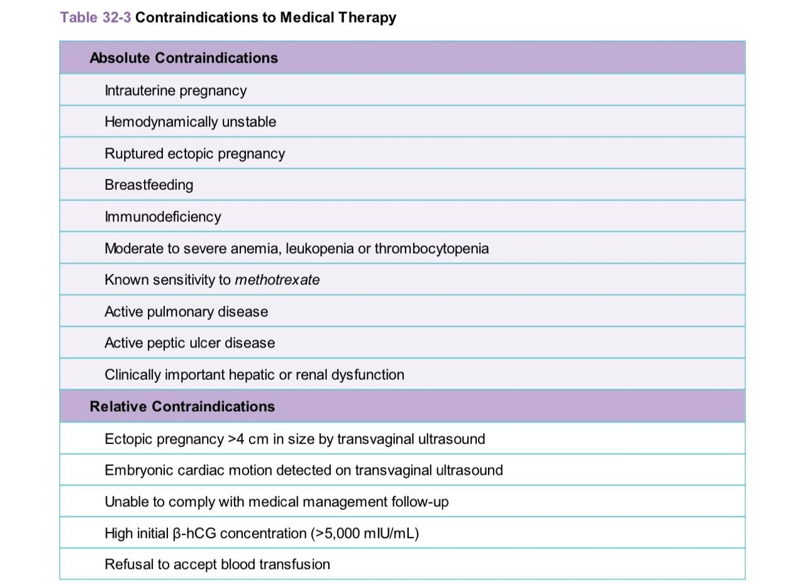

Slide 48
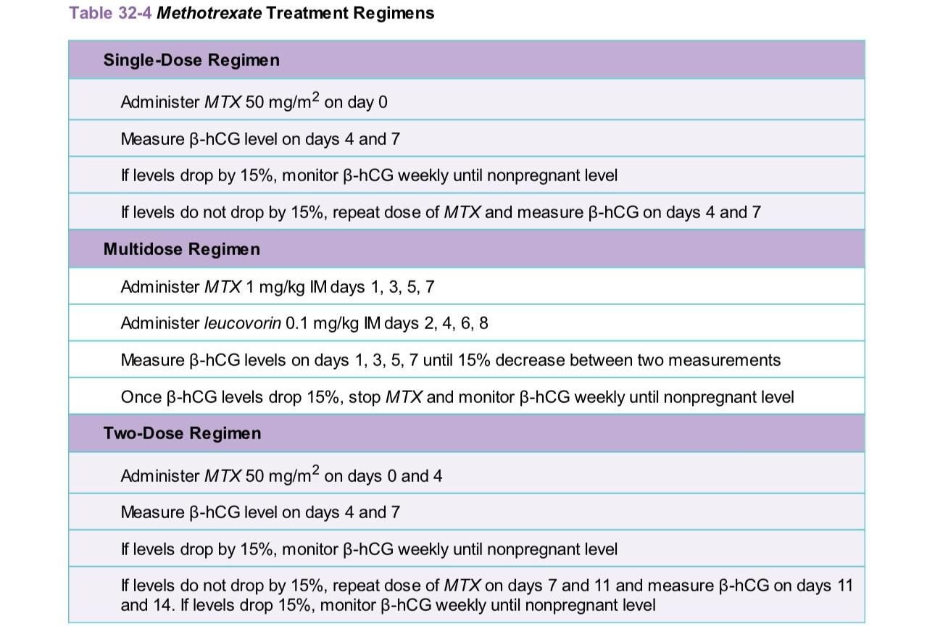

Slide 49
Obstetric causes of acute pain abdomen
Early Pregnancy:
Threatened abortion
Incomplete abortion
Uterine perforation
Ectopic pregnancy
Molar pregnancy with rupture theca lutein cysts
Ruptured corpus luteum
Late pregnancy/Labour:
Abruptio placenta
Uterine rupture
HELLP syndrome

Slide 50
Non obstetric causes of pain in pregnancy
Acute appendicitis
Biliary colic/ Cholecystitis
Acute Pancreatitis
Urolithiasis/Ureteric colic
Pyelonephritis
Sickle cell crisis
Degeneration of fibroid
Diverticulitis
Ovarian cyst complications
Bowel obstruction

Slide 51
Gynaecological causes of acute pain abdomen
Torsion / rupture ovarian mass
Pelvic inflammatory disease
Tubo ovarian abscess

Slide 52


