Slide 1

DEPARTMENT OF RADIODIAGNOSIS
VARUN ARJUN MEDICAL COLLEGE
AND ROHILKHAND HOSPITAL

Slide 2
CEREBRAL HEMORRHAGE-
RADIOLOGICAL EVALUATION
DEPARTMENT OF RADIODIAGNOSIS
MODERATED BY - DR.(COL) P.K. TIWARY
HOD AND PROFESSOR
DEPARTMENT OF RADIODIAGNOSIS

Slide 3
Learning Objectives
Traumatic Brain Injury
Who and When to Image in Head Trauma
Types of cerebral hemorrhage
Imaging modalities
MRI evolution of hemorrhage

Slide 4
TRAUMATIC BRAIN INJURY
Key Mechanisms
1. Impact Injury
Brain hits skull → gyral contusions
2. Acceleration–Deceleration
Sudden motion → brain shifts inside skull
3. Rotational Forces
Angular momentum → axonal stretching → Diffuse Axonal Injury (DAI)
4. Ground-Level Falls (GLF)
Significant injury possible
Risk ↑ in:
  Elderly
  Anticoagulated patients

Slide 5
Pathophysiological Classification
🔴 Primary Injury (at impact)
Skull fractures
Extraaxial hemorrhages:
  EDH
  SDH
Parenchymal injuries:
  Contusions
  Diffuse axonal injury
  Lacerations

Slide 6
CT (NCCT) — ⭐ GOLD STANDARD
Why CT?
Fast
Widely available
Detects:
  Hemorrhage
  Fractures
  Mass effect
  **CECT BRAIN IS CONTARINDICATED IN TRAUMA

Slide 7
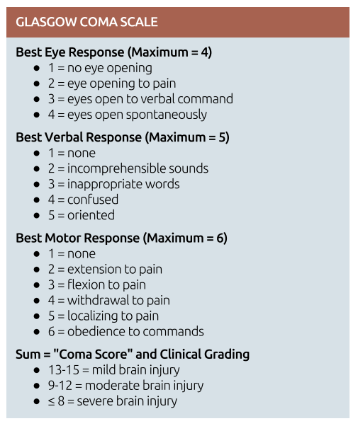
“Who and When to Image in Head Trauma”
WHO TO IMAGE?
Based on GCS (Core Principle)
🔴 Always Image
Moderate → GCS 9–12
Severe → GCS ≤ 8
➡️ Mandatory NCCT BRAIN

Slide 8
SPECIAL HIGH-RISK GROUPS
Age > 65
Children < 2 years
Anticoagulated patients
Loss of consciousness
Focal neurologic deficit
Intoxicated patients

Slide 9
Skull Fractures
Types
🔹 Linear
🔹 Depressed
🔹 Elevated
🔹 Diastatic
🔹 Growing Skull Fracture (Leptomeningeal cyst)

Slide 10
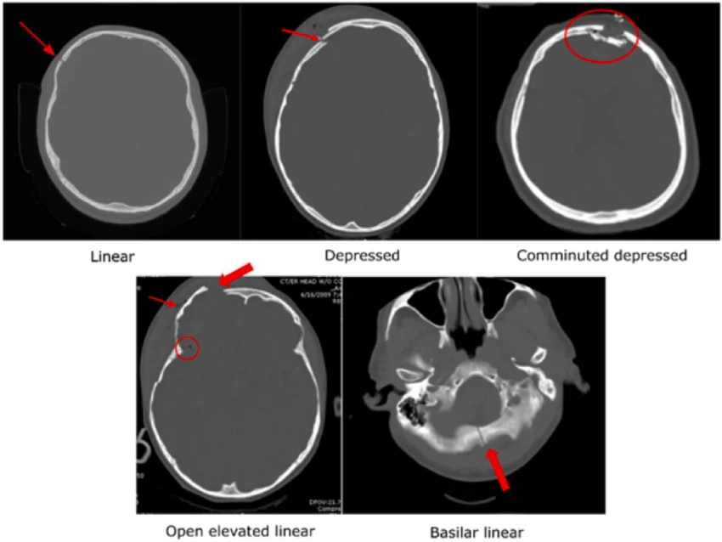

Slide 11
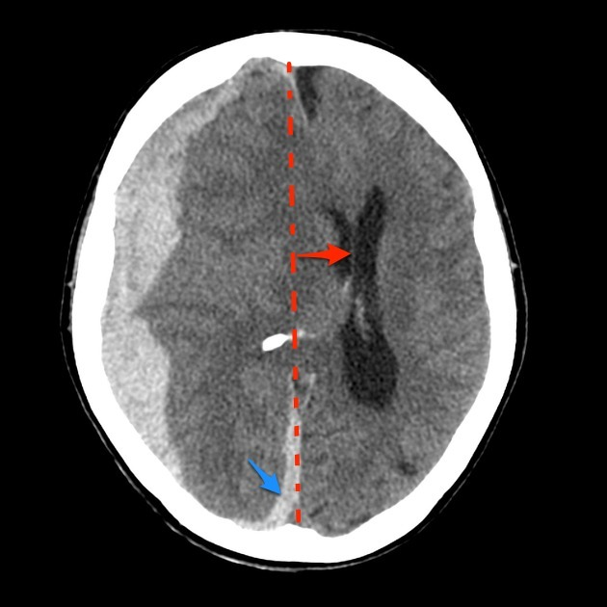
NCCT BRAIN
Hyperdense hemorrhage
Edema
Midline shift
IVH
Herniation

Slide 12
HEMORRHAGE CLASSIFICATION
Subarachnoid Hemorrhage
Subdural Hemorrhage
Epidural Hemorrhage
Intraparenchymal Hemorrhage
Intraventricular Hemorrhage

Slide 13
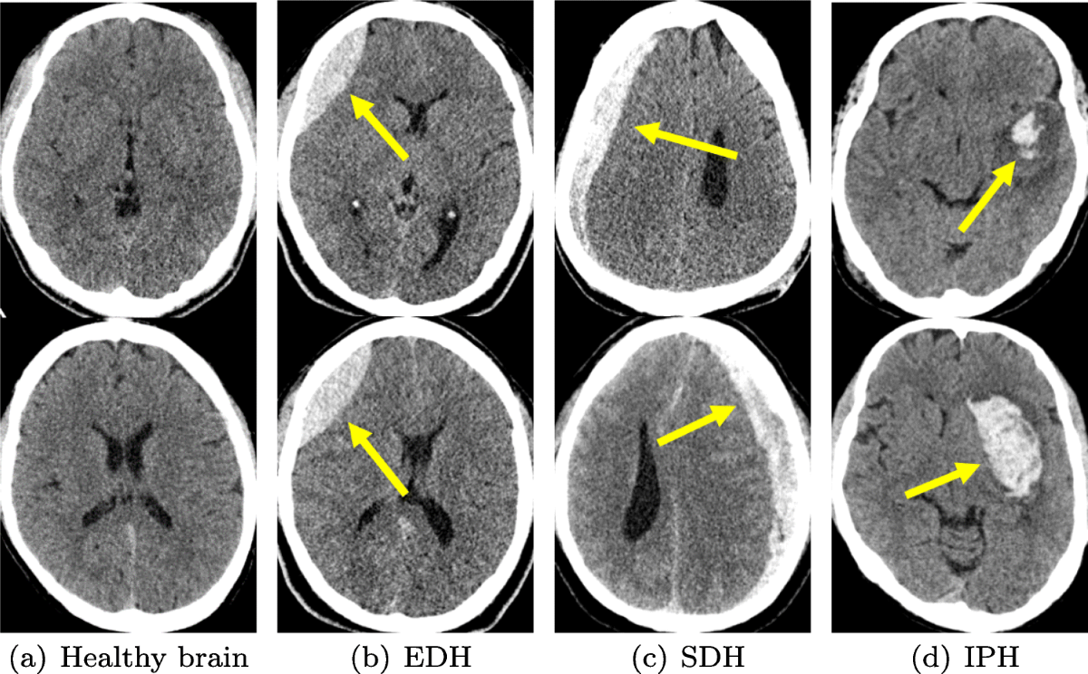

Slide 14
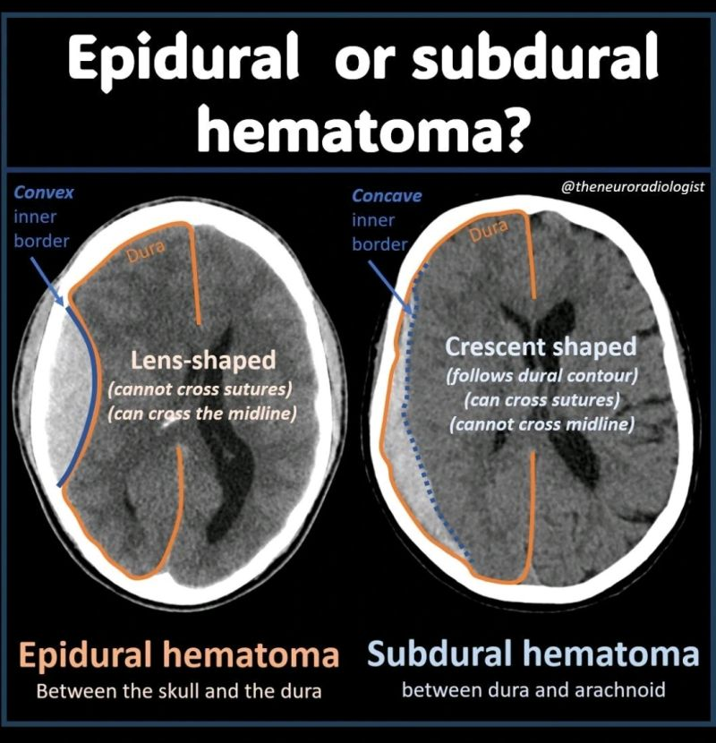
Epidural vs Subdural Hemorrhage
EDH: Lentiform, does not cross sutures
SDH: Crescentic, crosses sutures

Slide 15
EPIDURAL HEMORRHAGE
Arterial (90%) Most common: middle meningeal artery
90%:Unilateral & Supratentorial
Classic Presentation 👉 Lucid interval
Seen in ONLY ~50% cases
Swirl Sign
Hypodense area within hematoma 👉 Indicates:
Active bleeding , Unclotted blood

Slide 16
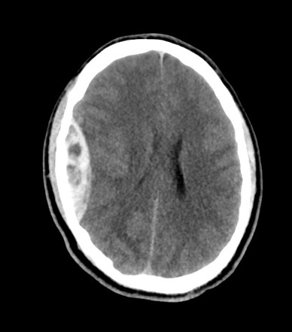

Slide 17
SUBDURAL HEMORRHAGE
Most Common Cause👉 Tearing of bridging veins
Spreads widely: Over hemisphere, Along falx, Along tentorium

Slide 18
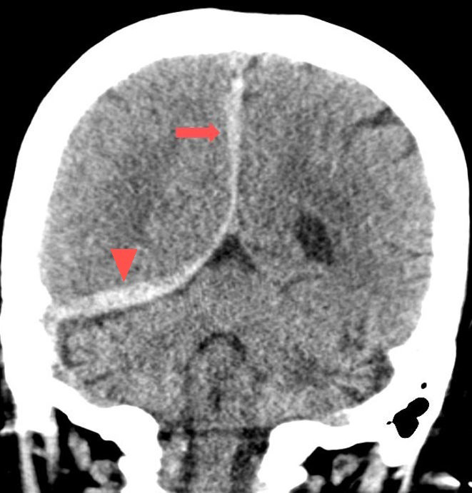

Slide 19
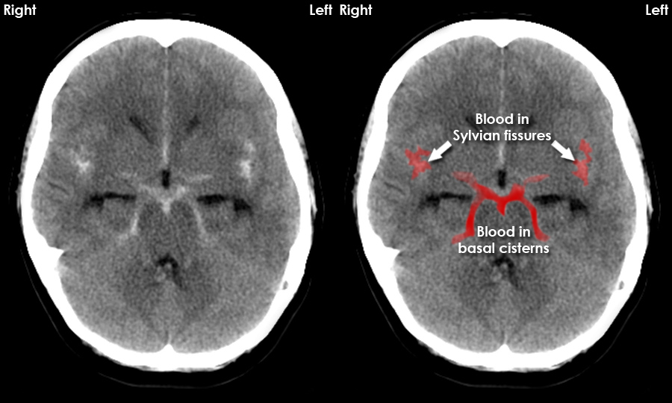
Subarachnoid Hemorrhage

Slide 20
SUBARACHNOID HEMORRHAGE
Etiology
Tearing of cortical arteries/veins
Ruptured contusions/lacerations into subarachnoid space
Typical Locations
Perisylvian region (most common)
Anteroinferior frontal sulci
Temporal sulci
Hemispheric convexities
Interpeduncular cistern

Slide 21
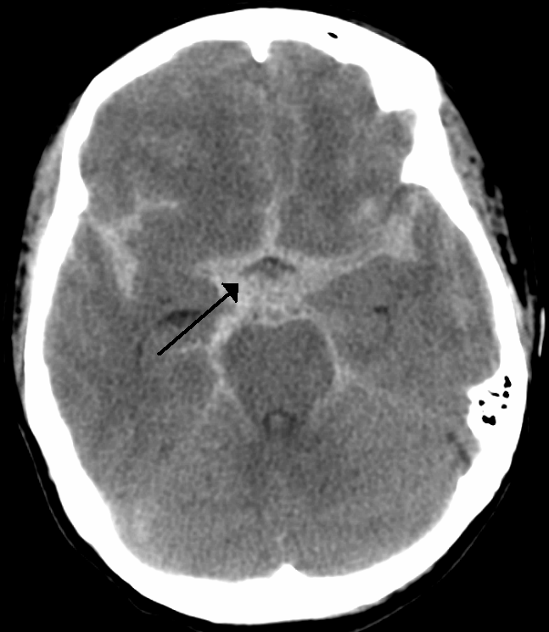

Slide 22
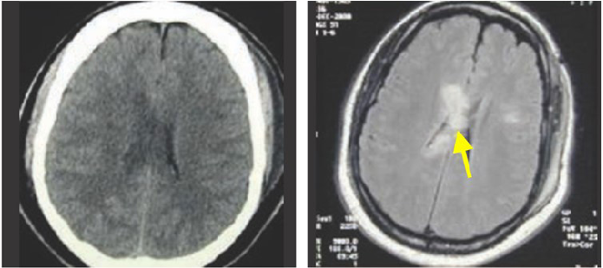
DAI (Diffuse axonal injury)

Slide 23
DAI (Diffuse axonal injury)
Etiology
Usually non-impact injury
High-speed MVCs, acceleration–deceleration, rotational forces
Most cases occur without skull fracture
Axonal stretching occurs at gray-white matter interfaces
Common Locations (High-Yield)
🔹 Subcortical white matter
🔹 Corpus callosum (genu & splenium)
🔹 Corona radiata
🔹 Internal capsule

Slide 24
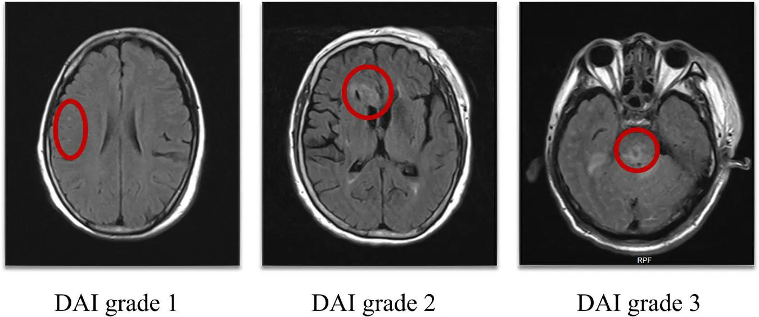
DAI (Diffuse axonal injury)
DAI grade 1: Lesions in the hemispheres
DAI grade 2: Lesions in the corpus callosum
DAI grade 3: Lesions in the brainstem

Slide 25
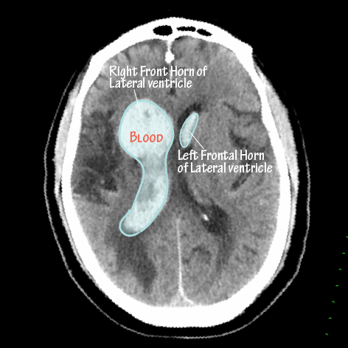
Intraventricular Hemorrhage

Slide 26
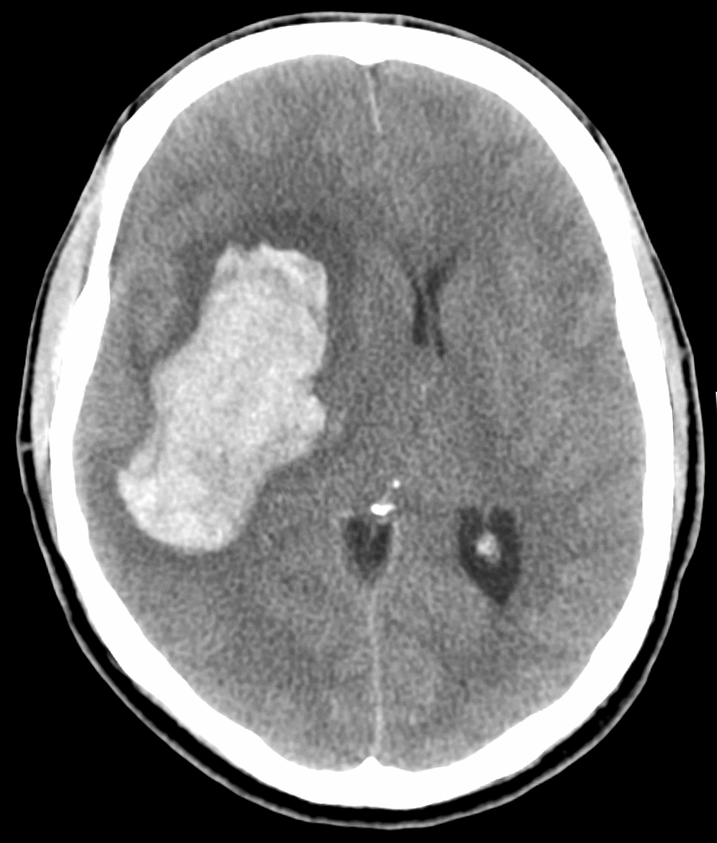
Hypertensive Hemorrhage
Common sites:
Basal ganglia
Thalamus
Pons
Cerebellum

Slide 27
Hemorrhage Mimics
Calcification
Contrast staining
**CAN BE DIFFERENTIATED ON THE BASIS OF HU VALUES

Slide 28
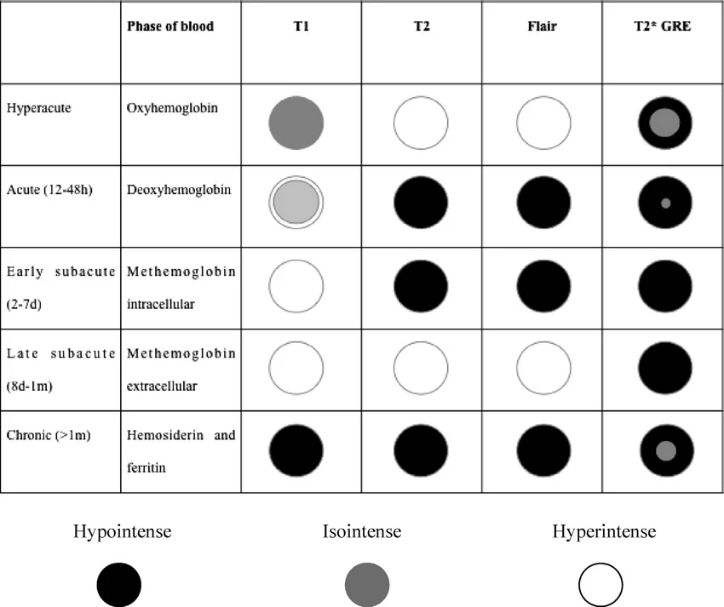
MRI Evolution Timeline
Hyperacute → Acute → Early subacute → Late subacute → Chronic

Slide 29
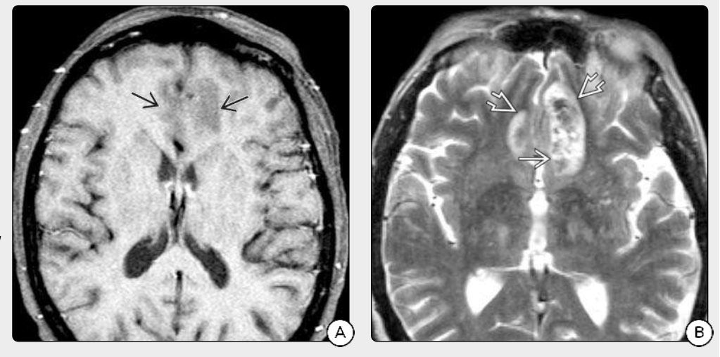
HYPERACUTE HEMORRHAGE

Slide 30
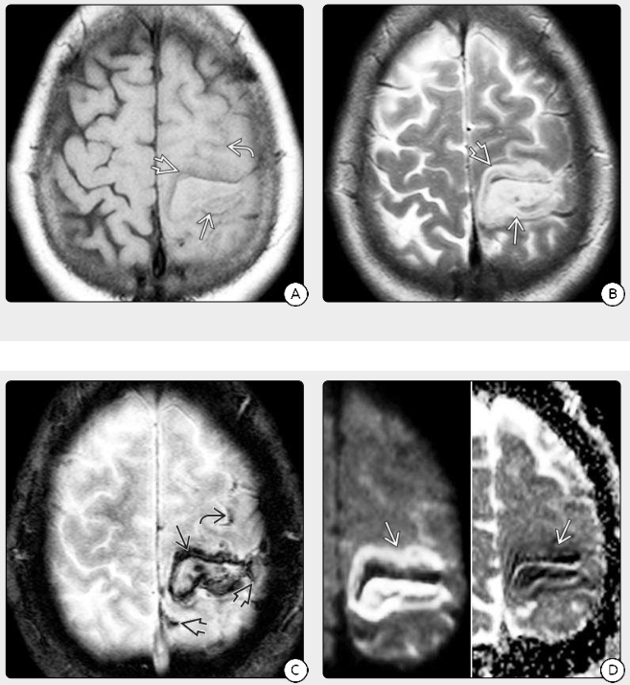
ACUTE HEMORRHAGE

Slide 31
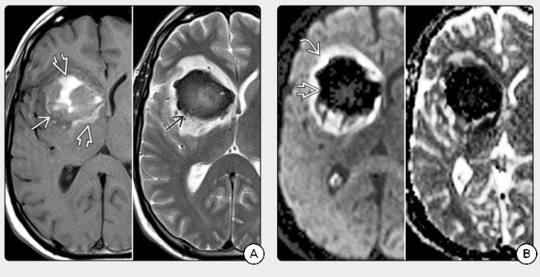
EARLY SUBACUTE HEMORRHAGE

Slide 32
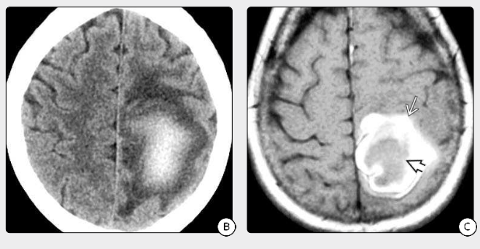
LATE SUBACUTE HEMORRHAGE

Slide 33
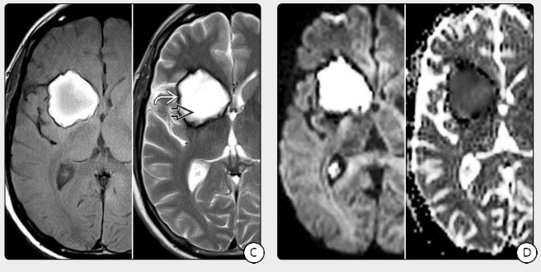
CHRONIC HEMORRHAGE

Slide 34
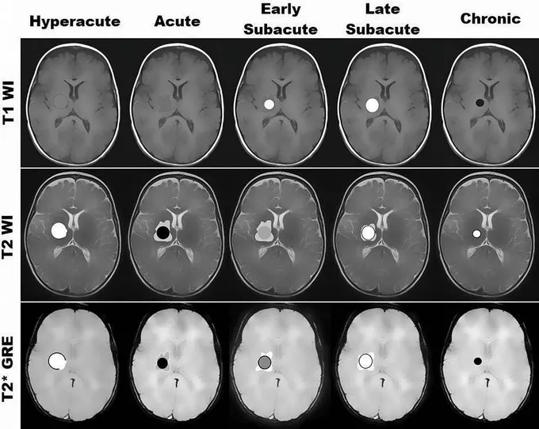

Slide 35
THANK YOU

