Slide 1
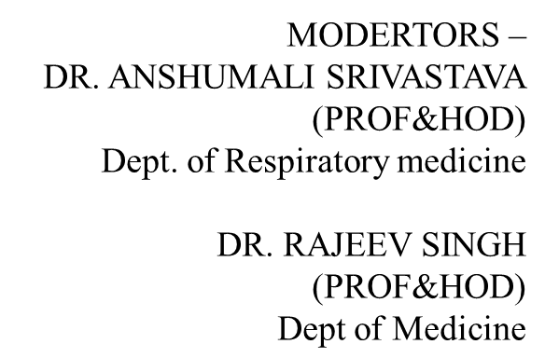
DYSPNEA

Slide 2
WHAT IS DYSPNEA?
Dyspnea derives from Greek word for "hard breathing". It is subjective expierene of uncomfortable breathing, is a symptom that typically results from cardiopulmonary problems that cause an increased drive to breath increase work of breathing or stimulation of specific receptors in the heart,lungs or vasculature.
It is a sign of a variety of disorders and is primarily an indication of inadequate ventilation or of insuﬃcient amount of oxygen in the circulating blood.

Slide 3
D ysp n ea h ap pen s w h en a " m i s m a tc h o ccu rs b etw ee n affe ren t a n d effe ren t sig na l i n g .
As th e b ra i n re ceives a fferen t ven t i l a tion i n fo rm a tio n , i t i s a b l e to co m pa re i t to th e cu rre n t l eve l of re sp i ra ti on by th e e fferen t s i g n a l s .
I f th e l evel o f res p i ra tion i s i n a pp ro pria te for th e b od y's s ta tu s a n d n eed , the n d ysp ne a m i g h t occu r

Slide 4
AETIO LO G Y
PULMONARY
AIRWAY DISEASE
B ron c h i a l Asth a m a
C h ro n i c ob stru c ti ve pu l m on a ry d i sea se
Acu te b ro n ch i t is
B ron c h i ec ta s i s
U pp er a irw a y obstru ction
LUNG PARENCHYMAL DISEASE
P n e u m o n i a
P u l m on a ry tu b ercu l osis I n te rsti ta l l u n g d i se a se Lu n g a bsc ess

Slide 5
AETIO LO G Y
PLEURAL DISEASE
P l e u ra l effusio n P n e u m o tho ra x E m pye m a
P l e u ra l th i c kin i n g
PULMONARY VASCULAR DISEASE
P u l m on a ry em bo li sm
P u l m on a ry h yperten s i on
OTHER CAUSES
O bstru ctive s l ee p a p n ea
C h est wa l l d e form it i es (e g : kyph osc ol i osis)

Slide 6
AETIO LO G Y
CARDIAC PUMP FAILIURE
H eart fai lu re
C ard i om yop athy
ISCHEMIC HEART DISEASE
Acu te corona ry syn d rom e
C hron ic i schem i c hea rt d is ease
VALVULAR HEART DISEASE
M i tral stenosi s
M i tral reg u rg i ta ti on Aortic s tenos is
Aortic reg urg i ta ti on

Slide 7
AETIO LO G Y
RHYTHM DISORDERS
Atrial fi b ri l la ti on
S up raventicul ar tachycard i a C om p l ete h eart bl ock PERICARDIAL DISEASE
Acu te p erica rd it is
P eri card ia l effu sion
CONGENITAL HEART DISEASE
Atrial s ep tal d efect
Ventri cula r sep ta l d efect

Slide 8
CARDIAC + PULMONARY
1 . CO P D w i th p u lm o na ry
h yp erten s i on a n d c orpu l m on a l e
2 . Ch ron i c p u lm o n ary em b ol ism
●
NON CARDIAC NON PULMONARY
1 . M e ta b ol i c c on d i t i on (D i a be t ic Ketoa c i d o s is )
Rib fra ctu re
N e u rova scu l a r d iso rd ers( M ysth e n ia G ra vis)
O torh i no l a ryn g ea l d i sord e rs 5 . O th ers

Slide 9
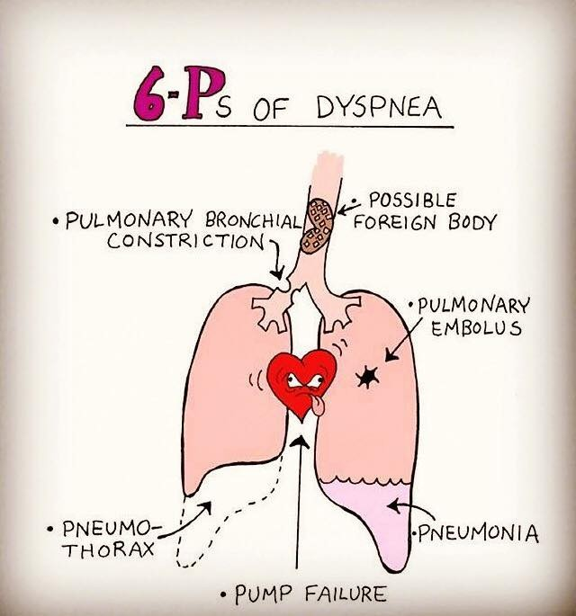

Slide 10
. P ATH O P H YSIO L O G
Y
RECEPTORS AND SIGNALS
Th e p a thw a y th a t l ea d s to d yspn e a v i a sp ec i fi c a cid -sen s i n g i on ch a n n e ls , m ec h a no rec epto rs a n d l u n g rec ep to rs l oc a te d i n d i ffe re n t zon e s o f th e
resp ira tory a ppa ra tu s .

Slide 11
Chemoreceptors
I n the caroti d bod ies and m edul la sup pl y in form ati on wi th reg ard to th e bl oo d gas levels of O 2, CO , and H
Juxtacapillary receptors
Sensi tive to p u lm o nary in ters titia l o edem a ,i n tense fi rin g o f thes e C-fi bers sends si gnal s to
fo reb ra in .( d i scovered b y I ndi an p hysio lo g i st nam ed ” D r. Autar Si ngh Pai n ta l in 1 9 55 . Thi s m i sm atch between
the m echanical s ta te of the l ungs and the central respi ratory d rive i s a co rn ers tone p athway behi nd the a ir hung er fe lt by p atient in co ngesti ve heart fa il ure.
. Stretch receptors.
. H ering -breuer refl ex
. Muscle spindles
Sig nals i n the chest wall Sig nal s the stretch and tensio n of the respi ratory m uscles
EFFERENT SIGNALS-
M o tor neuronal si gna ls descendi ng to the respi ratory m u scles, the m o st i m po rtant b e ing the d iap hragm
PATHOPHYSIOLOGY

Slide 12
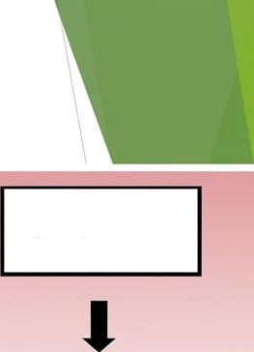






Acidosis or Hypercarbia
Airway Receptors
Hypoxemia
Decreased
Compliance
Airway
Resistance
carotid Body
Medullary Chemoreceptors
Lung or Muscle Mechanoreceptors
Dyspnea

Slide 13
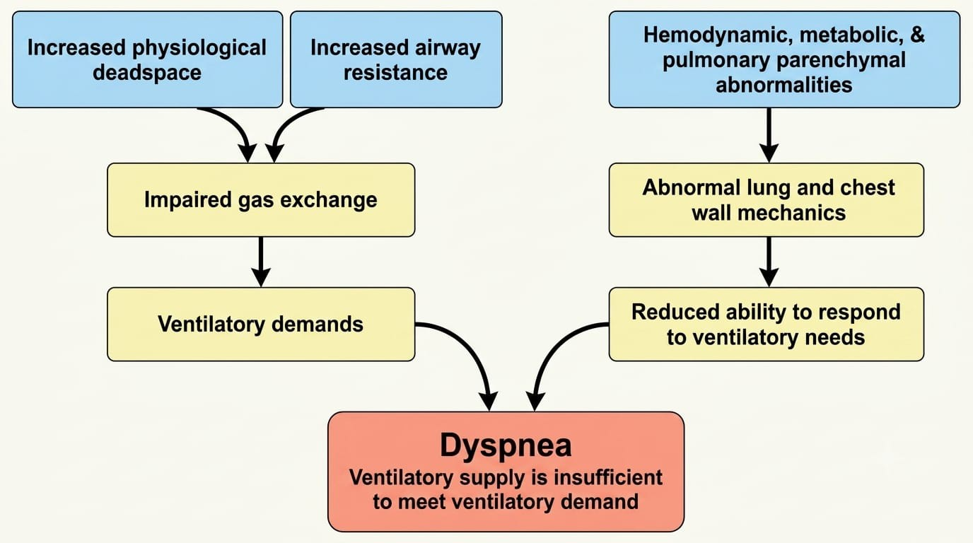

Slide 14
H ISTO RY TAKIN G : -

Slide 15
O N S ET
P O SI TI O N TIM IN G
S EVERITY
RELIEVIN G F AC TO RS
ASS O CIATED SYM P TO M S
H ISTO RY TAKIN G : -

Slide 16
C ARD IAC
1 . Ac ute M I
Con g estive h e a rt fa i l u re
Pe ric a rd i a l ta m p on a d e
Acu te va lvu l a r i n su ffi cien c y
Aortic d i ssec t io n
Com p l e te h ea rt b lo ck
. ACUTE(onset)
RESP IRATO RY
1 . Ac ute e xa c erba t i on of a sth m a
Pn e u m o th ora x
Pu l m on a ry em bo li sm
Fo reig n bo d y
La ryn g e a l e d em a

Slide 17
SUBACUTE
W ith i n h o u rs
1 . Asth m a
Left h e art fa il u re
Pn e u m o n i a
W ith i n d a ys
1 . P n eu m on i a
ARD S
Left h e art fa il u re
W ith i n w e eks
1 . P le u ra l effu s io n
An em i a
M u sc le we a kn ess
Tu m ors

Slide 18
CHRONIC PULMONARY CAUSES
Airw a ys
1 . CO P D
Asth m a
Ch ron i c bro n ch i ti s
Em pye m a
Cystic fi brosis
P l e u ra l
1 . Effu s i o n
M a l i g n a n c y
Fib rosis
P a ren c h ym a l
1 . I n terstitia l l u n g d i se a se
Va sc u l ar
1 . Va scu l it i s
2 . A-V m a lfo rm a t i on

Slide 19
D yspn e a th a t occ u rs m ostl y a t n i g h t
C on g estive c a rd i a c fa i l ure
C O P D
. B ron c h i a l a sth m a S l e ep a p n ea
P o st N a sa l d rip
N o ctu rna l Asp i ra t i on i n G ERD
TIM IN G O F DYS P N EA:-
Nocturnal onset dyspnea( Paroxysmal nocturnal dyspnea)
Se ve re d i ffi c u lty i n b re a th i n g th a t a w a ke n s th e p erson from s le ep , m akin g th e m s i t o r sta n d

Slide 20
POSTPRANDIAL DYSPNOEA
G ERD
ASP IRATI O N
FO O D ALLERG Y

Slide 21
GRADING OF DYSPNEA

Slide 22
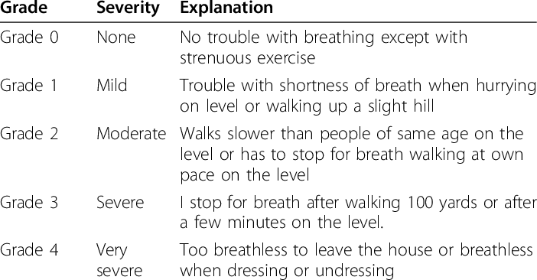
MODIFIED MEDICAL RESEACH COUNCIL (mMRC)

Slide 23
NEW YORK HEART ASSOCIATION (NYHA)
CLASS | 1 : | N o l im i ta tion with ord in ary p h ysi cal activity
CLASS | 2 : | M il d /s l i gh t l i m ita ti on of ord i na ry p hys ical a ctivi ty
CLASS | 3 : | M arked l im i ta tion of p hys ical activity , sym p tom s wi th exerti on
CLASS | 4 : | S ym p tom a t res t u na b le to carry out p h ysi cal activity wi thou t
d is com fort

Slide 24
P o s iti on o f d yspn ea :
-
. C la ssified i n to 3 :
-
1 . O RTH O P N EA
. P LATYP N EA
. TRE P O P N EA
4. B EN D O P N EA

Slide 25
Orthopnea
S h ortn ess of b rea th w h i ch occu rs wh en l yin g fl at, ca u s i n g th e p erson to h ave to s leep p rop p ed u p i n b ed or s i tti n g in a ch a i r.

Slide 26
CAUSES
CO N G ESTIVE H E ART FAI LU RE
LE FT VE N TRIC U LAR FAI LU RE CO P D
B RO N C H IAL ASTH AM A
M ASSIVE P LEU RAL E FFU SIO N ASC ITES
G E RD

Slide 27
PLATYPNEA
sh ortn ess of b reath th at i s rel i eved w h en lyi n g d ow n , an d w orsen s w h en s itt in g or sta n d i n g u p . I t i s th e op p osite of orth op n ea

Slide 28
Causes
Left a tri a l m yxom a
M a ssive p u l m o n a ry e m b ol i sm P a ra l ysis o f i n terc osta l m u scl e H e pa to- p u lm on a ry syn d rom e

Slide 29
TREP O P N EA
sh ortn ess of b reath th at i s sen sed wh il e l yin g on on e s id e bu t n ot on th e oth er (la teral recu m b en t p osition
D isease of on e lu n g /b ron ch u s
Con g estive cardiac fa i lu re

Slide 30
I n n ewl y d escrib ed sym p tom i n p atien t with h eart fa il u re i s m ed i ated via a fu rth er i n crea se i n ven tri cu l ar fil l i n g p ressu re d u ri n g b en d in g i n su b jects w h ose s it tin g ven tri cu la r feelin g
p ressu re are a l rea d y h i g h p articu l arl y i n p atien t w ith l ow card iac i n d ex
A p a ti en t s i ts i n a ch a i r b en d s at th e w a i st an d tou ch es h is feet b en d op n ea a lso kn ow n as flexo d ysp n ea i t con s i der i f d ysp n ea occu r w i th i n 3 0 sec of b en d in g
B EN D O P N EA

Slide 31
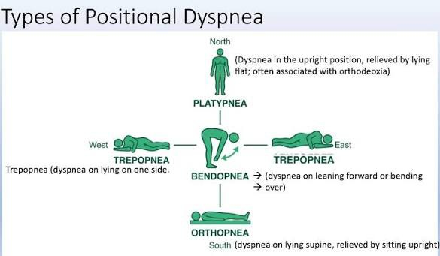

Slide 32
PRECIPITATING AND RELIEVING FACTORS
P REC IP ITATIN G FACTO RS
1 . Exercise
Expo sure ( cig a rette, a l l erg e n )
O cc u pa t i on a l expo sure
O be s i ty
Severe w eig h t l oss
M e d i ca t i on
RELIEVI N G FACTO RS
1 . Re st
M e d i ca t i on

Slide 33
ASSOCIATED SYMPTOMS
. Ch e st pa i n -c en tra l, p l eu rit i c o r pe ric a rd i a l
. W h ee ze
. Fever
. Co ug h -sp u tu m prod u ctio n a n d co lo u r
. Ch a n g e in p itch o f vo ic e
. P a lp i ta t i on a n d syn co pe
. H e m o ptysis
. D ysph a g ia a n d o d yn o ph a g i a
. Vom it i n g a n d d ia rrh oe a
. H ea rt b urn
. M u sc l e w ea kn ess o r m ya lg i a
. Visu a l d i stu rb a n ce s a n d he a d a c h e
. B on e p a in

Slide 34
ASSOCIATED SYMPTOMS
. Dysphagia and odynophagia
. Vomiting and diarrhoea Heart burn
. Muscle weakness or myalgia
. Visual disturbances and headache
. Bone pain

Slide 35
**O TH E R RE LEVAN T H I STO RY*
. P ast m ed i cal h i sto ry
. P ast surg i cal h i story
. D rug h i sto ry
. O ccup ation a l h i sto ry
. S m okin g h i story

Slide 36
PHYSICAL EXAMINATIONS:-
G en eral in sp ection
. An xiety m ay in d i cate p atien t h ave An xiety D i sord er
. Resp i ra tory D i stress ?
. Ab i l i ty to speak-in sen ten ces, p h rase, w ord , u n ab l e to sp ea k
. I s th ere a n y a u d ib l e w h eeze or strid or? I s th e voice h oarse?
. Pa ti en t's p osition
. Cyan osis or pa l l or?
. M en ta l S ta tu s : Al tered m en ta l statu s - h ypoxem i a or h yp ercap n i a

Slide 37
*Vital s i g n s*
. Pu lse ra te - U su a l ly tach yca rd i a , B RADYCARDIA in severe
h yp oxem i a Resp ira tory Rate - TACH YP N EA, DAN G ER i f > 3 5 -40 b p m or < 1 0 -1 2 bp m
. Tem p eratu re - FEVER
. B l ood Pressu re-↑
i f d ysp n oea i s s i g n i fi ca n t, m ay in d icate l i fe
th rea ten i n g p rob l em
W ith
C H ES T EXAM IN ATI O N
C ARD IO VAS CU LAR EXAM IN ATI O N
O TH ER EXAM I N ATI O N S

Slide 38
INVESTIGATIONS
INVESTIGATIONS
Complete blood count
Assess anemia and white cell count for infections
Blood C&S
Infections
Sputum AFB
To rule out TB
Arterial blood gas
To assess the acid-base status of patient to rule out ant acidosis
Electrolytes, BUN, creatinine and blood glucose
To assess metabolic derangement

Slide 39
RELEVANT SPECIAL INVESTIGATIONS
Chest radiography (CXR)
This has a great potential in aiding the diagnosis of many lung disorders that cause acute dyspnea and chest pain.
Electrocardiography (ECG).
The ECG is unlikely to be normal in the presence of structural heart disease.
Echocardiography
Spirometry

Slide 40
RELEVANT SPECIAL INVESTIGATIONS
The D-dimer.
This is a component of the evaluation of patients with suspected pulmonary embolism.
Point-of-care ultrasound scans and echocardiography.
These may aid clinicians in the diagnosis of acute cardiogenic pulmonary edema.

Slide 41
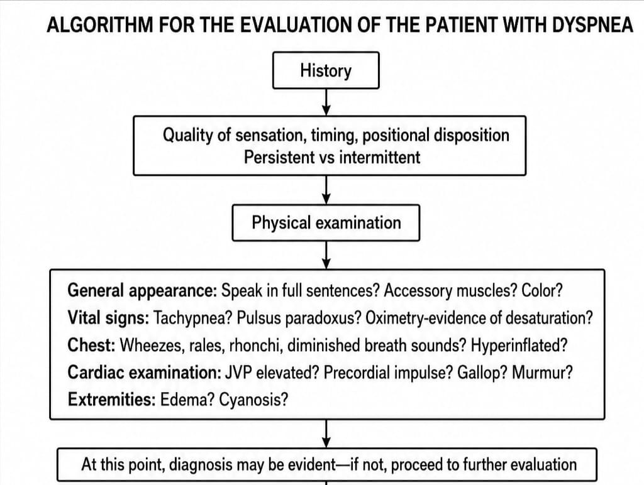
HOWTO EVALUATE PATIENTOFDYSPNEA?

Slide 42
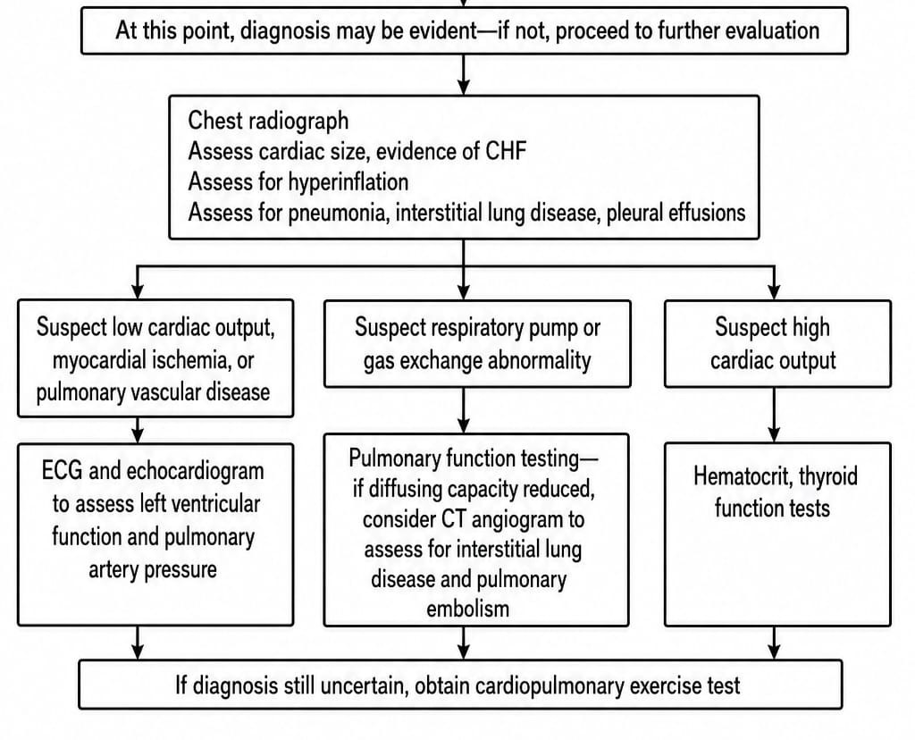

Slide 43
MANAGEMENT
Unstable patients typically present with one or more symptom patterns:
Hypotension, altered mental status, hypoxia, or unstable arrhythmia
Stridor and breathing effort without air movement (suspect upper airway obstruction)
Unilateral tracheal deviation, hypotension and unilateral breath sounds (suspect tension pneumothorax)
Respiratory rate above 40 breaths per minute, retractions, cyanosis, low oxygen saturation

Slide 44
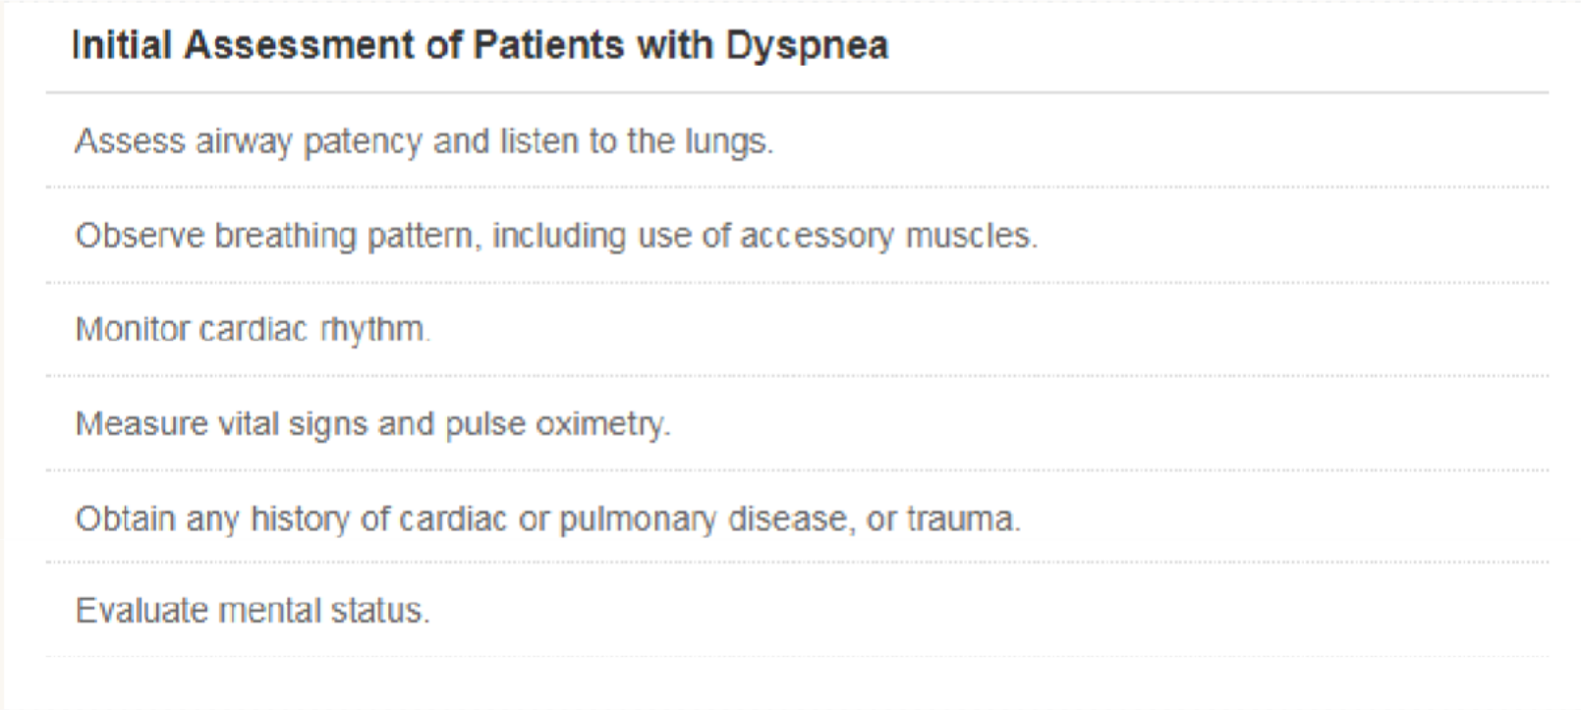

Slide 45
TREATMENT OF UNSTABLE PATIENT
Administer Oxygen
Consider intubation of the patient is gasping, apneic, or non- responsive
Establish IV line and start fluid resuscitation
Tension pneumothorax – Thoracentesis
Obstructive pulmonary Disease – Bronchodilator
Pulmonary edema – IV/IM furosemide

Slide 46
After patient has been stabilized;
Reassess the patient’s airway, mental status, ability to speak, and breathing effort
Check vital signs
Thorough history taking and physical examination (i.e. breath sounds and observe skin colour)

Slide 47
MANAGEMENT STRATEGIES
1 .Reduce ventilatory demand
Decrease sense of effort
Improve respiratory muscle function
Pulmonary rehabilitation

Slide 48
REDUCE VENTILATORY DEMAND
Treat the underlying causes
Infection
Pleural effusion
Pneumothorax
Pulmonary embolism
Foreign bodies
Congestive heart failure etc.
Supplemental oxygen with symptomatic and supportive treatment.

Slide 49
DECREASE SENSE OF EFFORT AND IMPROVE RESP MUSCLE
Positioning (leaning forward)
Energy conservation / pacing
Airflow
Relaxation/ Distraction/ Assurance
Controlled breathing techniques / Physiotherapy
Loose clothing
Correct obesity

Slide 50


