Slide 1
Examination of the Hip

Slide 2
Learning Objectives
Perform clinical examination of the hip
Common deformities and abnormal gait patterns
Assess movements, limb length and special tests

Slide 3
Clinical Approach
History
Gait assessment
Examination in standing position
Examination in supine and lateral positions
Measurements and special tests
Examination of adjacent joints and neurovascular status

Slide 4
History: Presenting Complaints
Pain: site, onset, duration, character and radiation
Limp and difficulty in walking
Stiffness and restriction of activities
Swelling, deformity or shortening
Instability, clicking or locking
Notes:
Slide 4
Limp: This may be painless as in CDH or coxa vara, or painful as in early arthritis.
Inability to walk: This may be due to a painful condition or due to mechanical failure in the region of the hip (e.g., fracture neck of the femur, polio etc.)
Swelling: A swelling arising from the hip comes to notice very late, except when it is from the greater trochanter or pubic bone.
Deformity: Deformity of the hip may be the presenting symptom. The patient walks with a bend at the hip. The cause of the deformity could be the hip joint per se or the structures around the hip

Slide 5
History: Relevant Details
Trauma or previous surgery
Fever, constitutional symptoms and tuberculosis contact
Morning stiffness or polyarticular symptoms
Childhood hip disease
Steroid use and other risk factors for avascular necrosis

Slide 6
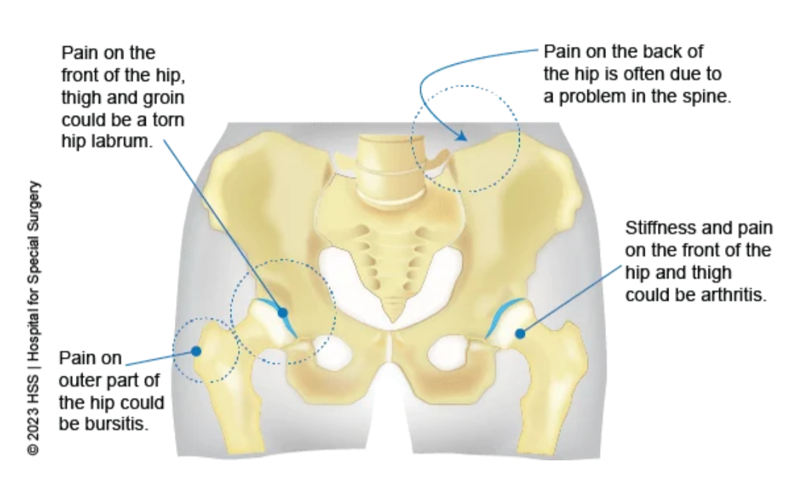
Pain Around the Hip
Hip pathology commonly causes groin pain
Pain may radiate to thigh or knee
Duration of pain
Lateral pain may arise from trochanteric structures
Posterior pain may originate from spine or sacroiliac region
Always examine the knee and lumbar spine
Notes:
Slide 6
Duration of the pain: Short duration pains are due to
trauma, acute infections, acute arthritis etc. Long duration pains are due to chronic infections, chronic arthritis, secondary osteoarthritis, tumours etc.

Slide 7
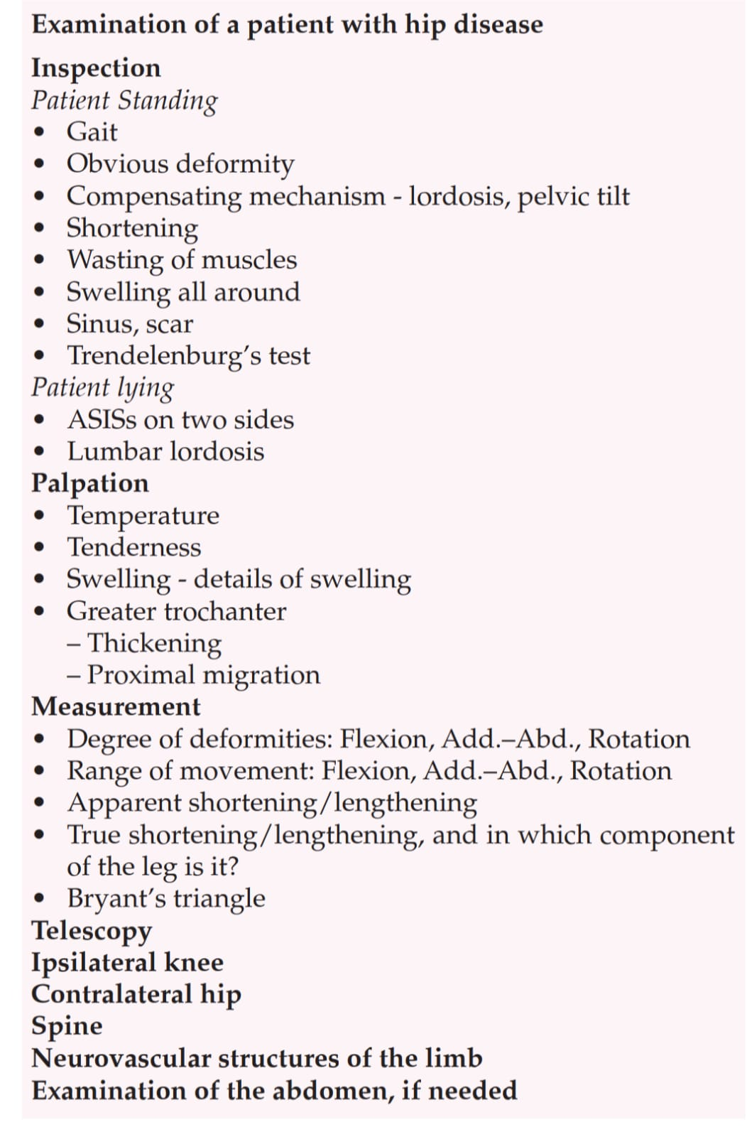

Slide 8
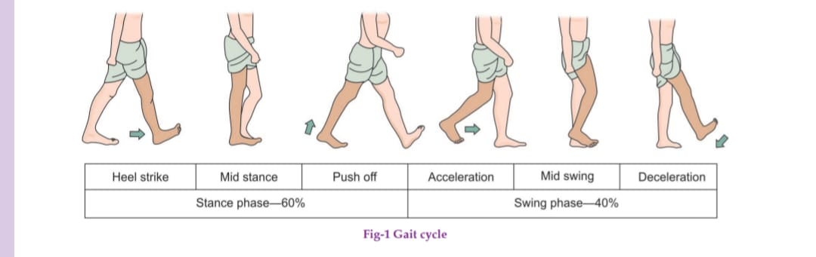
Gait Examination
Observe the patient walking from front, side and behind
Note stride length, stance phase and pelvic movement
Look for trunk lurch, circumduction and toe walking
Compare both sides

Slide 9
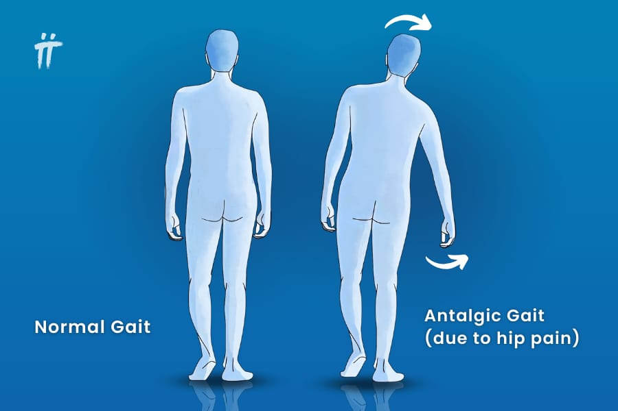
Antalgic Gait
In a painful hip disease, the patient can hardly
bear weight on the affected side. So, he quickly takes the
weight off the affected limb to the normal limb. Hence, he keeps the affected limb on the ground for a shorter time than the normal side

Slide 10
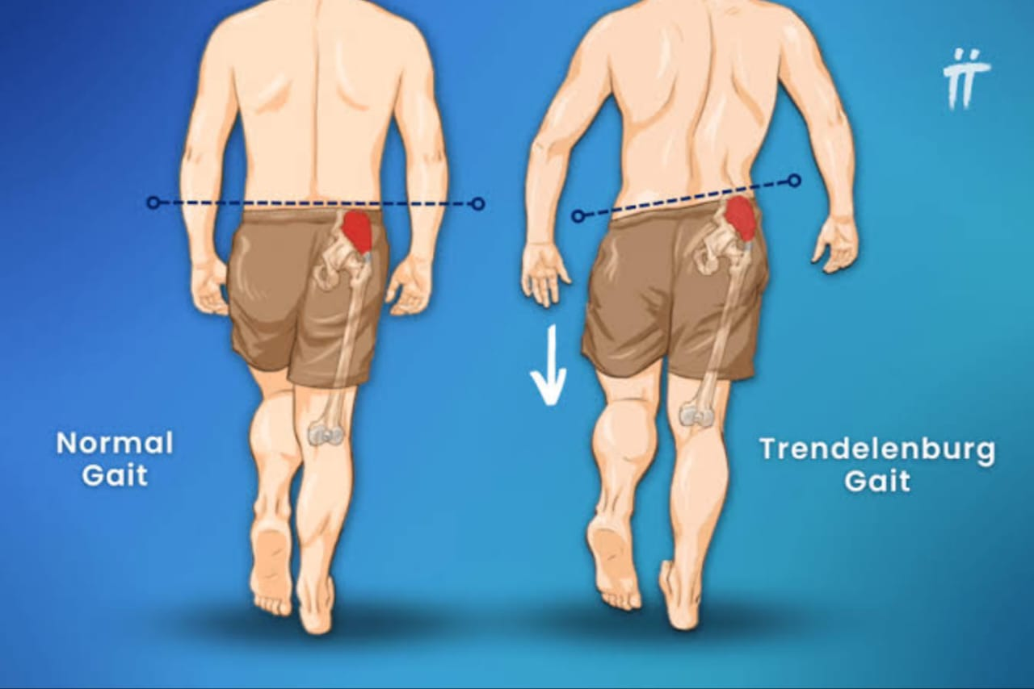
Trendelenburg Gait
In a hip disease, where the hip joint is
not stable, (i.e., the abductor mechanism of the hip is not
effective) in order to avoid falling, the torso of the patient
tilts to the affected side.

Slide 11
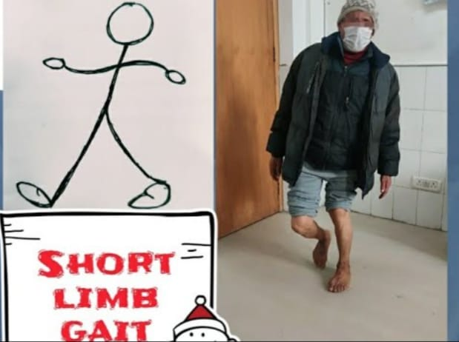
Short Limb Gait
If the affected limb has become short due
to some disease, when the patient walks, the whole affected side of the body dips down in order to make it possible for the patient to bring the foot to the ground.

Slide 12
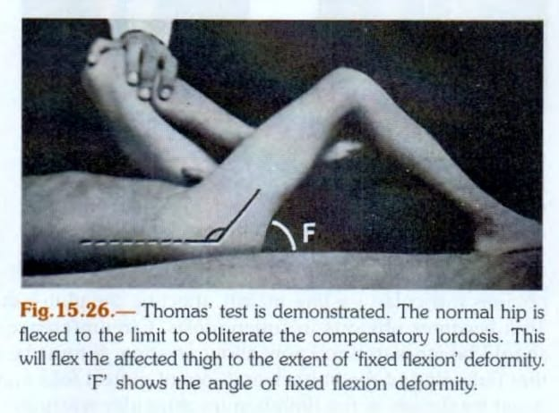
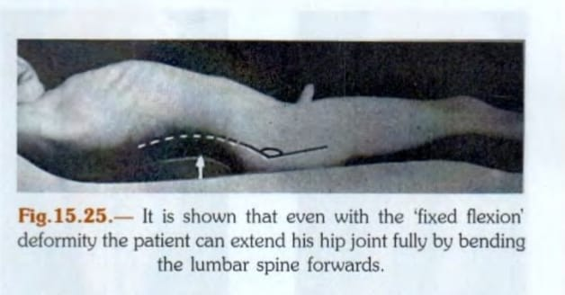
Fixed Flexion Deformity
Notes:
Slide 12
Flexion deformity: This is the commonest deformity of the hip, probably because the flexors of the hip are stronger than the extensors. When there is spasm of the muscles, the stronger flexors pull the hip in flexion. With mild flexion deformity of the
hip, the patient manages to walk ‘straight’ by compensatory lumbar lordosis.
Hip flexors - iliopsoas , rectus femoris
Hip extensors - Gluteus maximus , adductor magnus , hamstring muscles ( semimembranosus, semitendinosus, biceps femoris )

Slide 13
Examination in Standing Position
Adequate exposure from waist to feet
Inspect posture and spinal alignment
Assess pelvic tilt
Look for flexion, abduction/adduction and rotational deformity
Inspect muscle wasting, scars, sinuses and swelling

Slide 14
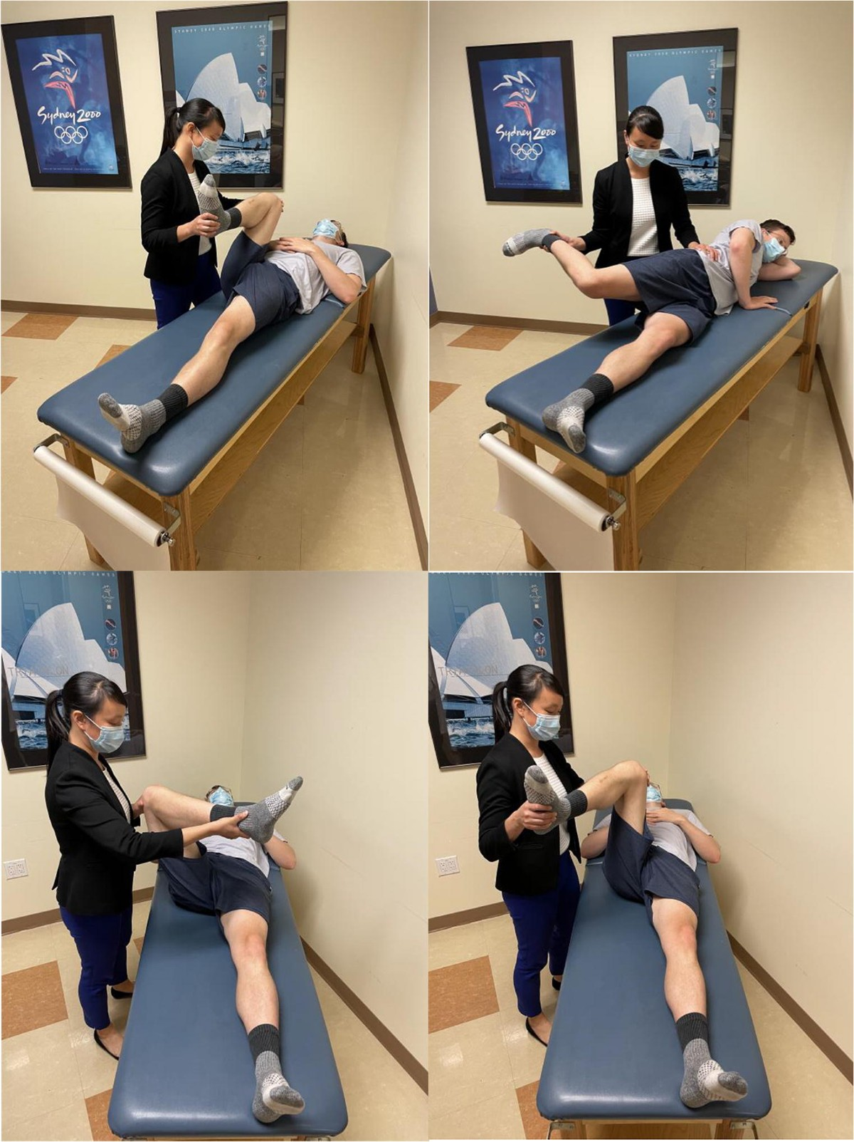
Supine Inspection
Ensure pelvis is square
Compare ASIS levels
Observe limb attitude and rotation
Look for apparent shortening
Inspect scars, sinuses, swelling and muscle wasting

Slide 15
Palpation
Assess local temperature
Identify tenderness
Palpate greater trochanter and surrounding structures
Examine groin for swelling or tenderness
Compare both sides

Slide 16
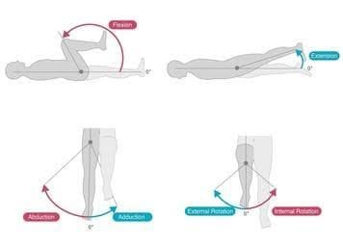
Range of Motion: General Principles
Test active movement first, then passive movement
Compare with opposite hip
Stabilize pelvis to avoid substitution
Record pain, restriction and end-feel

Slide 17
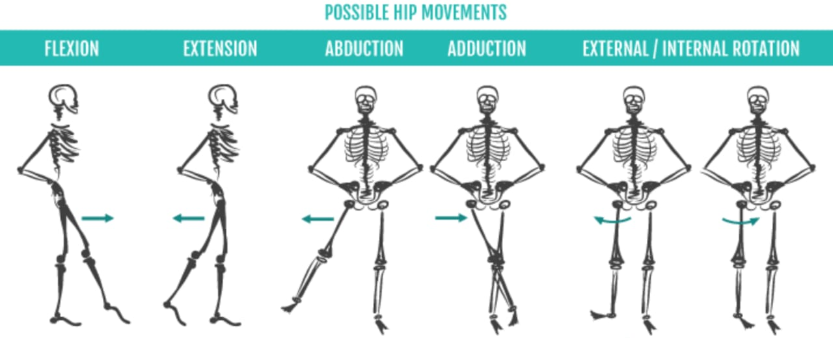
Sagittal Plane
Coronal Plane
Transverse Plane

Slide 18
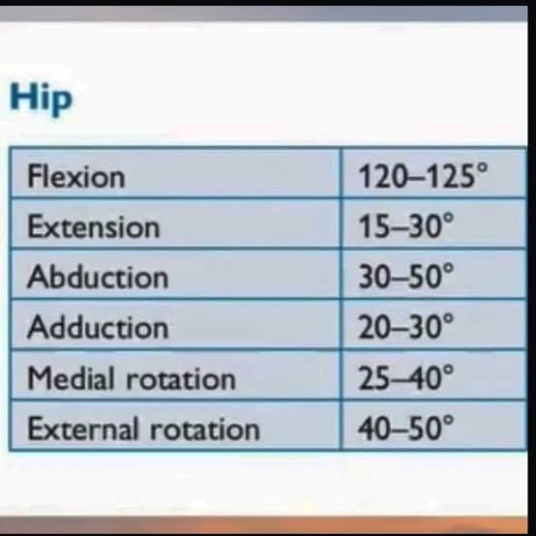

Slide 19
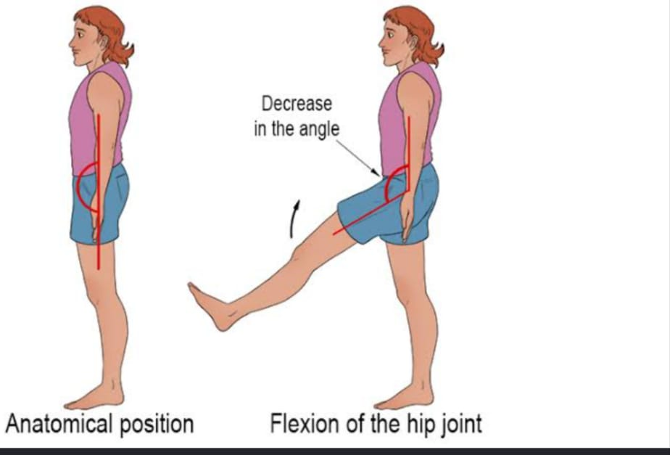
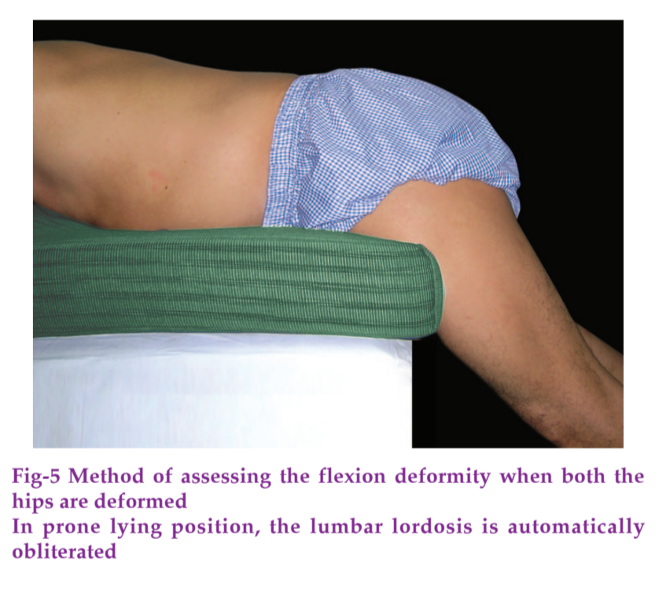
Hip Flexion
Flex the hip with the knee flexed
Observe available range and pain
Prevent pelvic rotation
Normal flexion is approximately 120°
Notes:
Chief flexor- iliopsoas
Rectus femoris
Sartorius

Slide 20
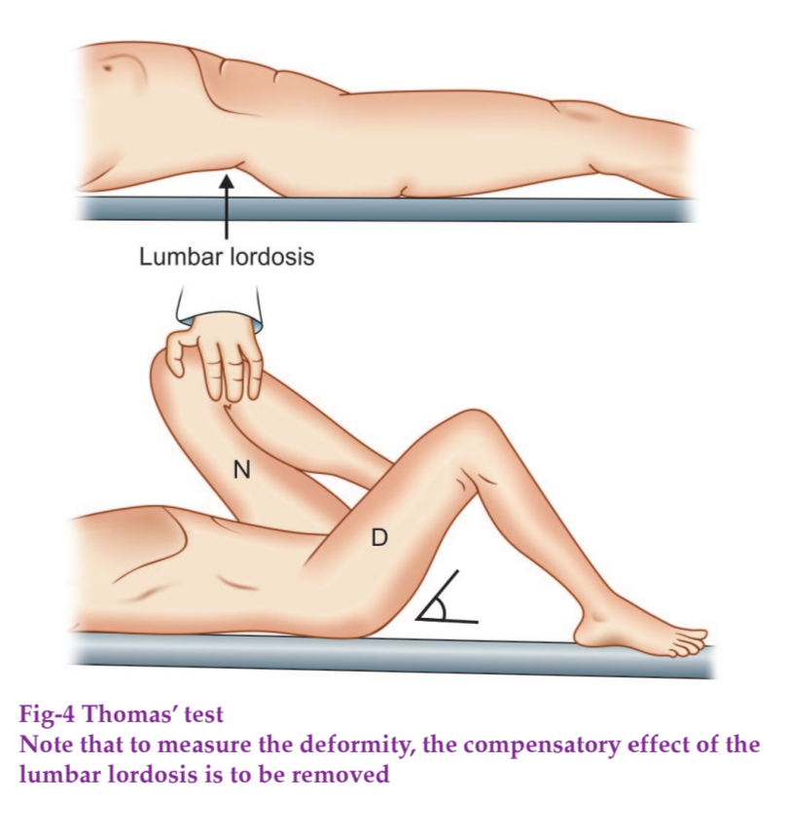
Thomas Hip Flexion Test
Detects fixed flexion deformity of the hip
Ask the patient to lie down on a flat hard surface
Flex opposite hip fully to obliterate lumbar lordosis
Observe whether the tested thigh rises from the couch
Angle between thigh and couch estimates fixed flexion deformity

Slide 21
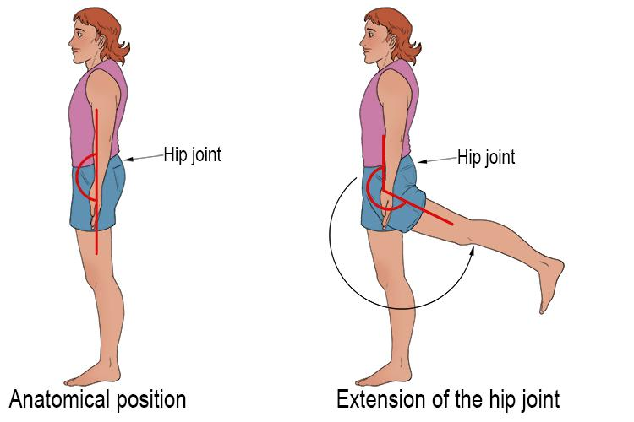
Hip Extension
Best assessed in prone or lateral position
Stabilize pelvis
Avoid compensatory lumbar lordosis
Normal extension is approximately 10–15°
Notes:
Chief extensor - Gluteus maximus
Hamstrings

Slide 22
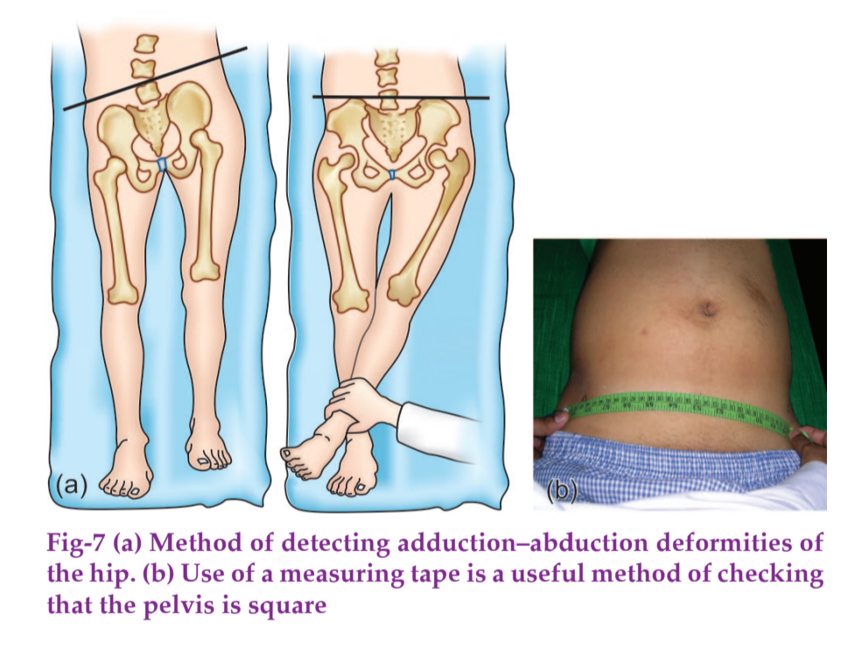
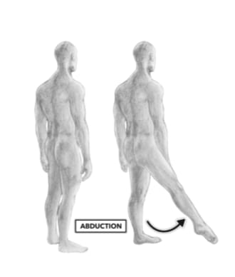
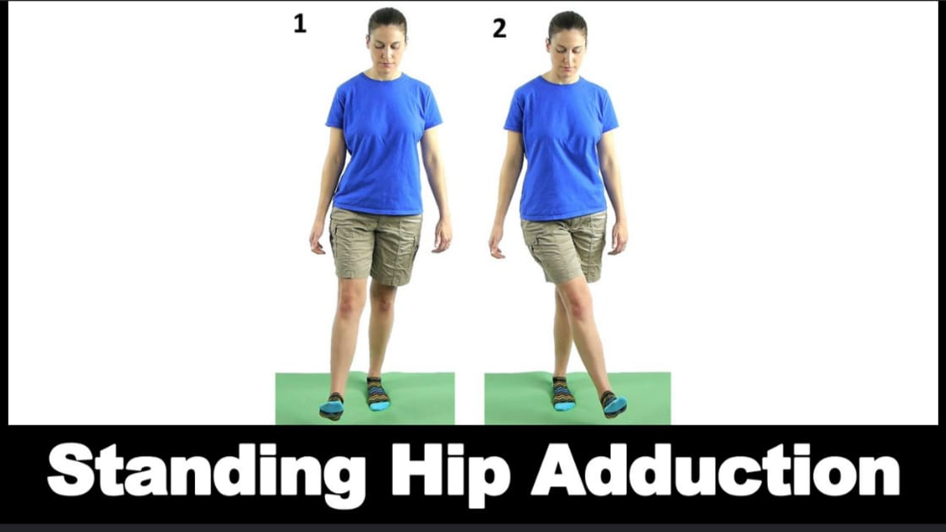
Abduction and Adduction
Keep pelvis square and stabilize opposite ASIS
Abduct limb until pelvic movement begins
Adduction is assessed by crossing the limb over midline
Compare range and pain on both sides
Notes:
Abductor -- gluteus medius
G. Minimus
Adductor-- adductor longus
A. Brevis
A. Magnus

Slide 23
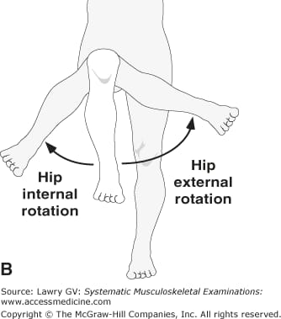
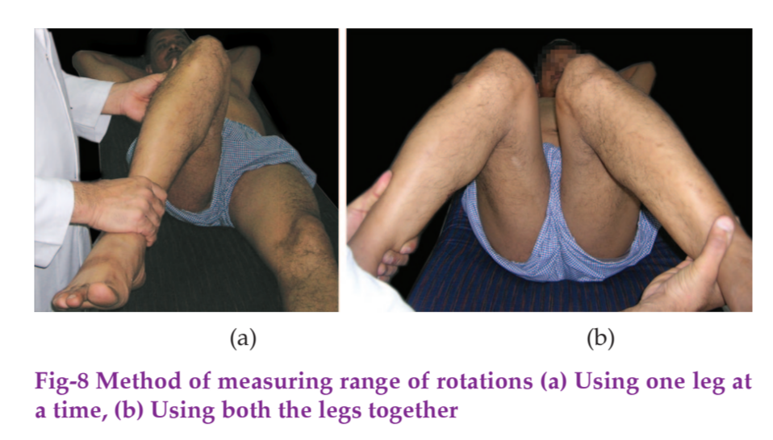
Rotation
Assess with hip and knee flexed to 90° or in prone position
Movement of foot laterally produces internal rotation
Movement of foot medially produces external rotation
Internal rotation is often restricted early in hip pathology
Notes:
External rotation - G. Maximus
Piriformis
Internal rotation - G. Medius and G minimus

Slide 24
Sequence of Movement Restriction
Pattern varies with pathology
In many hip disorders, internal rotation is affected early
Assess the complete range rather than relying on a single movement
Document fixed deformity separately from movement restriction

Slide 25
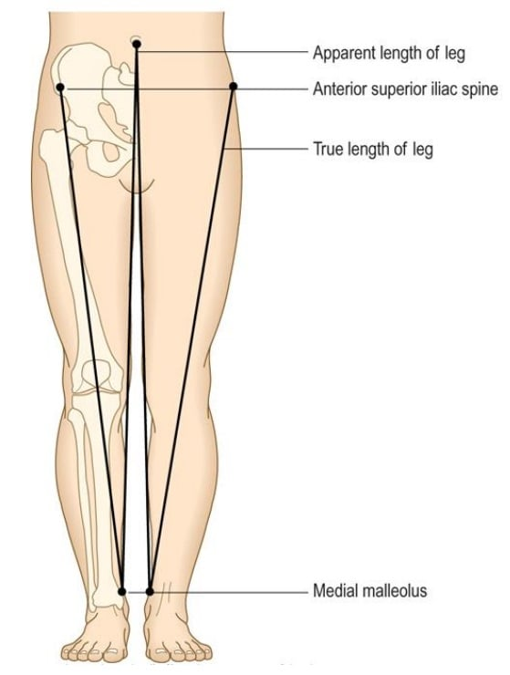
Limb-Length Assessment
Distinguish apparent from true shortening
Ensure pelvis is square before measurement
Compare both lower limbs using identical landmarks

Slide 26
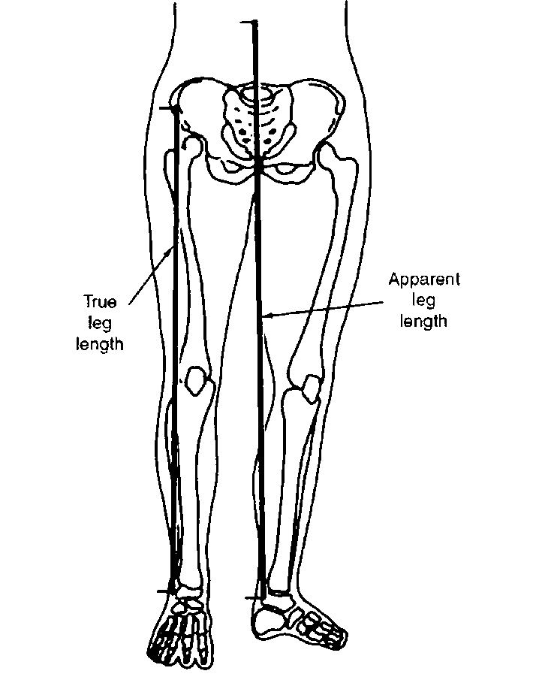
Apparent Limb Length
Measure from umbilicus to medial malleolus
Affected by pelvic obliquity and deformity
Useful when the pelvis cannot be squared

Slide 27
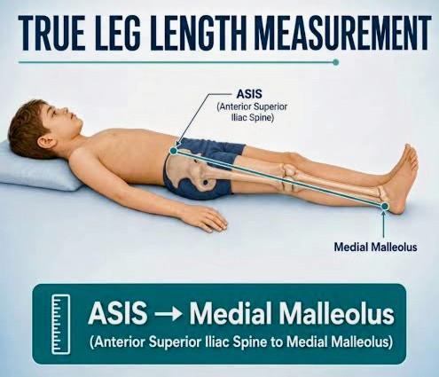
True Limb Length
Measure from ASIS to medial malleolus
Square the pelvis before measurement
Compare both sides
Segmental measurements help localize shortening

Slide 28
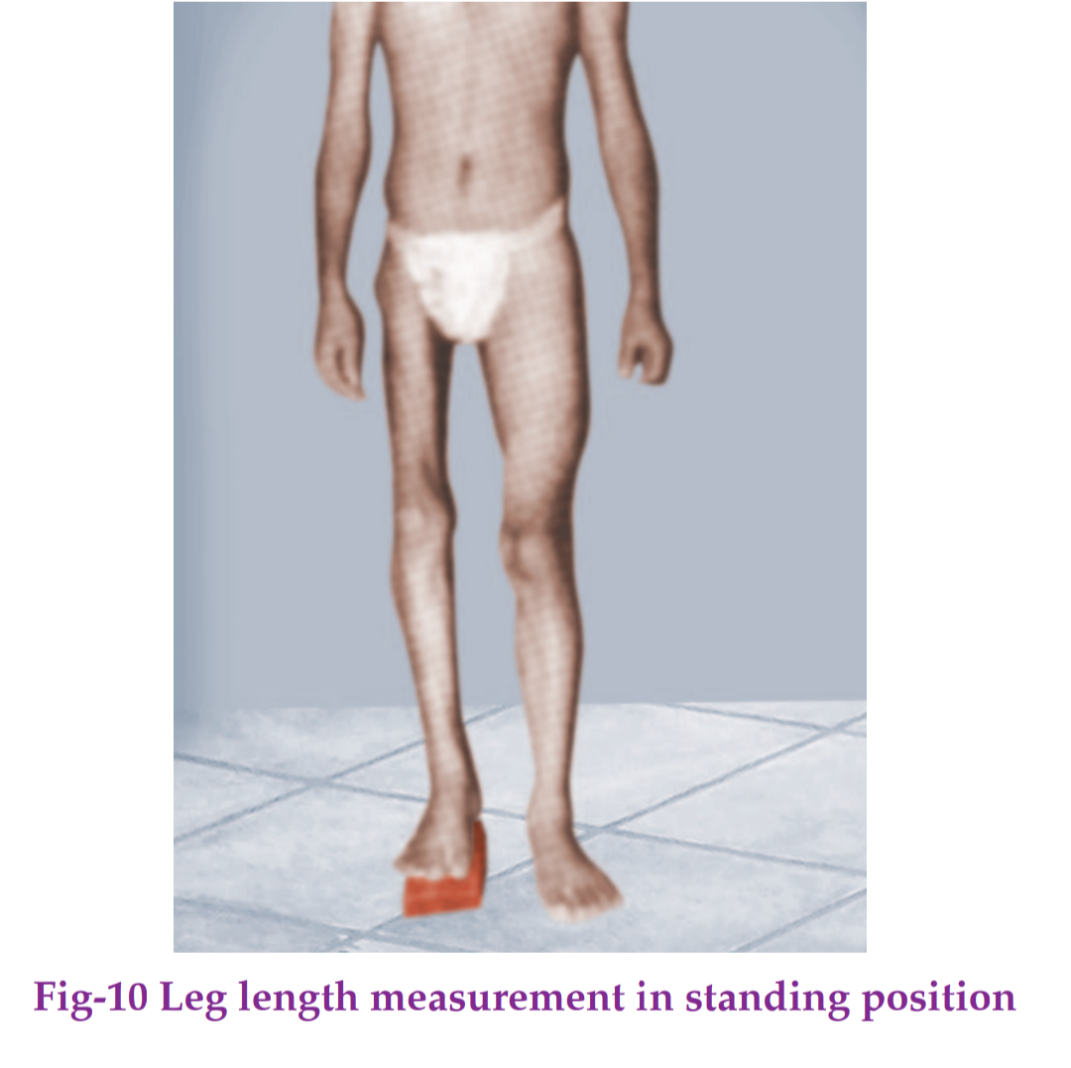
Standing Block Test
Place blocks under the short limb
Increase height until pelvis becomes level
Total block height estimates functional shortening

Slide 29
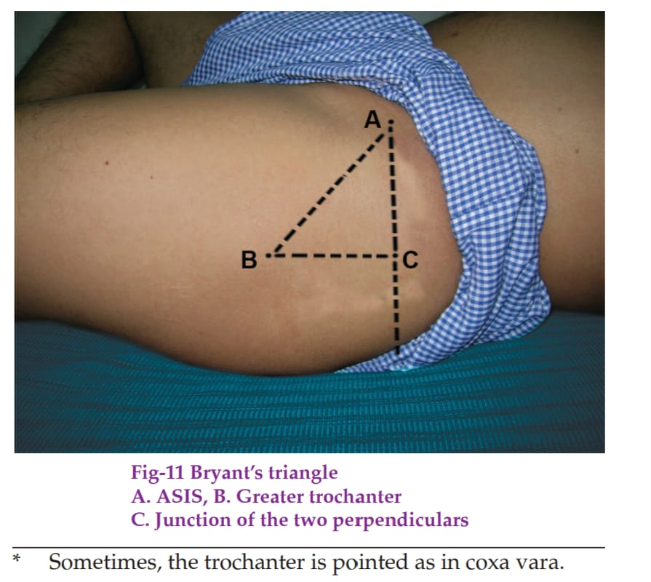
Bryant’s Triangle
Used to assess supratrochanteric shortening
Constructed using ASIS and greater trochanter landmarks
Compare the base of the triangle on both sides
Shortened base suggests proximal migration of greater trochanter
Notes:
Slide 31
In the diagram , 'A' represents ASIS , 'B' represents greater trochanter , a straight line is drawn from point B parallel to the Shaft of femur and another straight line is drawn from point A , the point of their intersection is point C .
The base BC is used to see the proximal shifting of greater trochanter .
Shortening may be due to :
Dislocation of the hip , fracture of neck of femur

Slide 30
Special Tests of hip

Slide 31
Qualitative Assessment of supratrochanteric shortening

Slide 32
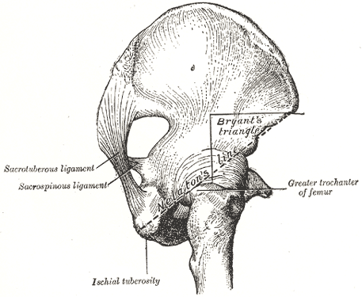
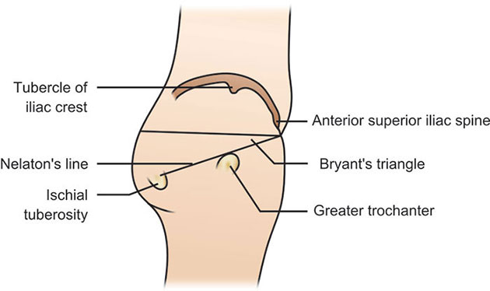
Nelaton's line
Purpose: Detects supratrochanteric shortening (high-riding greater trochanter).
Method:
Patient in lateral position.
Flex hip to 90°.
Draw an imaginary line from ASIS to ischial tuberosity.
Positive test:
Tip of greater trochanter lies above/crosses the line.
Indications:
Fracture neck of femur
Hip dislocation
Coxa vara

Slide 33
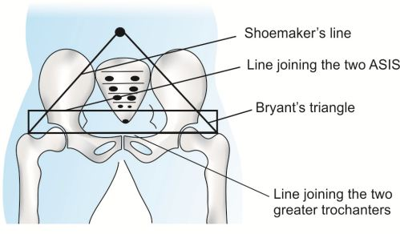
Shoemaker's line
Purpose: Detects supratrochanteric shortening.
Method:
Patient supine.
Draw line from greater trochanter to ASIS and extend across abdomen.
Repeat on opposite side.
Positive test:
Lines intersect below the umbilicus or away from the midline.

Slide 34
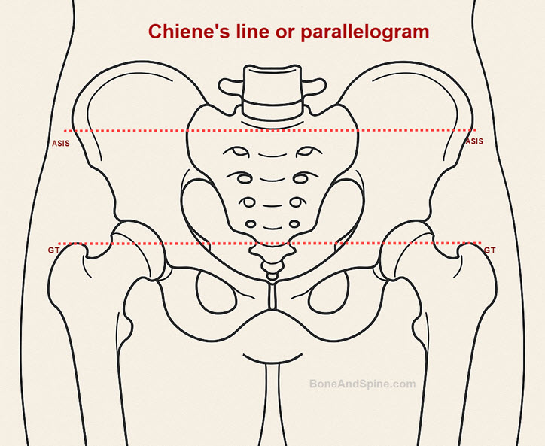
Cheine's Test
Purpose: Detects upward displacement of greater trochanter.
Method:
Join both ASIS.
Join both greater trochanters.
Positive test:
Two lines are not parallel; they converge toward affected side.

Slide 35
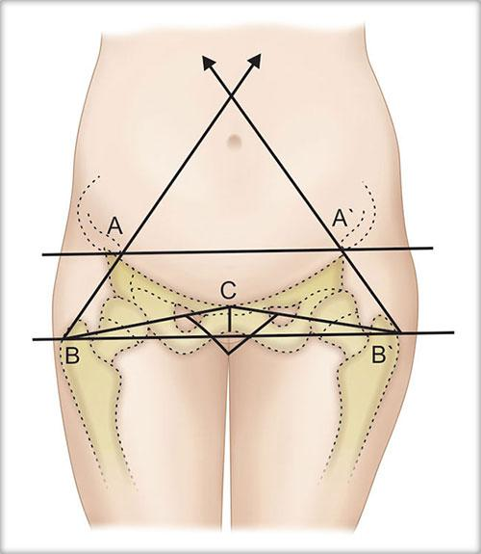
Morris Bitrochanteric Test
1)The patient lies in a supine position (flat on their back).
2)The examiner uses a tape measure or calipers to measure the distance from the pubic symphysis to the tip of the greater trochanter on both sides of the body.
3)The measurements of the affected side are compared to the unaffected, healthy side.
Interpretation of Results
Decreased Distance: Indicates central hip dislocation or internal rotation of the hip.
Increased Distance: Indicates external rotation of the hip.

Slide 36
Tests for Stability

Slide 37
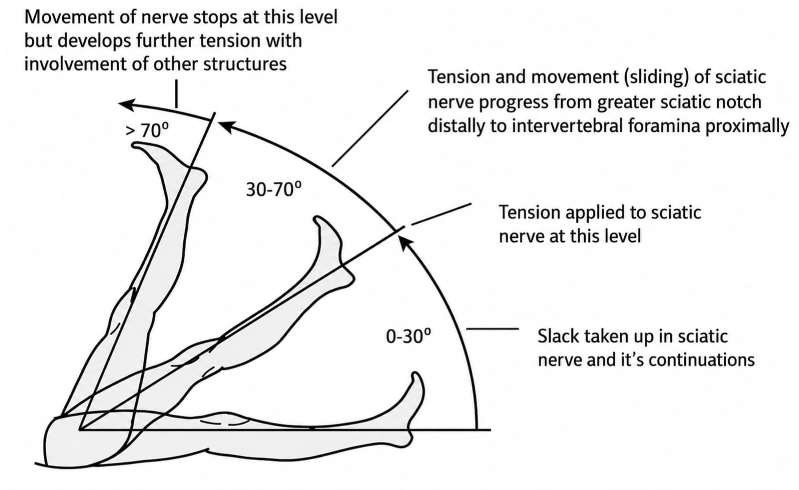
Stinchfield Test (Active Straight Leg Raise Test)

Slide 38
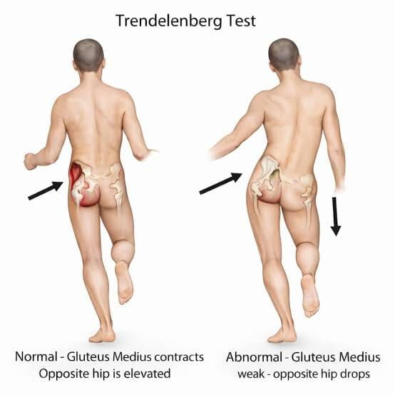
Trendelenburg Test: Principle
Assesses the hip abductor mechanism
Patient stands on one limb
Normally, abductors maintain the opposite side of pelvis
Pelvic drop on unsupported side indicates a positive test
Notes:
Slide 14
Trendelenberg test
It is assessed by investigating the abductor mechanism .
The components of abductor mechanism are hip joint( femoral head and acetabulum ) ,neck of femur ,
Intertrochanteric line , abductor muscles ( gluteus medius and minimus ) and superior gluteal nerve
If any of these structures is affected , Trendelenberg sign can be seen . The normal side sinks down .

Slide 39
Trendelenburg Test: Causes of Positivity
Weak or paralyzed hip abductors
Painful hip
Loss of stable fulcrum at hip joint
Shortened femoral neck or altered biomechanics

Slide 40
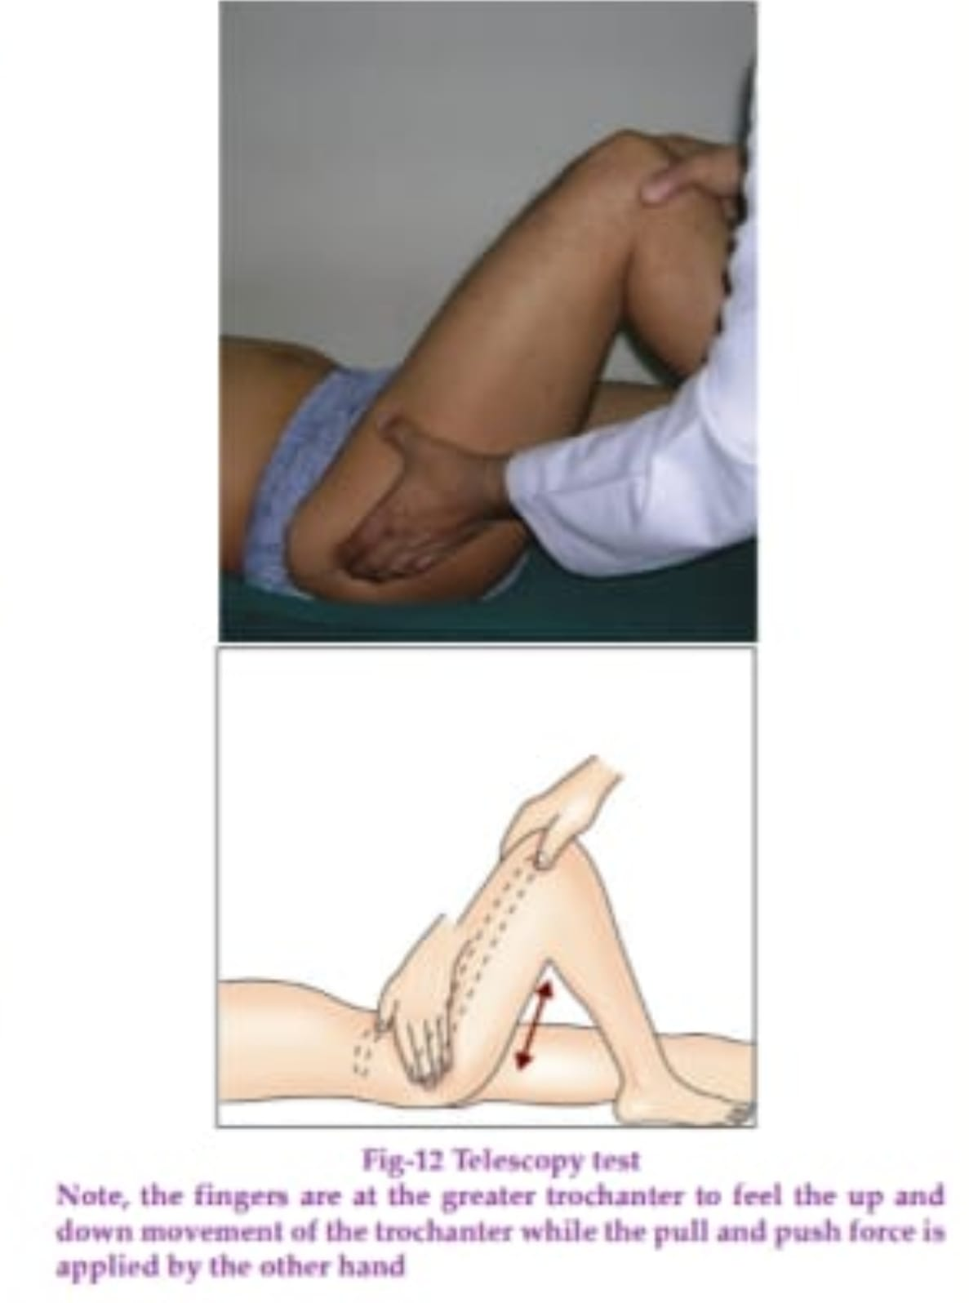
Telescopy Test
Assesses abnormal longitudinal mobility at the hip
Stabilize pelvis and apply push–pull force along femur
Excessive movement suggests loss of normal hip stability
Interpret with the overall clinical picture
Notes:
Slide 32
Telescopy
The thenar eminence of one hand is kept on ASIS and three fingers are kept on the greater trochanter . The other is kept on the knee while the knee and the hip are both flexed at 90° .Push and pull force is applied along the long axis of the thigh .
Telescopy test is positive when the hip is unstable wherein the up and down movement of greater trochanter is felt by the fingers .

Slide 41
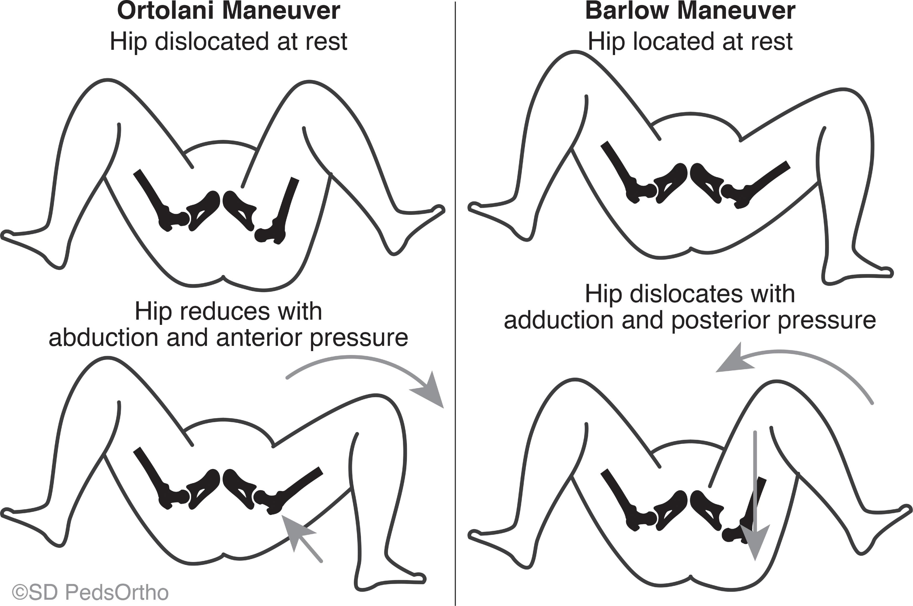

Slide 42
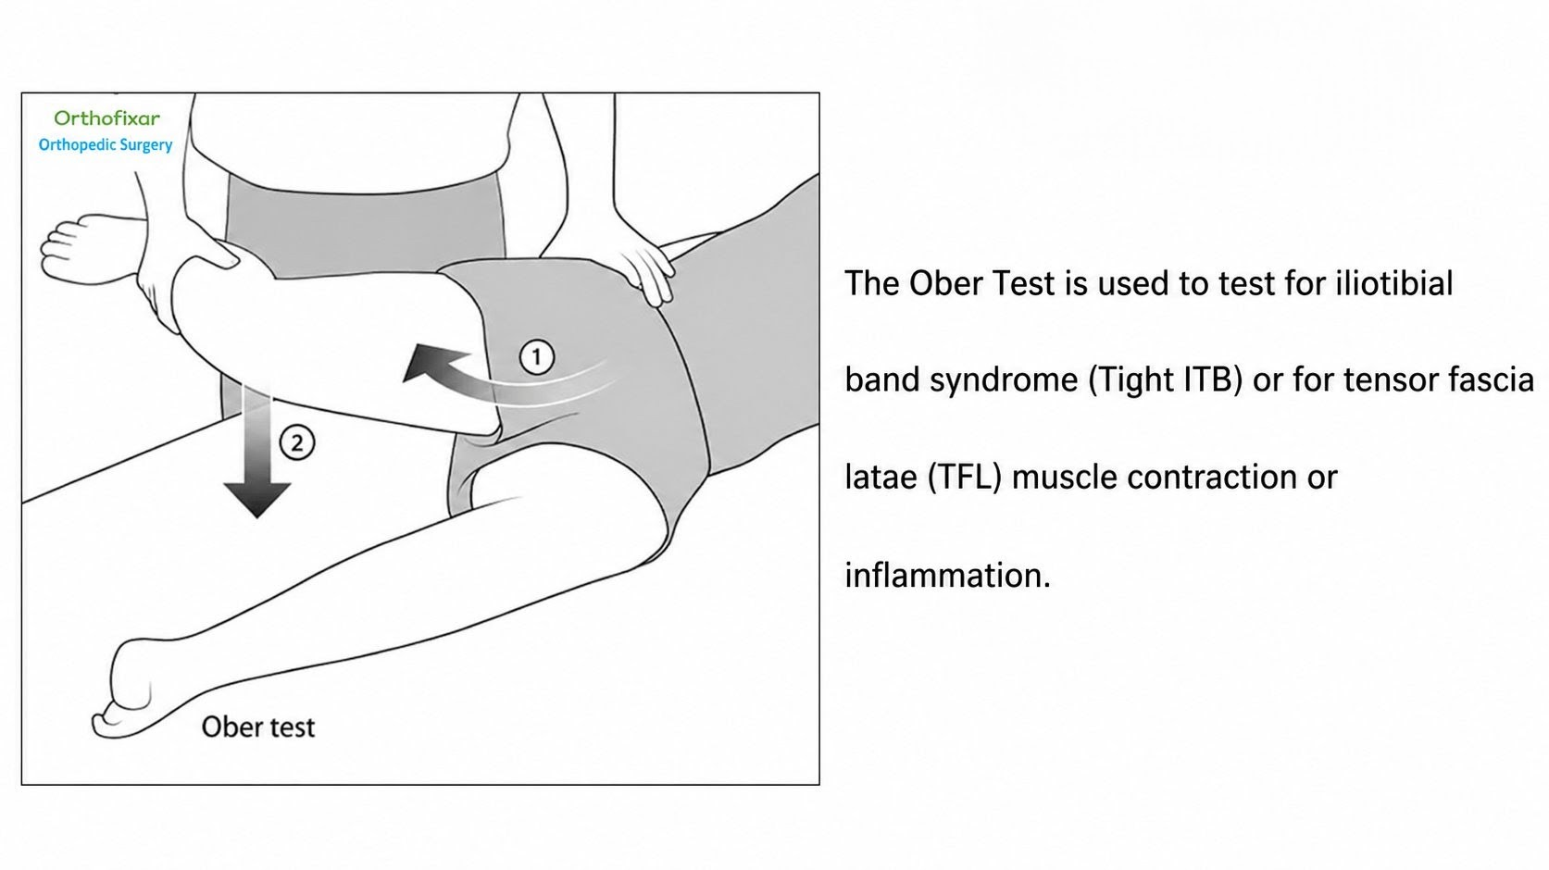
Ober's Test
( To test for ITB contracture )

Slide 43
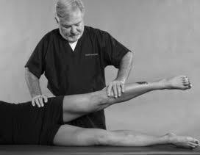
Gauvain's Sign
To detect active tuberculosis of the hip joint.
The test is typically performed with the patient lying down (often on their side):
1)Grasp the Femur: The examiner firmly holds the femur on the affected side in the region of the condyles.
2)Rotate the Hip: The examiner gently but sharply rotates the head of the femur within the acetabulum (inward or outward).
If the disease is active, this gentle rotation triggers a distinct, involuntary spasm or tightening of the abdominal muscles.

Slide 44
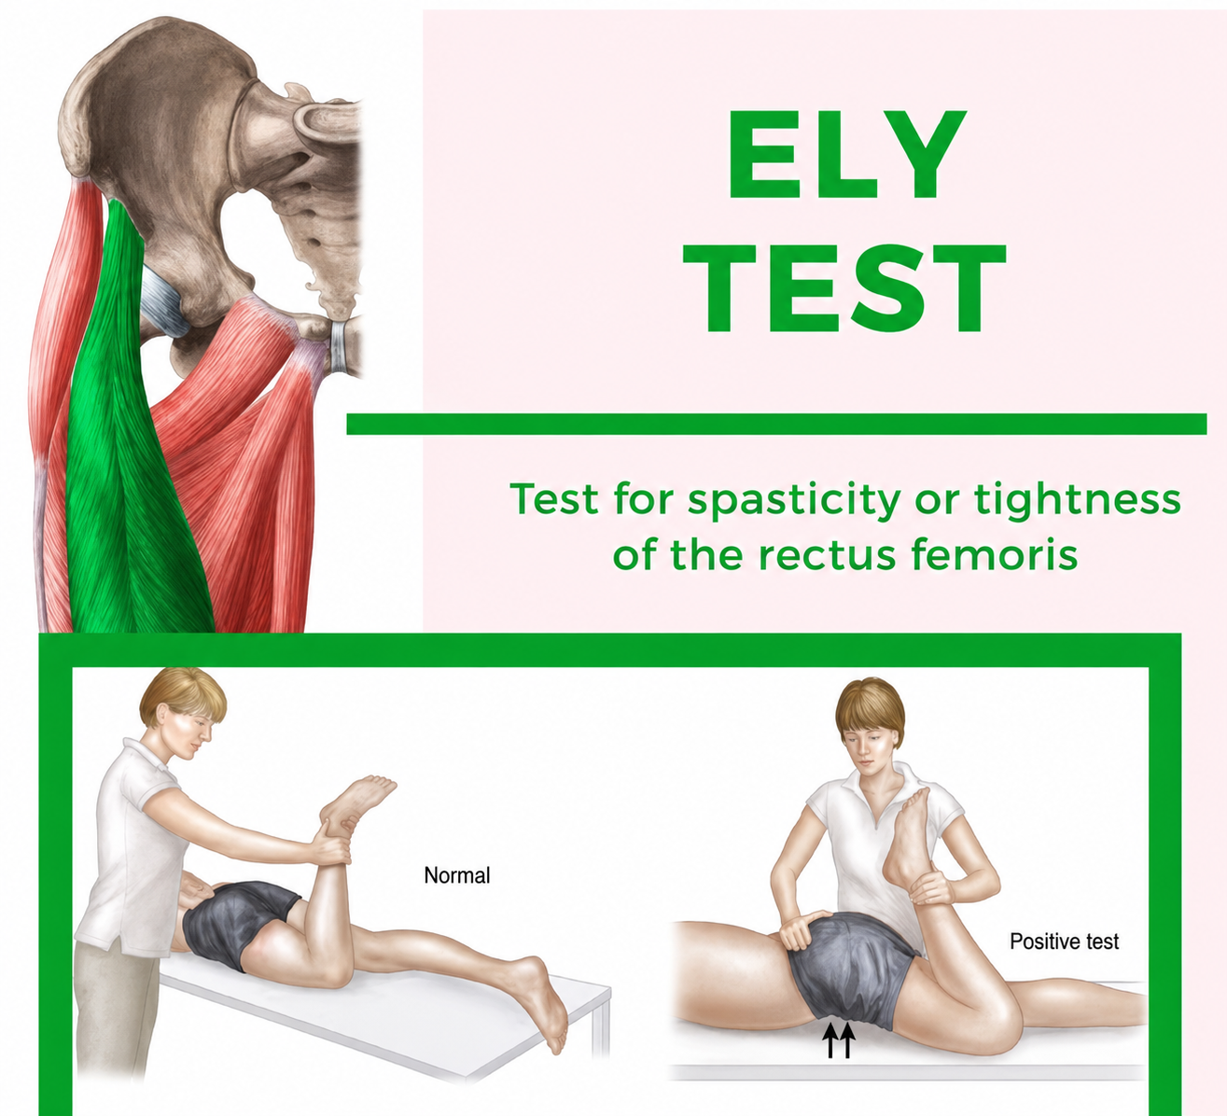
ELY TEST
Test for tightness or spasticity of the rectus femoris
Starting Position: The patient lies flat on their stomach (prone position) on a table or mat, keeping their body as relaxed as possible.
Action: The examiner stabilizes the pelvis with one hand and uses the other to passively flex the patient's knee, bringing their heel toward your buttocks.

Slide 45
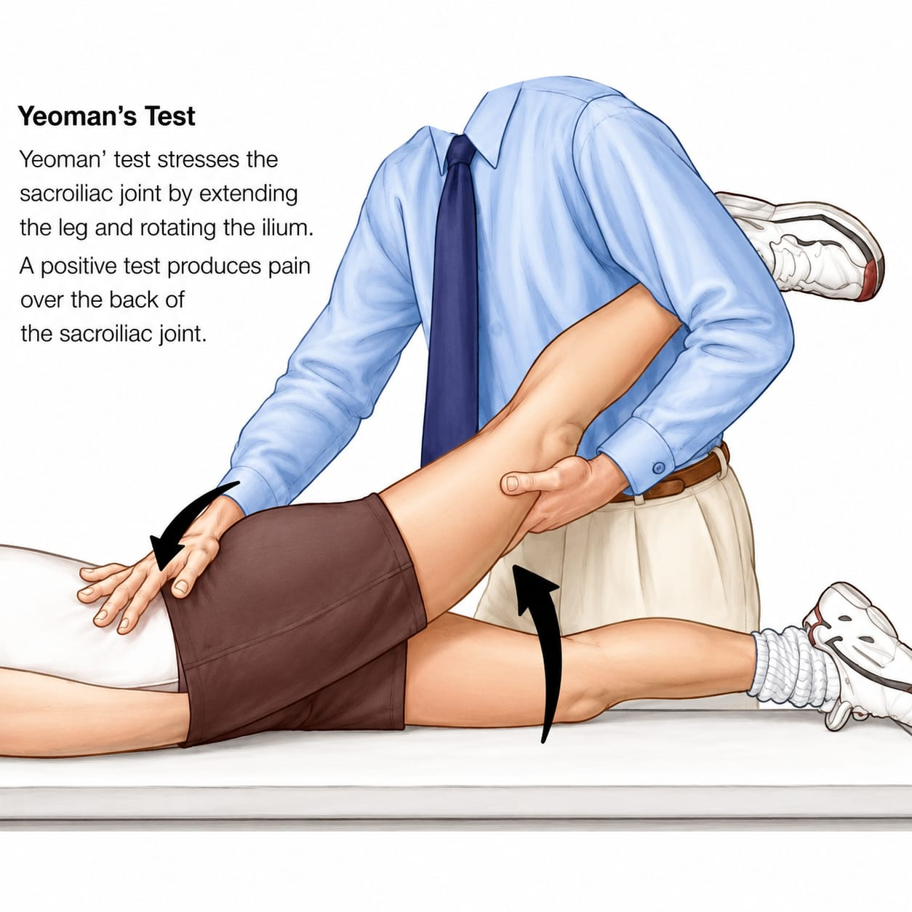

Slide 46
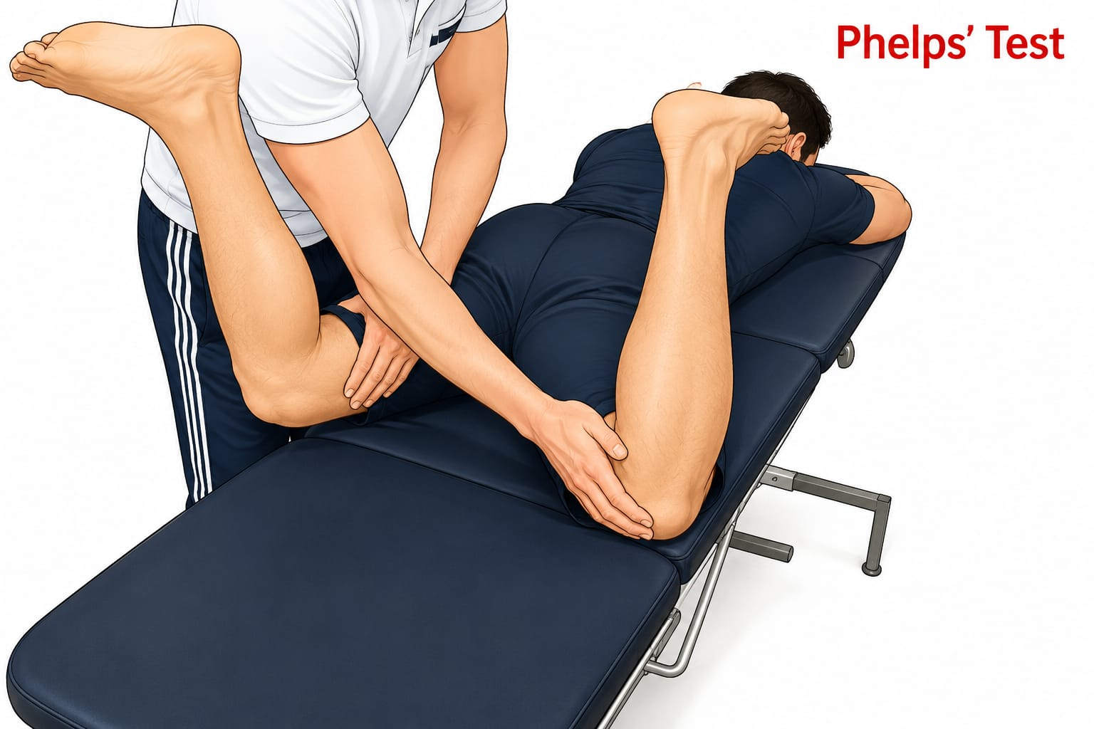
Phelp's test
To test gracilis tightness
1. Initial Position: The patient lies in a prone position with both knees fully extended.
2. First Abduction: The examiner passively abducts (spreads) the patient's legs as far apart as possible.
3. Second Abduction: The patient then flexes their knees to 90°, and the examiner passively attempts to abduct the hips even further

Slide 47
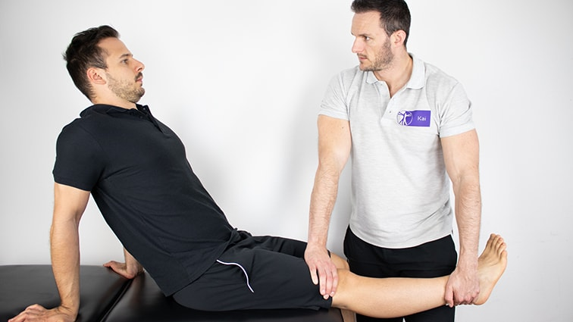
Tripod sign:
To assess tight hamstrings.
The patient sits on the edge of an examination table with knees bent at 90 degrees and legs hanging freely. The examiner then passively extends one knee
Positive Sign: If the patient leans backward or slumps their lumbar spine to relieve tension in the thigh, it indicates tight or shortened hamstrings.

Slide 48
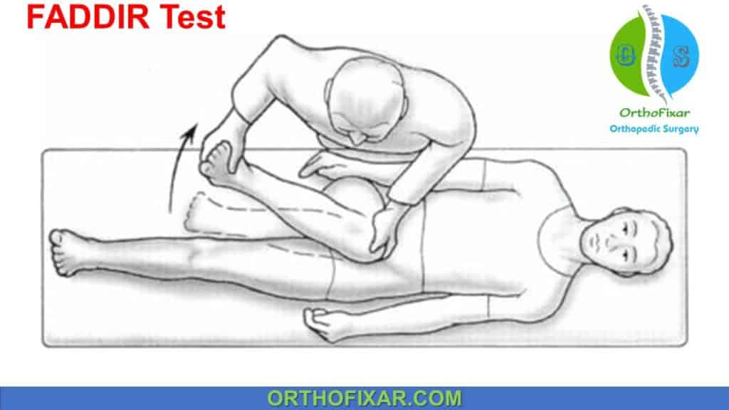
Piriformis Test (FADIR Test)
1)Patient Position: The patient lies flat on their back (supine).
2)Flexion: The hip and knee are flexed to about 90 degrees.
3)Adduction: The leg is brought across the midline of the body.
4)Internal Rotation: The hip is internally rotated by moving the foot and ankle outward away from the midline.

Slide 49
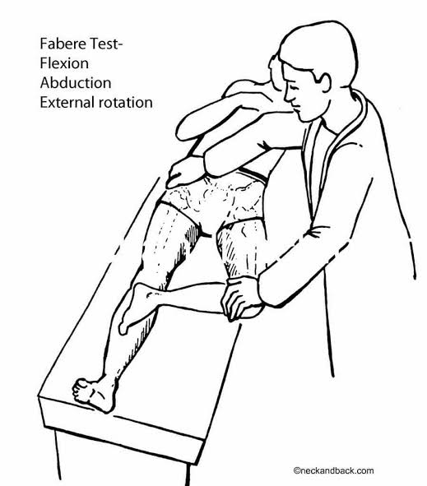
Patrick's Test (FABER Test)
1.The patient lies flat on their back (supine) on an examination table.
2.The examiner bends the knee of the leg being tested and places that ankle on top of the opposite, straight knee.
3.While gently stabilizing the opposite hip bone (the ASIS), the examiner slowly lowers the bent knee outward and downward toward the table
Notes:
Forms a figure of 4

Slide 50
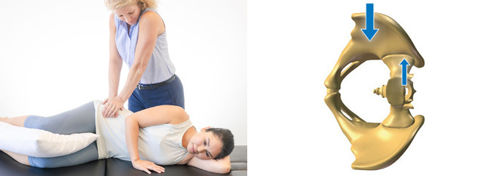
Erichson's Pelvic Compression Test
Used to detect sacroiliac joint (SIJ) pathology or dysfunction
1. Positioning: The patient is typically positioned lying on their side (lateral decubitus) or lying on their back (supine).
2. Action: The examiner applies firm, inward, and downward pressure on the patient's iliac crests

Slide 51
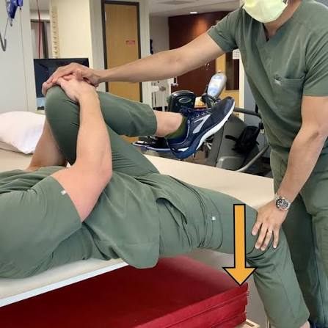
Gaenslen's test
Patient Position: The patient lies on their back near the edge of the examination table.
Knee-to-Chest: The patient pulls the knee closest to the center of the table toward their chest and holds it there.
Hyperextension: The examiner slowly lowers the outer leg off the edge of the table, passively pushing it into hip extension.
Counter-pressure: The examiner applies downward pressure on the flexed knee and upward/extending pressure on the hanging leg.

Slide 52
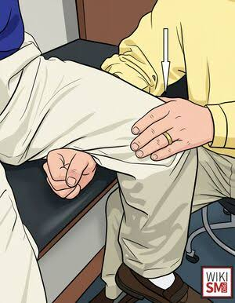
Fulcrum test:
used to screen for stress fractures, primarily in the femoral shaft (thigh bone) or the tibia.
Positioning: The patient sits on the edge of the examination table with their lower legs dangling.
Fulcrum Placement: The examiner places one forearm horizontally underneath the patient's thigh.
Applying Pressure: With the other hand, the examiner applies gentle, downward pressure on the top of the patient's knee. This action causes the femur to bend over the forearm.
Assessment: The examiner slides their forearm proximally up the thigh, repeating the downward pressure at various points along the bone.

Slide 53
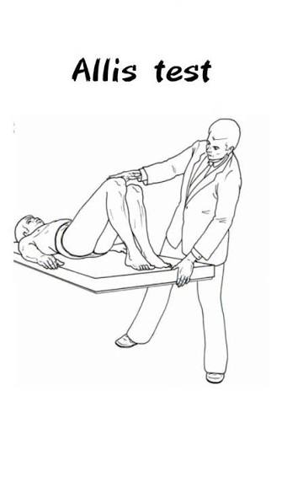
used to detect leg length discrepancies
Positioning: The patient lies on their back (supine) on an examining table.
Flexion: The hips are flexed to 45° and the knees are flexed to 90°, with the feet flat on the surface and ankles touching the buttocks.
Observation: The examiner looks at the relative height and position of the knees from the foot and side of the table
Interpretation
Negative: The knees are level and in line with one another.
Positive: One knee is higher or displaced relative to the other.

Slide 54
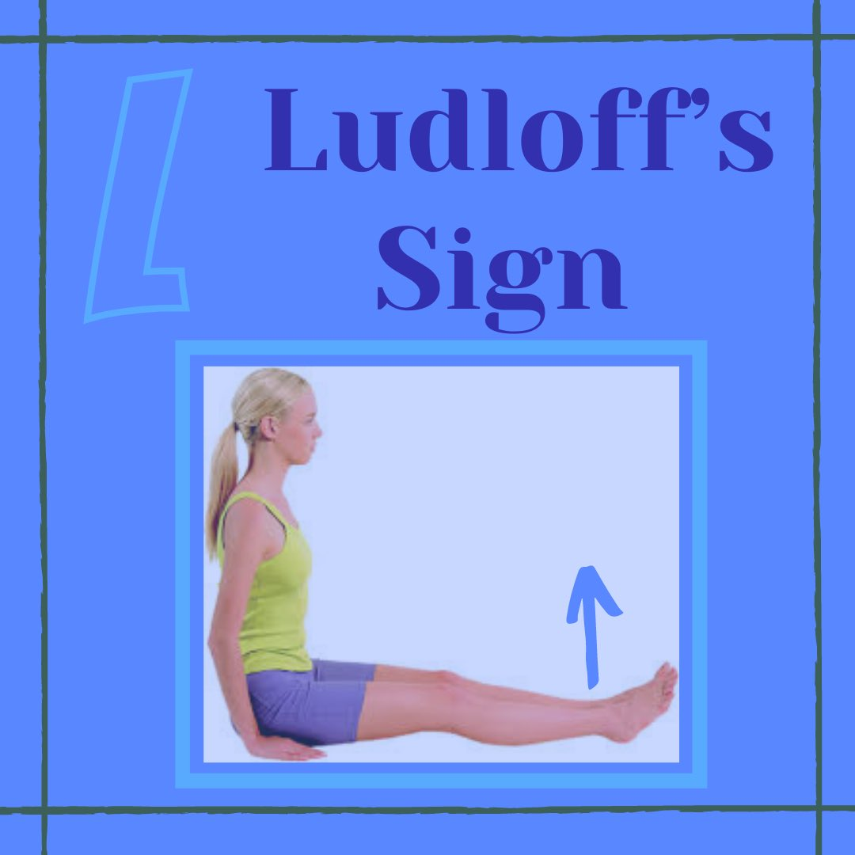
It is used to diagnose iliopsoas muscle tendinitis, strain, or a traumatic separation of the lesser trochanter
The patient sits on a chair with their knees fully extended. They are then asked to actively lift the heel of the affected leg off the
surface
If the patient experiences weakness or reproduces sharp pain in the groin area, the test is positive.

Slide 55
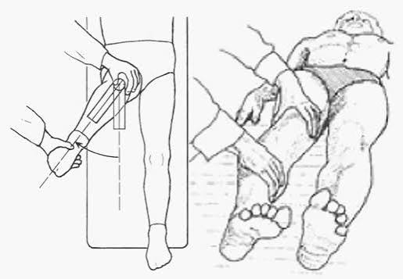
Sectoral sign
is a clinical physical examination finding for avascular necrosis (AVN) or osteonecrosis of the hip.
Method:
Compare internal rotation in hip extension and flexion.
Positive test:
Internal rotation is reduced in extension but improves in flexion

Slide 56
Examine Adjacent Regions
Lumbar spine
Sacroiliac joints
Knee joint
Opposite hip
Abdomen and groin when clinically indicated

Slide 57
Neurovascular Examination
Assess motor power and relevant myotomes
Check sensation
Assess peripheral pulses
Document deficits before intervention

Slide 58
Common Examination Errors
Inadequate exposure
Failure to square and stabilize pelvis
Confusing lumbar movement with hip movement
Incorrect limb-length landmarks
Omitting knee, spine or neurovascular examination

Slide 59
References
Maheshwari J, Mhaskar VA. Essential Orthopaedics. Examination of the Hip.

Slide 60
Thank You

