Slide 1
Examination of ulcer

Slide 2
ULCER
DEFINITION :-
A breach in the continuity of the covering epithelium of the skin or mucous membrane due to molecular death

Slide 3
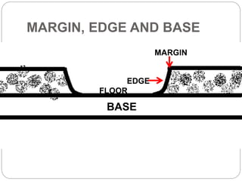
Parts of ulcer
Margin
Edge
Floor
Base

Slide 4
PARTS OF AN ULCER
MARGIN :- THE LINE WHERE ULCER MEETS THE NORMAL SURROUNDING SKIN . IT MAY BE REGULAR OR IRREGULAR . IT MAY ALSO BE ROUNDED OR OVAL .
EDGE :- THE TISSUE BETWEEN MARGIN AND FLOOR OF ULCER . IT REFLECTS PATHOLOGICAL NATURE OF THE ULCER
TYPES OF EDGES :-
1. SLOPING EDGE :- THE ULCER IS SHALLOW AND IT IS SEEN IN A HEALING ULCER .
ITS INNER PART IS RED BECAUSE OF RED , HEALTHY GRANULATION TISSUE
ITS OUTER PART IS WHITE DUE TO FIBROUS TISSUE .
ITS MIDDLE PART IS BLUE DUE TO EPITHELIAL PROLIFERATION .

Slide 5
2. UNDERMINED EDGE :- WHEN INFECTION IS AFFECTING THE SUBCUTANEOUS TISSUE MORE THAN THE SKIN THE EDGE BECOMES UNDERMINED
EXAMPLES - TUBERCULOUS Ulcer
3. PUNCHED OUT EDGE :- IT RESULTS FROM RAPID DEATH AND LOOSE OF WHOLE
THICKNESS OF THE SKIN WITH MINIMAL ATTEMPT OF HEALING
EXAMPLES - GUMMA IN SYPHILLIS AND NEUROPATHIC ULCER
4. RAISED AND BEADED EDGE :- DEVELOPS WHEN THERE IS SLOW GROWTH OF TISSUE IN THE EDGE OF THE ULCER
EXAMPLES- BCC (BASAL CELL CARCINOMA)/ RODENT ULCER
5. EVERTED EDGES (ROLLED OUT EDGE)- DEVELOPS WHEN THE TISSUE IN THE EDGE THE ULCER IS GROWING QUICKLY AND SPILLING OUT OF THE ULCER TO OVERLAP THE NORMAL SKIN
EXAMPLES- SQUAMOUS CELL CARCINOMA ( MALIGNANT ULCER )

Slide 6
C. FLOOR :- IT IS EXPOSED PART OF ULCER WHICH IS SEEN
IT CONTAINS GRANULATION TISSUE ( HEALTHY OR UNHEALTHY )
DISCHARGE MAY BE SEEN IN DIFFERENT TYPE OF ULCER
EXAMPLE :- HEALING ULCER SHOW SCANTY , SEROUS DISCHARGE
D. BASE :- BASE IS THE ONE ON WHICH ULCER RESTS . IT MAY BE BONE OR SOFT TISSUE .

Slide 7
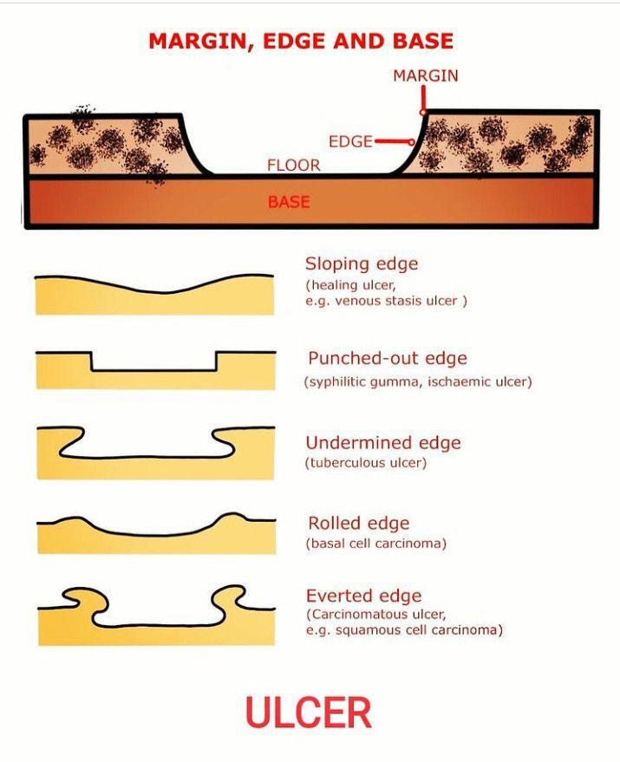

Slide 8
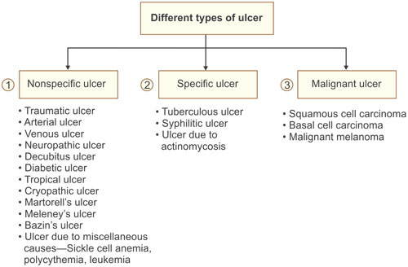

Slide 9
FEATURES | VENOUS ULCER | ARTERIAL ULCER | NEUROTROPHIC ULCER | TRAUMATIC ULCER | MALIGNANT ULCER
1. SITE | GAITER AREA 70% LATERAL 20% CIRCUMFERENTIAL 10% | MALEOLI , HEEL OR METATARSAL | PRESSURE AREA LIKE HEEL , SACRUM , GREATER TROCHANTER | SITE OF TRAUMA | FACE , LIPS OR TONGUE
2. SIZE OR SHAPE | LARGE , SHALLOW , VERTICALLY OVAL | SMALL , DEEP | VARIABLE | VARIABLE | VARIABLE
3. MARGIN | IRREGULAR | REGULAR | REGULAR | - | -
4. EDGE | SLOPING EDGE | PUNCHED OUT | PUNCHED OUT | SLOPING EDGE | EVERTED EDGE
5. FLOOR | GRANULATION | SLOUGH OR NECROTIC | SLOUGH | VARIABLE | NECROTIC TISSUE

Slide 10
FEATURES | VENOUS ULCER | ARTERIAL ULCER | NEUROTROPHIC ULCER | TRAUMATIC ULCER | MALIGNANT ULCER
6. BASE | FIX OR NO INDURATION | NO | NO | NO | INDURATED OF BASE AND SURROUNDING TISSUE
7. DEPTH | SHALLOW | DEEP | DEEP UP TO BONE | VARIABLE | SHALLOW
8. LYMPH NODE | ABSENT | ABSENT | ABSENT | ABSENT | PRESENT EXCEPT BCC
9. TENDER | PAINLESS | PAINFUL | PAINLESS | PAINFUL | PAINFUL

Slide 11
EXAMINATION OF ULCER
GENERAL PHYSICAL EXAMINATION :-
VITAL SIGN :-
. Heart rate
. Respiratory rate
. TEMPERATURE :- FOR SEPSIS OR SYSTEMIC INFECTION
. BLOOD PRESSURE :- HYPOTENSION MAY INDICATE SEPSIS OR POOR PERFUSION
GENERAL APPEARANCE :-
. SIGNS OF CHRONIC ILLNESS OR MALNUTRITION
. OBESITY
PALLOR OR CYANOSIS :-

Slide 12
MAY INDICATE ANAEMIA OR POOR PERFUSION – MAY INDICATE ULCER FORMATION AT PERIPHERY .
SIGNS OF SYSTEMIC DISEASE :-
. JAUNDICE ( LIVER DISEASE )
. CLUBBING ( CHRONIC HYPOXIA , SYSTEMIC DISEASE )
. EDEMA ( VENOUS INSUFFIENCY , HEART FAILURE , RENAL DISEASE )
. LYMPHADENOPATHY – MAY INDICATE INFECTION OR MALIGNANCY

Slide 13
inspection
Size and shape
Position
Margin of ulcer
Edges and types of edges
raised ulcer
Floor of the ulcer
slough
Surrounding skin / area

Slide 14
Local EXAMINATION
INSPECTION :-
SIZE / SHAPE – MEASURE THE SIZE OF ULCER IN CENTIMETERS .
IN CASE OF 2 DIMENSION ULCER MEASURE WITH MEASURING TAPE .
POSITION - MANY ULCERS HAVE CHARACTERISTIC SITE WHERE THEY OCCUR
EXAMPLES :- VARICOSE ULCER – ON MEDIAL ASPECT OF LOWER THIRD OF THE LEG
RODENT ULCER - UPPER PART OF THE FACE ABOVE A LINE JOINING THE ANGLE OF THE
MOUTH TO THE LOBULE OF EAR .
TUBERCULOUS ULCER - ON THE NECK AT SITE OF TUBERCULOUS LYMPHADENOPATHY
TROPHIC / NERUOPATHIC ULCER – ON WEIGHT BEARING AREA
ARTERIAL ULCER – OVER THE DORSUM OF FOOT / TOES .
MARGIN AND EDGE OF ULCER - MARGIN IS THE BORDER / TRANSISTIONAL ZONE OF SKIN AROUND THE ULCER

Slide 15
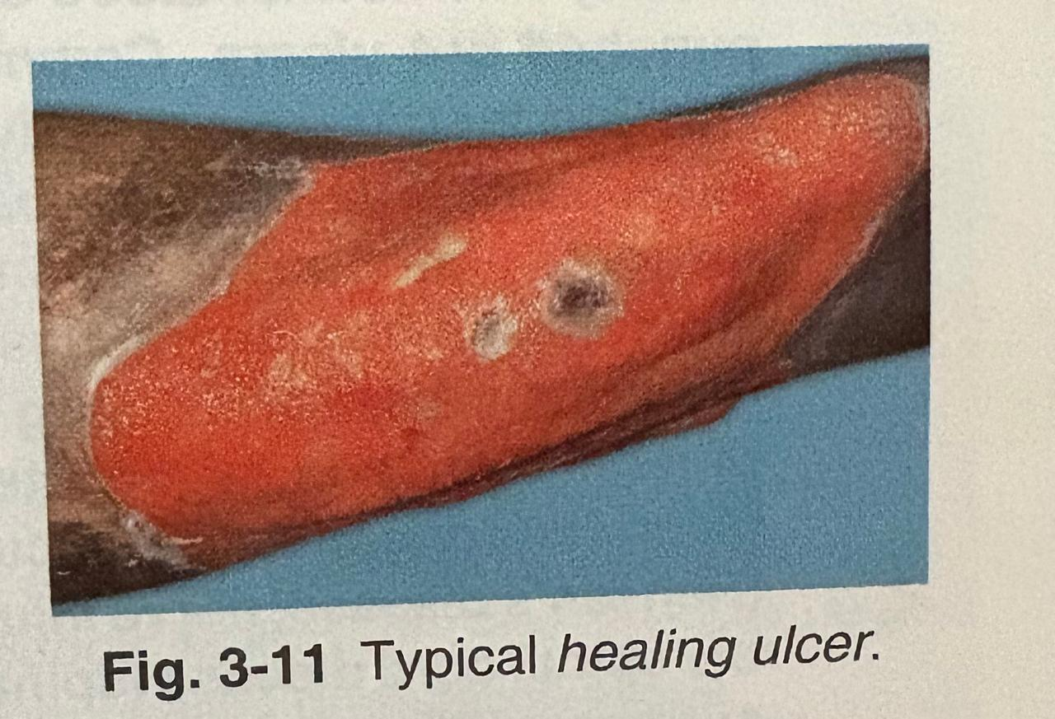
MARGIN OF HEALING ULCER :- OUTER – WHITE
MIDDLE – BLUE
INNER – RED
.

Slide 16
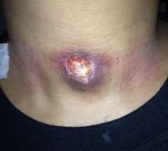
CHRONIC NON HEALING ULCER SHOWS FIBROSED MARGIN WITH THICKENED WHITE SKIN MARGINS WITH OUTER BLUE LINE OF GROWING EPITHELIUM .
EDGE :- MODE OF UNION BETWEEN THE FLOOR AND THE MARGIN OF ULCER . IT CAN BE INSPECTED AND PALPATED AS WELL .
SLOPING EDGE – IN A HEALING ULCER THE HEALTHY GRANULATION TISSUE OVER THE FLOOR IS SLIGHTLY BELOW THE SKIN SURFACE .
PUNCHED OUT EDGE – IN neurTrophic / arterial ulcer it BECOMES OVERCHANGED .
UNDERMINED EDGE - IN TUBERCULOUS ULCER SKIN BECOMES OVERCHANGED

Slide 17
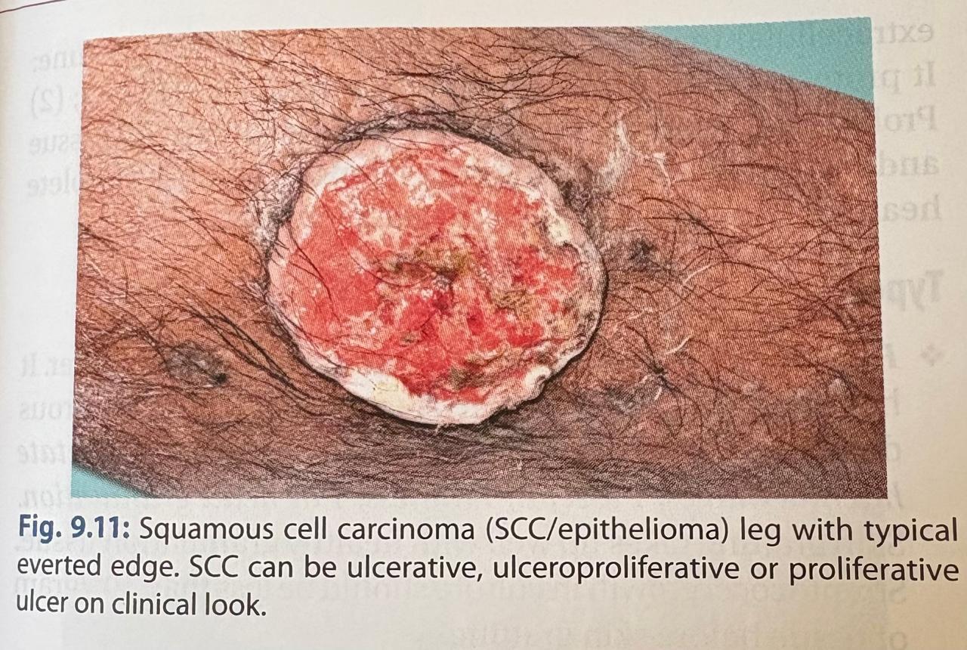
4. everted edge - malignant ulcer grows rapidly and get overchanged and raised above the skin level.

Slide 18
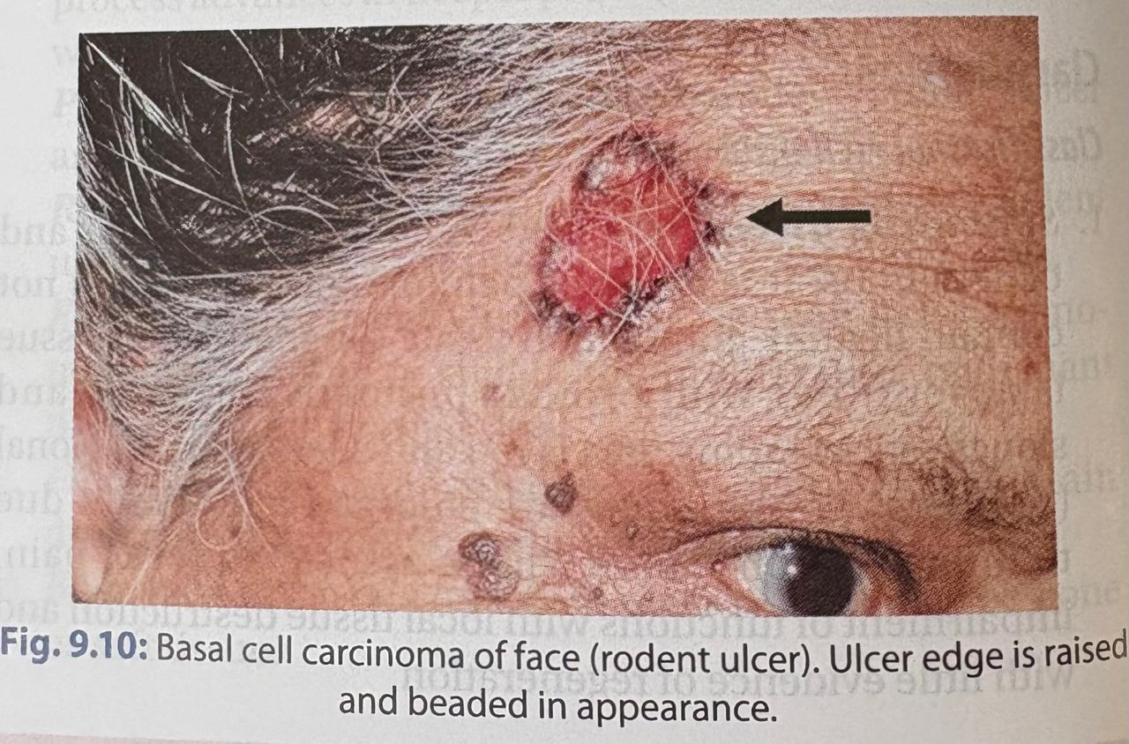
5. Raised ulcer - in bcc ( slow growing ulcer can be seen )

Slide 19
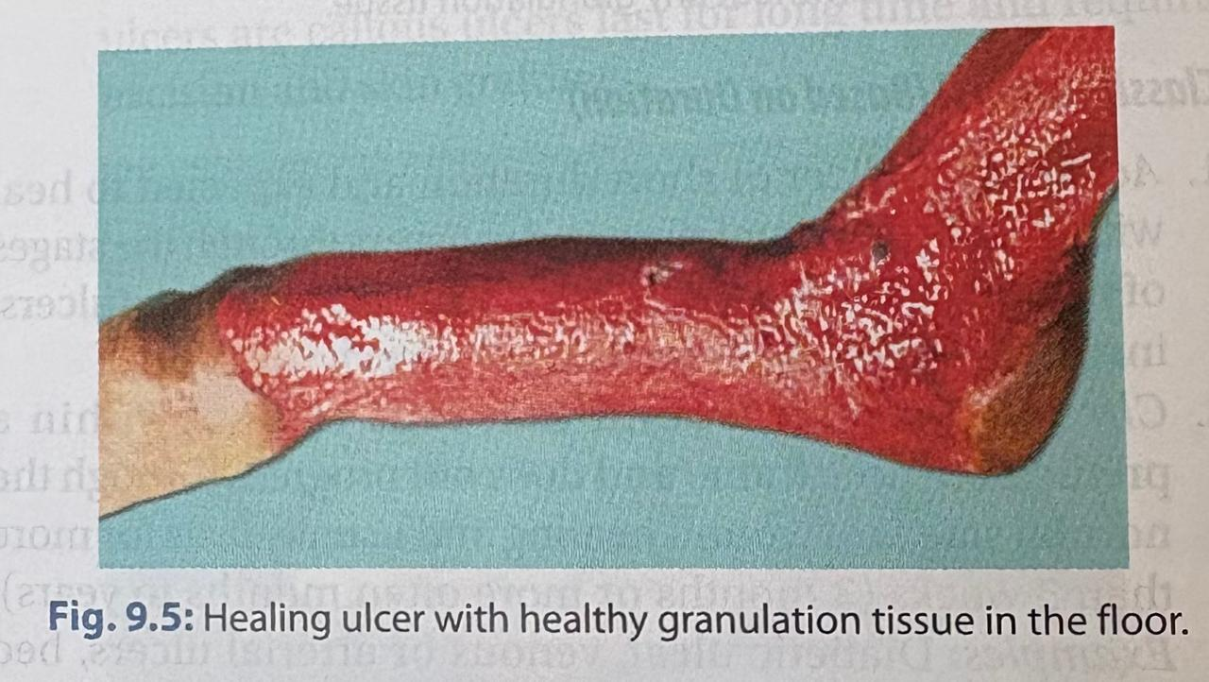
Floor of the ulcer – exposed part of ulcer
example – healthy ulcer :- healthy granulation tissue
no slough
small amount of serous discharge

Slide 20
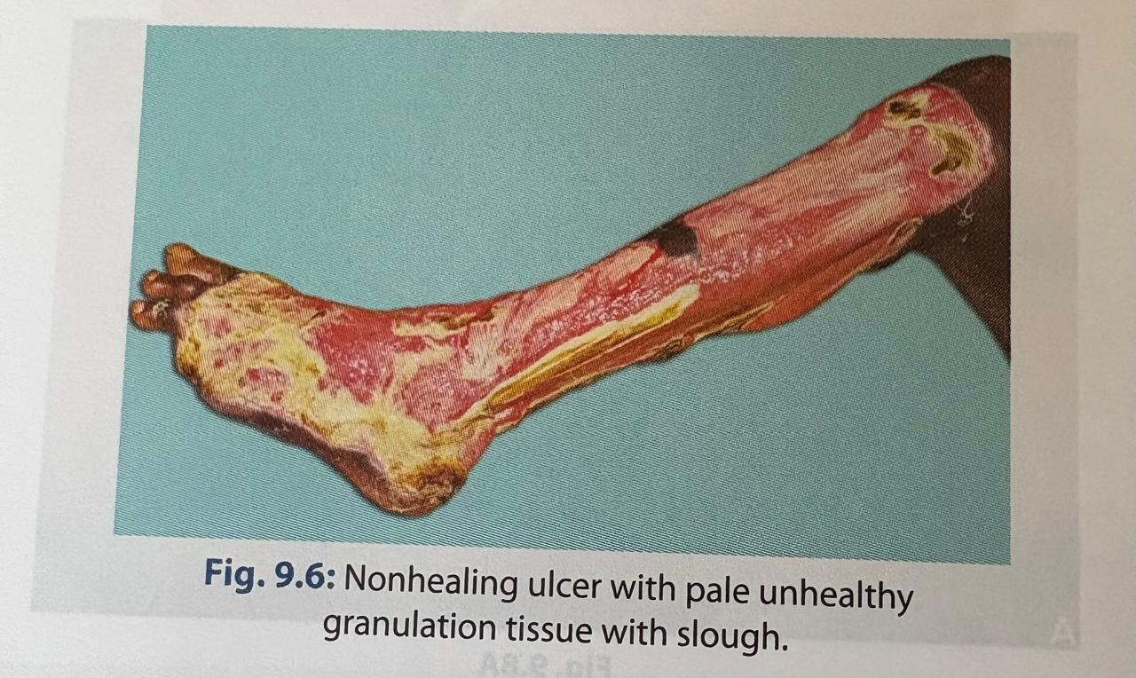
. Slough – is necrotic soft tissue not yet separated from living tissue

Slide 21
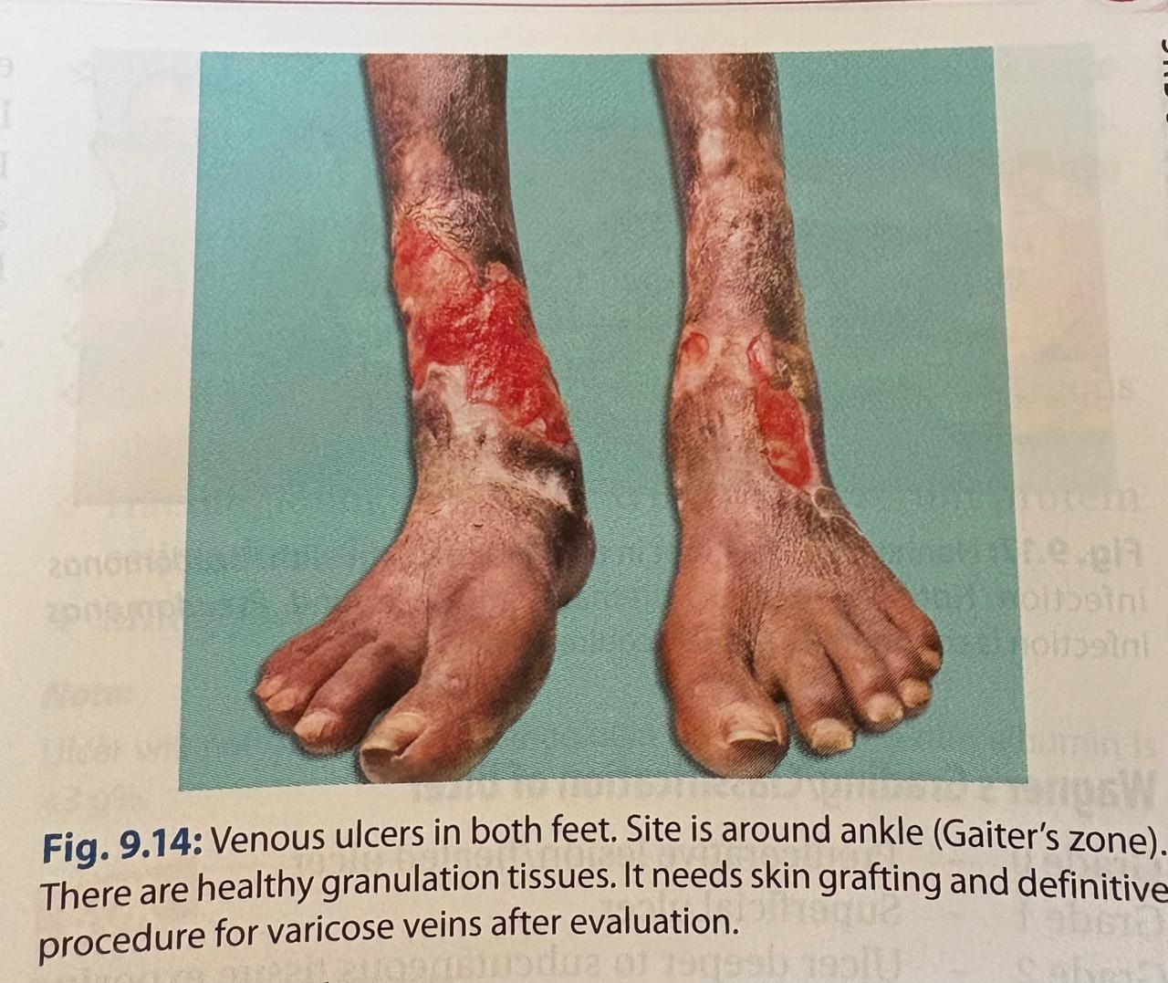
7. Surrounding skin or area – is shiny red and oedematous due to cellulitis .
dark pigmentation surrounded the ulcer – suggestive of varicose ulcer
scars of skin surrounding ulcer – tuberculous ulcer
hypopigmentation of surrounding skin - chronic non healing ulcer

Slide 22
. PALPATION :-
palpate the surrounding skin for temperature and tenderness .
TENDERNESS – ACUTE INFLAMMED ULCER IS ALWAYS EXQUISITELY TENDER
CHRONIC ULCER SUCH AS TUBERCULOUS AND SYPHILITIC ULCER ARE SLIGHTLy TENDER
VARICOSE ULCER MAY OR MAY NOT BE TENDER
NEOPLASTIC ULCER ARE NEVER TENDER
Surrounding skin - by evaluating the temperature of skin palpate by the back of finger and comparing the opposite normal side then note the tenderness around the surrounding area .

Slide 23
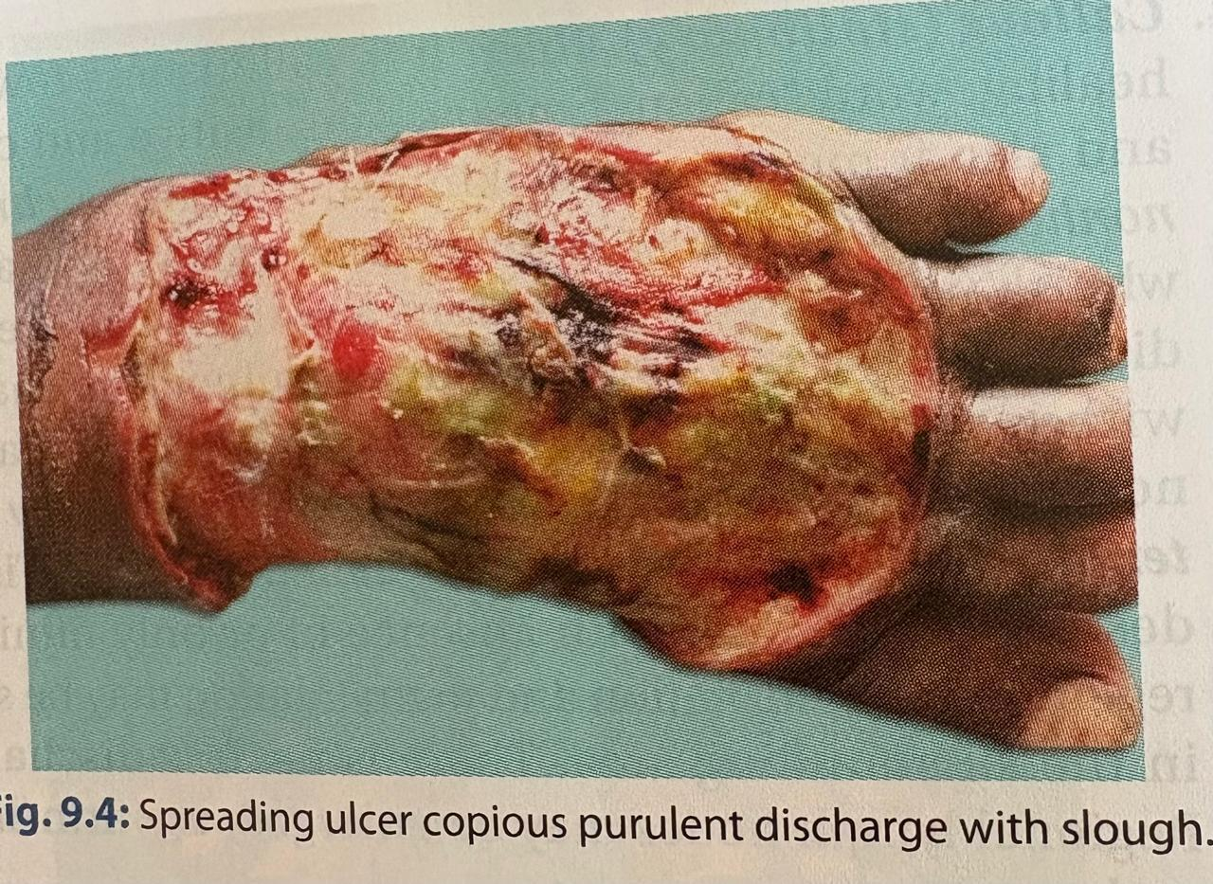
warm and tenderness suggest inflammation in spreading ulcer
now palpate the edge and the floor of the ulcer with a gloved finger

Slide 24
The edge is – 1. soft in healing ulcer
2. firm in non healing ulcer
3. hard in malignant ulcer
Now palpate the granulation tissue over the floor and note whether it bleeds on touch
In a healthy granulation tissue shows pinpoint haemorrhagic SPOTS WHILE IN MALIGNANT ULCER MAY BLEED PROFUSELY
BASE – ALL CHRONIC ULCER HAVE FIRM BASE DUE TO FIBROSIS . HARD BASE SHOULD RAISE THE SUSPICION OF MALIGNANCY

Slide 25
Focal EXAMINATION :-
REGIONAL LYMPH NODE – ACUTE INFLAMMED ULCER LYMPH NODES BECOME ENLARGED AND TENDER
IN TUBERCULOUS ULCER LYMPH NODE BECOME ENLARGED AND SLIGHTLY TENDER
IN GUMMATOUS AND RODENT ULCER LYMPH NODE ARE NOT INVOLVED
IN MALIGNANT ULCER NODES ARE STONY HARD
VASCULAR - WHEN ULCER IS SITUATED ON LOWER PART OF THE LIMB – SUGESTIVE OF VARICOSE VEIN IN UPPER PART OF THE LEG OR THIGH
IF THERE IS NO VARICOSE VEIN AND CAUSE OF ULCER IS NOT DETERMINED THE CLINICIAN MUST EXAMINE CONDITION OF THE ARTERIES PROXIMAL TO THE ULCER
EX. ATHEROSCLEROSIS , BERGER’S DISEASE ETC MAY BE THE CAUSE OF THE ULCER FROM POOR CIRCULATION
NEUROLOGICAL ( EXAMPLE – TINGLING SENSATION )

Slide 26
SYSTEMIC EXAMINATION
CARDIOVASCULAR SYSTEM :- FOR EVIDENCE OF CONGESTIVE HEART FAILURE WHICH DELAYS HEALING OF ULCER .
RESPIRATORY SYSTEM :- FOR TUBERCULOSIS
ABDOMINBAL SYSTEM :- FOR EXAMINE SPLEENOMEGALY IN HEMOLYTIC ANAEMIA IN LEG ULCER

Slide 27
QUESTIONS AND ANSWERS
Q1. A 54-year-old male presents with a non-healing ulcer over his lower third of the leg. On examination, the ulcer has an everted edge, an indurated base, and bleeds easily on touch. What is the most likely diagnosis?
Varicose Ulcer
Squamous Cell Carcinoma
Tuberculous Ulcer
D) Syphilitic (b)

Slide 28
Q2. Which type of ulcer edge is uniquely characterized by an "undermined edge", typically seen when the pathogenic process destroys subcutaneous tissue faster than the overlying skin?
Punch-out edge seen in trophic ulcers
Sloping edge seen in healing venous ulcers
Undermined edge seen in tuberculous ulcers
Raised pearly white edge seen in basal cell carcinoma
©

Slide 29
Q3. When evaluating an ulcer during a bedside clinical examination, 'induration' is best evaluated by which palpatory action?
Pressing directly on the floor of the ulcer
Palpating the edge and feeling the surrounding skin between the index finger and thumb
C) Evaluating the temperature profile of the proximal limb
Checking for cross-fluctuation in the ulcer center
(b)

Slide 30
Q4. A "punched-out" edge with a deep floor exposing underlying tendons or bone is characteristic of which of the following ?
Non-healing Trophic/Arterial Ulcer
Healing Granulation Tissue
Venous Stasis Ulcer
Rodent Ulcer
(A)

Slide 31


