Slide 1
FEVER OF UNKNOWN ORIGIN
Moderator:
Dr. VIVEK KUMAR VERMA
1

Slide 2
FEVER
2

Slide 3
Fever is an elevation of body temperature that exceeds the normal daily variation and occurs in conjunction with an increase in the hypothalamic set point .
A normal body temperature is ordinarily maintained despite environ-
mental variations because the hypothalamic thermoregulatory center
balances the excess heat production derived from metabolic activity
in muscle and the liver with heat dissipation from the skin and lung
3

Slide 4
              The mean oral temperature is 36.6°C (confidence interval, 35.7–37.3°C).
              Rectal temperatures are generally 0.4°C (0.7°F) higher than oral readings.
              The lower oral readings are probably attributable to mouth breathing, which is a factor in patients with respiratory infections and rapid breathing.
              Lower-esophageal temperatures closely reflect core temperature.
              Tympanic membrane thermometers measure radiant heat from the tympanic membrane and nearby ear canal and display that absolute value
              women who menstruate, the temperature is generally lower during the 2 weeks before ovulation; it then rises by ~0.6°C (1°F) with ovulation and stays at that level until menses occur.
4

Slide 5
FEVER PATTERN
•Intermittent Fever ⁃ Any fever characterized by intervals of normal temperature
i.e the temperature Spikes but falls back to baseline each day.
-Malaria, pyaemia , septicemia
•Continuous Fever ⁃ Temperature remains above baseline throughout the day and does not fluctuate more than 1⁰C in 24 hours
⁃ Lobar pneumonia, Typhoid, Meningitis, UTI, Brucellosis
•Remittent Fever - A fever pattern in which temperature varies during each 24hour
period but never reaches baseline .
⁃ Enteric Fever, Bacterial Endocarditis, Viral Pneumonia
4

Slide 6
•Relapsing Fever - Recurrent episodes of fever separated by a few days of
normal afebrile periods.
e.g- Borrelia infections
•Undulant Fever - An infectious disease due to the bacteria Brucella,
It is called undulant because the fever is typically undulant, rising
and falling like a wave.
It is also called brucellosis after its bacterial cause
4

Slide 7
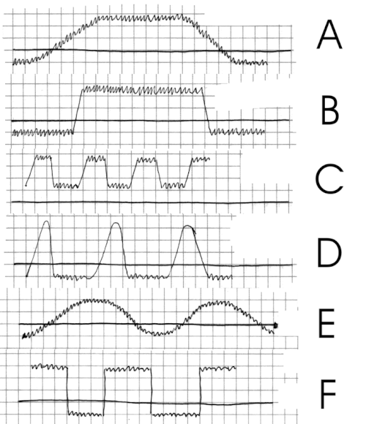
a)&b) Continuous fever
c) Remittent fever
d) Intermittent fever
e) Undulant fever
f) Relapsing fever
4

Slide 8
FEVER OF UNKNOWN ORIGIN
2

Slide 9
●FUO was originally defined by Petersdorf and Beeson in 1961.
•FUO is now defined as:
1. Fever >38.3°C (101°F) on at least two occasions
2. Illness duration of at least 3 weeks
3. No known immunocompromised state
7

Slide 10
4. Diagnosis that remains uncertain after a thorough history-taking,
physical examination, and the following obligatory investigations:
• ESR and CRP (C-reactive protein) level
• Platelet count, leukocyte count (total and differential), and hemoglobin
- Electrolytes, creatinine, total protein, ferritin and protein electrophoresis
- Enzymes such as alkaline phosphatase, alanine aminotransferase, aspartate aminotransferase
lactate dehydrogenase, creatine kinase
• Antinuclear antibodies, and rheumatoid factor
• Culture: Blood cultures (three negative cultures) and urine culture
- Radiology: Chest X-ray, abdominal USG
• Tuberculin skin test or interferon-y release assay.
8

Slide 11
CAUSES
2

Slide 12
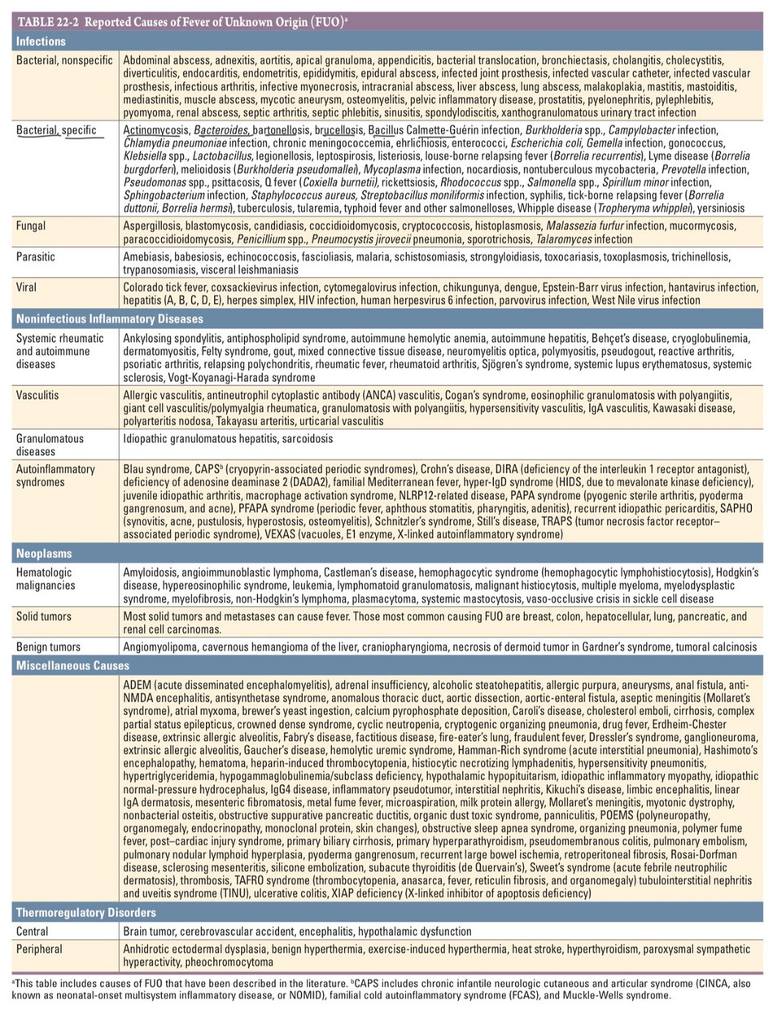
2

Slide 13
FUO has both infectious and non-infectious etiology.
          Infections (36%): This accounts for the majority of FUO cases. All groups of microbial infections (both localized and systemic) can cause FUO such as:
          Bacterial infections: Mycobacterial infections, typhoid fever, rickettsial infections, brucellosis, listeriosis, spirochete infections, etc.
          Viral infections: Dengue, HIV infection, HSV infection, cytomegalovirus and EBV infection etc.
          Parasitic infections: Malaria, amoebiasis, leishmaniasis, filariasis, toxoplasmosis, etc.
          Fungal-Aspergillosis, blastomycosis, candidiasis, cryptococcosis, histoplasmosis,
10

Slide 14
          Neoplasms (19%): For example, lymphoma, leukemia, myeloma, renal, colon, and liver cancers, etc.
          Non-infectious inflammatory diseases (19%): For example, connective tissue disorders like rheumatoid arthritis, SLE (systemic lupus erythematosus), etc.
          Miscellaneous and undiagnosed causes (26%).
          Thermoregulatory Disorders
          Central -Brain tumor, cerebrovascular accident, encephalitis, hypothalamic dysfunction
          Peripheral -, benign hyperthermia, exercise-induced hyperthermia, heat stroke, hyperthyroidism, pheochromocytoma
11

Slide 15
INVESTIGATIONS
2

Slide 16
Microscopy
              Blood microscopy: Useful for detection of malaria parasites (ring forms and gametocytes),filarial nematodes (microfilariae), Leishmania donovani (for amastigote forms),Toxoplasma (tachyzoites) and trypanosomes (trypomastigote forms)
              Stool wet mount: For the detection of cyst, trophozoite or ova of a parasitic agent causing FUO(e.g. Entamoeba histolytica)
              Gram stain of pus, sputum and other specimens can be carried out for detection of the causative agent, Ziehl-Neelsen stain for M. tuberculosis.
              Periodic acid-Schiff (PAS) or Gomori methenamine silver (GMS) stain for the detection of fungal morphology.
13

Slide 17
Culture
              Blood culture is done for typhoid fever, brucellosis
              Culture on Lowenstein Jensen medium is done for M. tuberculosis
              Culture of pus and exudate specimen from the abscesses: for the detection of the causative agent
              Sabouraud dextrose agar (SDA) culture: For fungal isolation
              Cell line culture: Culture in appropriate cell lines is useful for the isolation of virus, e.g. human diploid cell line for cytomegalovirus (CMV), though not commonly available.
14

Slide 18
Serological Tests
              ELISA and rapid tests for viral diseases
              Standard agglutination test: For brucellosis
              Microscopic agglutination test: For leptospirosis
              Cold agglutination test: For Mycoplasma
              Weil Felix test: For rickettsial diseases
              Paul-Bunnell test: For infectious mononucleosis
              Widal test: For typhoid fever
              Microimmunofluorescence test for chlamydial infections
              Rheumatoid arthritis (RA) factor: For rheumatoid arthritis
15

Slide 19
Other Tests
              Complete blood count: Increased neutrophil count indicates pyogenic infections
              Raised ESR (erythrocyte sedimentation rate)
              Histopathological examinations of the biopsies obtained from tumors may suggest the underlying etiology
              Imaging methods: Chest X-ray (for diagnosis of tuberculosis) and CT or MRI scan to identify the malignant tumors and their extension
              ECG and echocardiography for rheumatic fever and infective endocarditis.
16

Slide 20
APPROACH
2

Slide 21
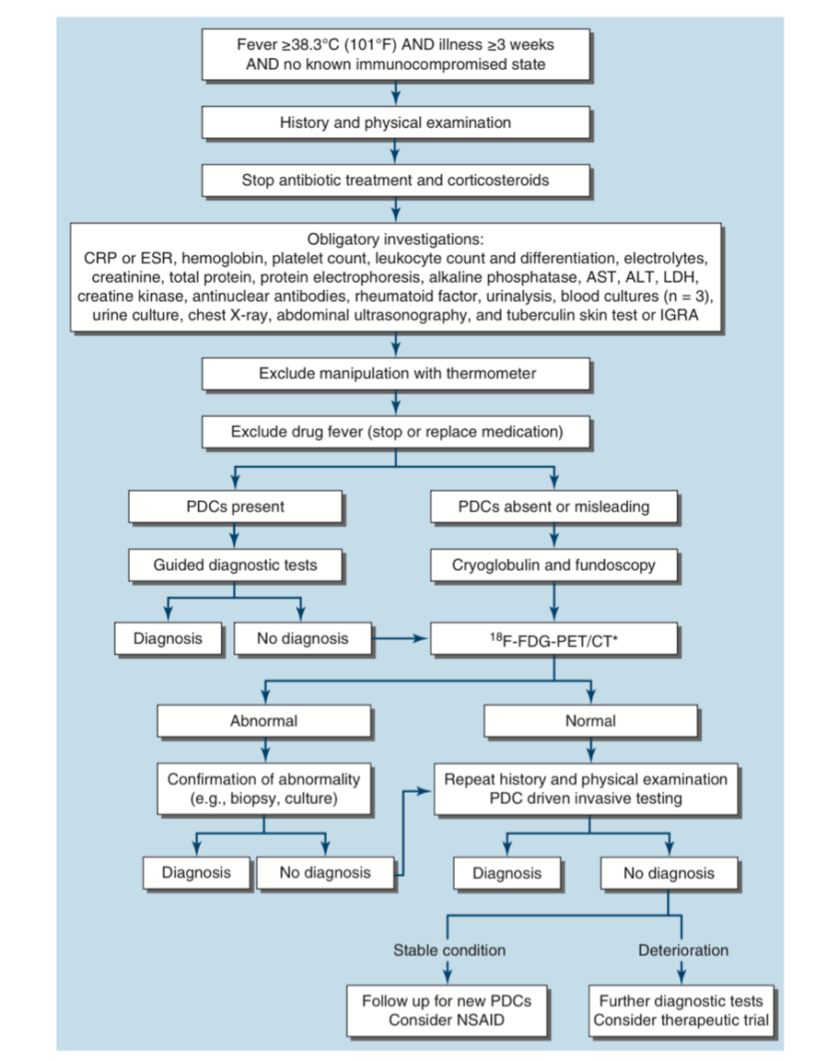
18

Slide 22
19

Slide 23
20

Slide 24
TREATMENT
2

Slide 25
General Principles
              Establish the diagnosis before initiating specific treatment.
              Repeated history and physical examination are often more valuable than indiscriminate investigations.
              Avoid unnecessary empirical therapy, as it may obscure the diagnosis.
              2.Supportive Care Adequate hydration and nutrition. Antipyretics (e.g., paracetamol) for patient comfort.
              Monitor clinical status and organ function.
22

Slide 26
3. Empirical Therapy
Empirical antimicrobial therapy is generally NOT recommended in classical FUO because it can:
Mask the underlying disease.
Reduce the yield of cultures and biopsies.
Delay definitive diagnosis.Exceptions (where empirical therapy may be justified):
              Neutropenic patients with fever.
              Critically ill or septic patients.
              Strong suspicion of tuberculosis when diagnostic confirmation is difficult.
              Suspected giant cell (temporal) arteritis (start corticosteroids promptly to prevent irreversible visual loss).
              Selected immunocompromised patients (e.g., advanced HIV infection).
23

Slide 27
4. Specific Treatment
              Treatment depends on the underlying cause:
              Infections: Appropriate antimicrobial therapy.
              Malignancies: Surgery, chemotherapy, radiotherapy, or targeted therapy.
              Inflammatory/autoimmune diseases: Corticosteroids, immunosuppressants, or biologic agents.
              Drug fever: Discontinue the offending medication.
24

Slide 28
5. Observation
              If the patient is clinically stable and investigations are unrevealing, careful observation with periodic reassessment is appropriate.
              A proportion of patients with FUO remain undiagnosed but experience spontaneous resolution of fever.
25

Slide 29
Questions
2

Slide 30
1. FUO is defined as a core body temperature of:
A. ≥36.5°C
B. ≥37.0°C
C. ≥38.3°C
D. ≥39.5°C
25

Slide 31
2. The classic definition of PUO includes fever lasting:
A. >3 days
B. >1 week
C. >3 weeks
D. >6 weeks
25

Slide 32
3. Empirical antibiotic therapy in stable patients with classical FUO is generally:
A. Recommended immediately in all patients
B. Avoided until a diagnosis is more clearly established
C. Mandatory after 24 hours
D. Always combined with steroids
25

Slide 33
4. Which drug is commonly associated with drug-induced fever?
A. Paracetamol
B. VITAMIN C
C. Phenytoin
D. Metformin
25

Slide 34
5. The most common infectious cause of FUO worldwide is:
A. Tuberculosis
B. Malaria
C. Dengue
D. Influenza
25

Slide 35
6. Which investigation should generally be performed early in the evaluation of FUO?
A. PET-CT for every patient
B. Detailed history and repeated physical examination
C. Bone marrow biopsy for all patients
D. Exploratory laparotomy
25

Slide 36
7. Which malignancy is classically associated with FUO?
A. Basal cell carcinoma
B. Papillary thyroid carcinoma
C. Lipoma
D. Hodgkin lymphoma
25

Slide 37
8. Which imaging modality is particularly useful in localizing occult inflammatory or malignant lesions in FUO?
A. Plain X-ray abdomen
B. Ultrasonography only
C. FDG PET-CT
D. IV urography
25

Slide 38

2

