Slide 1
Management of disease of salivary gland

Slide 2
Salivary gland
Major glands: parotid, submandibular and sublingual.
Parotid: largest gland; mainly serous secretion.
Submandibular: mixed gland, predominantly serous; Wharton’s duct.
Sublingual: mainly mucous; multiple ducts, with possible drainage via Bartholin duct.

Slide 3
Basic anatomy
Parotid duct (Stensen): crosses masseter, turns medially and opens opposite upper second molar.
Submandibular duct (Wharton): runs forward in floor of mouth and opens beside the frenulum.
Sublingual ducts open along the sublingual fold.
Clinical relevance: duct location helps in diagnosis and stone removal.

Slide 4
Classification
Inflammatory: acute and chronic sialadenitis.
Obstructive: sialolithiasis and duct stenosis.
Cystic lesions: ranula and mucoceles.
Autoimmune: Sjögren syndrome.
Neoplasms: benign and malignant tumours.

Slide 5
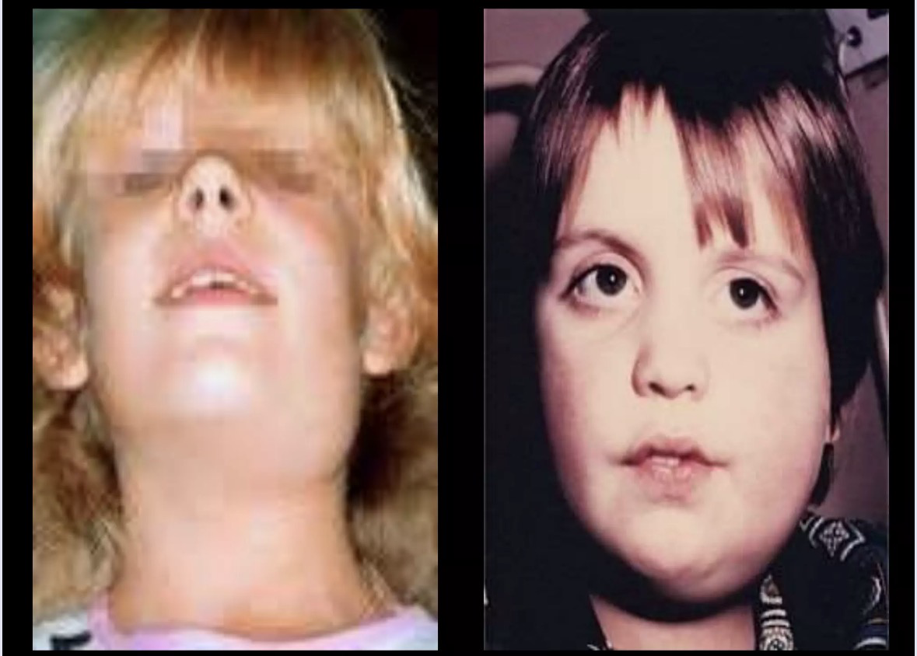
Acute bacterial sialadenitis
Usually presents with painful, tender swelling of a salivary gland.
Fever and purulent discharge from the duct may occur.
Predisposing factors: dehydration, poor oral hygiene, reduced salivary flow and systemic illness.
Parotid is commonly involved.

Slide 6
Management
Hydration and correction of dehydration.
Appropriate antibiotics covering common oral flora.
Analgesics/antipyretics.
Sialogogues and gentle gland massage where appropriate.
Treat the underlying predisposing factor.
Abscess requires drainage.

Slide 7
Chronic sialadenitis
Recurrent painful swelling, often related to meals.
Commonly associated with duct obstruction or stones.
Gland may become firm and fibrotic.
Management: improve salivary flow, hydration, oral hygiene and treat obstruction.
Persistent, severely diseased glands may require surgical excision.

Slide 8
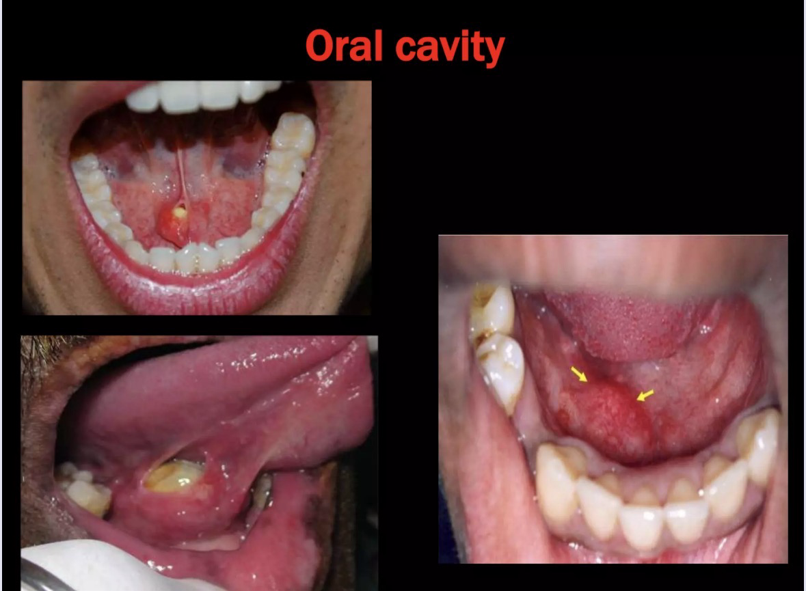
Sialolithiasis
Formation of a calculus within a salivary duct or gland.
Submandibular gland is the commonest site.
Typical symptom: painful swelling during meals ('meal-time syndrome').
Stone may be palpable in the floor of mouth if located in Wharton’s duct.

Slide 9
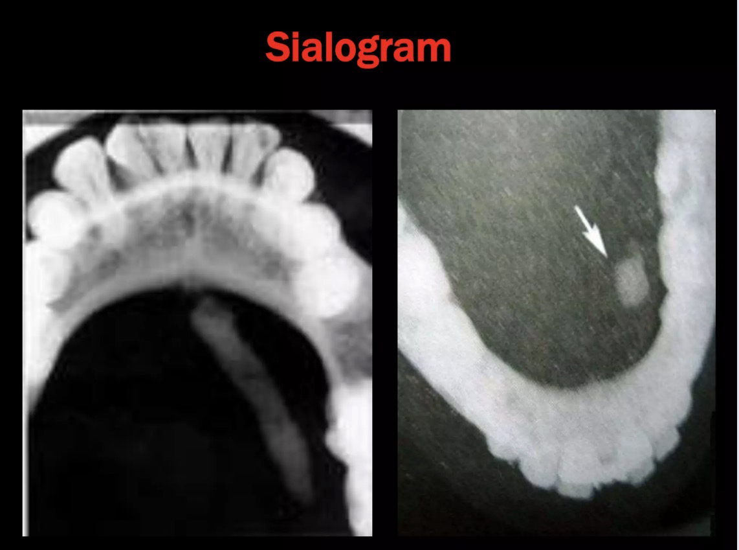
Diagnosis
Clinical examination and bimanual palpation.
Plain radiograph can demonstrate many radiopaque stones.
Ultrasound is useful for gland and duct stones.
CT may be used when the stone is difficult to localize or complications are suspected.
Sialography is generally avoided during acute infection.

Slide 10
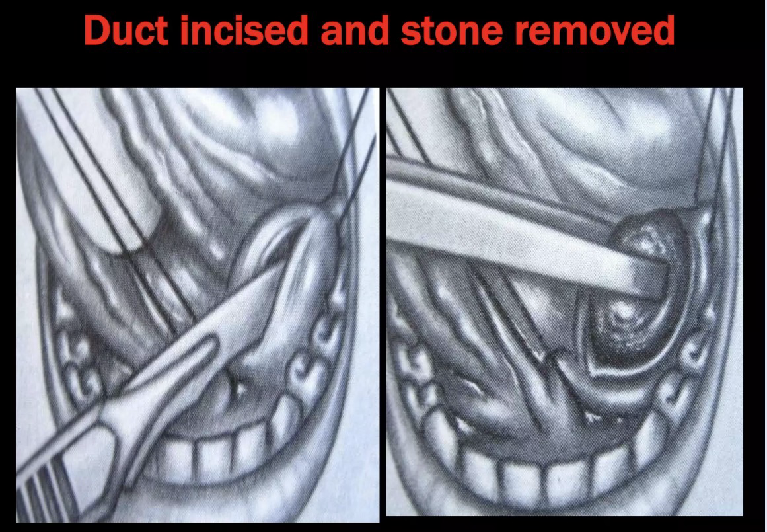
Management
Small distal duct stone: hydration, sialogogues and massage; transoral removal when indicated.
Larger or impacted stones may require endoscopic or surgical removal depending on site and size.
Intraparenchymal stones with a chronically diseased gland may require gland excision.
Treat associated infection when present.

Slide 11
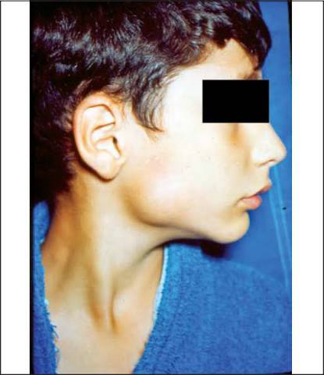
Epidemic parotitis
Viral infection caused by mumps virus.
Usually causes painful swelling of one or both parotid glands.
Management is mainly supportive: fluids, analgesics and soft diet.
Antibiotics have no role unless secondary bacterial infection is present.
Prevention: MMR vaccination.

Slide 12
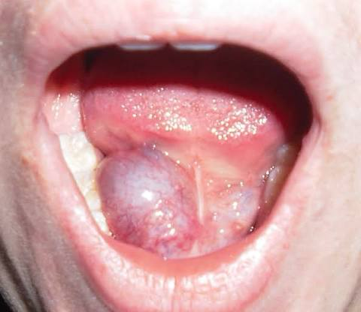
Ranula
Mucous retention/extravasation lesion arising from the sublingual gland.
Usually appears as a bluish, fluctuant swelling in the floor of mouth.
Simple ranula is confined to the floor of mouth.
Plunging ranula extends into the neck through/around the mylohyoid.

Slide 13
Management
Small lesions may occasionally resolve or be managed conservatively.
Definitive treatment for recurrent ranula: excision of the involved sublingual gland with treatment of the ranula.
Simple aspiration alone has a high recurrence rate.
Plunging ranula requires attention to the cervical component and the sublingual source.

Slide 14
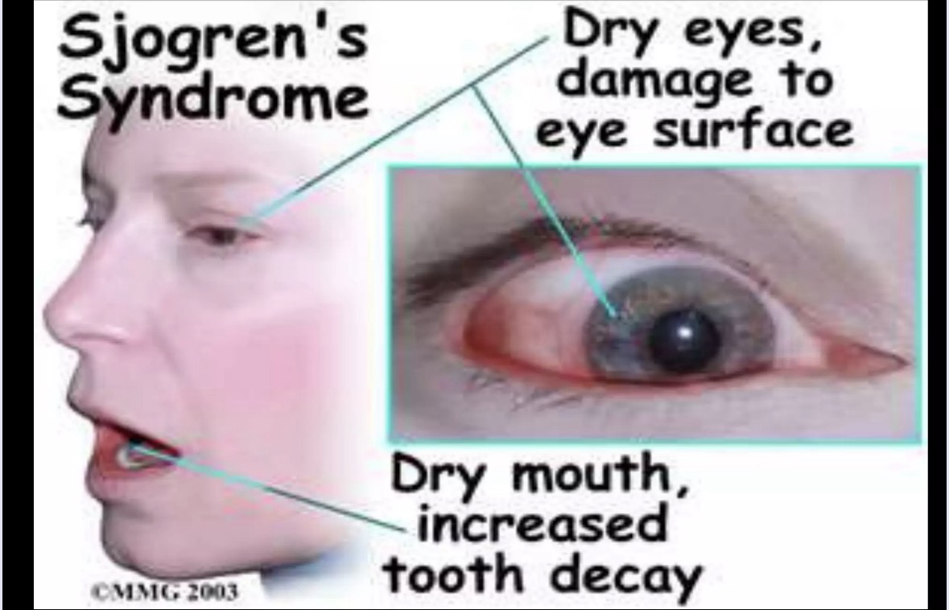
Sjogren Syndrome
Autoimmune disorder affecting exocrine glands.
Main features: xerostomia and dry eyes (keratoconjunctivitis sicca).
Parotid enlargement may occur.
Patients have increased risk of lymphoproliferative disease, particularly lymphoma.

Slide 15
Management
Symptomatic treatment of dry mouth: frequent water intake and saliva substitutes.
Sialogogues may help when residual gland function is present.
Good dental hygiene and regular dental review.
Artificial tears and ophthalmic management for dry eyes.
Systemic disease requires specialist/medical management.

Slide 16
Salivary gland tumor
Most salivary gland tumours occur in the parotid.
Most parotid tumours are benign.
Common benign tumour: pleomorphic adenoma.
Common malignant tumours include mucoepidermoid carcinoma and adenoid cystic carcinoma.

Slide 17
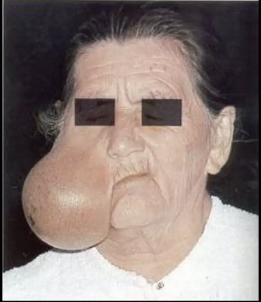
Pleomorphic adenoma
Most common benign salivary gland tumour.
Most commonly arises in the parotid gland.
Usually presents as a slow-growing, painless, firm swelling.
Facial nerve function is usually normal in benign disease.

Slide 18
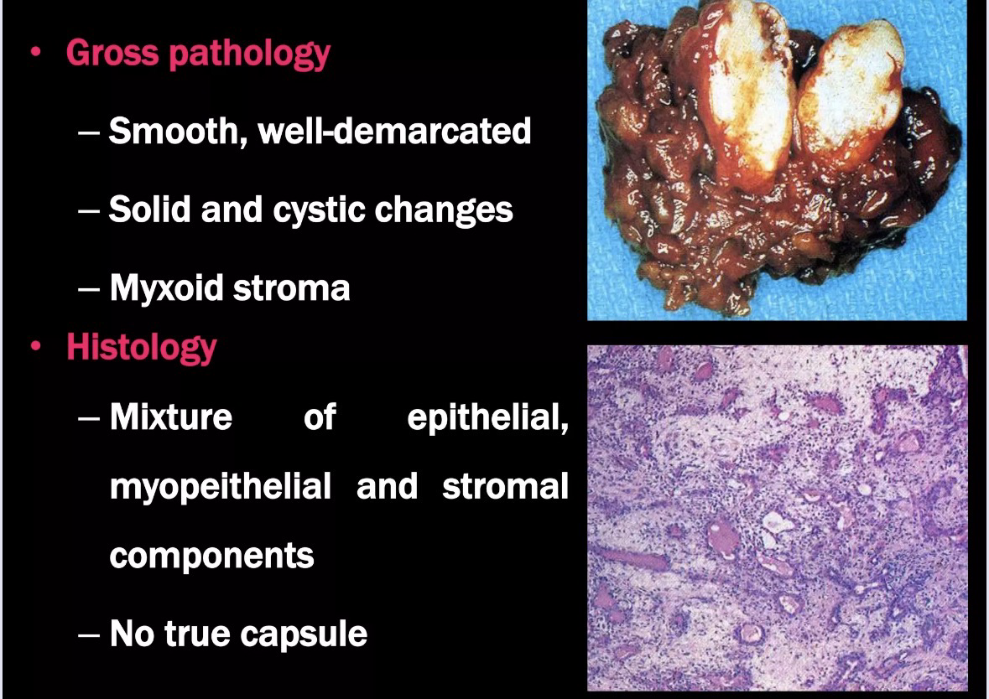

Slide 19
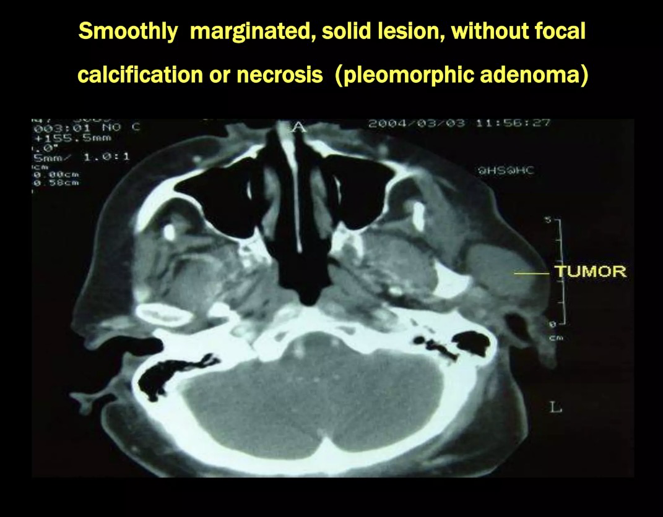

Slide 20
Management
Surgical excision is the treatment of choice.
Parotid lesions require an appropriate form of parotidectomy with facial nerve preservation when not involved.
Simple enucleation is avoided because of tumour extensions and risk of recurrence.
Long-standing lesions have a risk of malignant transformation.

Slide 21
Warthin tumor
Benign tumour occurring predominantly in the parotid gland.
Often occurs in older adults and may be associated with smoking.
May be multifocal or bilateral.
Management is individualized: observation or appropriate surgical excision depending on diagnosis, symptoms and clinical setting.

Slide 22
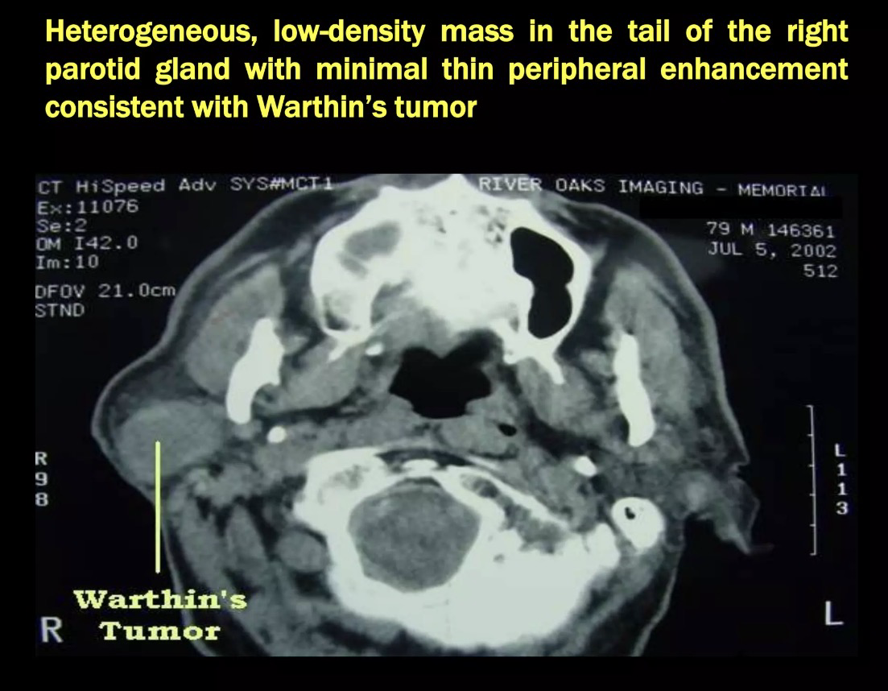

Slide 23
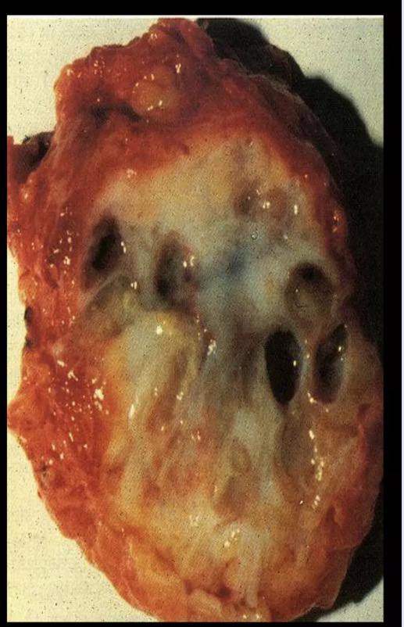
Mucoepidermoid carcinoma
Most Common salivary gland malignancy
3-8 decade , peak in 5th decade
Female more than male
Well circumscribed to partially encapsulated to uncapsulated
Investigation- CT and MRI
FNAC

Slide 24
Management
Stage1 and 2 – Wide Local Excision
Stage 3 and 4 – Radical Excision
neck dissection
Postoperative radiotherapy

Slide 25
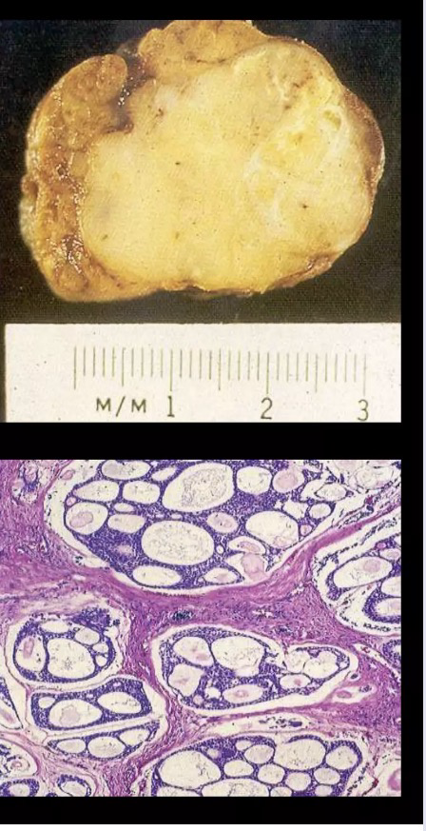
Adenoid Cystic carcinoma
2nd most common malignancy
Pain, paresthesis, facial weakness
Well circumscribed
Cribriform pattern- ‘swiss cheese ‘ appearance
Treatment- Complete Local Excision

Slide 26
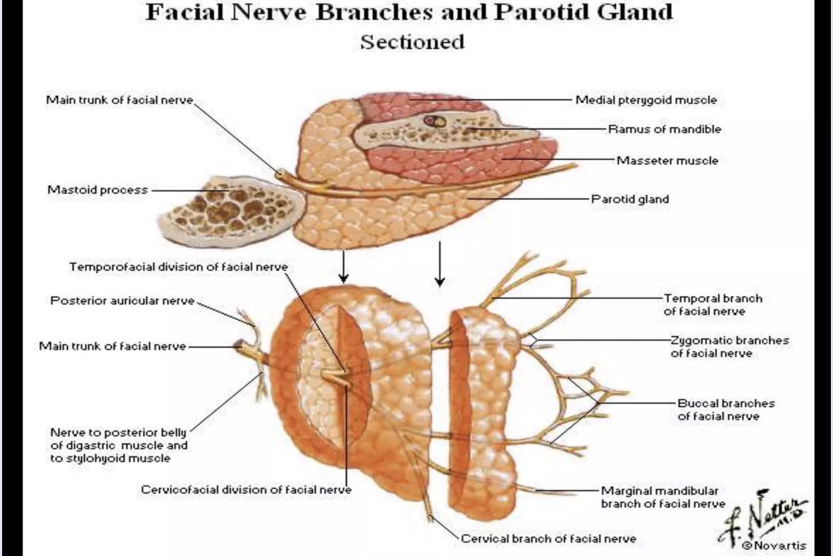
Facial nerve

Slide 27
Q1. The treatment of choice for a small stone located near the opening of Wharton’s duct is:
A. Parotidectomy
B. Transoral removal of the stone
C. Radiotherapy
D. Chemotherapy
Ans. Transoral removal of stone

Slide 28
Q2. The definitive treatment for recurrent chronic submandibular sialadenitis with an affected gland is:
A. Submandibular gland excision
B. Tonsillectomy
C. Parotidectomy
D. Radiotherapy
Ans. Submandibular Gland excision

Slide 29
Q3. The treatment of choice for pleomorphic adenoma of the parotid gland is:
A. Simple enucleation
B. Radiotherapy alone
C. Appropriate parotidectomy
D. Antibiotics
Ans. Appropriate parotidectomy

Slide 30
Q4 The treatment of a benign tumour of the superficial lobe of the parotid gland is commonly:
A. Superficial parotidectomy
B. Total laryngectomy
C. Submandibular gland excision
D. Radiotherapy
Ans Superficial Parotidectony

Slide 31
Q5. During parotidectomy, the nerve that must be carefully identified and preserved is:
A. Trigeminal nerve
B. Facial nerve
C. Vagus nerve
D. Hypoglossal nerve
Ans. Facial Nerve

Slide 32
Q6. The treatment of a ranula is:
A. Antibiotics alone
B. Excision of the sublingual gland
C. Parotidectomy
D. Radiotherapy
Ans. Excision of sublingual gland

Slide 33
Q7. A malignant tumour of the parotid gland with involvement of the facial nerve generally requires:
A. Observation only
B. Enucleation
C. Removal of the involved facial nerve with appropriate tumour surgery
D. Antibiotic treatment
Ans Removal of involved facial nerve with appropriate tumor surgery

Slide 34
Q8. The most important principle during surgery for a parotid malignancy is:
A. Always sacrifice the facial nerve
B. Preserve the facial nerve if it is not involved by tumour
C. Avoid lymph node dissection
D. Perform enucleation
Ans. Preserve the facial nerve if its not involved by tumor

Slide 35
Q9. The preferred surgical treatment for a Warthin tumour of the parotid is generally:
A. Enucleation only in every case
B. Appropriate parotidectomy/local excision depending on site and extent
C. Total laryngectomy
D. Radiotherapy in all cases
Ans. Appropriate parotidectomy/local excision depending on aite and extent

Slide 36
Q10. The treatment of choice for acute bacterial parotitis is:
A. Radiotherapy
B. Antibiotics with hydration and sialogogues
C. Superficial parotidectomy
D. Steroids alone
Ans. Antibiotics with hydration and sialogogues

