Slide 1

OPHTHALMIC EMERGENCIES
PRESENTED BY-
DEPARTMENT OF OPHTHALMOLOGY

Slide 2
INTRODUCTION
An ocular emergency is a condition that can cause a sudden loss of or decrease in a person’s vision.
Emergencies in ophthalmology can be of various kinds, ranging from trauma cases to acute eye inflammations.
Early and appropriate management can reduce morbidity and complications.

Slide 3
Ocular emergencies can be divided into:
True Emergencies
Urgent Emergencies
Semi-Urgent Emergencies

Slide 4
I. True Emergencies
(Therapy should be instituted within minutes)
Chemical burns of the cornea and eye
Central Retinal Artery Occlusion (CRAO)
Ophthalmic Artery Occlusion

Slide 5
II. Urgent Emergencies
(Therapy should be instituted within hours)
Penetrating or perforating globe injury / open globe injury
2. Endophthalmitis
3. Acute angle-closure glaucoma
4. Pupillary block glaucoma
5. Orbital cellulitis
6. Cavernous sinus thrombosis
7. Corneal ulcer
8. Corneal foreign body
9. Corneal abrasion
10. Acute iridocyclitis with synechiae formation
11. Acute retinal tear or haemorrhage
12. Acute retinal detachment
13. Descemetocoele
14. Hyphema and raised intraocular pressure
15. Lid lacerations or trauma to the surrounding orbit, brow, or glabella
Note: Vision should be checked periodically — every 4 hours or as required.

Slide 6
III. Semi-Urgent Emergencies
(Therapy within days)
Optic neuritis
Ocular tumors
Acute episcleritis
Blow-out fractures of orbit

Slide 7
Objectives
Understand evaluation protocols
Learn stabilisation techniques
Recognize indications for referral
Identify management steps

Slide 8
OCULAR EMERGENCIES
BLUNT TRAUMA
PENETRATING TRAUMA
NON TRAUMA
RED EYE
WHITE EYE
CRAO
RETINAL DETACHMENT
ACUTE ANGLE CLOSURE GLAUCOMA
ENDOPHTHALMITIS
ORBITAL CELLULITIS
TRAUMA

Slide 9
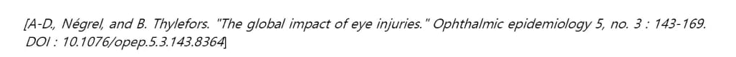
Why do we care ?
common problem - in primary care ,emergency medicine
account for - 6–9% (all ophthalmology-related litigation)
Male: female =5:1
55M – restricting activities
7,50,000 – hospitalisation
2,00,000 –open globe injuries
~1.6 M – blind
2.3M -B/L low vision
19 M –U/L blindness or low vision

Slide 10
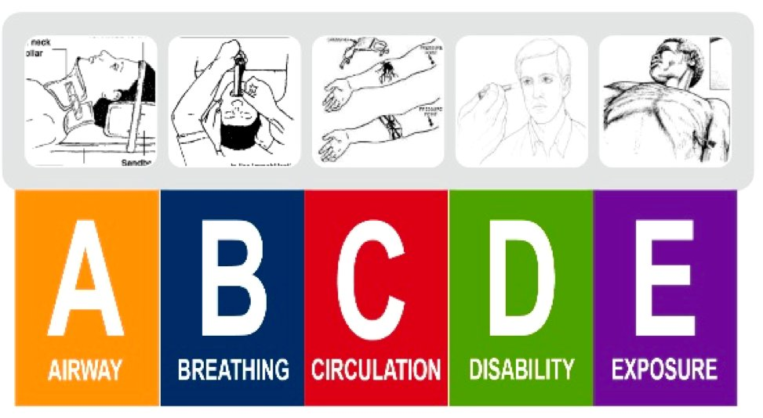
"ABCs" before any history or exam!

Slide 11
Ocular trauma

Slide 12
Important Precautions / AVOID
No anaesthetic agent until diagnosis is confirmed (especially in suspected globe injury).
Avoid ointments, eye drops, or any instillation before confirming diagnosis, especially in trauma.
Avoid use of atropine or cycloplegics until necessary.
No steroids unless specifically indicated.

Slide 13
Trauma Evaluation
1. History – Nature of injury, causative agent, clean/dirty wound.
2. Visual acuity – Record baseline.
3. Open globe / closed globe – No pressure on suspected open globe.
4. Eyelid injuries – Lid margins, globe integrity, depth, posterior extension
5. Foreign body (FB) – Remove superficial FB carefully.
6. Examine lens – Before opacity develops.
7. Don’t remove protective shields if globe injury is suspected.
8. If intraocular foreign body (IOFB) suspected → Tetanus prophylaxis, systemic antibiotics.
9. Palpate orbital rim – Suspect fractures and orbital emphysema.

Slide 14
10. Auscultate orbit – Bruit in orbital vascular malformation.
11. Record pupillary reaction – RAPD, size, shape.
12. Eye exam under magnification – SLE, cornea, anterior chamber.
13. Measure IOP only if no suspicion of open globe.
14. Imaging: X-ray or CT scan for IOFB
MRI only if no metallic FB suspected
15. Initiate broad-spectrum antibiotics, antifungal and analgesics.
16. Culture FB if removed during emergency.
17. Photograph patient – If facilities available, for documentation (especially if legal or surgical

Slide 15
CHEMICAL BURN
Chemical exposures and burns are usually caused by a splash of liquid but can also be caused by transferring a chemical from hands to eyes by rubbing or by being sprayed by aerosols.
Treatment should be instituted IMMEDIATELY, even before testing vision, unless an open globe is suspected.
This includes alkali, acids, solvents, detergents, and irritants . Alkalis cause more damage as they cause saponification and can penetrate deeper.

Slide 16
Types of chemical
ALKALI
ACID
IRRITANT
Most dangerous Rapid penetration
less severe than alkali ,
do not penetrate as readily
Neutral pH
more discomfort

Slide 17
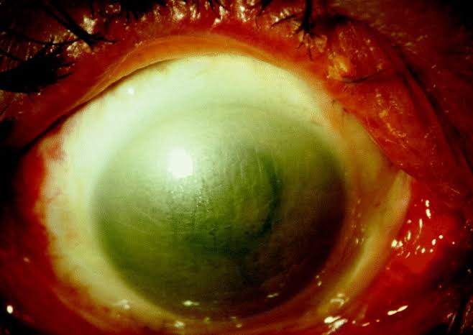
The severity of chemical Injury depends on :
Properties of the chemical
Concentration and volume
Area of affected ocular surface
Duration of exposure
Related effect - thermal damage.

Slide 18
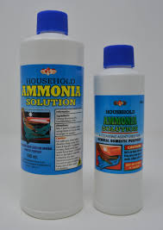
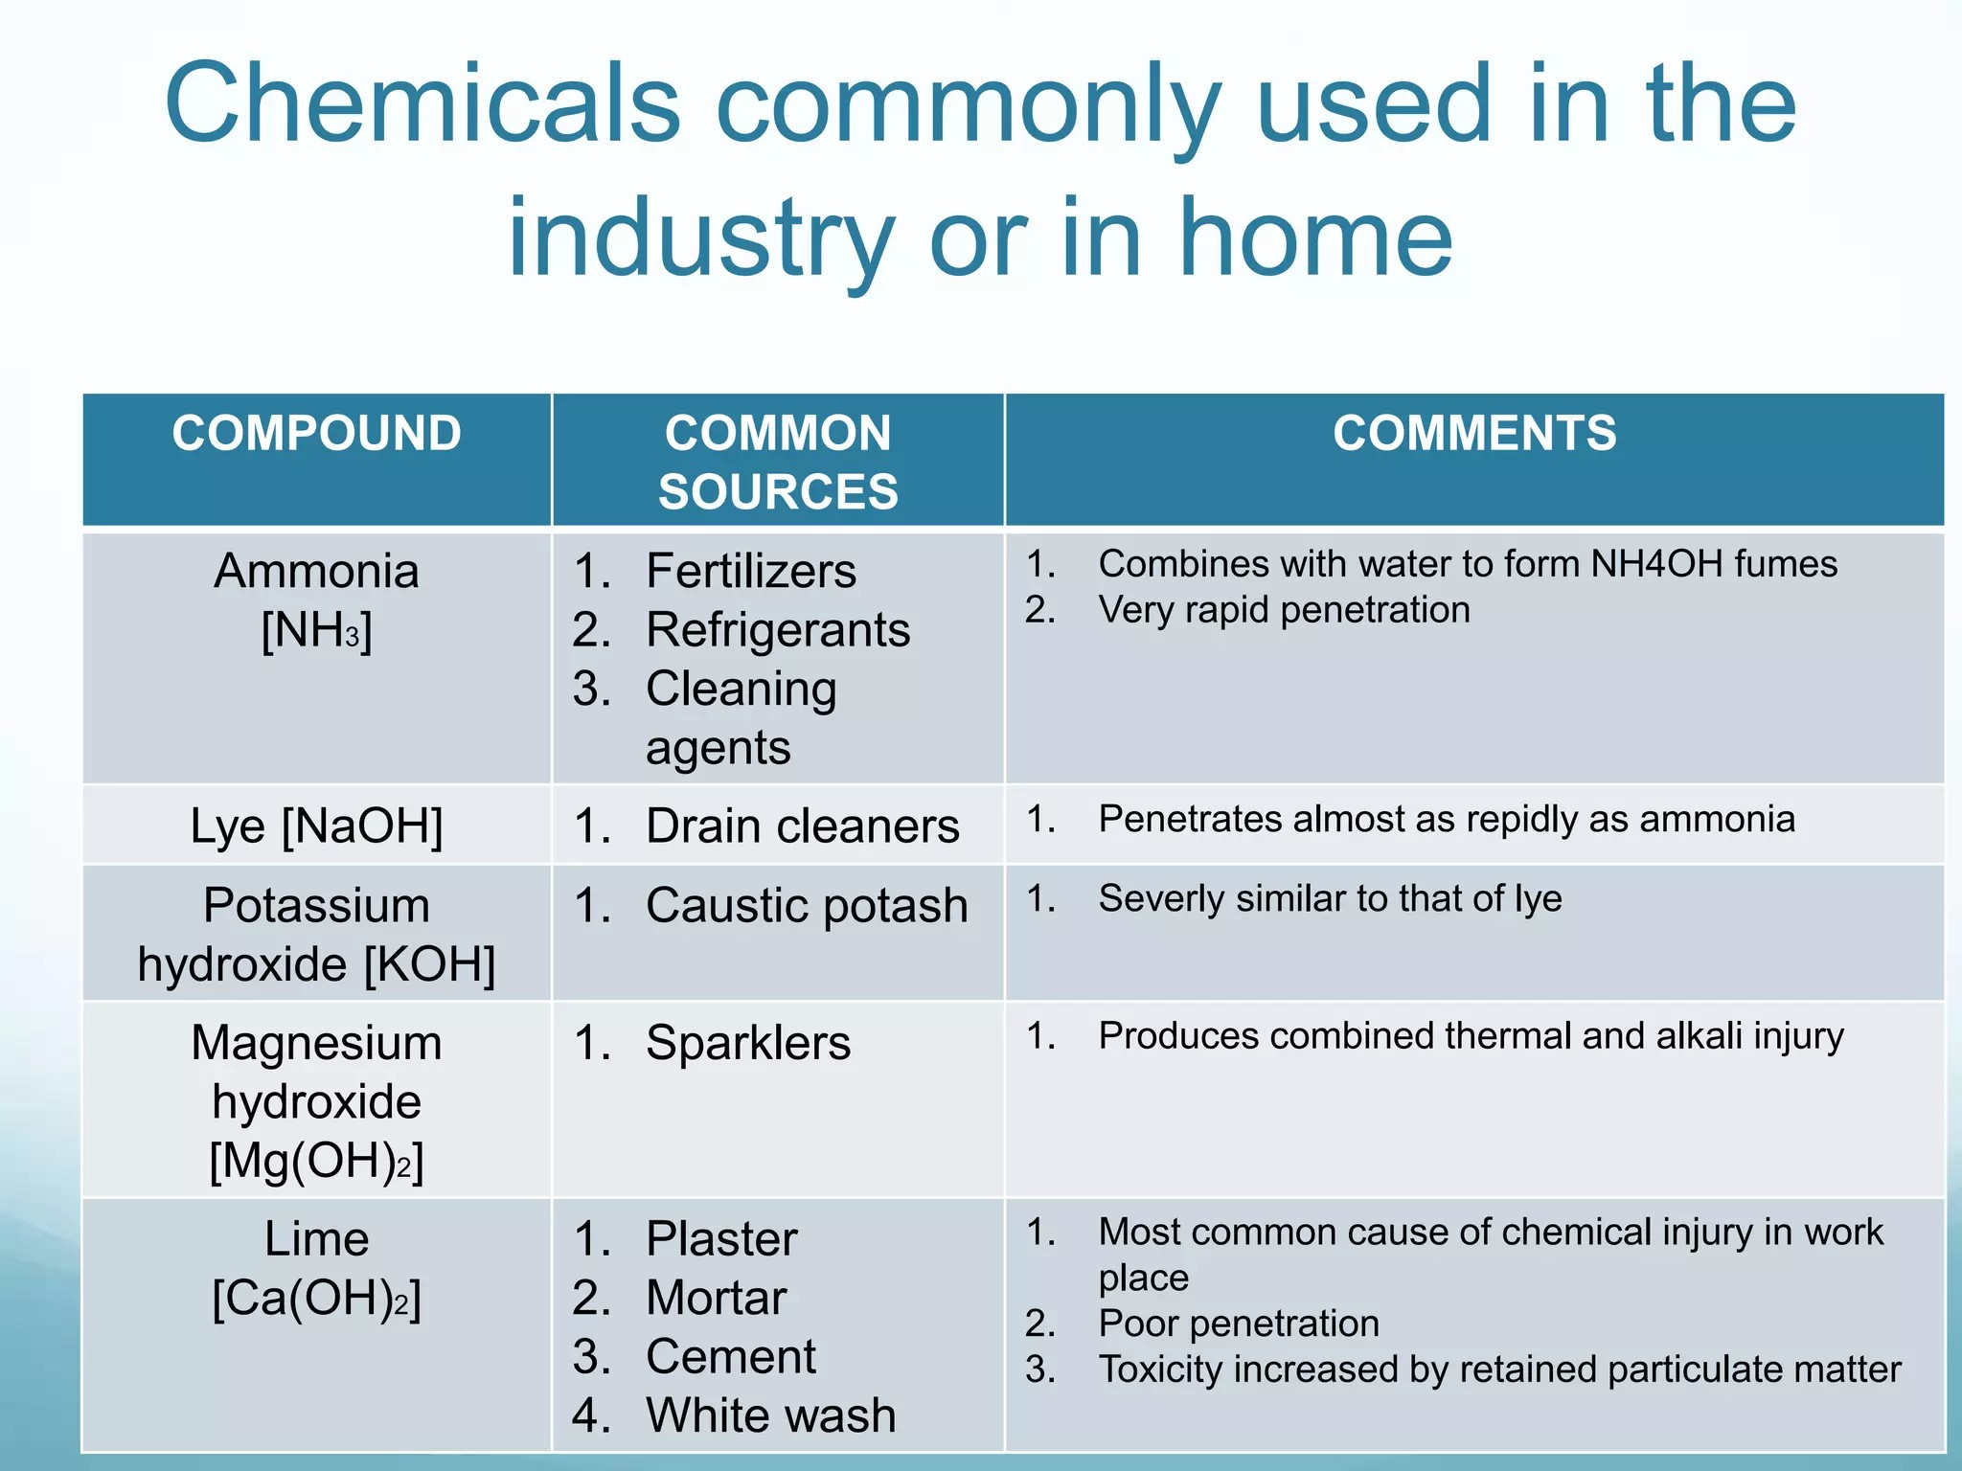
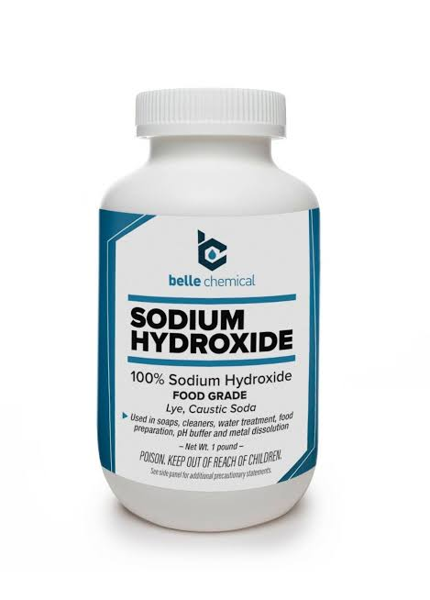

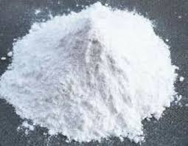
ALKALI

Slide 19

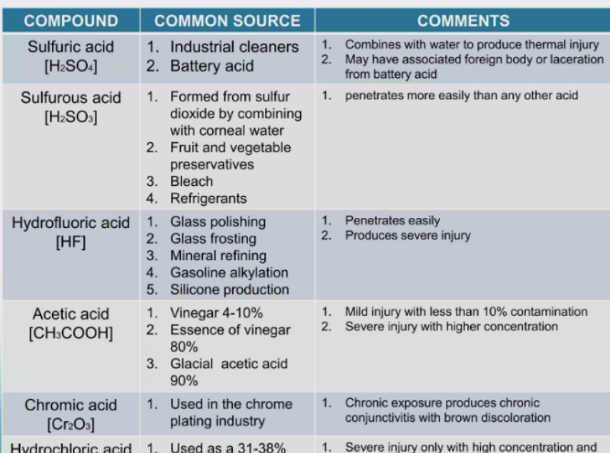
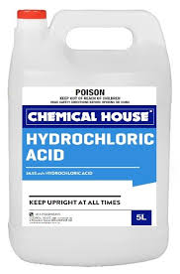
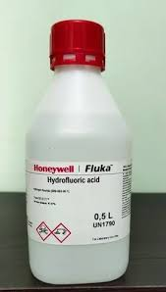
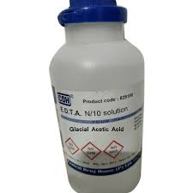
ACID

Slide 20
Pathophysiology of chemical injury

Slide 21
Alkali
Alkali substance dissociate into a hydroxyl ion and cation in the ocular surface .e.g - NaOH =Na+. + OH -.
At high pH,Hydroxyl ion saponify cell membrane fatty acids and intercellular bridges --> facilitation of penetration of the alkali through cornea and into Anterior segment . It also causes a shift of hydrogen ions - -> cell death.
Hydration of GAGs → loss of clarity of stroma

Slide 22
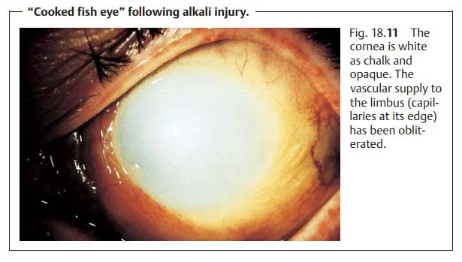
Intraocular structure involvement depends upon →Degree of Penetration and pH aqueous solution
pH >11.5 →severe Ocular damage

Slide 23
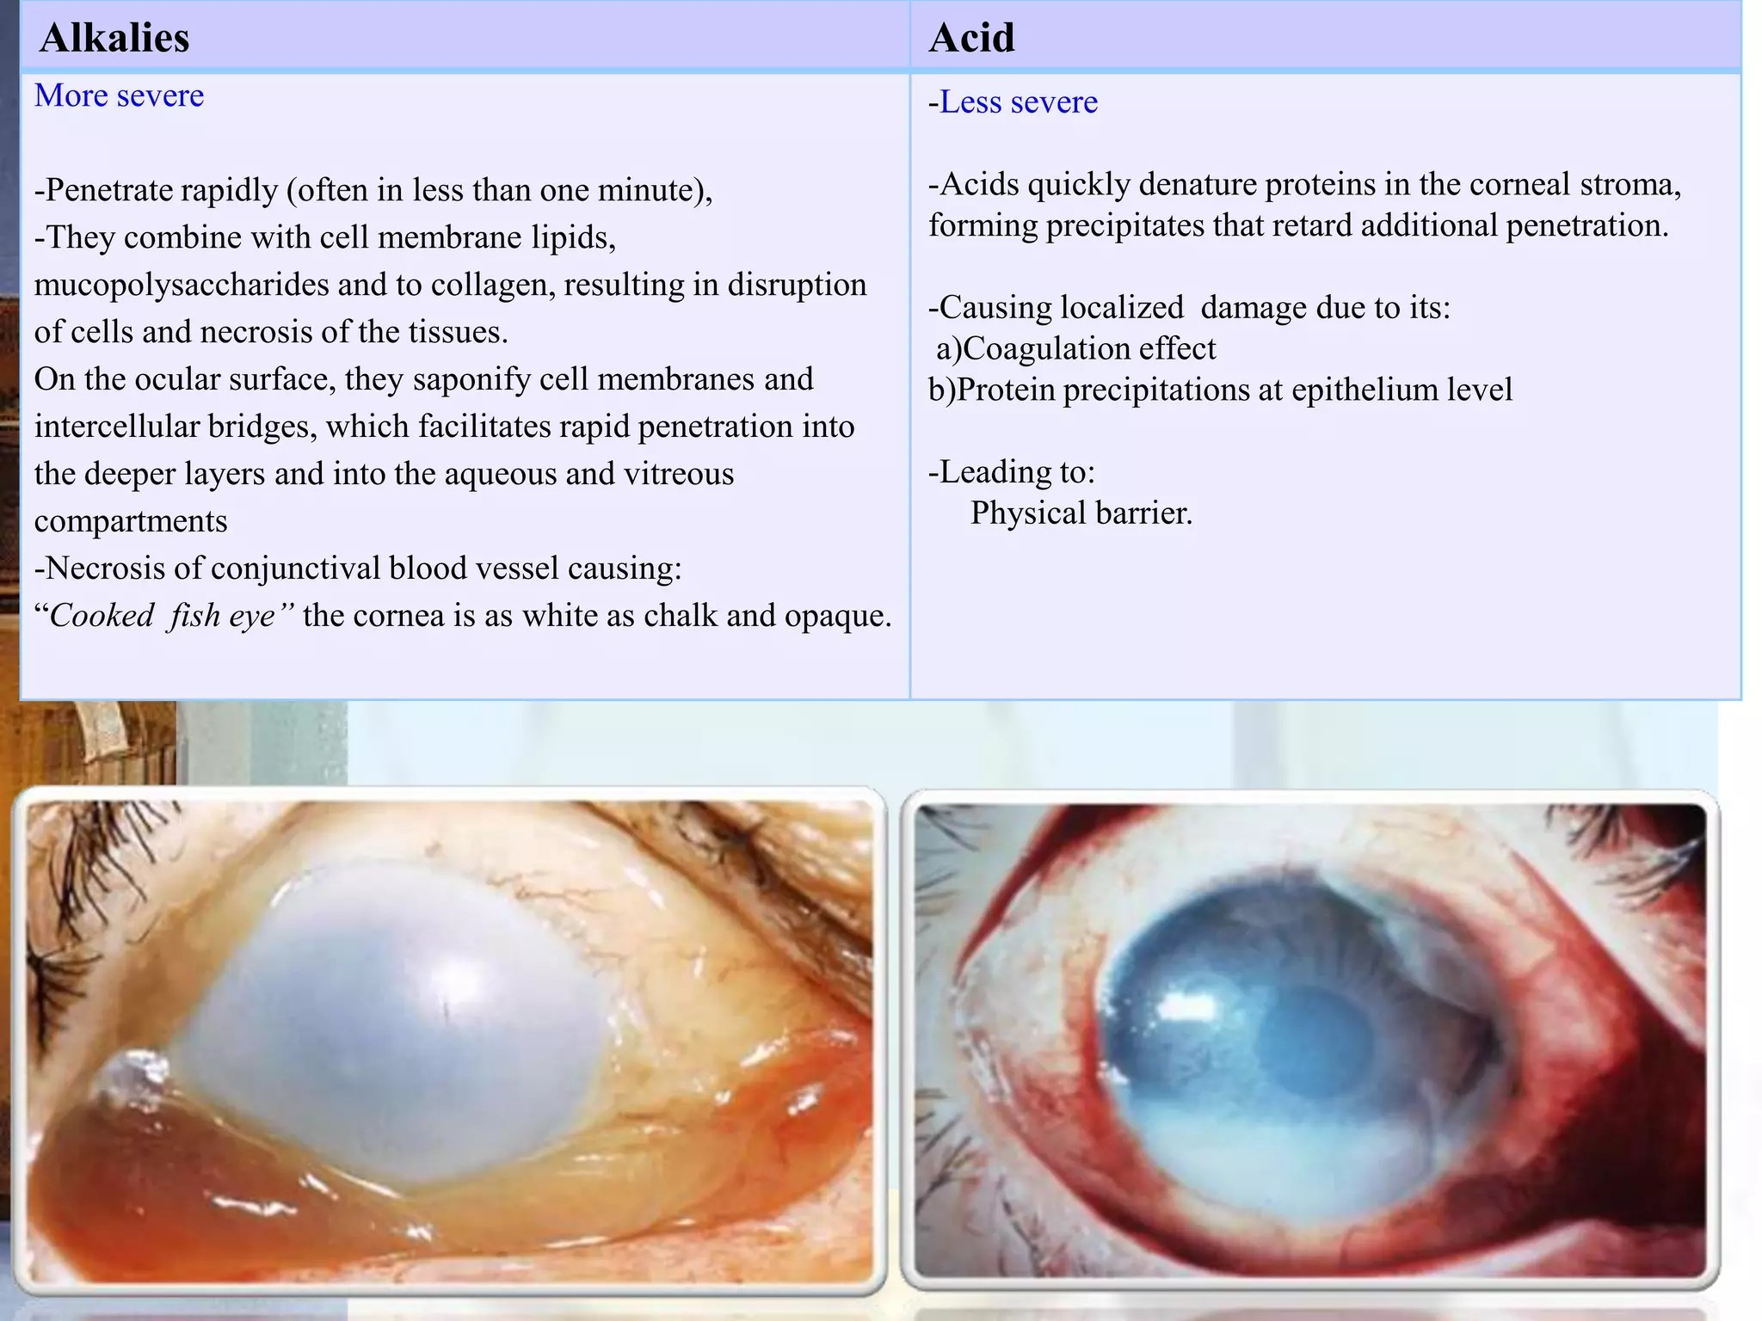
ACID injury
They usually cause minor injuries
and heal with little or no damage
Acid dissociate into hydrogen ions
and anion in the cornea . e.g. HCl = H+ + Cl -
H+ molecules damage the ocular surface by altering the pH while the anion causes protien denaturation , precipitation,and coagulation of corneal stroma → ground glass appearance of epithelium
Protien coagulation prevent deeper penetration of acids (for weak acid )
Strong acids → may continue to penetrate deeply ,alter tissue similar to alkali.

Slide 24
-Pain
-Rednes
-Watering
- Decrease vision
-Foreign body sensation
Invasion of the corneal surface by conjuctiva and vascular tissue
Pathophysiology
NECROSIS OF CONJUNCTIVAL/CORNEAL EPITHELIUM With DISRUPTION AND OCCLUSION OF LIMBAL VASCULATURE
Persistent corneal epithelial defects with sterile corneal ulceration and perforation
Breakdown and precipitation of glycosaminoglycan
Stromal corneal opacification
Anterior chamber penetration
Iris & lens damage
Impaired collagen production & stromal repair
Decrease ascorbate secretion
Ciliary epithelial damage

Slide 25
Symptoms- redness, watering, light sensitivity, pain, decreased vision.
Signs- corneal haze, congestion or blanching at limbus, raised intraocular pressure
Emergency Treatment:
Copious irrigation using saline or Ringer lactate solution for at least 30 minutes.
Tap water can be used in the absence of these solutions.
An eyelid speculum and topical anesthesia can be placed prior to irrigation.
Upper and lower fornices must be everted and irrigated.

Slide 26
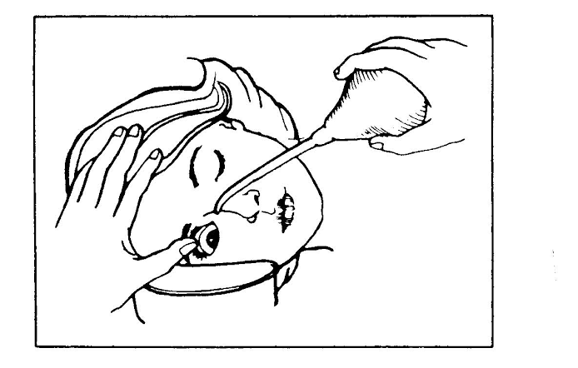
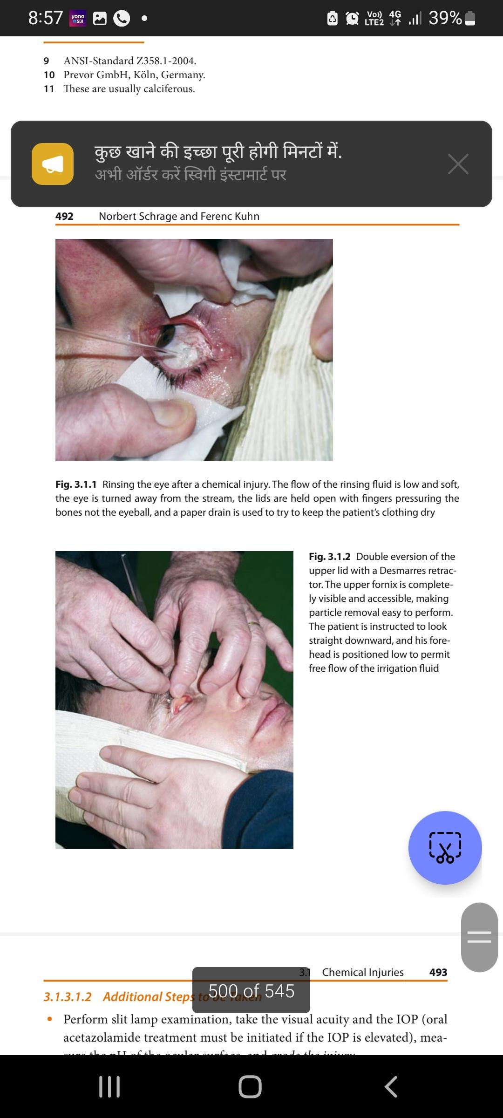
Irrigation
cornerstone of managing chemical burns
Immediate ocular irrigation is necessary prior to taking history or completing the rest of Ocular examination.
can be initiated by bystanders
Early irrigation play critical role in limiting the duration of exposure.
goal –to remove the offending substance and restore the physiologic pH

Slide 27
Explain to the patient what will take place
Use anesthetics if necessary
Position –ideally be seated upright with their
head supported and tilted toward the affected
Side. Eye is turned away from stream
  Carefully seperate the lids – held open with
  fingers pressuring the bones not the eyeball,
  manual opening of the eyelid to combat blepharospasm.
During irrigation, –asked to blink frequently ,to look in all directions – to ensure that the conjunctival sacs are irrigated.
administered nasal to lateral,
  poured away from the non-affected eye– to prevent injury to that eye.
The flow of the rinsing fluid is low and soft,
  infusion bottle should be 3 -8 cm above eye level
Covering the noninjured eye with a shield , may help prevent additional chemical injury.

Slide 28
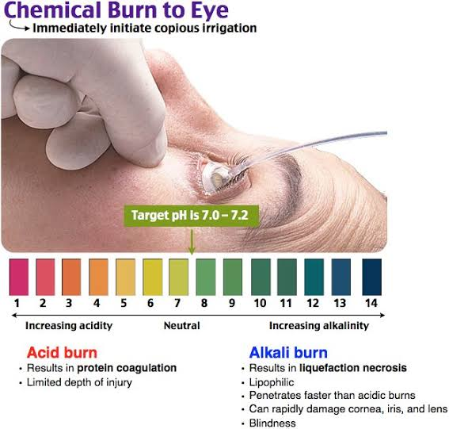
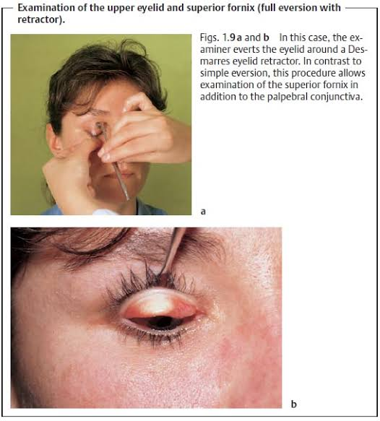
Done for a minimum of 30 minutes using 1-3 L of
Fluid or continued until a physiological pH is reached.
PH ,monitored using pH paper ,
  measured at least 5 minutes after stopping
  irrigation.
Double eversion of the upper lid - Desmarres retractor
  upper fornix is completely visible and accessible
  making particle removal easy to perform.
  instruct patient to look straight downward,
  forehead is positioned low to permit free flow of
  irrigation fluid
over irrigation can result in corneal edema.

Slide 29
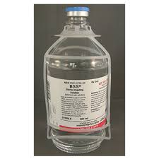
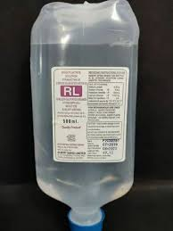
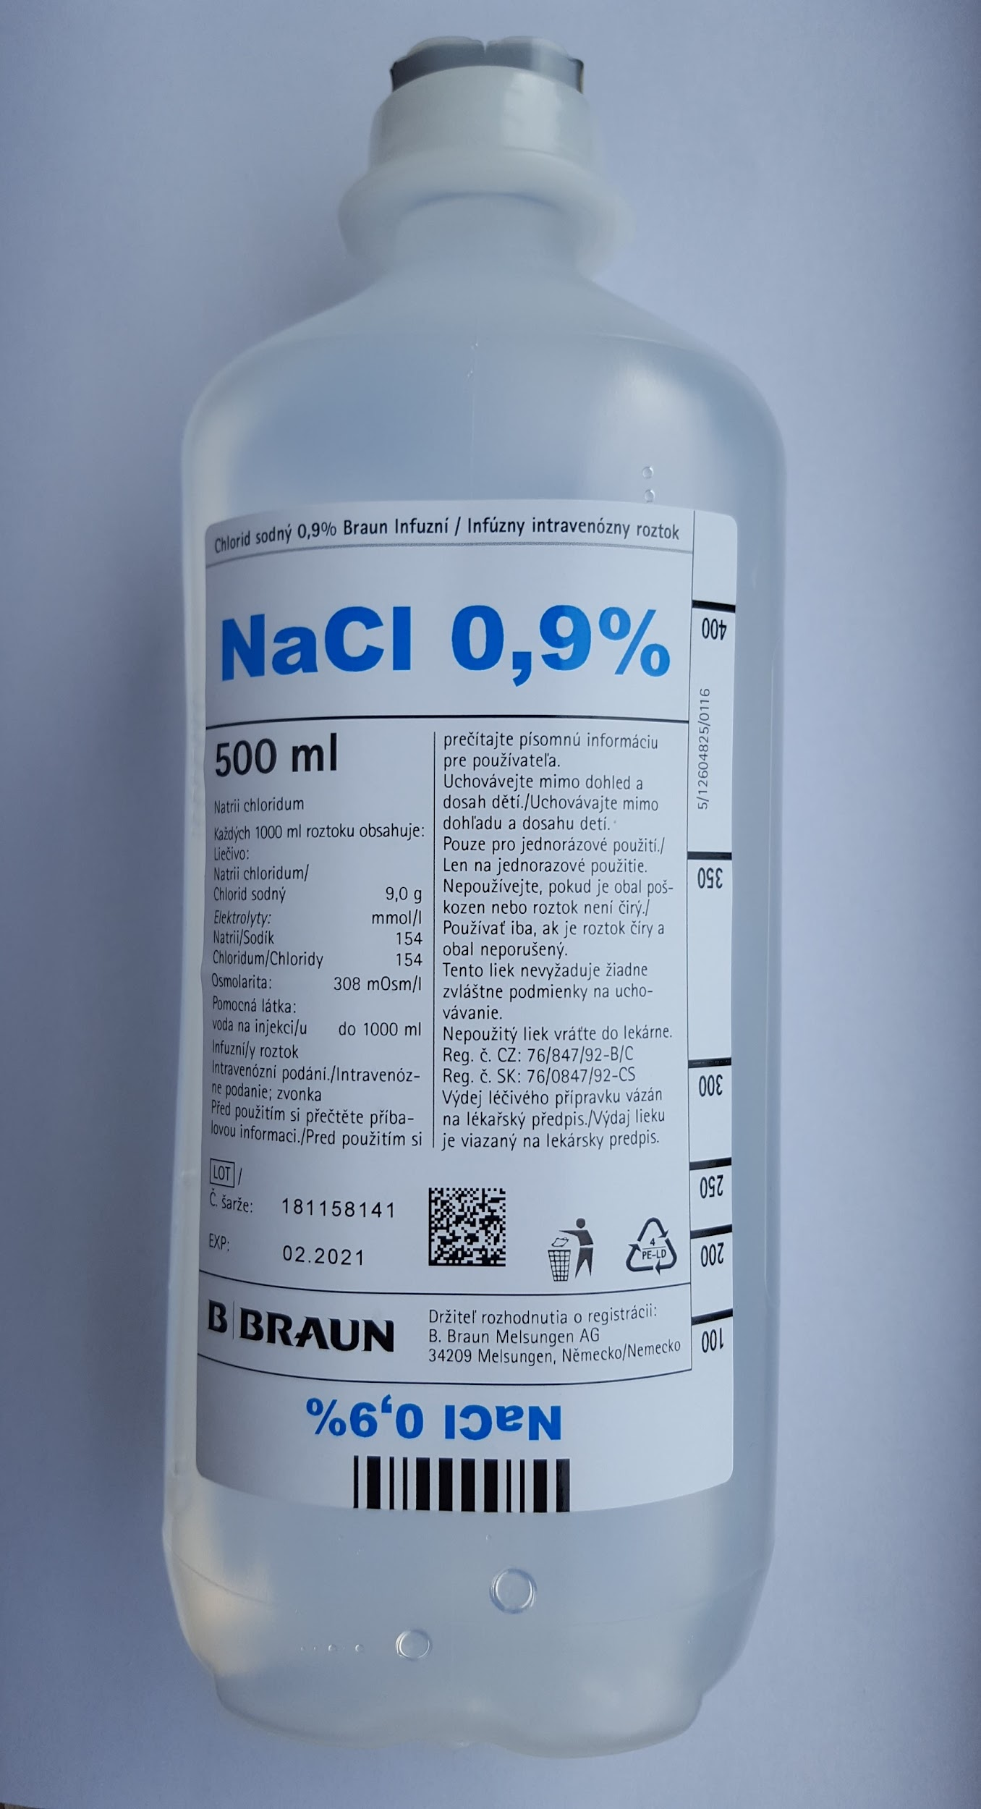

Types of Irrigating fluid
BSS
isotonic
RL
Isotonic
NS
Isotonic
widely available, not sterile , hypotonic

Slide 30
Conjunctival fornices should be swept with a moistened cotton-tipped applicator or glass rod to remove any sequestered particles of caustic material and necrotic conjunctiva.
Manual use of intravenous tubing connected to an irrigation solution facilitates the irrigation process.
Topical steroid for the first 7-10 days – to reduce inflammation.
Topical and systemic tetracycline to inhibit collagenase and neutrophil activity.

Slide 31
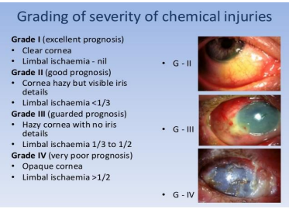
ROPER-HALL GRADING SYSTEM

Slide 32
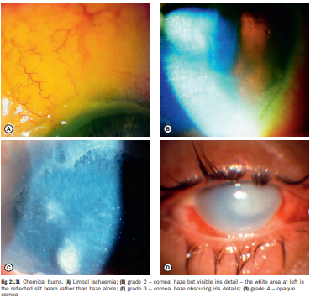

Slide 33
BETTS Classification
EYE INJURY
CLOSED GLOBE
CONTUSION
LAMELLAR LACERATION
OPEN GLOBE
RUPTURE BLUNT TRAUMA
LACERATION
PENETRATING INJURY
IOFB
PERFORATING

Slide 34
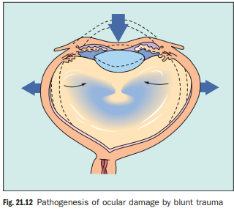
Blunt trauma
The most common causes of blunt trauma are squash balls, elastic luggage straps and champagne corks.
Severe blunt trauma to the globe results in anteroposterior compression with simultaneous expansion in the equatorial plane associated with a transient but severe increase in IOP.

Slide 35
Although the impact is primarily absorbed by the lens–iris diaphragm and the vitreous base, damage can also occur at a distant site such as the posterior pole.
The extent of ocular damage depends on the severity of trauma and tends largely to be concentrated to either the anterior or posterior segment.
Apart from obvious ocular damage, blunt trauma commonly results in more obscure long-term effects; the prognosis is therefore necessarily guarded

Slide 36
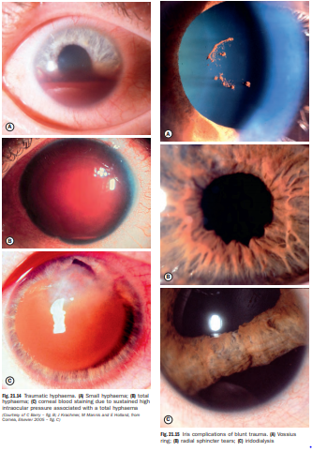

Slide 37
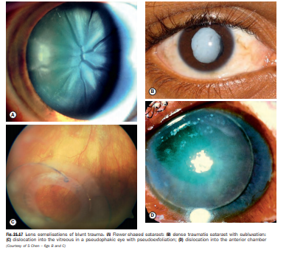

Slide 38
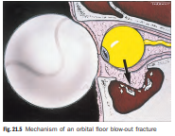
ORBITAL BLOW-OUT FRACTURE
Symptoms:
Pain on attempted eye movement (orbital floor fracture: pain on vertical eye movement: medial wall fracture: pain on abduction/adduction)
local tenderness, eyelid edema
binocular diplopia
crepitus after nose blowing
Acute tearing is usually due to ocular surface irritations (e.g., conjunctival chemosis, corneal abrasion, iritis).

Slide 39
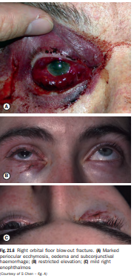
Signs:
Critical-
Restricted eye movements
(especially in upward or lateral gaze or both)
subcutaneous or conjunctival emphysema
hyposthesia in the distribution of the infraorbital
nerve (i.e., ipsilateral check and upper lip)
Enophthalmos
(may initially be masked by orbital edema)

Slide 40
Measure IOP. Check pupils and color vision to rule out a traumatic neuropathy.
Other-
Nosebleed, eyelid edema, and ecchymosis.
Superior rim and orbital roof fractures may show hypesthesia in the distribution of the supratrochlear or supraorbital nerve (ipsilateral forehead) and ptosis.
Trismus, malar flattening, and a palpable step-off deformity of the inferior orbital rim are characteristic of tripod (zygomatic complex) fracture.
Optic neuropathy may be present

Slide 41
Workup-
Complete ophthalmologic examination, including measurement of extra ocular movements and globe displacement.
Compare the sensation of the affected cheek with that on the contralateral side.
Palpate the orbital rim for step-offs.
Evaluate the globe carefully for a rupture, hyphema or microhyphaema, traumatic iritis, and retinal or choroidal damage.

Slide 42
Forced-duction test is performed if restriction of eye movement persists beyond one week
X-ray of the orbits.
CT orbit scans are to be obtained in all cases of suspected orbital fractures.
Treatment
Broad spectrum oral antibiotics [e.g., cephalexin (250 to 500 mg PO, q.i.d.; or ciprofloxacin 500 mg PO, q.i.d) for 7 days.
Instruct patient not to blow nose.
Nasal decongestant for 3 days.

Slide 43
Apply ice packs in first 24 to 48 hours.
Consider oral steroids if extensive swelling limits examination of ocular motility and globe position.
If corticosteroids are used, systemic antibiotics should also be considered.
Neurosurgical consultation is recommended for all fractures involving the orbital roof, frontal sinus, or cribriform plate and for all fractures associated with intra cranial hemorrhage.
Otolaryngology or oral maxillofacial surgery consultation is recommended for frontal sinus, midfacial, and mandibular fractures.

Slide 44
RUPTURED GLOBE AND PENETRATING OCULAR INJURY
Symptoms: History of trauma, fall, or sharp object entering globe. Pain, decreased vision, loss of fluid from the eye.
Signs:
Critical-
Full-thickness sclera or corneal laceration,
severe subconjunctival hemorrhage,
a deep or shallow AC compared to the fellow eye
peaked or irregular pupil,
iris defects,
lens material in the AC,
foreign body tract in the lens, or
limitation of extraocular motility (greatest in direction of rupture).

Slide 45
Other-
Low IOP (although it may be normal or increased)
iridodialysis, hyphema
periorbital ecchymosis
vitreous hemorrhage
dislocated or sub-luxated lens
traumatic optic neuropathy
Commotio retinae
choroidal rupture, and retinal breaks may be seen but are often obscured by vitreous hemorrhage

Slide 46
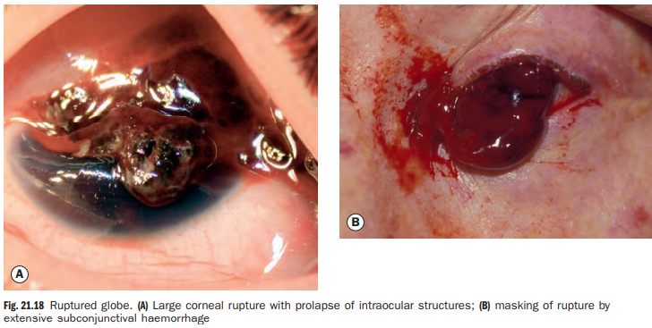
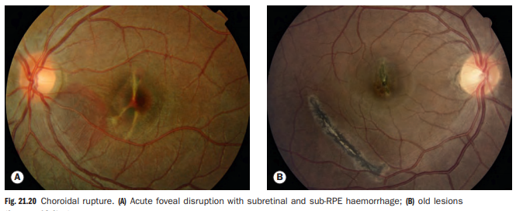

Slide 47
Work-up and treatment:
Once the diagnosis of a ruptured globe is made, further examination should be deferred until the time of surgical repair in the operating room.
This is to avoid placing any pressure on the globe and risking extrusion of intraocular contents.

Slide 48
Once the diagnosis is made, then the following measures should be taken:
Protect the eye with a shield
X-ray of the orbits
Bed rest, Avoid bending over and Valsalva maneuvers.
Systemic antibiotics should be administrated within 6 hours of injury.
Tetanus toxoid.
Administer antiemetic
Analgesics
Surgical repair

Slide 49
Intraocular foreign body
Introduction An intraocular foreign body (IOFB) may traumatize the eye mechanically, introduce infection or exert other toxic effects on the intraocular structures.
It may lodge in any of the structures it encounters, thus may be located anywhere in the anterior or posterior segments.
Notable mechanical effects include cataract formation secondary to capsular injury, vitreous liquefaction, and retinal haemorrhages and tears.
Stone and organic foreign bodies are associated with a higher rate of infection, and this is particularly high with soil-contaminated or vegetable matter.

Slide 50
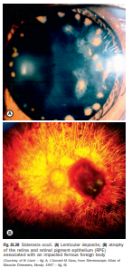
Intravitreal antibiotic prophylaxis is generally recommended.
Many substances, including glass, many plastics, gold and silver are inert.
However, iron and copper may undergo dissociation and result in siderosis and chalcosis respectively.

Slide 51
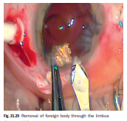
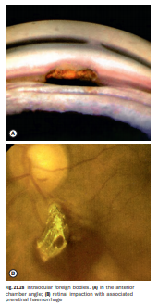

Slide 52
Diagnosis
History. A careful history may be key to determining the origin and nature of the foreign material
Examination should pay special attention to possible sites of entry or exit.
Topical fluorescein may be helpful to identify an entry wound.
Projection from wounds may allow logical deduction of the location of a foreign body.
Gonioscopy and fundoscopy must be considered, taking care to minimize pressure on the eye.

Slide 53
Associated signs such as lid laceration and anterior segment damage should be noted.
CT with axial and coronal cuts is used to detect and localize a metallic IOFB, providing cross-sectional images with a sensitivity and specificity superior to plain radiography and ultrasonography.
MRI is contraindicated in the context of a metallic (specifically ferrous) IOFB

Slide 54
Treatment
Repair of the entry site and infection prophylaxis should not be delayed.
If expertise and facilities are not available for single procedure wound repair and IOFB removal, as the outcome may not be compromised with delayed removal.
Magnetic removal of ferrous foreign bodies involves the creation of a sclerotomy adjacent to the foreign body, with application of a magnet followed by cryotherapy to the retinal break.
Scleral buckling may be performed to reduce the risk of retinal detachment if this is judged to be high.

Slide 55
Forceps removal may be used for non-magnetic foreign bodies and magnetic foreign bodies that cannot be safely removed with a magnet.
It involves pars plana vitrectomy and removal of the foreign body with forceps either through the pars plana or limbus depending on the circumstances.

Slide 56
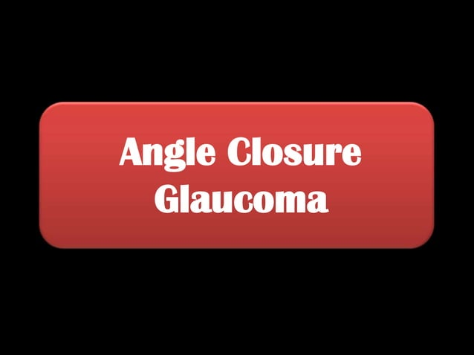

Slide 57
GLAUCOMA
Glaucoma is defined as a group of conditions that have in common a chronic progressive optic neuropathy that results in characteristic morphological changes at the optic nerve head and in retinal nerve fiber layer along with visual field loss associated .Intraocular pressure is a key modifiable factor.s progressive damage along with visual field loss. Intraocular pressure is a key modifiable factor.

Slide 58
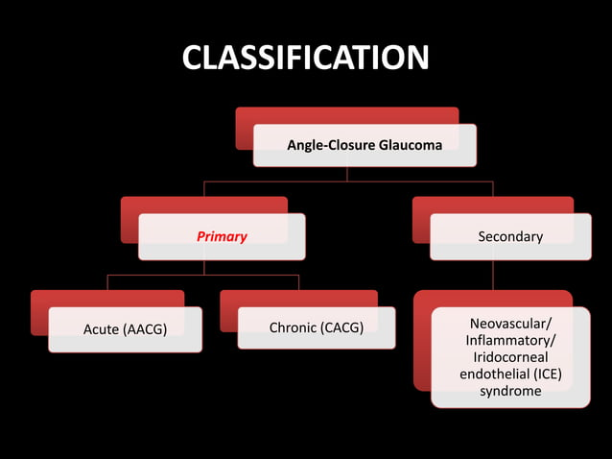

Slide 59
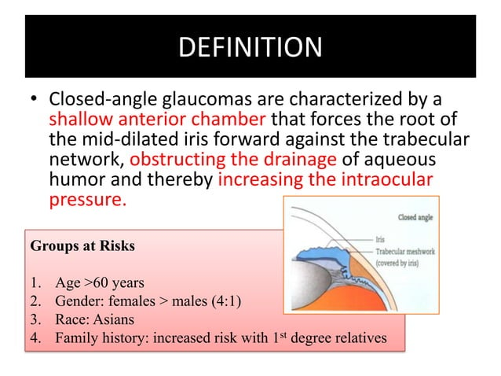

Slide 60
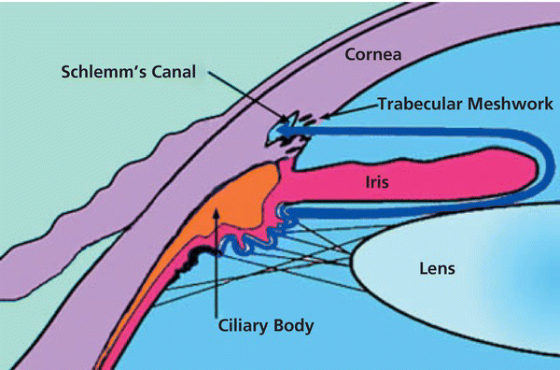

Slide 61
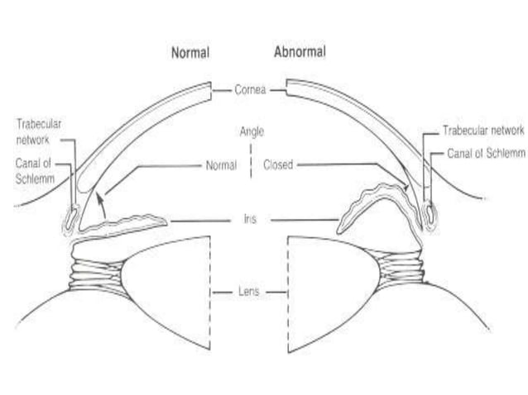

Slide 62
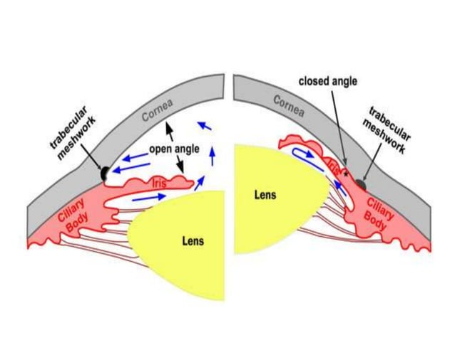

Slide 63
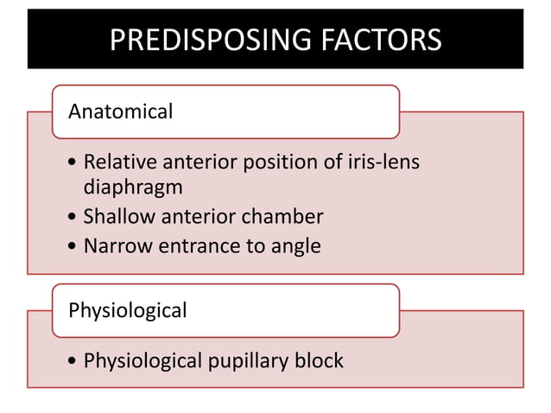

Slide 64
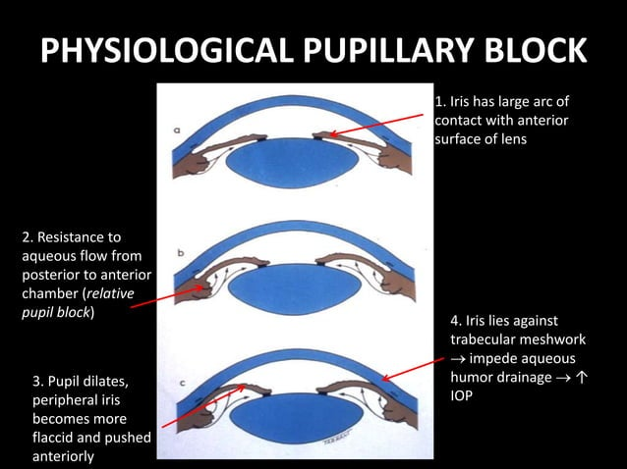

Slide 65
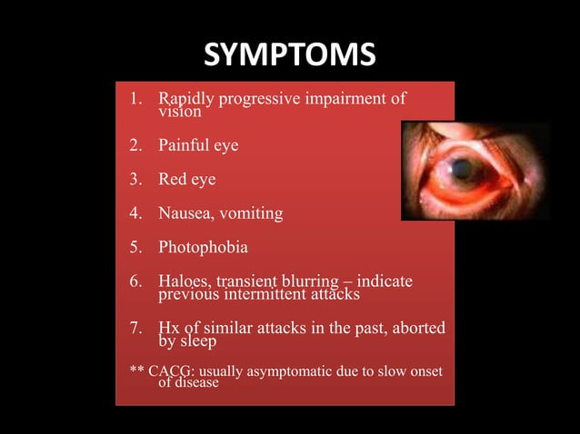

Slide 66
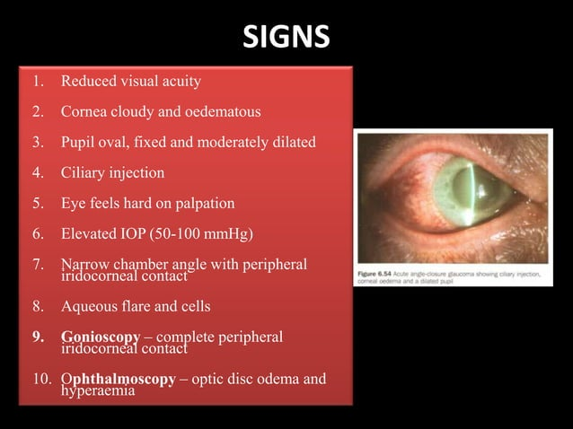

Slide 67
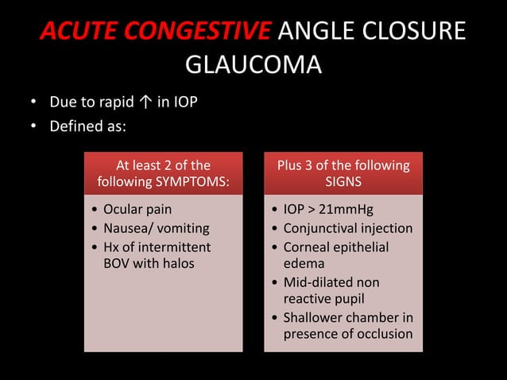

Slide 68
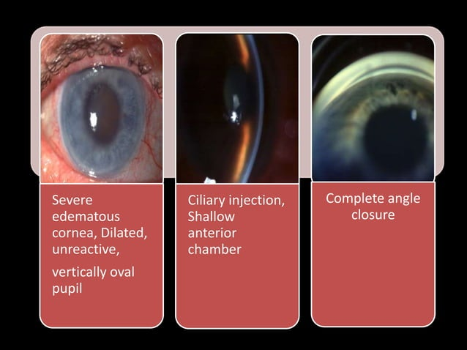

Slide 69
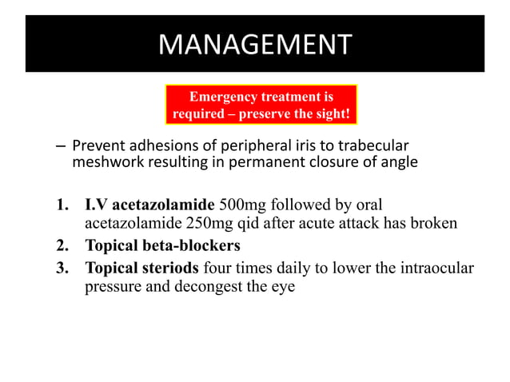
Being an emergency,any patient coming up with the symptoms of acute angle closure glaucoma should be immediately referred to an ophthalmologist.
We, as an ophthalomolgist,start by measuring the intraocular pressure of both the eyes.
Second step comes with administrating intravenous acetazolamide 500mg along with 250mg acetazolamide stat orally.
A single dose of apraclonidine 0.5% ,timolol 0.5% and prednisolone 1% or dexamethasone 0.1% is instilled into the affected eye,leaving 3-5 minutes between each.
Pilocarpine 2% one drop to the affected eye,repeated after half an hour and one drop of 1% into the fellow eye.
Analgesia and an antiemetic may be required.

Slide 70
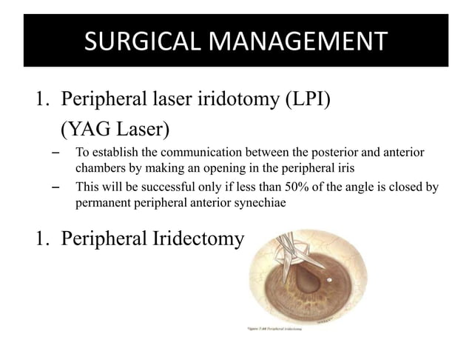
Peripheral laser iridotomy done using YAG LASER- done to establish communication between anterior and posterior chambers.
Peripheral iridectomy –done by giving a small incision so that the aqueous humor can be drained out lowering down the intraocular pressure.

Slide 71
CORNEAL ABRASION
&
CORNEAL FOREIGN
BODY

Slide 72
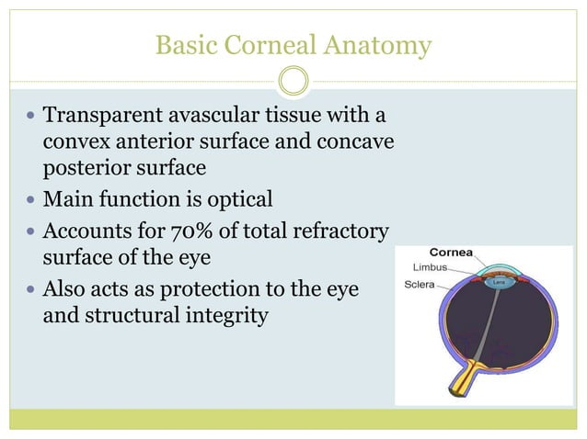

Slide 73
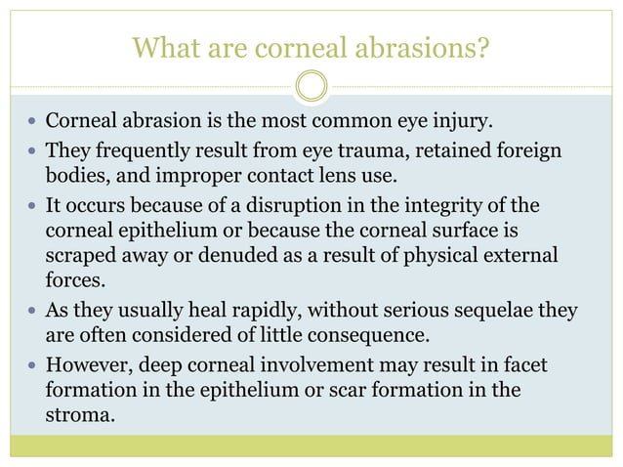

Slide 74
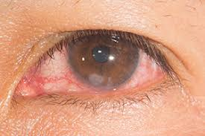
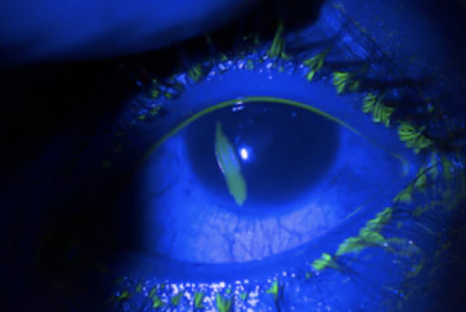
A pictorial representation of corneal abrasion in the eye which has been stained with fluorescein dye and being viewed under cobalt blue light showing a vertical corneal abrasion.

Slide 75


Slide 76


Impacted Corneal Foreign Body
which is being removed in a sterile condition using a 26 gauze needle.

Slide 77


Slide 78


Slide 79


Slide 80
Management
Antibiotic eye drops like Ciprofloxacin or Moxifloxacin in the affected eye can be used.
In case of abrasions ,antibiotic eye patching can be done using the same antibiotic eye ointments.
The patching should be done for atleast 4-6 hours if the abrasion is very painful or >50% of corneal surface is involved,a 24 hr patch has to be applied.
Although eye patching should be avoided in case if infiltration are present or if there is history of trauma with vegetative matters.
We can also advise ibuprofen analgesics if the patient is complaining of
pain in the traumatic eye.
Removal of rust ring on a routine basis at time of foreign body removal is not recommended because of potential damage to Bowman’s membrane and resultant scarring.
Contact lens should be avoided for atleast 2 weeks.
Along with the treatment patient should be counselled well.
In case of any surgery done under general anaesthesia,anaesthesist should patch the eyes well as it may lead to corneal abrasion further leading to exposure keratitis.

Slide 81



If the patient presents to the ER and you see any discharge,infiltrate in the abrasion or pus in the anterior chamber along with significant visual loss or a history of penetrating trauma “RING THE OPHTHALMOLOGIST ON CALL”

Slide 82


Slide 83


Slide 84


Slide 85


ORBITAL CELLULITIS
&
CAVERNOUS SINUS THROMBOSIS

Slide 86

Orbital Septum
The orbit is separated from the soft tissue of the eyelid by the orbital septum. It is a thin, fibrous membrane that separates the preseptal space to the postseptal space.
The orbital septum originates from periosteum of the orbital rim and inserts into the tarsal plate of the upper and lower eyelids.
The orbital septum usually proves to be an effective barrier that prevents the spread of infection from the eyelids posteriorly to the orbit.

Slide 87

Epidemiology
Orbital cellulitis -Common in children, diabetics and immunocompromised
Orbital cellulitis is much less common than preseptal cellulitis
Winter months as a result of the increased incidence of paranasal sinus infection.
No predilection for gender or race (except in children where orbital cellulitis affects four times as many females).
Both conditions are more common in children:
orbital cellulitis more frequently affects those aged 7-12 years, whereas preseptal cellulitis occurs at younger ages (80% of patients are under 10 years of age and most are younger than 5 with a mean age of 21 months).

Slide 88

Preseptal cellulitis
Infection of subcutaneous tissue anterior to orbital septum.
Causes-
Skin trauma such as laceration or insect bites. The offending organism are S.aureus or S. pyogenes .
Spread of local infection , such as from an acute hordeolum, dacryocystitis or sinusitis.
From remote infection of the upper respiratory tract or middle ear by haematogenous spread
Signs-
Swollen, often firm, tender and red eyelid with periorbital oedema
In contrast to orbital cellulitis proptosis and chemosis are absent; visual acuity, pupillary reactions and ocular motility are unimpaired.
MRI or CT not indicated unless orbital cellulitis or a lid abscess is suspected or if there is a failure to respond to therapy.

Slide 89

TREATMENT
Treatment is with oral co-amoxiclav 250-500/125 mg 2-3times daily every 8 hours.
Severe infection may require intravenous antibiotics.
Patients tetanus status should be ascertained in cases following trauma.
Resolution is quick and complete.

Slide 90

ORBITAL CELLULITIS
Bacterial orbital cellulitis is a serious infection of the soft tissues behind the orbital septum.
It can be sight and life threatening.
It can occur at any age but is more common in children.
Causative organisms are
Strep pneumoniae , S. aureus, Strep pyogenes and H. influenzae.

Slide 91
Routes of Infection
1 Sinus-related , most commonly ethmoidal, typically affects children and young adults.
2 Extension of preseptal cellulitis through the orbital septum.
3 Local spread from adjacent dacryocystitis, mid-facial or dental infection.
4 Haematogenous spread.
5 Post-traumatic develops within 72 hours of an injury that penetrates the orbital septum. The typical clinical features may be masked by associated laceration or haematoma.
6 Post-surgical retinal, lacrimal or orbital surgery.

Slide 92
Why orbit is predisposed for spread of sinus infection?
Free vascular communication between orbit and the sinuses
Orbital veins are valveless
Thin bone
Medial orbital wall has numerous defects (zuckerkandl dehiscence)

Slide 93

PRESENTATION
Symptoms
Rapid onset of pain exacerbated by eye movement.
Swelling of the eye.
Malaise, headache, nausea & vomiting
Fever may occur reported in 61% of pt in children
Visual impairment and double vision.
Recent history of nasal, sinus or respiratory symptoms.

Slide 94
PRESENTATION
Signs
Pyrexia, often marked
VA may be reduced and colour vision impaired, raising the posibility of optic nerve compression
Lid edema- Tender, firm, erythematous and warm eyelids with periocular and conjunctival oedema, conjunctival injection and sometimes subconjunctival hemorrahge. The signs are usually unilateral, though oedema may spread to the contralateral eyelids.
Proptosis, often obscured by lid swelling, is most frequently lateral and downwards and rapidly progressive
Painful ophthalmoplegia
Intraocular pressure may be raised
Choroidal folds and optic disc swelling

Slide 95
Complications
1. Ocular complications –
Exposure keratopathy
Raised intraocular pressure
Endophthalmitis
Occlusion of the central retinal artery or vein
Optic neuropathy (RAPD & optic disc edema)
2. Intracranial complications- (rare but extremely serious)
Meningitis
Brain abscess
Cavernous sinus thrombosis.
3. Subperiosteal abscess is most frequently located along the medial orbital wall.

Slide 96
D/D
Thyroid eye disease
Dacryocystitis
Dacryoadenitis
Cavernous sinous thrombosis
Carotid cavernous fistula
Retinoblastoma
Rhabdomyosarcoma
Idiopathic orbital infammatory disease
Orbital myositis
Orbital trauma
Wegener’s granulomatosis

Slide 97

Lab studies..
TLC,DLC(leucocytes count are raised) but blood culture are frequently negative in adults.
Any discharge from skin breaks should be swabbed and sent to microbiology for culture. Throat swabs and samples of nasal secretions may also help diagnosis.
ESR is elevated

Slide 98
Ultrasonography rules out orbital myositis and determines the location of orbital abscess and foreignbody
CT of the sinuses as well as the orbit ± brain is vital to confirm the diagnosis and exclude a subperiosteal or intracranial abscess.
MRI is also sometimes performed
Lumbar puncture if meningeal or cerebral signs develop.

Slide 99
Medical Management
1 Hospital admission with otolaryngological assessment and frequent ophthalmic review is mandatory.
2 Antibiotic therapy involves intravenous ceftazidime, with oral metronidazole to cover anaerobes. Vancomycin is a useful alternative in the context of penicillin allergy.
Intravenous antibiotic therapy should be continued until the patient has been apyrexial for 4 days, followed by 1-3 weeks of oral treatment.
3 Monitoring of optic nerve function every 4 hours by testing pupillary reactions, visual acuity, colour vision and light brightness appreciation
4 Anti inflammatory drugs & analgesics
5 Nasal decongestants – drain the sinuses.
6 Pt with proptosis require lubrication of ocular surface

Slide 100
Surgical Management
Surgical intervention in which the infected sinuses and orbital
collections are drained should be considered in the following circumstances:
Lack of response to antibiotics.
Subperiosteal or intracranial abscess.
Atypical picture, which may merit a biopsy
Progression of visual loss

Slide 101

Cavernous sinus Anatomy
Large venous space situated in the middle cranial fossa, on either side of body of the sphenoid bone.
Each sinus is about 2 cm long and 1 cm wide.
Interior is divided into a number of spaces by trabeculae.

Slide 102

Cavernous sinus Anatomy
Boundries
Anterior - superior orbital fissure and the apex of the orbit.
Posterior - apex of petrous temporal bone and crus cerebri of midbrain.
Medial – Hypophysis cerebri and sphenoidal air sinus.
Lateral – temporal lobe and uncus.
Superior – optic tract, internal carotid artry and ant perforated substance.
Inferior – foramen lacerum, junction of body and greater wing of sphenoid.

Slide 103

Contents
Superior to inferior (within the lateral wall of the sinus)
  Oculomotor nerve (CN III)
  Trochlear nerve (CN IV)
  Ophthalmic nerve, the V₁ branch of the trigeminal nerve (CN V)
  Maxillary nerve, the V₂ branch of CN V
  Trigeminal ganglion

Slide 104

Contents
Structures through the centre of the sinus are the internal carotid artery with the sympathetic plexus around it and the Abducens nerve (CN VI) which runs inferolateral to the internal carotid artery

Slide 105

Tributries (from orbit)
Sup ophthalmic vein
Inf ophthalmic vein
Central vein of retina
Medial ophthalmic vein

Slide 106

From brain..
Superficial middle cerebral vein
Inferior cerebral vein from temporal lobe.

Slide 107
From Meninges
Spheno pareital sinus
Frontal trunk of middle mengial vein may drain either into pterygoid plexus or into the sphenoparietal sinus or cavernous sinus.

Slide 108

Draining channels
1) Into Transverse sinus through the superior Petrosal sinus.
2) Into Internal jugular vein through inferior Petrosal sinus and through plexus around Internal carotid artery.
3) Pterygoid plexus through emissary veins
4) Right and left cavernous sinus communicates with each other through Intercavernus sinus and through basilar plexus of veins.

Slide 109

Communications and source of infections
All communications are valveless and blood can flow through them in either directions
Anteriorly superior and inferior ophthalmic vein receive blood from face, nose, paranasal sinus and orbit therefore infection may spread from infected facial wounds, erysipelas, squeezing of styes, furuncles, orbital cellulitis and sinusitis.
Posteriorly Labyrinthine veins opening into inferior petrosal sinuses bring infections from middle ear
Superorly it communicates with veins from cerebrum and may be infected from meningitis and cerebral abscesses
Inferiorly it communicates with pterygoid plexus and pterygoid plexus also drains the tonsillar region.
Medially infection from one side transfers to other side by intercavernous sinuses.

Slide 110
Cavernous sinus thrombosis
Cavernous Sinus Thrombosis, as the name states, is the formation of blood clot (thrombus) in the cavernous sinus.
It is important to know that CST affects cranial nerves III, IV and VI, which are necessary for eye movement, and cranial nerve V, which gives sensation to the top and middle portion of the face. Therefore, it is a serious, life-threatening infection that requires aggressive medical and surgical intervention.

Slide 111

Etiology of CST
Cavernous sinus thrombosis is usually caused by a bacterial infection spreading from the face, sinuses or teeth. The most common bacterial culprit is staphylococcus aureus and streptococcus is the second leading cause and rarely aspergillus fumigatus and mucormycosis
Infections that can lead to septic CST include sinusitis, boils, dental infections, facial cellulitis and ear infections.
Other aseptic causes includes trauma, neurosurgery, pregnancy, sickle cell disease, polycythemia and OCP .

Slide 112
HISTORY
History of the patient:-
  Patients generally have sinusitis or a midface infection (most commonly a furuncle)
  Headache, fever and malaise typically precede the development of ocular findings. As the infection tracts posteriorly, patients complain of orbital pain and fullness accompanied by periorbital edema and visual disturbances.
  In some patients, periorbital findings do not develop early on, and the clinical picture is subtle.
Without effective therapy, signs appear in the contralateral eye by spreading through the communicating veins to the contra lateral cavernous sinus. This is pathognomonic of CST. The patient rapidly develops mental status changes from CNS involvement and/or sepsis. Death follows shortly thereafter

Slide 113
PRESENTATION
Clinical picture presents the following systemic, ocular and nervous symptoms:
Initial sign and symptoms:
  The earliest clinical sign is congestion of the eye on the unaffected side
Nervous symptoms:-
Severe pain in the eye and forehead in the area of distribution of Ophthalmic nerve.
Involvement of the third, fourth and sixth cranial nerves individually and sequentially resulting in the paralysis of the muscles supplied and eventually total ophthalmoplegia.
Sixth nerve palsy is the most common
Paralysis of the V cranial nerve results in the loss of sensation in the top and the middle portion of the face.

Slide 114

PRESENTATION
Ocular symptoms:-
Eyelids get swollen leading to ptosis with chemosis and proptosis of the eyeball.
Reduced corneal sensations.
Pupils become dilated with reduced or absent pupillary response
Optic disc shows congestion and oedema.
Papilledema, retinal hemorrhages, decreased visual acuity and blindness may occur
Exophthalmos
Systemic signs indicative of sepsis:-
Chills, Fever, Shock, Delirium and coma appears as late findings.

Slide 115
Differential Diagnosis:-
CST needs to be differentiated from…
Cellulitis
Epidural Hematoma
Epidural and subdural infections
Glaucoma, Acute angle closure cases
Orbital infections
Periorbital infections
Sinusitis
Subarachnoid hemorrhage
Subdural hematoma

Slide 116
Clinical features | Orbital cellulitis | Cavernous sinus thrombosis
laterality | unilateral | Initially unilateral becomes bilateral
Degree of proptosis | marked | moderate
Ocular movements | Marked limitation | Complete limitation to palsy
Edema in mastoid region | absent | present
General symptoms | mild | marked
Source of infection | Usually ethmoiditis | orbit, nose, tonsillar, mastoid.

Slide 117
Complication of Cavernous Sinus thrombosis
Intracranial extension of infection may result in meningitis, encephalitis, brain abscess, pituitary infection, and epidural and subdural empyema.
Cortical vein thrombosis can result in hemorrhagic infarction.
Extension of the thrombus to other sinuses can occur.

Slide 118

INVESTIGATIONS
Lab Studies:-
CST is a clinical diagnosis and lab studies are seldom specific. Blood tests like CBC and Blood cultures
Serum studies like ESR,CRP,ACE,ANCA
Imaging studies:-
MRI
CT
Carotid angiography
Orbital venography.

Slide 119
TREATMENT OF CAVERNOUS SINUS THROMBOSIS
Because it is often difficult to distinguish septic and non-septic causes of CST, the initial management is the same. Only when aseptic aetiology is ruled out definitively an antibiotics be withdrawn. In practice, therefore, the treatments are the same for both aseptic and septic disease.

Slide 120
Antibiotics
Initial antimicrobial therapy include nafcillin or oxacillin 1 to 2 g q 4 to 6 h combined with a 3rd-generation cephalosporin (eg, ceftriaxone 1 g q 12 h)
A drug for anaerobes (eg, metronidazole
500 mg q 8 h) should be added if an underlying sinusitis or dental infection is present.
Vancomycin 1gm 1 hourly to cover for potential methicillin-resistant Staphylococcus aureus (MRSA) until the actual culture results are available
Antifungal therapy with amphoteracin B
A prolonged duration of parentral therapy typically three to four weeks is suggested

Slide 121
Anti coagulants
The indication of anticoagulation is still debated
Anticoagulation carries a significant risk of hemorrhage if cortical venous infarction or necrosis of intracavernous portions of the carotid artery are present.
Anticoagulant is contraindicated in the presence of intracerebral hemorrhage or other bleeding diathesis.
In the absence of contraindications with either unfractionated heparin or low molecular weight heparin for several weeks to several months.
A reduction in mortality from 40% to 14% with UFH and reduction in neurological morbidity from 61% to 31% when anticoagulation combined with antibiotics.

Slide 122
Corticosteroids
The role of corticosteroids is controversial in many cases of CST.
Reducing intra-orbital congestion in patients with orbital oedema
Reducing cranial nerve inflammation in patients with cranial nerve dysfunction.
The course of CST leads to pituitary insufficiency, however, corticosteroids definitely are indicated to prevent adrenal crisis. Dexamethasone or hydrocortisone should be considered

Slide 123
Surgical Interventions
No surgical interventions are recommended.
Some patients require abscess drainage, sphenoidectomy,ethmoidectomy,mastoidectomy or orbital decompression.
Patient should be followed closely.

Slide 124
Prognosis
100% mortality prior to effective antimicrobials
Typically, death is due to sepsis or central nervous system (CNS) infection.
With aggressive management, the mortality rate is now less than 30%.
Morbidity, however, remains high, and complete recovery is rare.
Roughly one sixth of patients are left with some degree of visual impairment, and one half (50 %) have cranial nerve deficits.

Slide 125
CENTRAL RETINAL ARTERY OCCLUSION(CRAO)
DEFINITION:-
Central retinal arterial occlusion is an ophthalmic emergency characterized by the sudden blockage of the central retinal artery, the primary blood vessel supplying the retina.
This occlusion leads to rapid ,painless and severe vision loss in the affected eye.

Slide 126
CENTRAL RETINAL ARTERY OCCLUSION(CRAO)
ANATOMY
The ophthalmic artery is the first branch of the internal carotid artery and enters the orbit underneath the optic nerve through the optic canal.
The central retinal artery is the first intra orbital branch of the ophthalmic artery, which enters the optic nerve 8-15 mm behind the globe to supply the retina.

Slide 127


Slide 128
Etiology
CRAO is classified into nonarteritic CRAO and arteritic CRAO according to the basic pathophysiology.
Nonarteritic CRAO comprises more than 90% of cases.
An embolism is the most common cause of nonarteritic CRAO. Atherosclerosis of the carotid artery may be noted on the same side in around 70% of patients with CRAO or branch retinal arterial occlusion.
The 3 main types of emboli are cholesterol ,calcium, and platelet-fibrin.
The most common type of retinal embolus is composed of cholesterol, accounting for around 46% to 80% of all retinal emboli. Platelet-fibrin is the second most common type, accounting for 6% to 32%. Calcific embolus is less common, accounting for 6% to 16%.

Slide 129
The causes of arteritic CRAO include giant cell arteritis, systemic lupus erythematosus, polyarteritis nodosa, antiphospholipid syndrome, granulomatosis with polyangiitis, and Takayasu arteritis.
Rapid differentiation between thromboembolic and arteritic processes is essential as optimal therapy differs, and the rapid administration of steroids for vasculitic causes of CRAO is associated with improved outcomes. Typically, this is completed by checking for inflammatory markers, including erythrocyte sedimentation rate (ESR) and C-reactive protein (CRP), which are raised in giant cell arteritis.

Slide 130
Patients presents with sudden, painless, vision loss that occurs over seconds.
Visual acuity may vary depending on the location of the obstruction. Complete vision loss to no light perception should raise suspicion of an ophthalmic artery occlusion.
Patients with central retinal artery occlusion (CRAO) complain of visual loss over the entire field of vision.

Slide 131
SIGNS
In central retinal artery occlusion, the classic findings of retinal whitening and a cherry red spot are due to opacification of the nerve fiber layer as it becomes edematous from ischemia.
The fovea is cherry red because it has no overlying nerve fiber layer. This finding may take hours to develop, and the edema is associated with a worse visual prognosis. Over the course of about a month, the inner retina becomes atrophic as the swelling resolves.

Slide 132
Examination of the retinal blood vessels shows segmental blood flow, classically described as boxcarring. This is best appreciated with slit-lamp biomicroscopy. Over about the course of a week, the vessels reperfuse.
Chronic signs of retinal artery occlusion include pale optic disc, thinned retinal tissue, attenuated vessels, retinal pigment epithelial mottling, and severely decreased vision. In the case of BRAOs, there may be artery-to-artery anastomoses.

Slide 133


Slide 134


Slide 135
Diagnostic procedures
Optical coherence tomography reveals hyperreflectivity and edema of the inner retinal layers in acute stages. The amount of retinal edema is related to visual prognosis.
The front edge of fluoresceine (an arterial dye front-the angiographic feature with highest specificity) is seen to travel very slowly to the peripheral retina along the branches of retinal arteries.
Complete lack of filling of the retinal vessels is very rare. Delayed choroidal filling should point to an ophthalmic or carotid artery obstruction.

Slide 136
Laboratory test
An erythrocyte sedimentation rate (ESR), C-reactive protein (CRP), and complete blood count (CBC) with platelets should be obtained in patients over the age of 50 who have symptoms of giant cell arteritis .
Patients younger than 50 should have a hypercoagulable workup including antiphospholipid antibody syndrome, autoimmune conditions, inflammatory disorders, and other hypercoagulable states .
In older individuals, atherosclerosis and emoboli are the most likely cause of the ischemia. Evaluation of the heart with echocardiography should be performed to determine cardiac function and abnormalities of the valves. Electrocardiograms and heart monitoring may reveal a rhythm defect. Carotid artery stenosis should be evaluated with carotid ultrasound

Slide 137
Management
General treatment
Retinal artery occlusion is an emergency that requires emergent systemic evaluation for cerebral vascular accident (CVA).
Patients with acute CRAO, BRAO and amaurosis fugax should be referred to the nearest stroke center for further immediate management.

Slide 138
Ocular massage is a conservative therapy that may theoretically cause emboli to travel more distally to reduce the area of ischemia. A three-mirror contact lens is placed on the eye and pressure is applied for 10 sEC, to obtain retinal artery pulsation or flow cessation followed by a 5 sEC release.
Increasing carbon dioxide concentration has also been proposed to induce vasodilation. The patient is instructed to breathe into a bag in order to increase carbon dioxide concentration.
Alternatively, a patient may be given an oxygen mask to try to increase oxygen perfusion through the choroidal circulation. A mixture of 95 % oxygen and 5 % carbon dioxide has also been proposed to increase blood flow.
Topical timolol 0.5% and intravenous acetazolamide 500 mg to achieve a more sustained lowering of intraocular pressure

Slide 139
Similar, anterior chamber paracentesis may be performed by removing 0.1-0.4 ml of aqueous fluid from the anterior chamber using a small gauge needle (27 or 30 gauge). Theoretically, the paracentesis lowers the intraocular pressure and may allow the embolus (if any) to move further down the vessel and away from the central retina. In addition, the intraocular pressure may be decreased medically with eyedrops.
Hyperosmotic agents. Mannitol or glycerol have been used for their possibly more rapid IOP-lowering
Vasodilating medications that have been utilized to increase retinal blood flow in retinal arterial occlusion include nitroglycerine, and isosorbide dinitrate

Slide 140
Ophthalmologist plays an important role in the management of these patients by referring them for the prophylactic medical or surgical treatment to forestall the development of permanent neurological sequelae as patients with retinal embolization have an increased risk of developing a permanent stroke over the next few months .
It should be noted that the leading cause of death in patients with retinal arterial obstruction is cardiovascular disease.

Slide 141
Retinal detachment
Normally, the retinal pigment epithelium (RPE) is able to maintain adhesion with the overlying neurosensory retina through a variety of mechanisms.
These mechanisms include active transport of subretinal fluid across RPE , metabolic activity of RPE, and interdigitation of the photoreceptor outer segments and the RPE microvilli.
With retinal detachment, these mechanisms are overwhelmed leading to separation of the neurosensory retina from the retinal pigment epithelial layer.

Slide 142


Slide 143


Slide 144
Retinal detachment occurs when subretinal fluid accumulates between the neurosensory retina and the retinal pigment epithelium. This process can occur in three ways.
One mechanism involves occurrence of a break in the retina allowing liquified vitreous to directly enter the subretinal space. This is known as a rhegmatogenous retinal detachment.
the second mechanism involves proliferative membranes on the surface of the retina or vitreous. These membranes can pull on the neurosensory retina causing a physical separation between the neurosensory retina and retinal pigment epithelium. This is called a tractional retinal detachment.
The third mechanism for retinal detachment is due to accumulation of subretinal fluid due to inflammatory mediators or exudation of fluid from a mass lesion or insufficient RPE function. This mechanism is known as a serous or exudative retinal detachment.

Slide 145
Patients present with symptoms of new onset significant photopsia and/or persistent new floaters should be suspected of having a retinal tear, which could lead to a retinal detachment.
A patient with constant fixed or slowly progressive visual field loss should be suspected of having a detachment until proven otherwise.
Important information in the history includes onset of symptoms, presence and duration of decreased central visual acuity, prior trauma, prior surgery, hemorrhage, and a complete past medical history.

Slide 146



Slide 147
risk factors
Age: The vitreous liquefies as a normal part of aging, increasing the risk for subsequent detachment.
Myopia (nearsightedness): Individuals with myopia have a longer axial length of the eyeball, which increases their risk of developing posterior vitreous detachment.
Trauma: Blunt and penetrating trauma to the eye can disrupt the vitreous, leading to posterior vitreous detachment and retinal detachment.
Cataract surgery: Previous cataract surgery, particularly when associated with vitreous loss, is linked to shifts in the vitreous, increasing the risk of posterior vitreous detachment.
Inflammation: Inflammatory eye conditions, such as uveitis, are associated with an increased risk of posterior vitreous detachment.[

Slide 148
Other Risk Factors
Family history of retinal detachment
Previous retinal detachment in the other eye
Lattice degeneration: Thinning of the retina, which increases its susceptibility to breaks or tears.
Cystic retinal tuft: A small, raised spot present on the retina from birth that increases the risk for tears and detachment.

Slide 149
DIAGNOSIS
The gold standard for diagnosing retinal detachment is a dilated fundus examination to check the back of the eye using an indirect ophthalmoscope.
If the view of the retina is not clear, imaging techniques such as ultrawide-field fundus photography, B-scan ultrasonography, and optical coherence tomography (OCT) may help to identify detachment.
Fundus photography provides a detailed view of the back of the eye, potentially revealing retinal tears or breaks

Slide 150
Treatment
retinal detachment typically requires prompt surgical intervention to preserve vision.
The 3 main options include pneumatic retinopexy, vitrectomy, and scleral buckle.
These are selected based on how the patient presents, including the number, location and size of retinal tears, surgeon preference, and cost.[

Slide 151
Pneumatic retinopexy
Pneumatic retinopexy is A procedure often used for small and uncomplicated retinal detachments, particularly those involving a single tear in the superior part of the retina.
A gas bubble (sulfur hexafluoride) is injected into the vitreous cavity to push the retina back into place against the back of the eye.
Additionally, freezing (cryotherapy) or lasers are used to seal the retinal tears and prevent further detachment.

Slide 152


Slide 153
Vitrectomy
IT is a surgical procedure used to treat complicated retinal detachments.
It is especially useful for large retinal tears or tears that are not easily visible. Vitrectomy is also used for proliferative vitreoretinopathy, which is the growth of scar tissue on the retina that can occur after a retinal detachment.
In this technique, the vitreous gel is removed from the eye to relieve the pulling force on the retina.Any fluid behind the retina is drained, and tears are sealed with freezing or lasers.
The removed vitreous is then replaced with either a gas bubble or silicone oil, which stabilizes the retina.

Slide 154



Slide 155
Scleral buckle surgery
Scleral buckle surgery is a procedure in which one or more silicone bands are placed around the outer layer of the eye, known as the sclera.
The procedure typically begins with freezing (cryotherapy) to seal retinal tears.
Next, the silicone band is placed to create an indentation on the sclera, applying inward pressure that helps reattach the retina to the back of the eye.
After surgery, the person is often positioned in a prone position to reduce the risk of hemorrhages by preventing blood from reaching the macula.
The band typically remains in place permanently unless complications occur

Slide 156


Slide 157
prognosis
If left untreated, retinal detachment can lead to permanent vision loss.
Visual outcomes may vary even after successful reattachment.The results for a patient’s vision depend greatly on whether the macula, the central part of the retina responsible for detailed vision, remains attached.
If the macula detaches, the risk of poor vision increases, particularly if surgery is delayed.
Other factors that can affect the prognosis include the extent of the detachment and the timing of surgery, with earlier treatment generally leading to better outcomes.

Slide 158
Prevention
Patients at high risk for retinal detachment, such as those with myopia (nearsightedness), those who have had cataract surgery, those with a previous detachment in the other eye, and those with lattice degeneration or posterior vitreous detachment (PVD), should be educated on the symptoms and warning sings of retinal detachment and seek urgent treatment if they occur.
They should also have regular eye exams, even if they are not experiencing symptoms.
Individuals with certain types of retinal tears or breaks may require treatments such as lasers or freezing (cryotherapy) to prevent detachment.
Additionally, these patients are advised to avoid contact sports, eye trauma, and other high-risk activities, and to wear protective eyewear to reduce the risk of eye injury

Slide 159


Slide 160
Conclusion
- Timely referral ensures appropriate management.
- Recognize limitations and prioritize vision preservation.
- Always document and stabilize the patient before referral.

