Slide 1
POST-PARTUM HEMORRHAGE
[RECENT UPDATES AND FIGO GUIDELINES]
BY- DR SANTHANAM SAMPATH
(Head of department -Obstetrics and Gynaecology)

Slide 2
INDEX
INTRODUCTION
DEFINITION
EPIDEMIOLOGY
TYPES OF PPH
RISK FACTORS
MISSION NEEeV
AMTSL (ACTIVE MANAGEMENT OF THIRD STAGE OF LABOR)
E-MOTIVE
MANAGEMENT OF PPH
REFRACTORY PPH

Slide 3

Why PPH is a concern ?

Slide 4
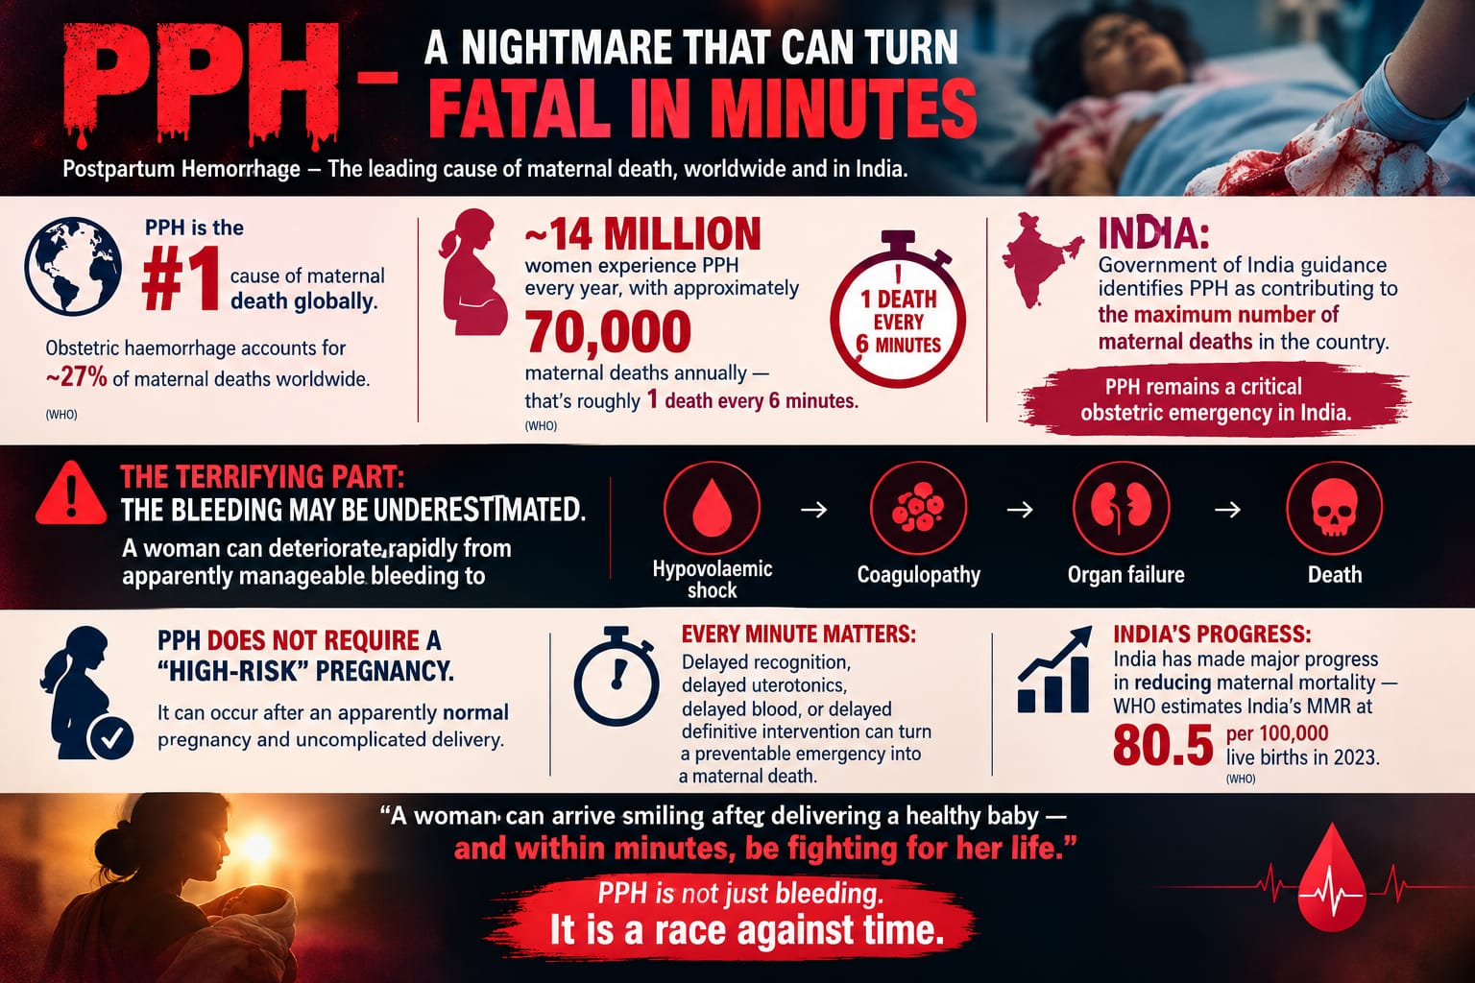

Slide 5
DEFINITION
Historically, blood loss >500 ml after a vaginal delivery or 1 litre after a caesarean section within 24 hours of birth constituted PPH.
Classified as mild (500 to 1000 ml), moderate (1000 to 2000 ml), and severe (>2000 ml).
Clinically, any blood loss causing haemodynamic instability (ie, tachycardia, hypotension, oliguria) also constitutes PPH

Slide 6
Definition of PPH – 2025 Update
Blood loss ≥300 mL with warning signs such as
Atonic uterus
Heavy blood loss,
Large clots or constant trickle of blood.
Change in vital signs- Pulse>100 bpm,
- SBP<100mmH &
- DBP<60mmhg,
- Shock Index >1
Blood loss >500 mL even if the woman has no other concerning signs.

Slide 7
SHOCK INDEX
FORMULA- HEART RATE/ SYSTOLIC BLOOD PRESSURE
NORMAL ( NON PREGNANT ): 0.5-0.7
NORMAL [PREGNANT]:0.7-0.9
>0.9: WARNING SIGN OF HEMODYNAMIC COMPROMISE
>0.1: SEVERE INSTABILITY ; BLOOD TRANSFUSION LIKELY REQUIRED
>1.4:MORTALITY RISK AS HIGH AS 40%; MULTIPLE BLOOD PRODUCTS REQUIRED.

Slide 8
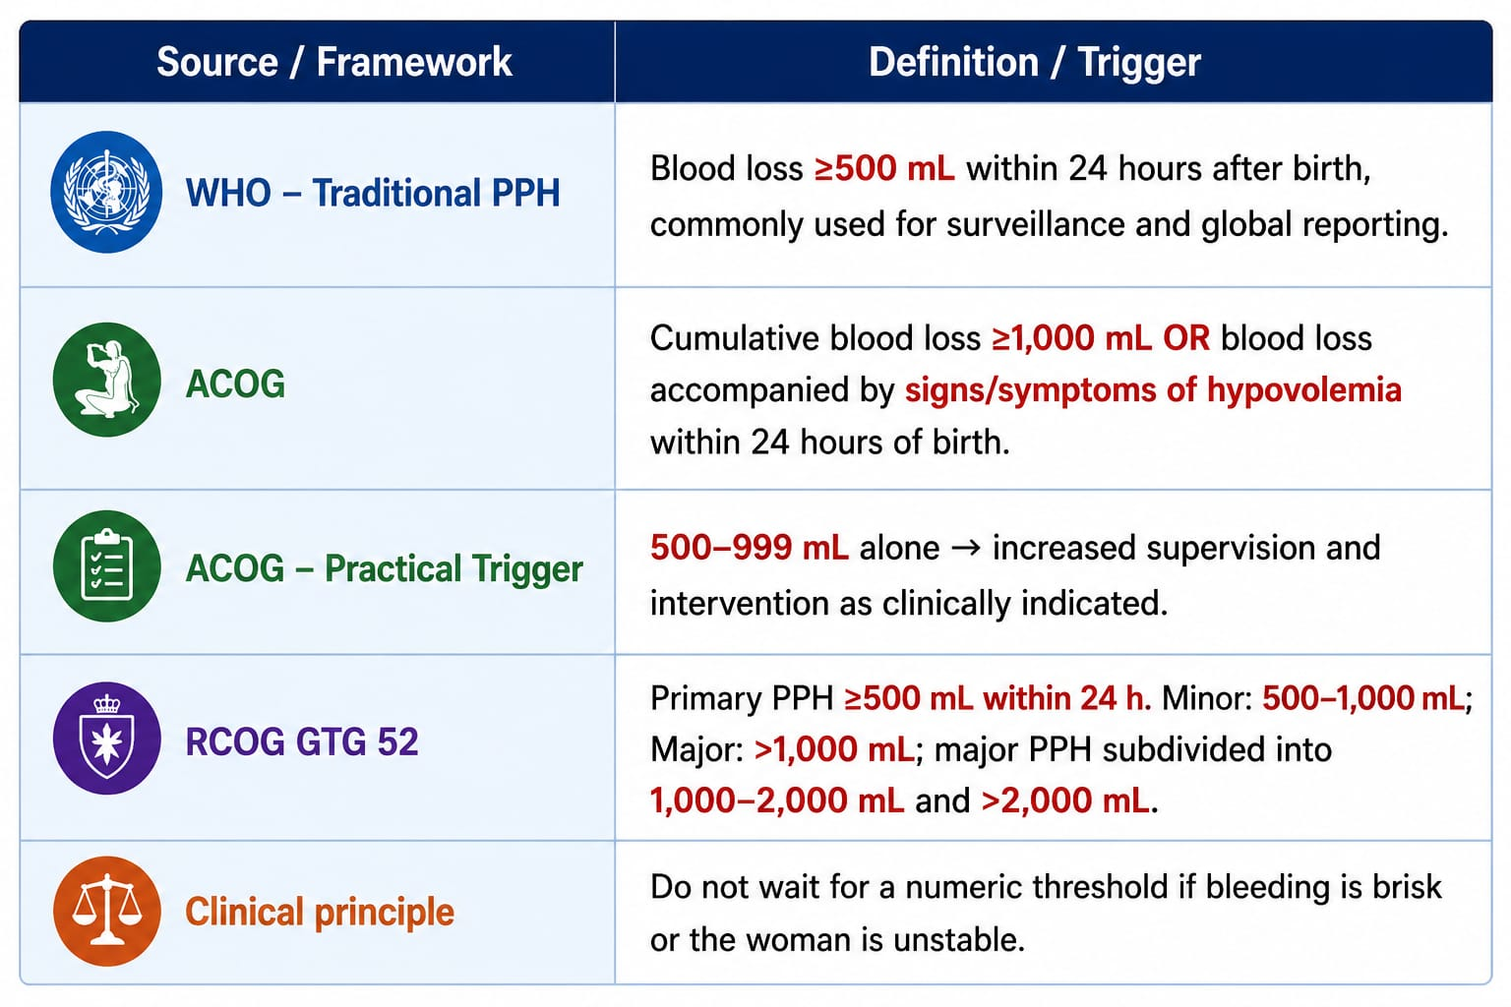

Slide 9
EPIDEMIOLOGY
Most common cause of maternal mortality in India is obstetric hemorrhage (approximately 47%).
PPH is the most common cause of maternal death worldwide.
PPH occurs in approximately 6% of first pregnancies and approximately 4 to 5% of subsequent pregnancies.
Recurrence rate is up to 15%.
Most deaths due to PPH Occur within the first 24 hours after birth.

Slide 10
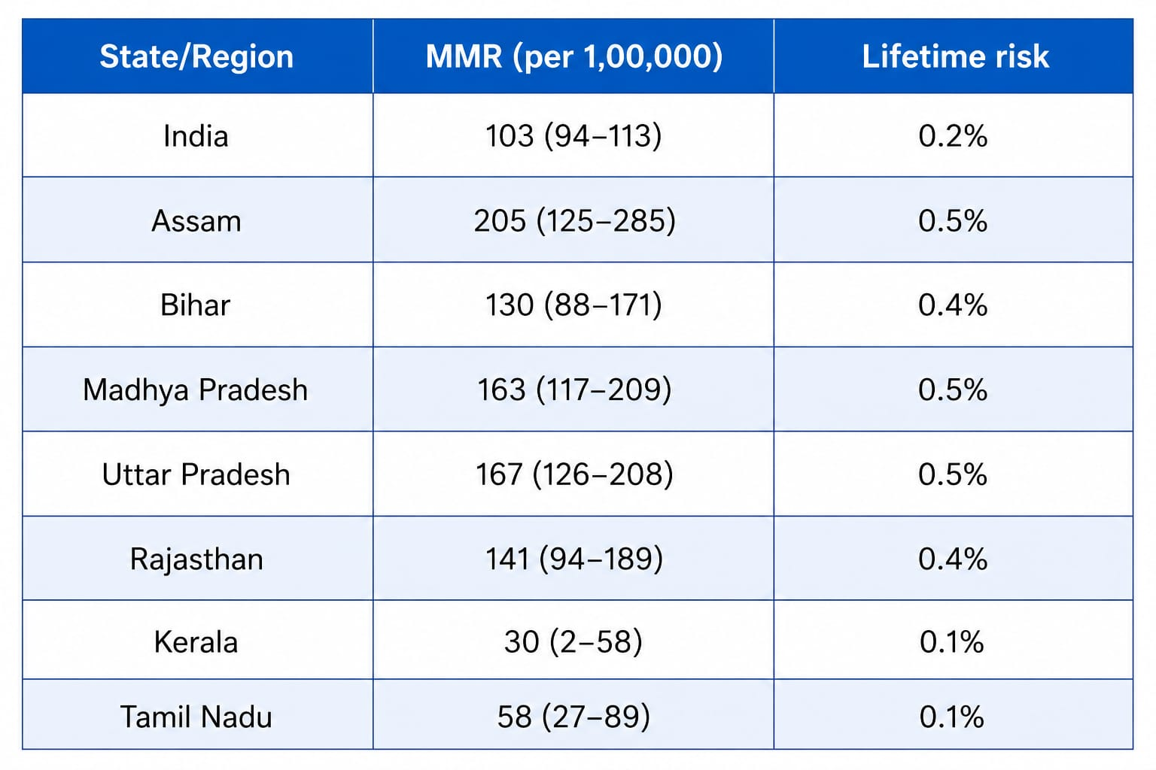

Slide 11
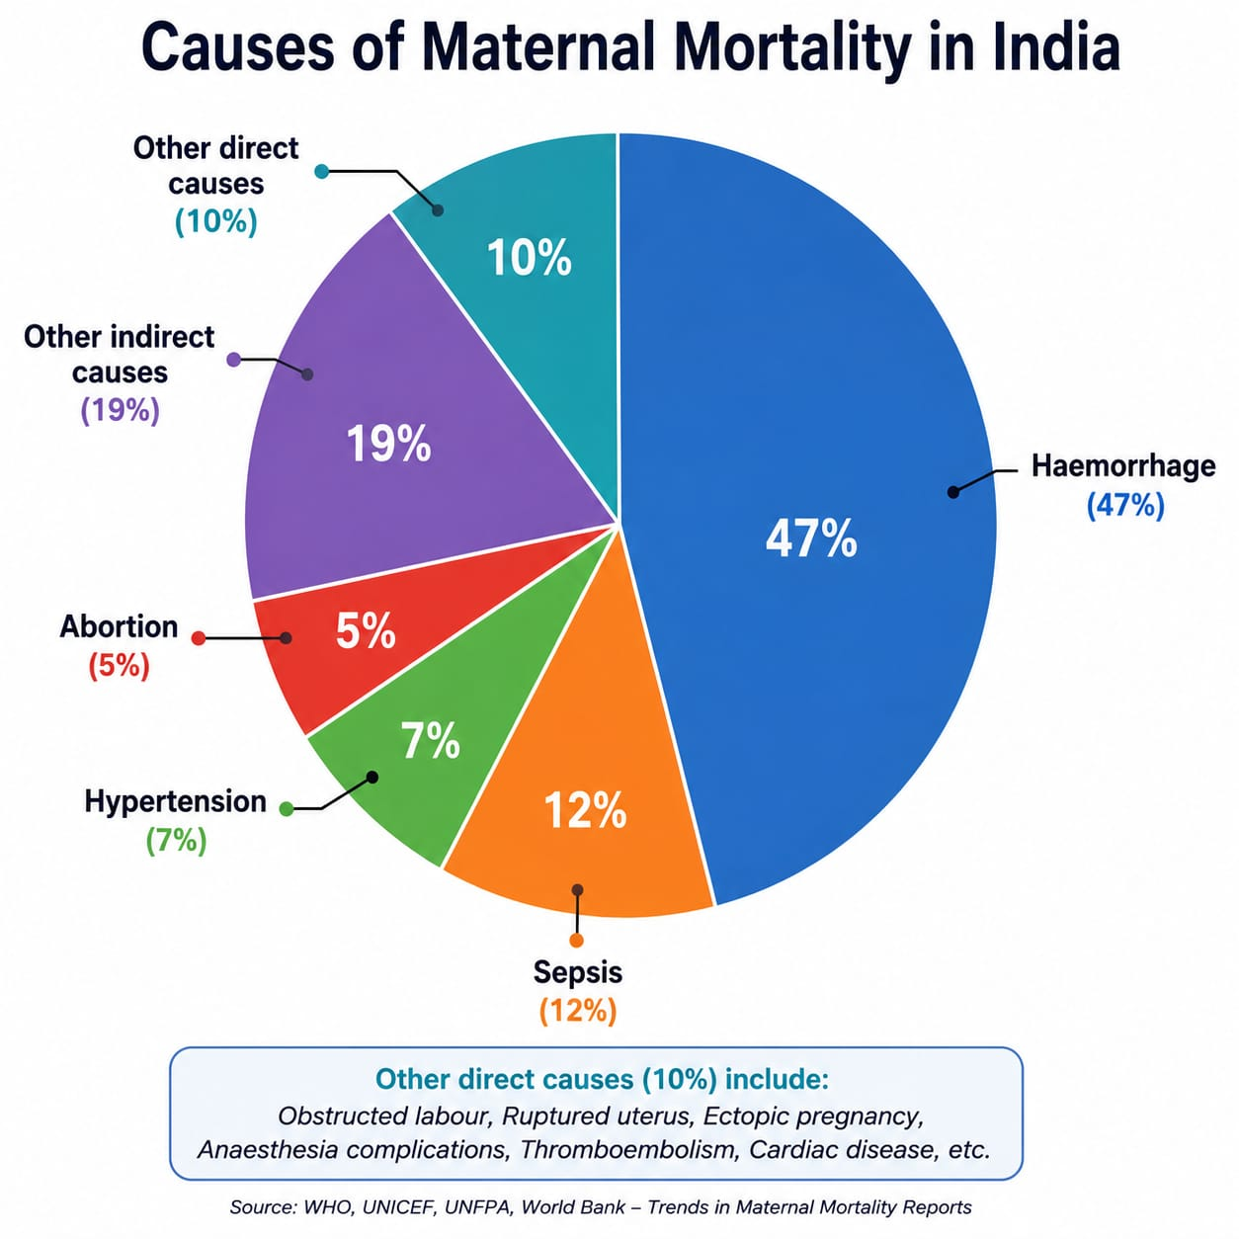

Slide 12
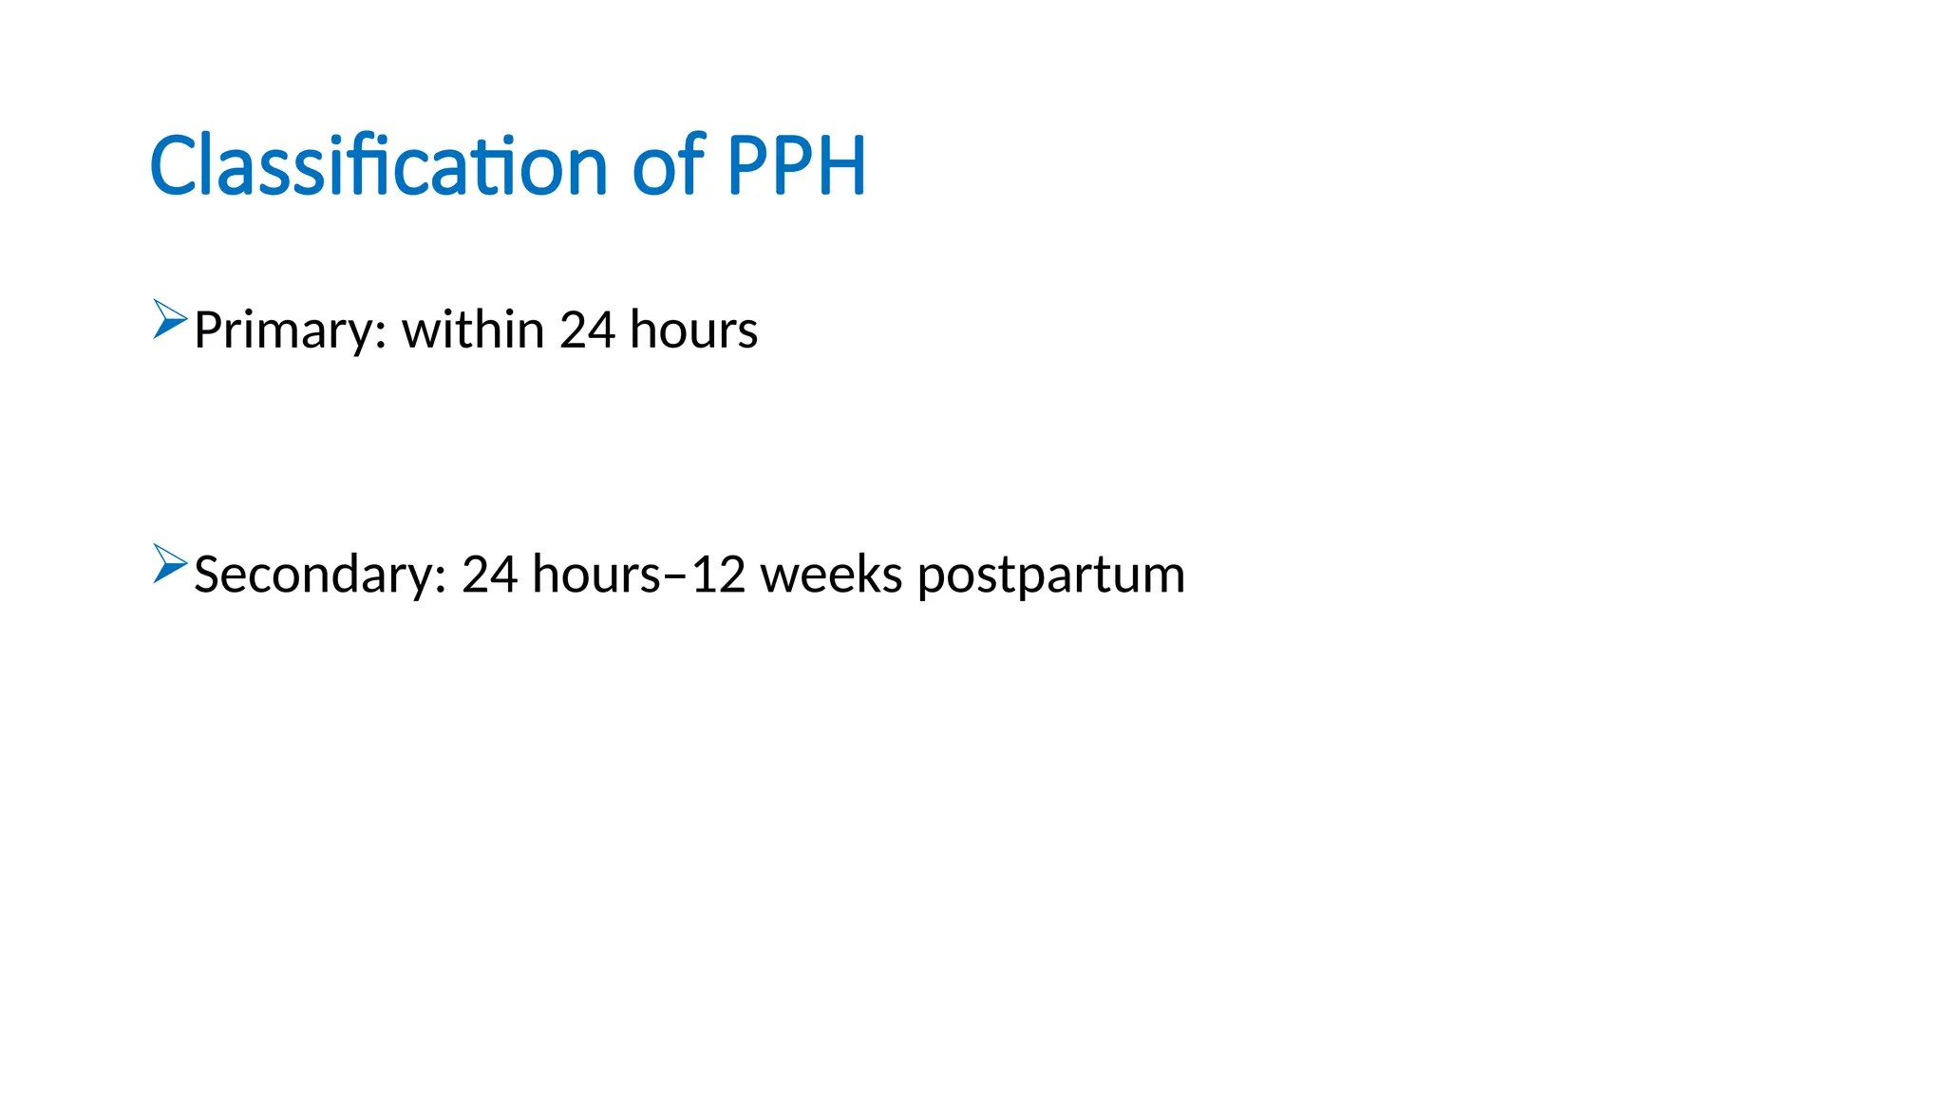

Slide 13
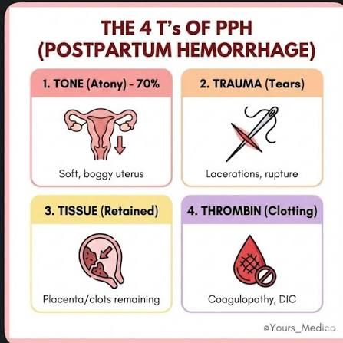

Slide 14
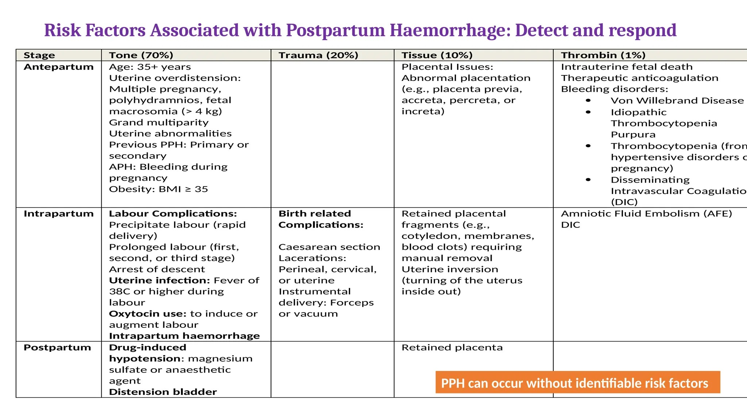

Slide 15
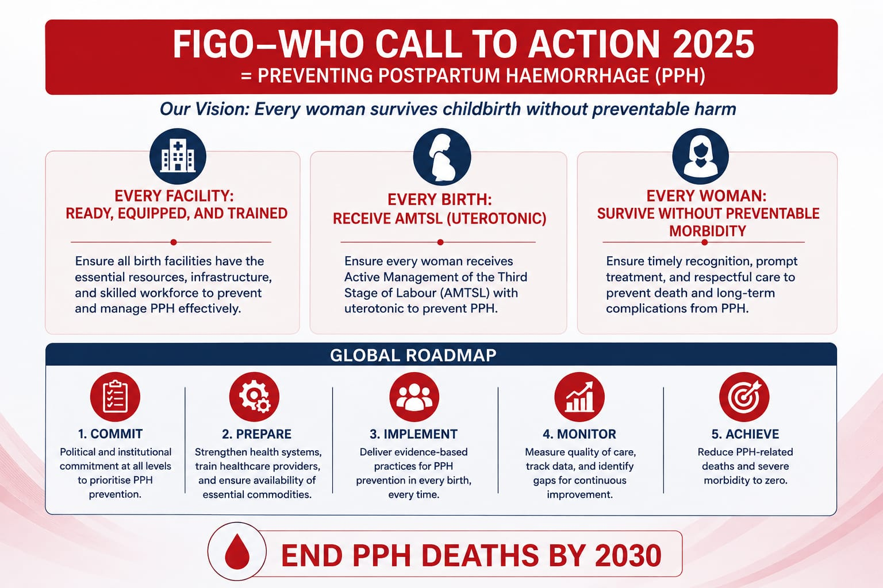

Slide 16
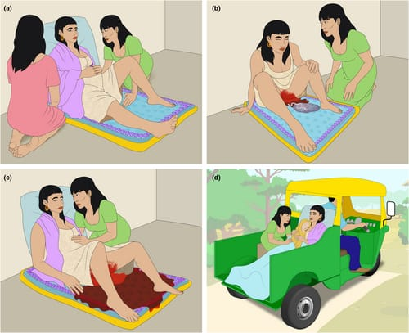
MISSION NEEeV-
PREVENT THE PREVENTABLE
AIM- Prevention & early management of postpartum hemorrhage (PPH)
Step 1 AMTSL (Active Management of Third Stage of Labor)
Step 2 Monitoring of Vitals and any complication.
Step 3 Diagnosis of PPH, Shock Index Monitoring +Blood measuring DRAPE
Step 4 EMOTIVE PPH bundle
Step 5 Early Referral after Stabilization if not Equipped

Slide 17
PREVENTION AND EARLY DIAGNOSIS OF PPH
“DON’T WAIT FOR PPH TO BEGIN”
1.Give a uterotonic
2.Place the blood measurement tool
3.Deliver placenta with controlled cord traction (CCT)
4.Check uterine tone and massage if soft.
5.Check bleeding.
6. Monitor every fifteen minutes

Slide 18
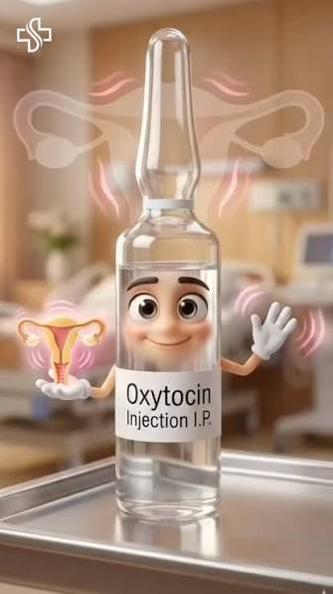
WHAT IS THE MOST IMPORTANT PHARMACOLOGICAL INTERVENTION FOR PREVENTION OF PPH?

Slide 19
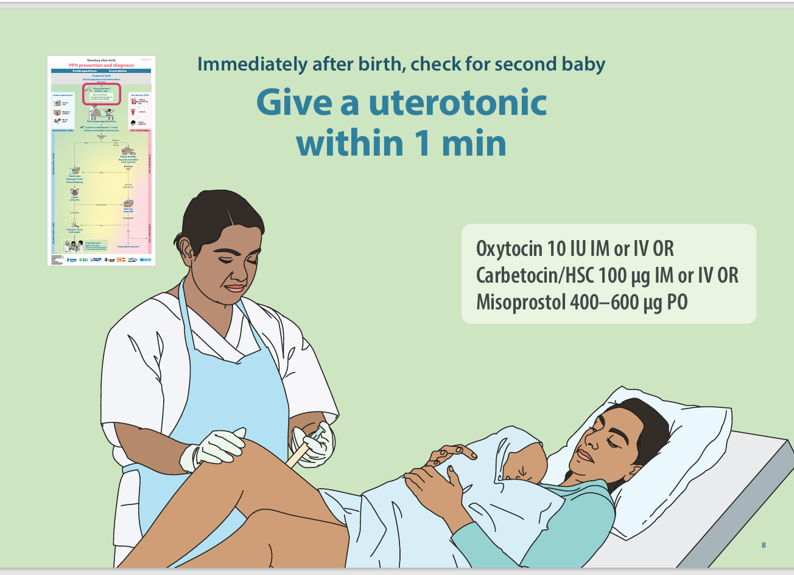
  1.GIVE A UTEROTONIC WITHIN 1 MIN AFTER DELIVERY OF BABY-
A. Oxytocin
10 IU (IM) or (IV). Intravenous preferred if IV line already in place: 10 IU diluted and given slowly over 1–2 min.
Refrigerate (2–8°C)
B. Carbetocin
Heat-stable carbetocin (HSC)
100 µg (1 mL) IM or IV.
If IV, administer slowly over 1 min.
No refrigeration needed, protect from light
C. Misoprostol
400–600 µg orally (PO) sublingually (SL) or per rectum (PR)

Slide 20
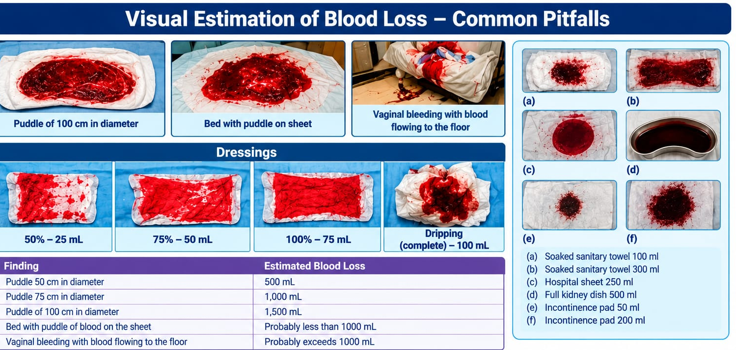
2. PLACE THE TOOL FOR MEASURING BLOOD LOSS ACCURATELY

Slide 21
WHY VISUAL ESTIMATION FAILS?
OUR EYES ARE PARTICULARY UNRELIABLE, AS BLOOD LOSS INCREASES AND LEADS TO OVER OR UNDERESTIMATION.

Slide 22
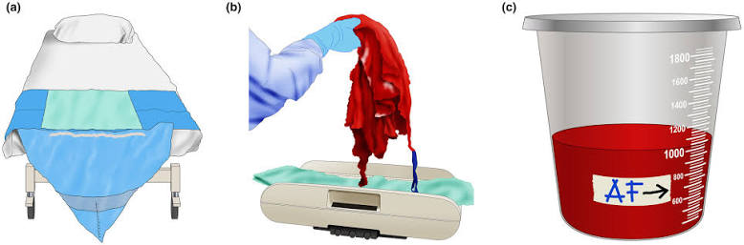
B. QUANTITATIVE METHODS
IT MEASURES , DON’T GUESS.
Dangerous bleeding can be a slow,
steady stream or a large gush.
WHO recommends objective methods only like:-
Drapes with a calibrated funnel
Trays with calibrated lines
Sweep blood and clots into the tool. Continuously check amount of blood in the tool and blood flow.
Gravimetric weighing = soaked weight – dry weight of gauzes/pads

Slide 23
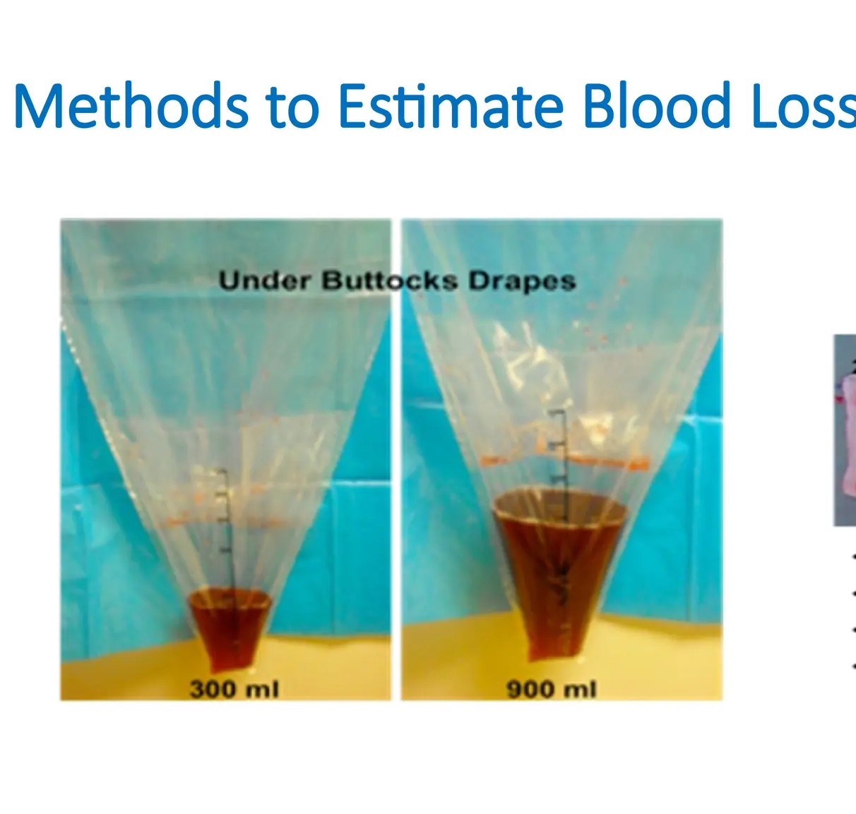
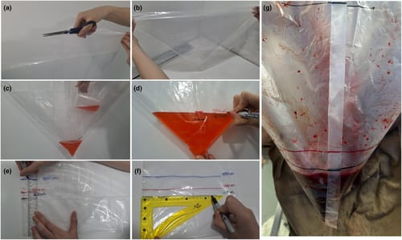

Slide 24
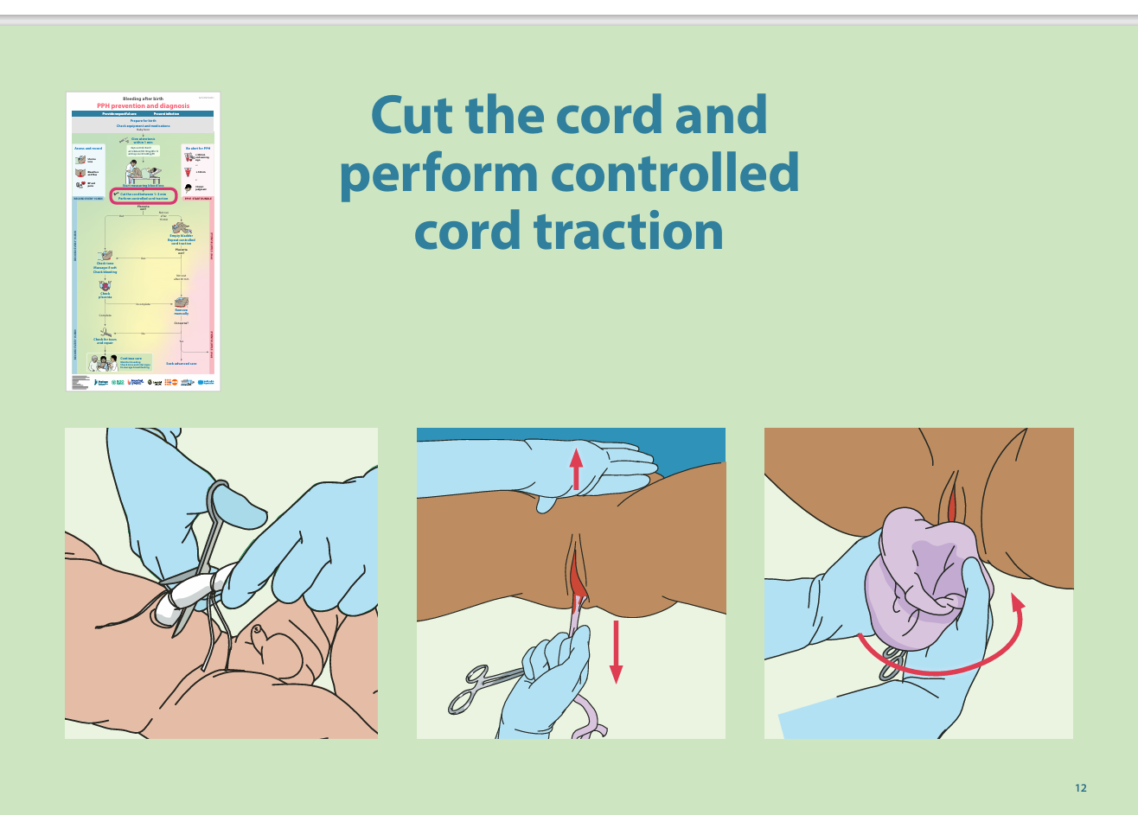
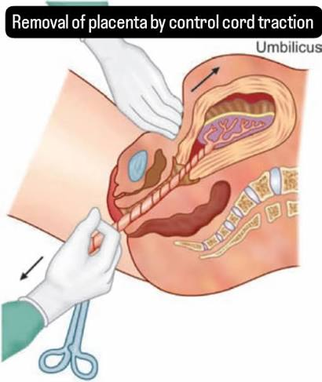
3. CONTROLLED CORD TRACTION
Wait for 1–3 min to cut the cord
Cut immediately if the woman is bleeding heavily or the baby is not breathing well.
Controlled cord traction only By skilled health workers
Controlled cord traction is done only during contractions.
Never pull hard on the cord.
Stop if resistance is felt to avoid tearing off the cord and uterine inversion.

Slide 25
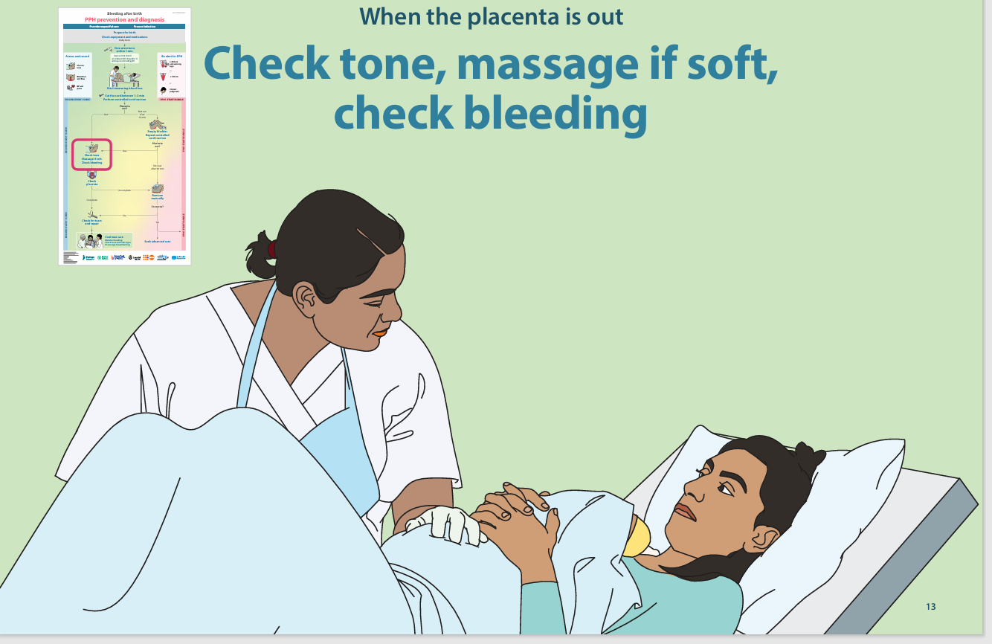
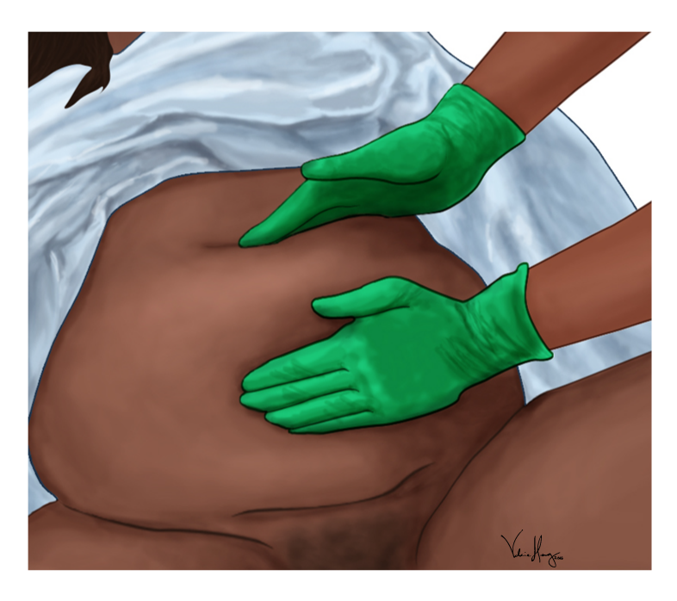
4. UTERINE TONE ASSESMENT
Check tone and massage only when soft
Uterus should be firm ,at midline, and at the level or below the umbilicus
If the fundus rises, is off to the side or becomes soft again it may be full of clots or the bladder may be full
Massage
Check the uterus at least every 15 min for the first hour

Slide 26

HOW WILL YOU ASSES THE TONE?
A soft uterus is the most common cause of PPH
A hard uterus feels like forehead.
A soft uterus feels like the tip of nose
Uterine tone can change quickly
A full bladder may slow uterine contraction
If placenta is not out and there is heavy bleeding,
start PPH treatment bundle immediately, then move to manual removal

Slide 27
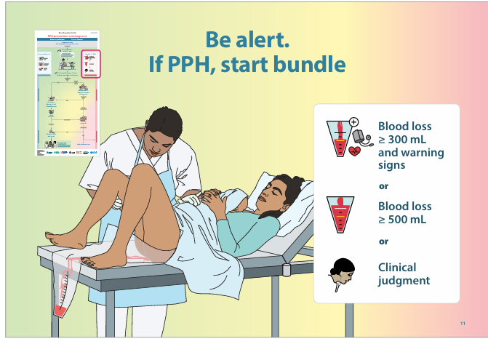
5.Check for bleeding
1) ≥300 mL of blood loss and a warning sign such as:
Atonic uterus, heavy blood flow, large clots, or constant trickle of blood.
2) ≥500 mL or more of blood
3)Clinical judgement : Rate of blood loss and presence of risk factors
Be Alert
Start PPH Bundle

Slide 28
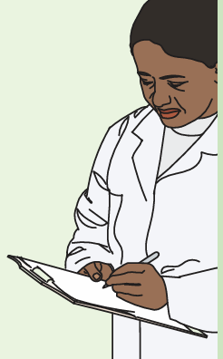
6.MONITORING
Blood pressure, pulse rate and Shock index after the delivery of Placenta, or 15 min after birth (if placenta not delivered)
Monitor For Every 15 min for the first hour.
Then every 30 min for the next 2 h

Slide 29
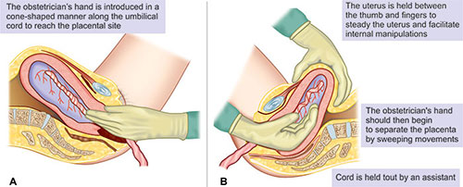
Placenta usually delivers within 15 min, when a uterotonic is given for prevention.
If it takes longer than 15 min: encourage and empty bladder, repeat Control cord traction.
If placenta is not out till 30 minutes, remove manually
If unable to remove the placenta or tissue appear very adherent ,suspect placenta accreta
Call for help and advanced care.
Proceed to laparotomy and possible total hysterectomy
If PPH, but placenta is not out
Start PPH bundle immediately, then move to manual removal

Slide 30
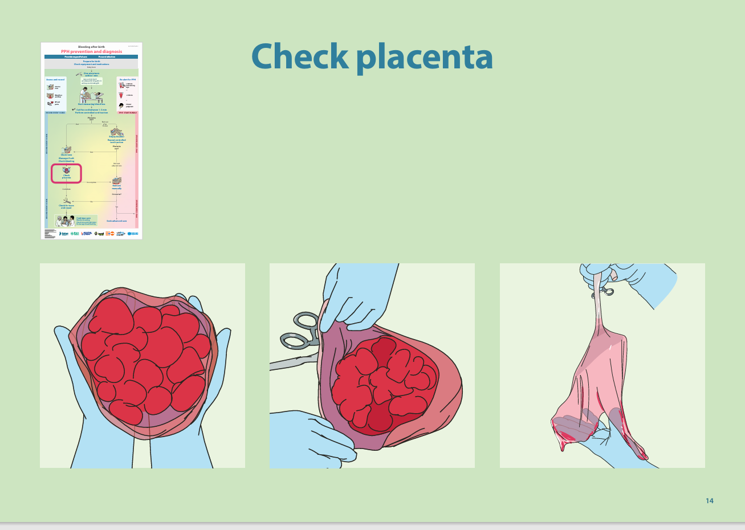
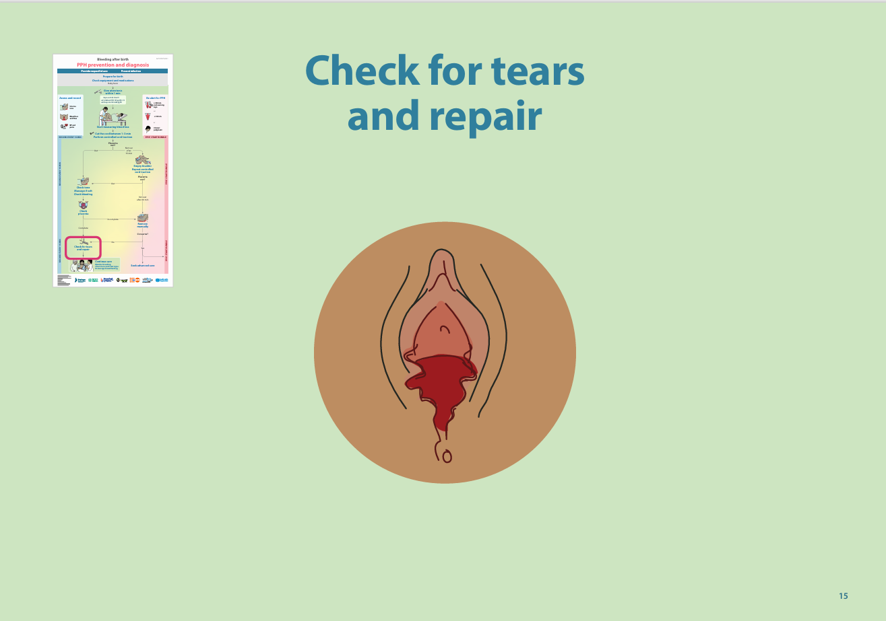
Check Placenta for completeness – identify missing lobes & if any remove manually.
If uterus is firm, placenta is complete but bleeding is there:- Tears are likely the cause
Assess for tears and repair
If PPH, start treatment bundle immediately

Slide 31
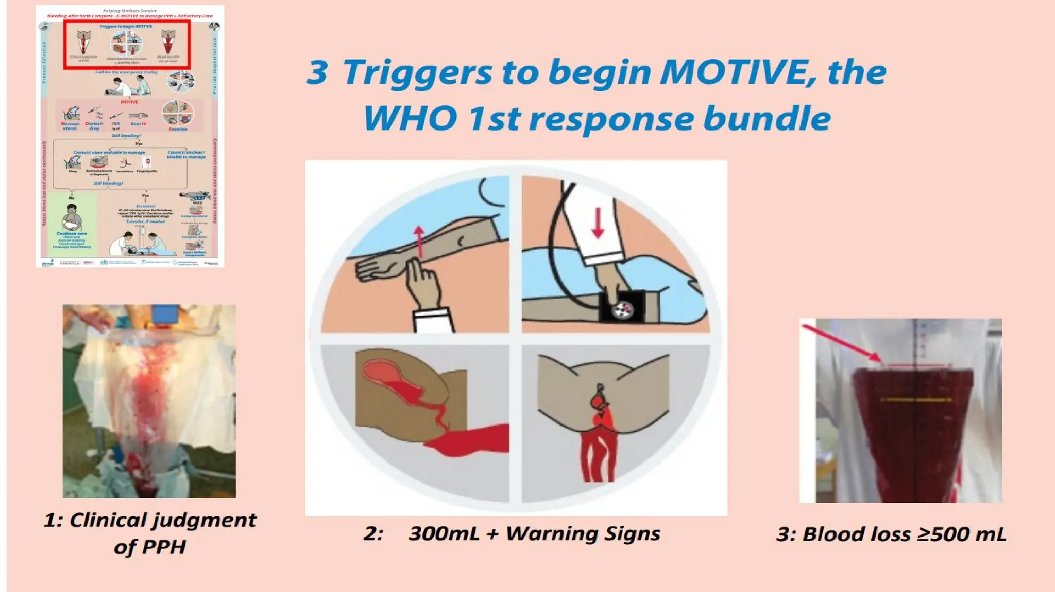

Slide 32

Early diagnosis is the first step of treatment Once PPH Is Diagnosed
Call for help

Slide 33
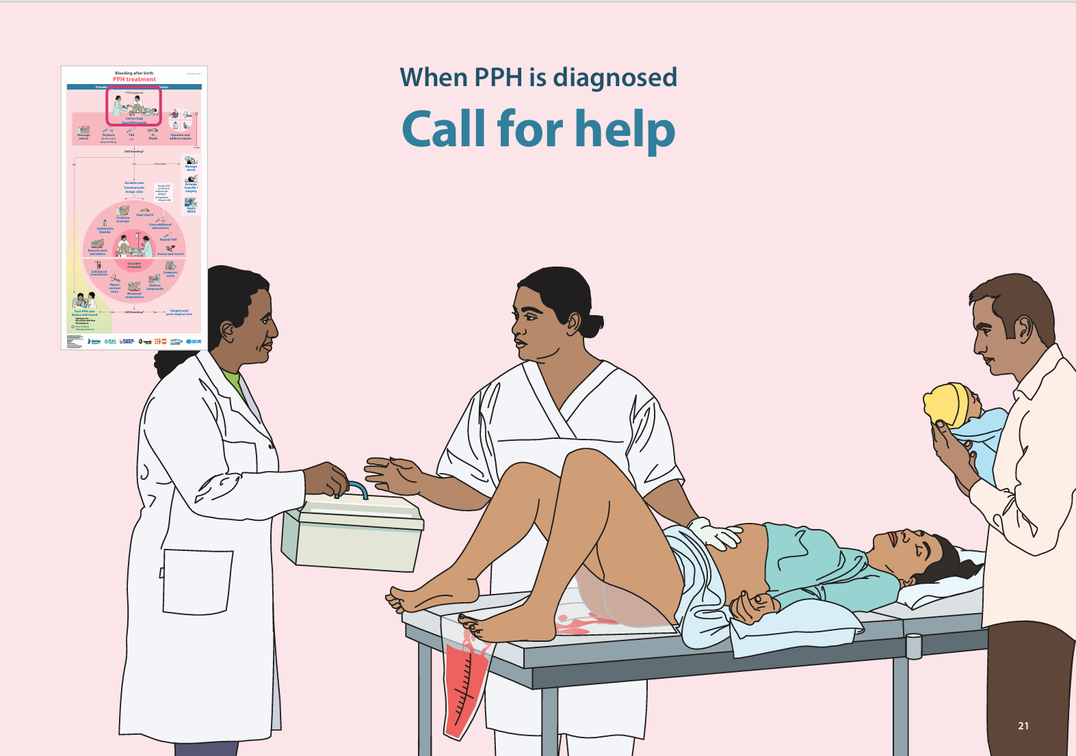
WHEN PPH IS DIAGNOSED:-
1.Call for help ,
2.Arrange emergency equipment and medication.
3. Assess for shock.
4.Communicate with woman, the health team and establish roles
5.Start the treatment bundle

Slide 34
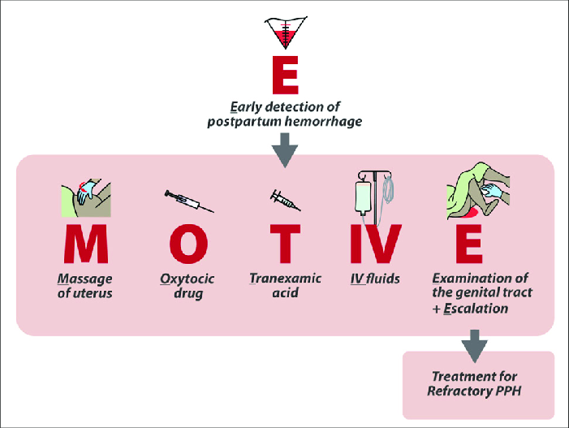
E-MOTIVE BUNDLE
Treatment Bundle is set of interventions that, when given together, improves outcomes.

Slide 35
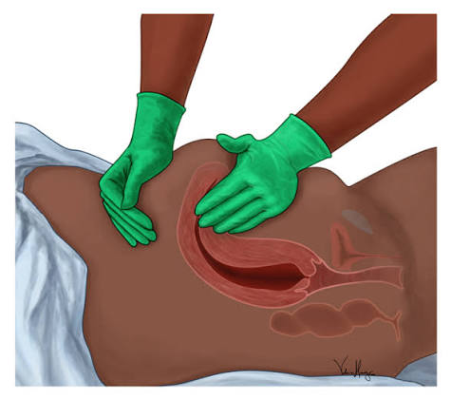
Massage the uterus
To stimulate contractions and expel any blood and blood clots.
Uterine massage for maximum of 2 minutes initially
Once contracted, check every 15 minutes and massage repeated if the uterus becomes soft again.
If alone, massage first, then move on.

Slide 36
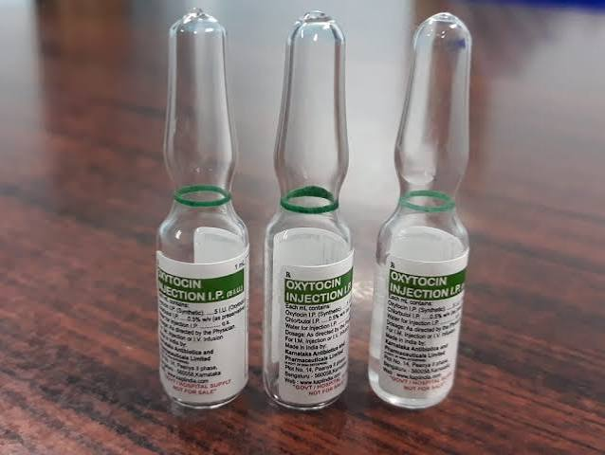
Oxytocin/uterotonic
It is the recommended uterotonic drug for the treatment of PPH
Give oxytocin 10 IU Intravenously diluted in 100–500 mL of crystalloid fluids as fast as possible (preferable to avoid hypotension)
or as bolus over 1–2 min slowly
If no IV line give oxytocin 10 IU intramuscular or misoprostol 800 µg per oral .

Slide 37
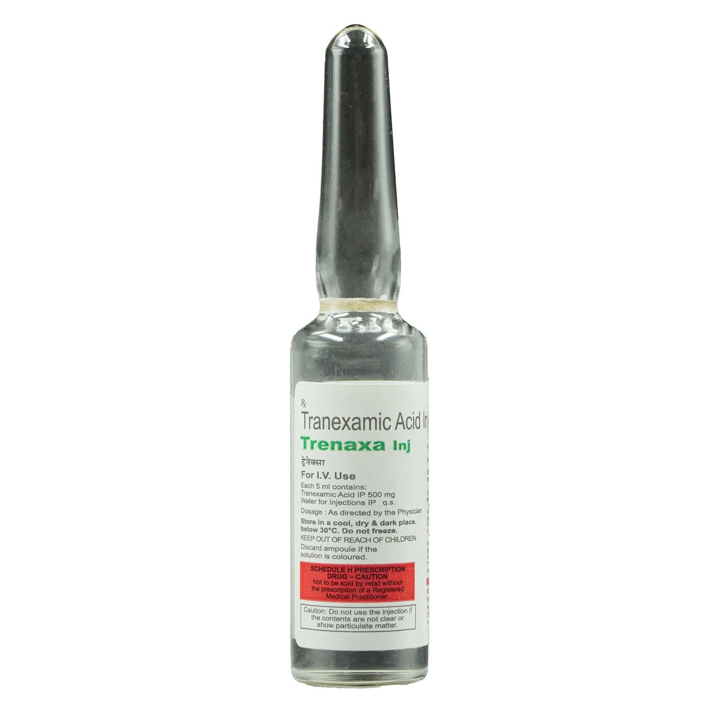
TRANEXAMIC ACID
Give
1 g Intravenously over 10 min, within first 3 hrs of birth.
Faster administration can cause hypotension.
TXA and oxytocin can be given in the same line,but not
mixed in the same fluid.
Do not start Tranexamic acid:-
If 3 hrs. or more since birth
If there is a contraindication or hypersensitivity to TXA,
known thromboembolic event, renal failure or history of convulsions.

Slide 38
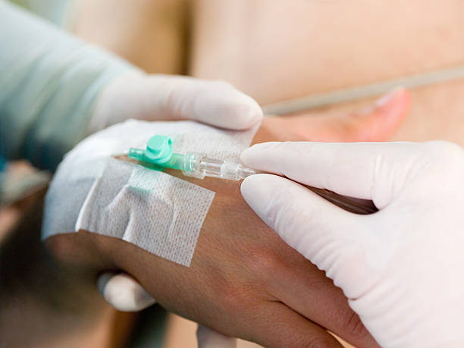
IV - INTRAVENOUS FLUIDS
Start iv
Use 18 gauge cannula or largest available.
Collect blood for lab testing for:-
CBC, cross-match and clotting factors
Serum electrolytes, liver and renal function test.
Begin infusion of crystalloid fluids NS or RL, if not given with oxytocin already.
If clinically indicated, insert 2nd IV line with crystalloid fluids (NS or RL) for fluid resuscitation

Slide 39
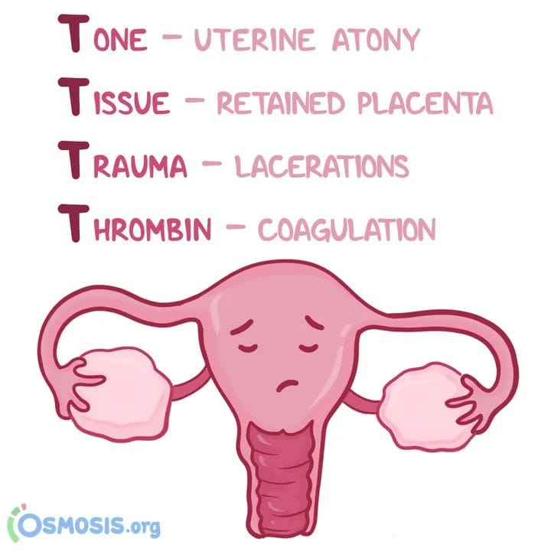
Examine to find out cause
Tone: If the uterus is soft, massage
-Assess for full bladder, Catheterize
Tissue
-Inspect the placenta for missing lobes,
fragments or membranes.
-If the placenta is adherent, suspect accreta
and surgery is needed.
Trauma
Check for perineal. vaginal and cervical tears, and repair.
-If inverted uterus, replace and follow local protocols.
- If suspect uterine rupture, seek advanced care.
Thrombin/coagulopathies
- Collect blood lab testing for Hb, type and cross match, prothrombin time, partial thromboplastin time and platelets ,fibrinogen, coagulopathy

Slide 40
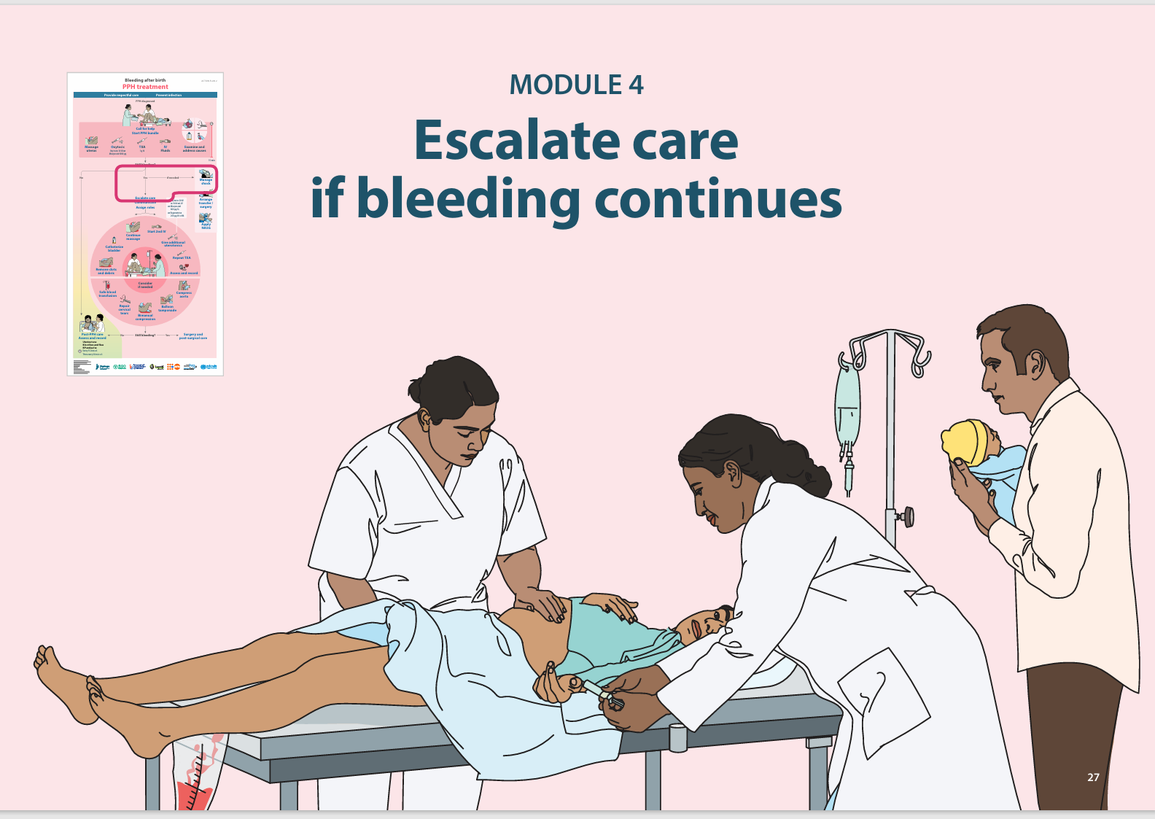
The last E in MOTIVE is also for escalation.
ESCALATE care
• If bleeding: is heavy while giving the bundle, or continues after bundle is complete, or is more than 1000 mL at any time.
• If a woman: has extensive trauma or has uterine inversion or is hypotensive or unresponsive.
• If unable to identify or manage the cause.
Act fast. The woman’s life is in danger.

Slide 41
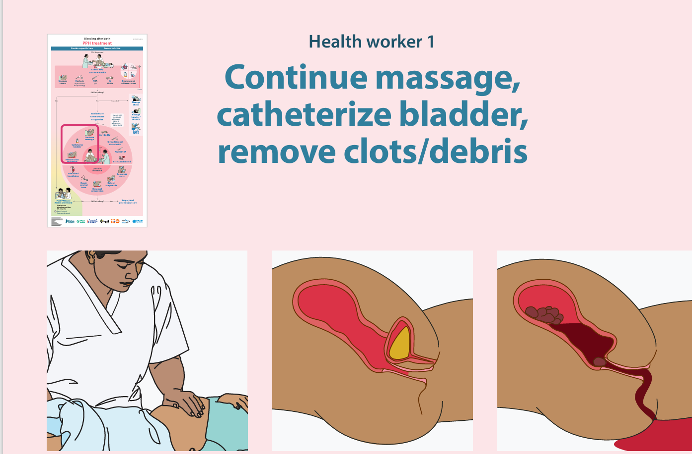
REFRACTORY PPH:-
-It refers to ongoing uncontrolled bleeding despite initial first line medical management.
Call for more help
Call Senior
Oxygen inhalation
Continue monitoring
Call for the anesthetist
Communicate
Massage
Catheterize the bladder
Give a single dose of antibiotics
Remove clots from cervix & uterus
Prepare for blood transfusion
Start Temporary methods
If shock , manage ABC
If needed arrange transfer or surgery.

Slide 42
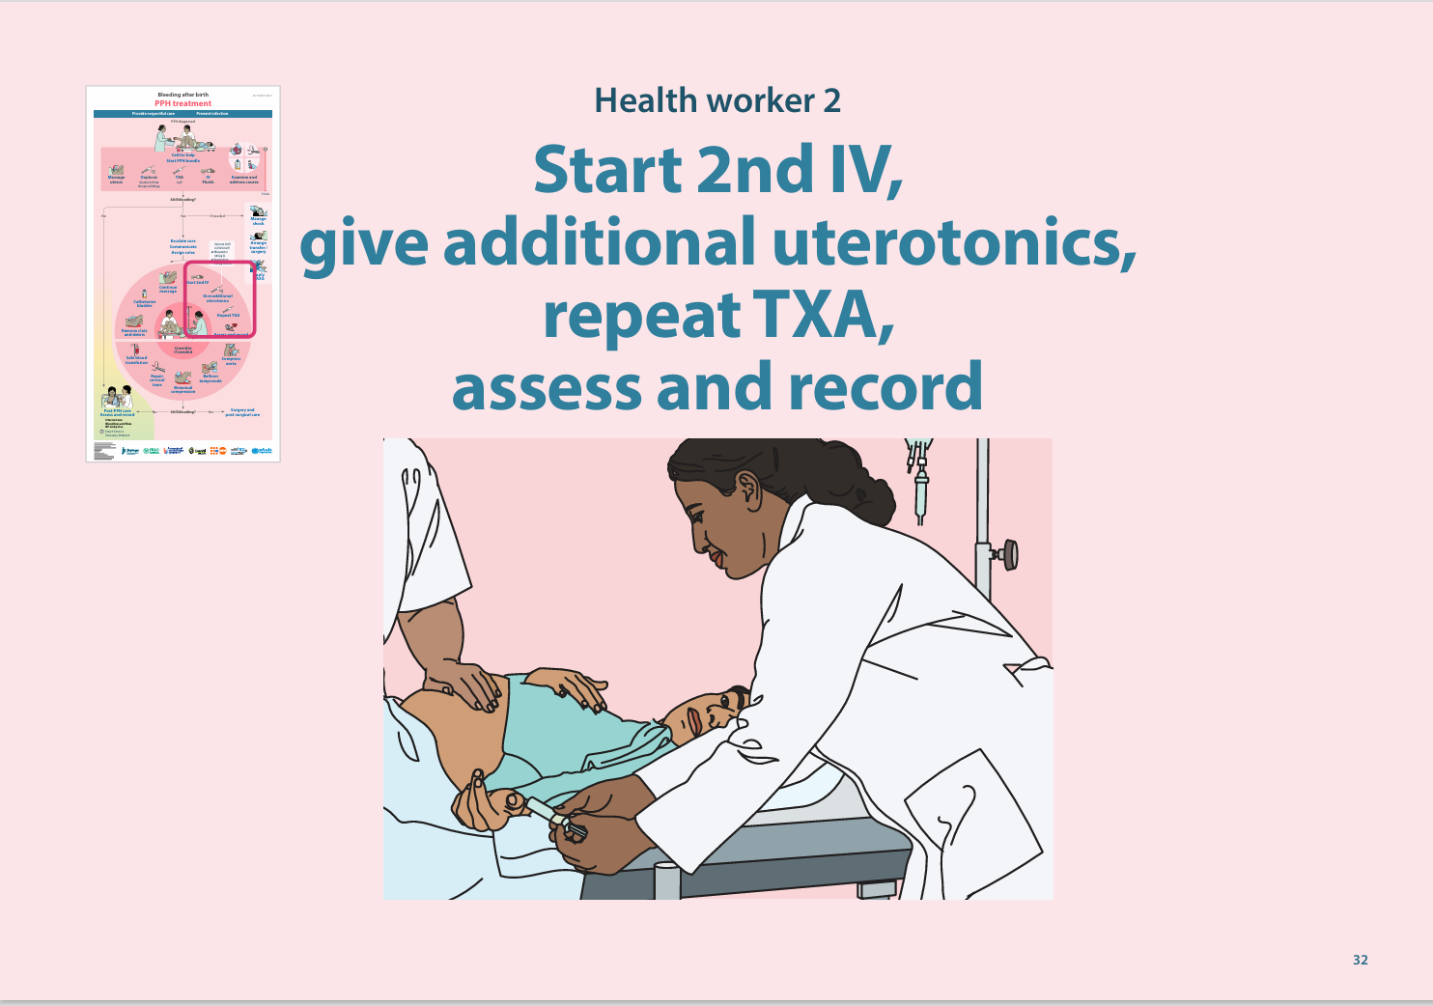
Give additional uterotonics.
Oxytocin
20 IU in 1 L crystalloid fluids (NS or RL) IV. Infuse at 40 drops/min over 4 h.
Do not give more than 3 L of IV fluids with oxytocin in 24 h.
Maximum 60 IU in 24 h.
Ergometrine or ergometrine/oxytocin fixed dose
Ergometrine200 µg IV or IM in 15 min ,if needed, repeat every 4 h up to 5 doses (1 mg total) in 24 h.
Do not use either if suspected retained placenta or if hypertension cannot be ruled out.
Misoprostol
800 µg SL or PR
Carboprost
250 mcg intramuscular, repeated upto 2 mg maximum ( avoid if asthmatic)

Slide 43
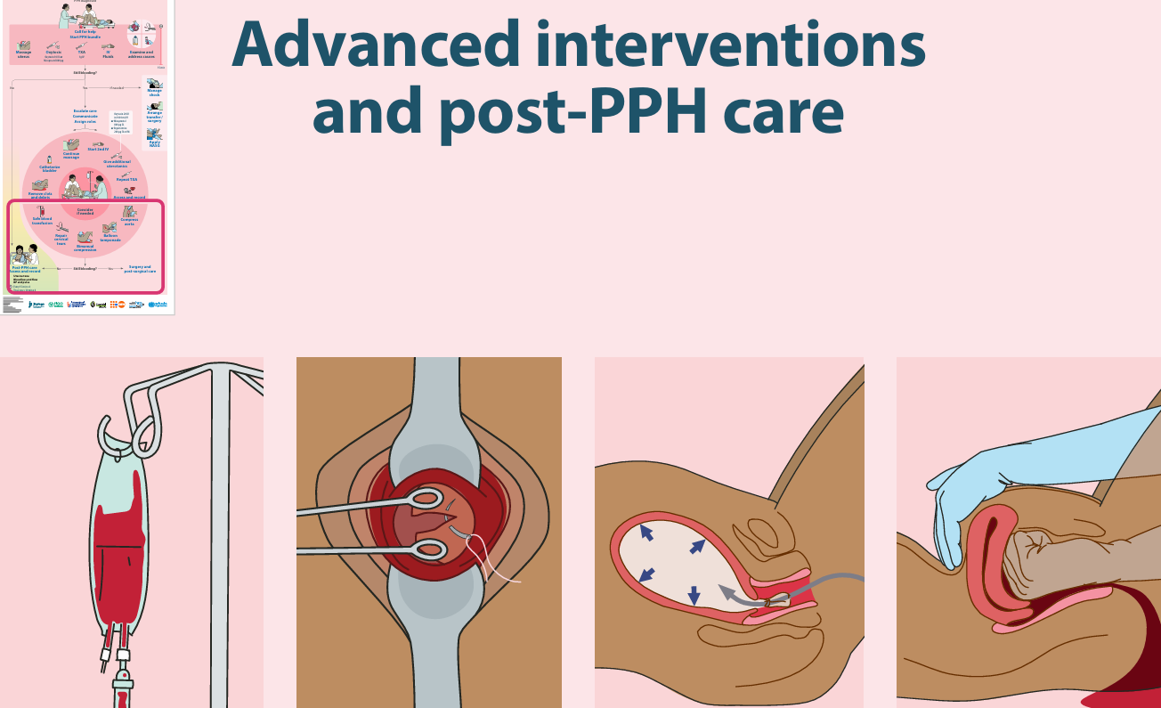
ADVANCE INTERVENTION
Start safe blood transfusion in severe or ongoing PPH
Recheck and repair vaginal and cervical lacerations that might have been missed
Apply bimanual uterine compression & aortic compression
Insert uterine balloon tamponade
Non pneumatic anti shock garment

Slide 44
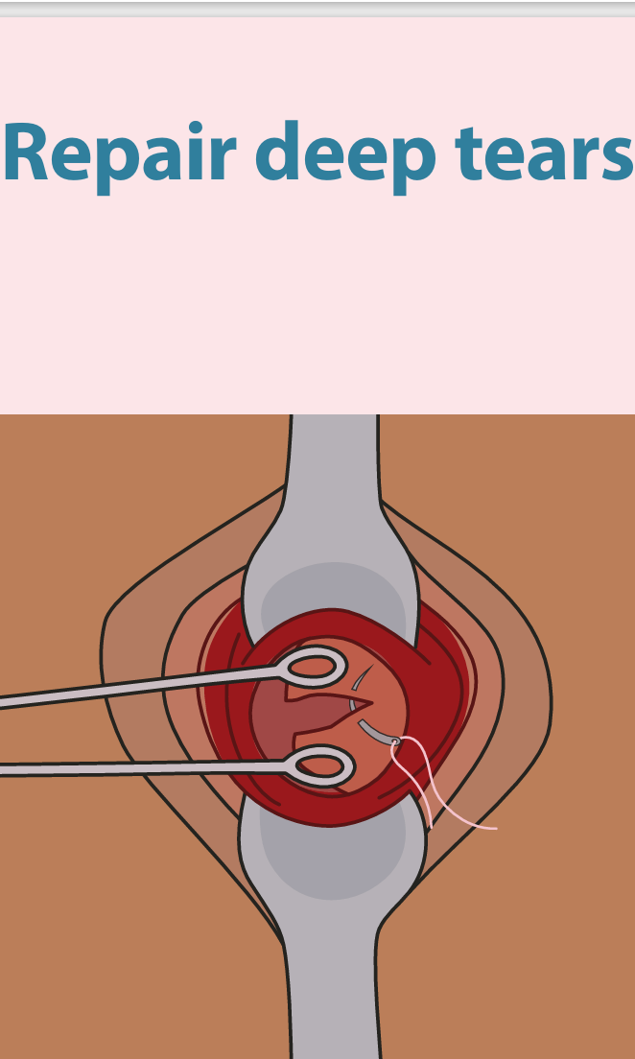
Identify and repair vaginal and cervical tear
Bleeding from a tear may be slow, heavy, or spurting from an artery.
Seek advanced care if repair does not stop bleeding – surgery may be required

Slide 45
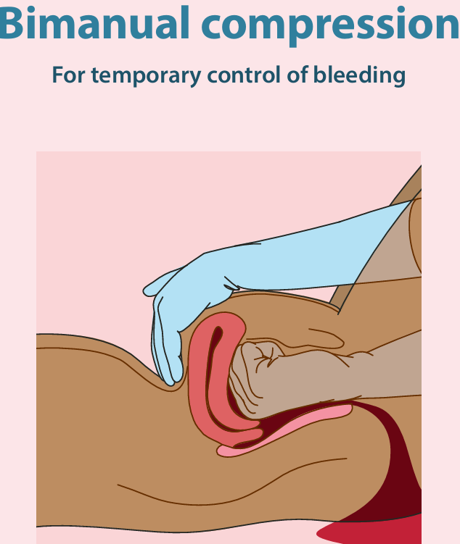
Bimanual uterine compression
One hand in the anterior vaginal fornix and one hand behind the uterine fundus, squeezing the uterus between the hands for at least 5 min.
After 5 min, slowly remove hand ,If bleeding restarts, resume compression.
If no bleeding: continue IV infusion

Slide 47
Uterine balloon tamponade (Bakri balloon or condom catheter):
Insert into uterine cavity under sterile conditions.
Inflate with 300 to 500 ml warm saline,once correct placement confirmed.
Only insert after ruling out retained tissue and uterine rupture.
Check fundal height for concealed bleeding.
Can remain in situ for 12 to 24 hours.
To deflate: Remove 100 ml every 15 minutes while monitoring vitals; re-inflate if bleeding restarts.

Slide 48
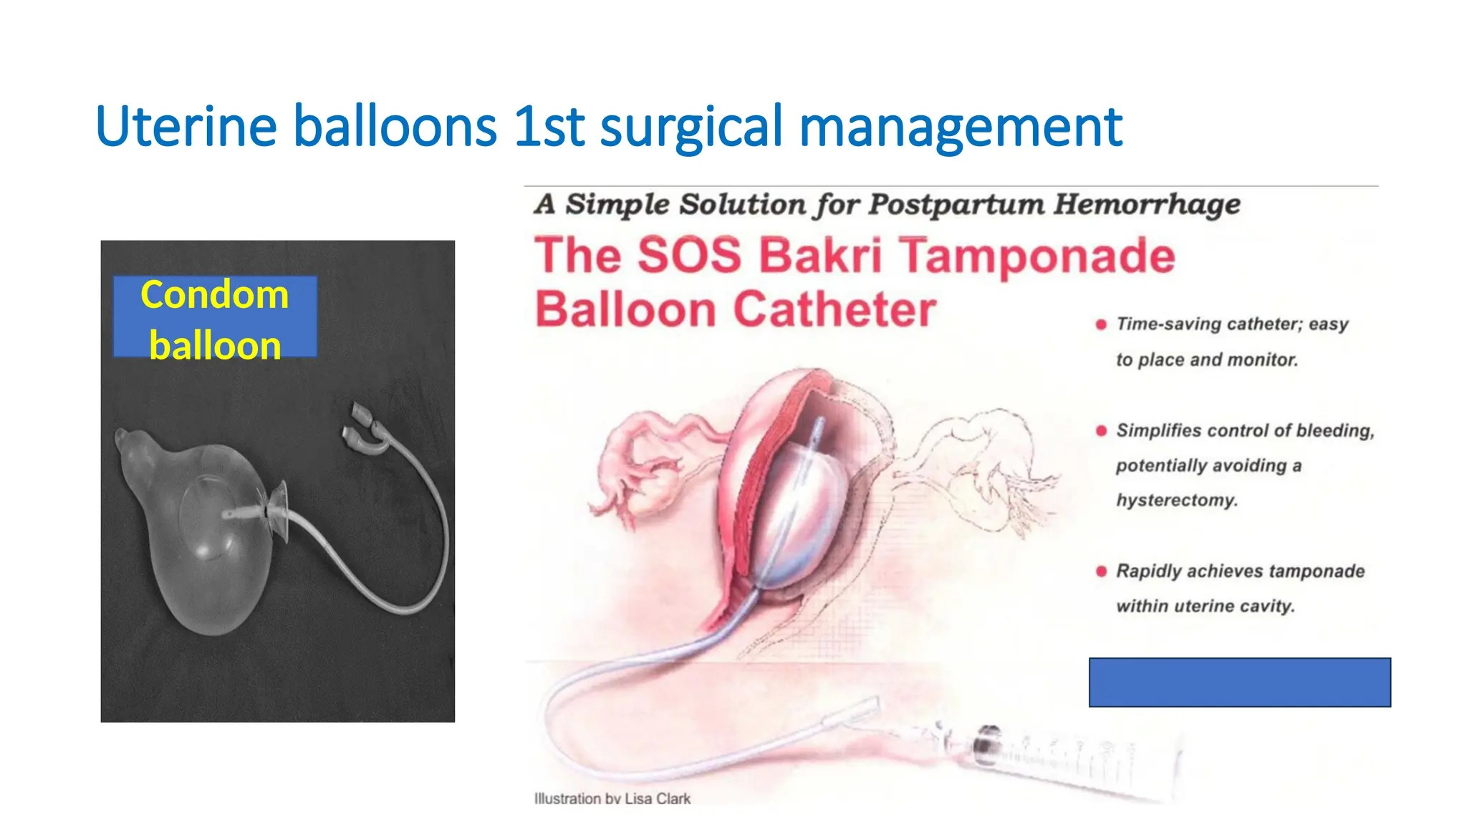

Slide 49
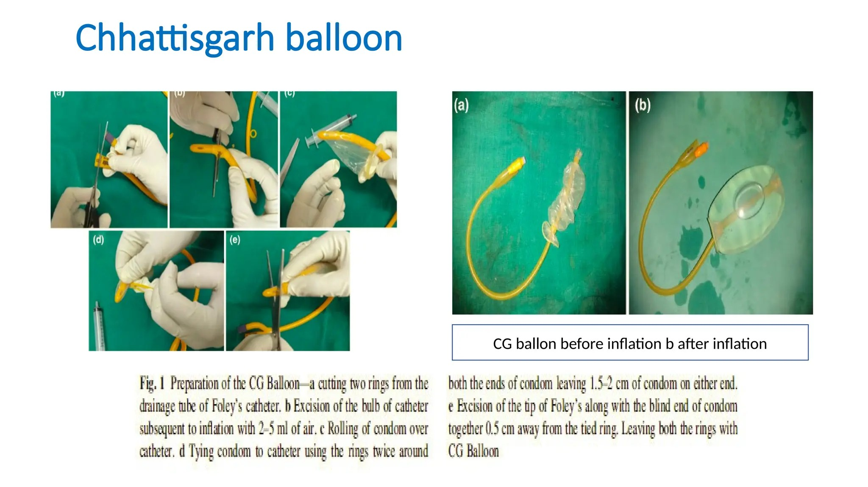

Slide 50
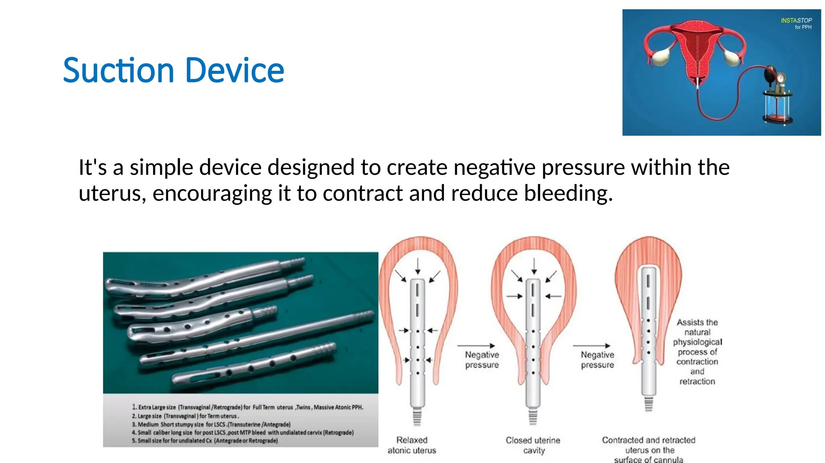
Paniker Suction Cannula
Steel cylindrical cannula, approximately 25 cm length, 12 mm diameter.
Available in straight and curved types.
Inserted into flabby uterine cavity and connected to suction at 700 mmHg.
Negative pressure brings anterior & posterior walls together, decreasing blood loss.
Small holes on the cannula can become blocked by clots; replacement cannula must be available.

Slide 51
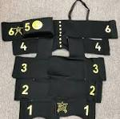
NON PNEUMATIC ANTI SHOCK GARMENT:-
Apply segments 1 to 6 in sequence (Legs- Pelvis - Abdomen).
Provides circumferential counter-pressure, reduces blood loss, improves perfusion to vital organs, and stabilises shock.
Keep in situ until the patient is stable.
To remove: Open one segment at a time (Starting from segment 1), wait 15 to 20 minutes between each, monitor vitals; if systolic BP drops mmHg or pulse rises , re-apply.
It forces blood to the heart, lungs, and brain to prevent shock, or stabilize a woman in shock.
NASG does not treat PPH but gives time to seek treatment

Slide 52
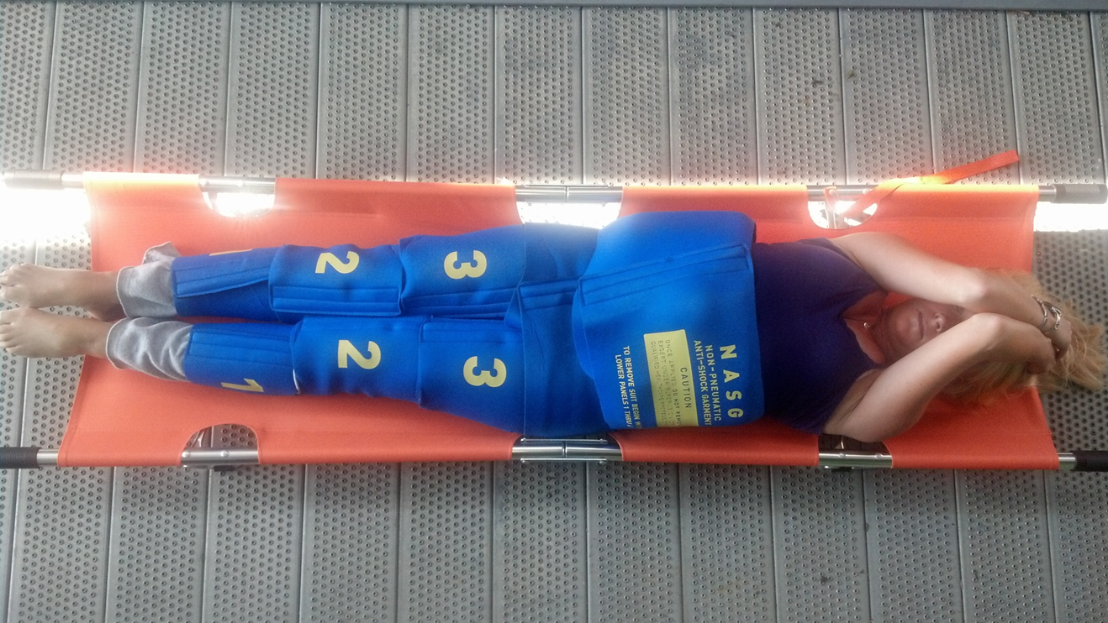
Non-pneumatic Anti shock garment(NASG)

Slide 53
ADVANCE INTERVENTION
Till now
Completed the PPH bundle. • Called for more help, assigned tasks. • Inserted a 2nd IV and given extra doses of medications. • Repaired tears, removed the placenta, and clots and tissue as needed. • Applied NASG, if available
Even now If bleeding continues,
consider
More than one cause of bleeding.
Uterine rupture, especially if augmented labor or prior CS.
Deep vaginal or cervical laceration.

Slide 54
When all these methods fail, address the causes :-
Do surgical interventions like
1. Compression sutures
2. Stepwise devascularisation
3. Uterine artery embolisation
4. Emergency peripartum hysterectomy – decision-making is important
Conservative methods are used only when the woman is haemodynamically stable.
In Haemodynamically unstable- Radical surgery, Subtotal /Total hysterectomy

Slide 55
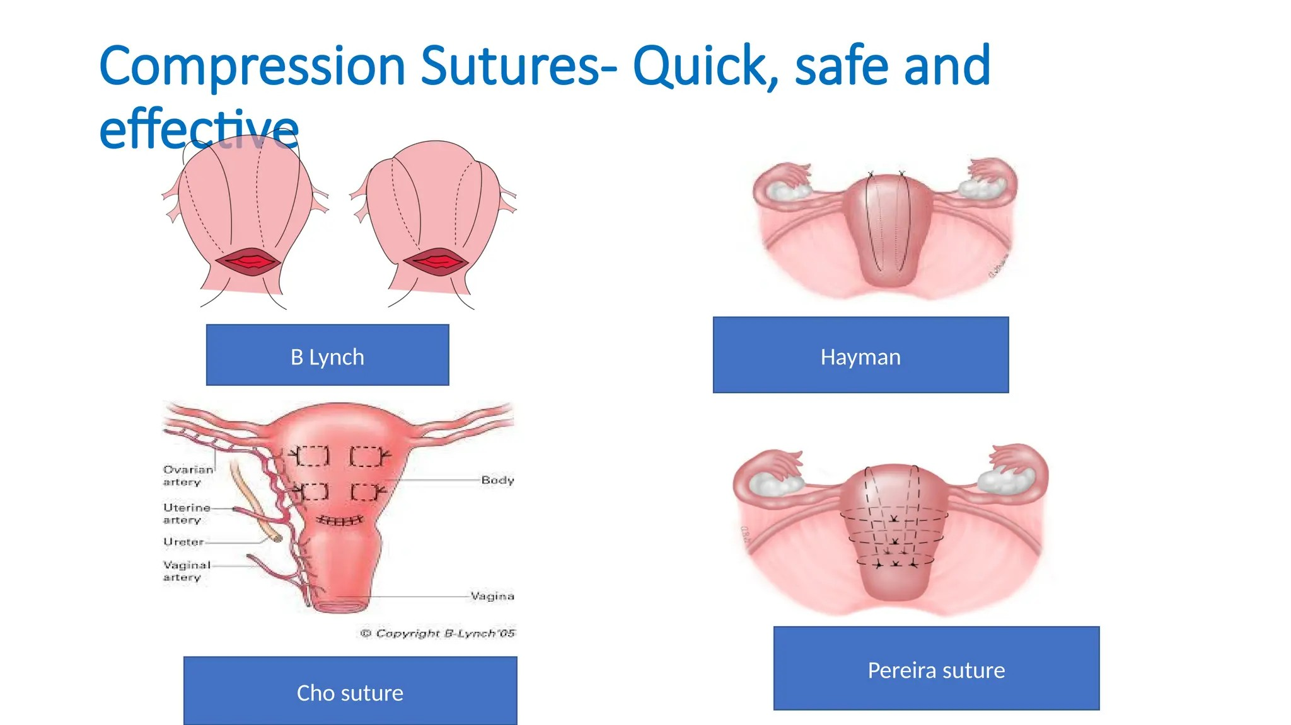

Slide 56
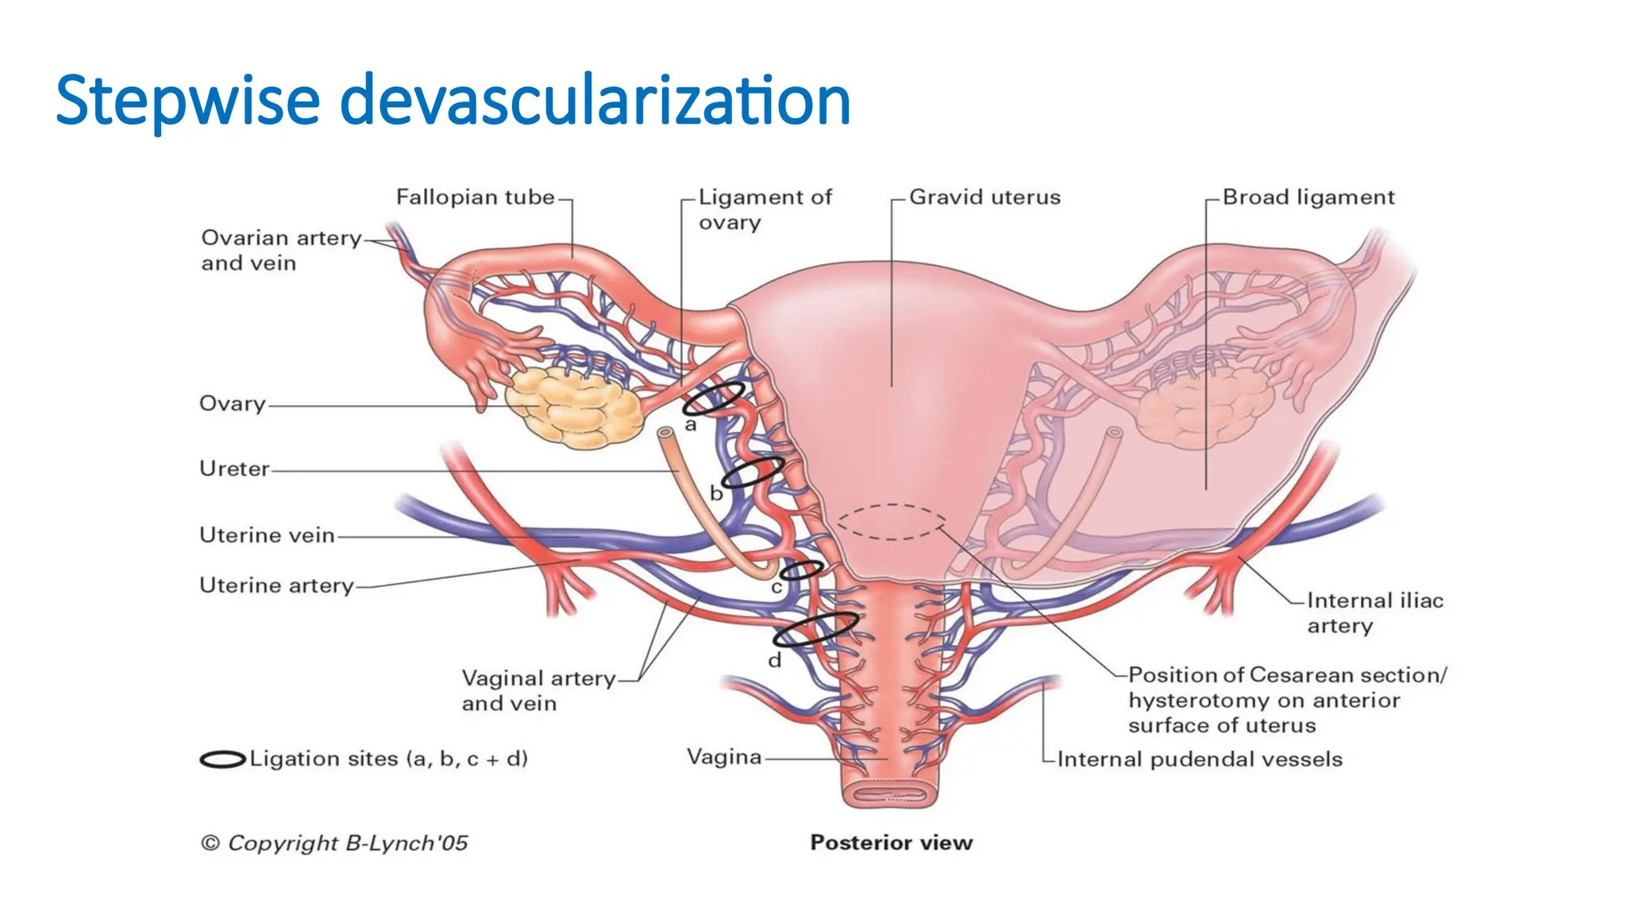

Slide 57
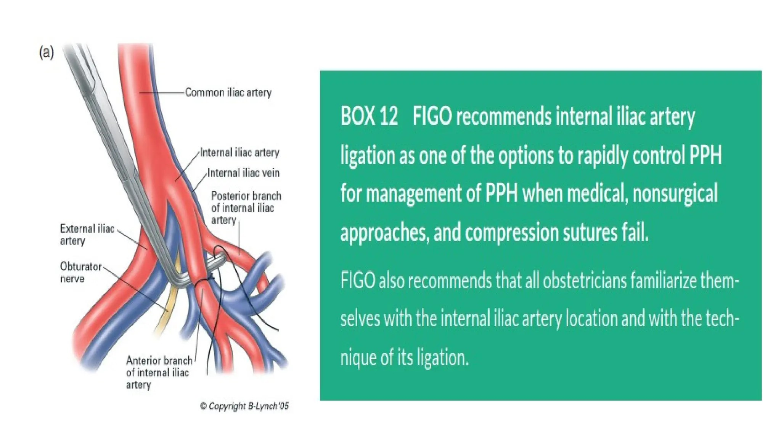

Slide 58
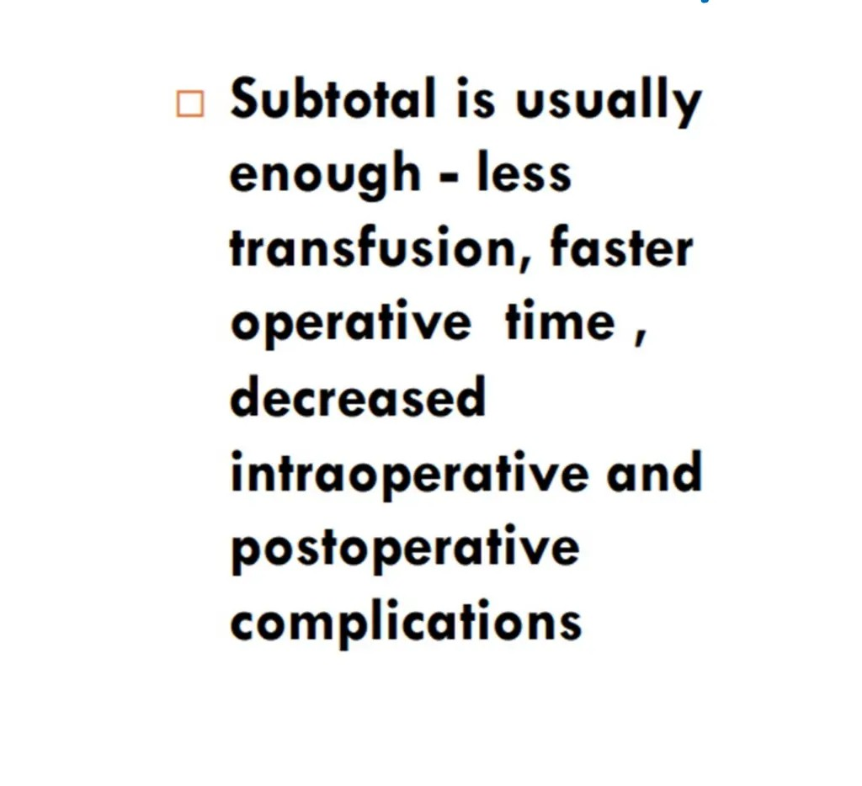
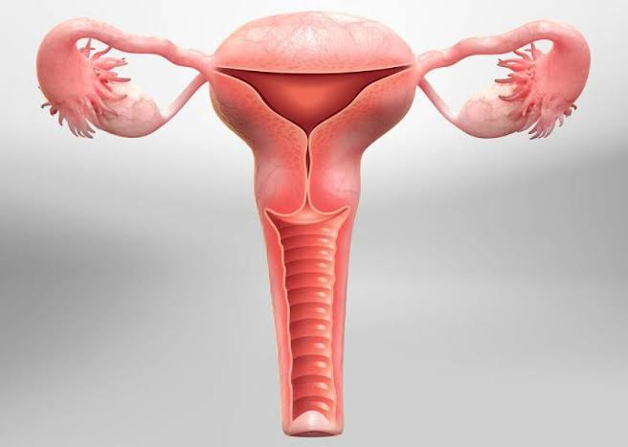
Hysterectomy

Slide 59
The "Golden Hour“
Critical first 60 minutes following diagnosis
Use all modalities of PPH treatment in first 60 minutes.
As the more time elapses from the point of severe shock to resuscitation chances of survival decreases

Slide 60
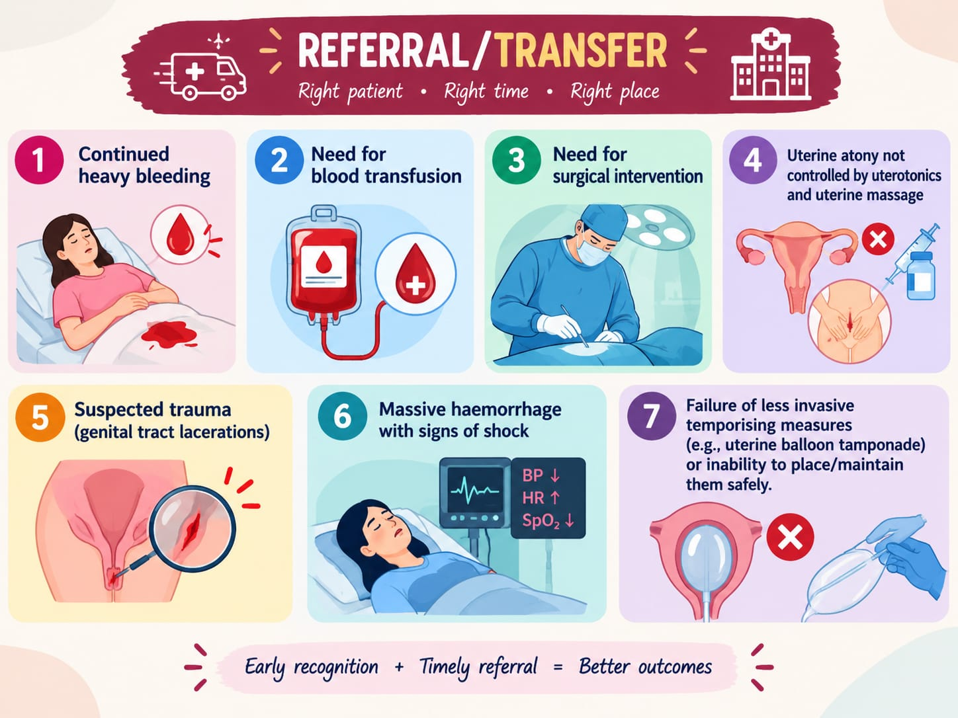
.

Slide 61
Follow the “stabilize, temporise, transfer” principle
Early recognition → Immediate action → No delay in transport.
Inform receiving centre (OBG team + blood bank readiness).
Transfer with skilled staff and continuous monitoring
Referral note must include: vitals, drugs given, IV lines, interventions

Slide 62
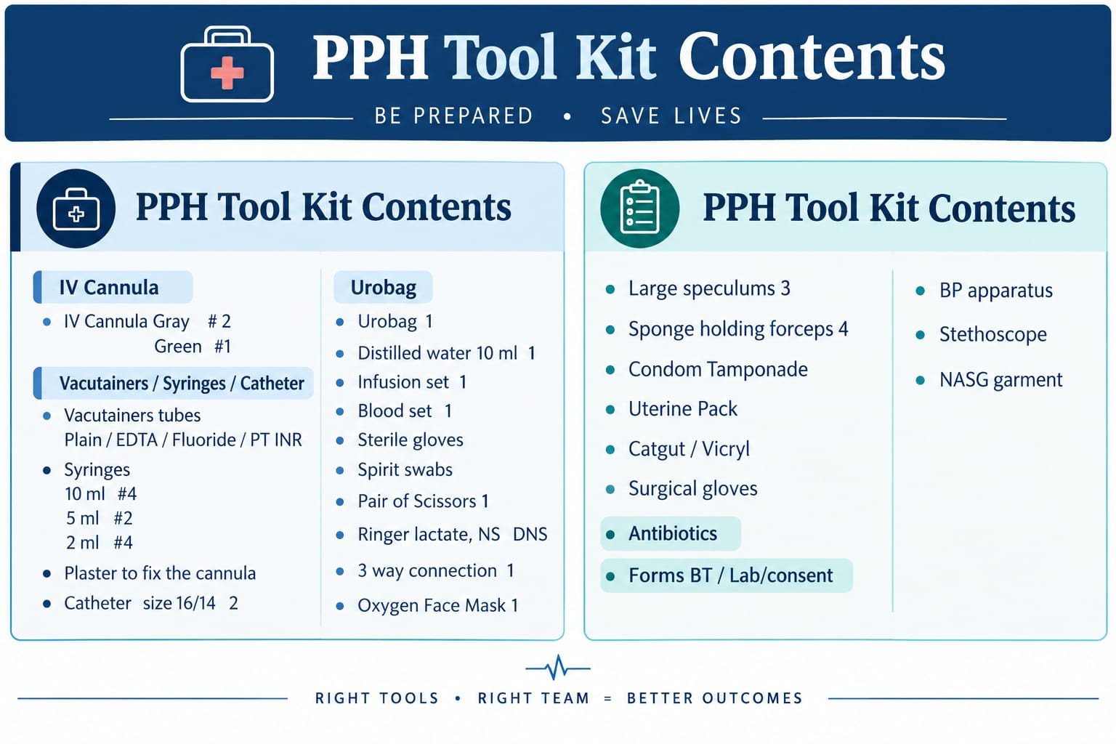

Slide 63
TAKE HOME MESSAGE
THE SUCCESSFUL MANAGEMENT OF PPH IS NOT ABOUT ONE DRUG,ONE SURGEON OR ONE INTERVENTION .
IT IS ABOUT :
-RECOGNIZING HAEMORRHAGE EARLY
-MOBILIZING THE TEAM IMMEDIATELY
-CONTROLLING THE SOURCE
-REPLACING WHAT IS LOST AND
-ESCALATING BEFORE PATIENT REACHES IRREVERSIBLE SHOCK

Slide 64
5 mistakes that kill in PPH
Underestimating blood loss
Waiting for hypotension
Waiting for the entire team before starting treatment
Giving uterotonics without checking contraindications
Delaying escalation/referral

Slide 65
MCQ’S
Q1. According to the WHO 2025 guideline, early action for PPH should be considered when:
A. Blood loss ≥500 mL only
B. Blood loss ≥1000 mL only
C. Blood loss ≥300 mL with abnormal vital signs
D. Any blood loss after delivery
Answer:

Slide 66
Q2. The most common cause of primary PPH is:
A. Retained placental tissue
B. Genital tract trauma
C. Uterine atony
D. Coagulopathy
Answer:

Slide 67
Q3 Which is the most appropriate principle during a major PPH emergency?
A.Complete diagnosis before starting treatment
B. Treat sequentially, one step at a time
C. Resuscitation, identification of cause and haemorrhage control should occur simultaneously
D. Wait for laboratory results before activating the haemorrhage protocol
Answer:

Slide 68
Q4. A woman develops PPH 20 minutes after vaginal delivery. The uterus is boggy and bleeding is heavy. What is the most appropriate immediate approach?
A. Wait for Hb report before treatment
B. Uterine massage + uterotonic + Tranexemic acid + IV access/resuscitation
C. Immediate hysterectomy
D. Antibiotics alone
Answer:

Slide 69
Q5. Which of the following represents the “4 Ts” causes of PPH?
A. Tone, Trauma, Tissue, Thrombin
B. Tone, Temperature, Tissue, Thrombosis
C. Trauma, Temperature, Thrombin, Tension
D. Tone, Tissue, Thrombosis, Tachycardia
Answer:

Slide 70


Thank You

